Slide 1

The Mechanics of TomoTherapy

Slide 2
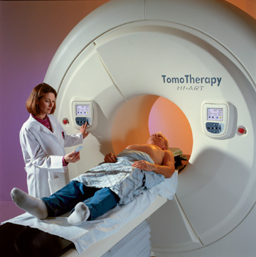
TomoTherapy HI⋅ART Machine
Gantry System.
85cm
85 cm Opening
Touch Screen Controls
40 cm X 1.6 m IMRT Treatment Field @ Isocenter
T-MKT-AP0068

Slide 3
6MV High Dose Source
(800MU/min, 1.5mm point source)
Primary Collimator
(0 to 5.0 cm)
Binary MLC
(64 leaves, ea @ 0.61cm)
Approximate 85cm
85 cm Gantry Aperture
Gantry System.
40 cm VRCT FOV
Approximate 50cm
VRCT Detector System

Slide 4
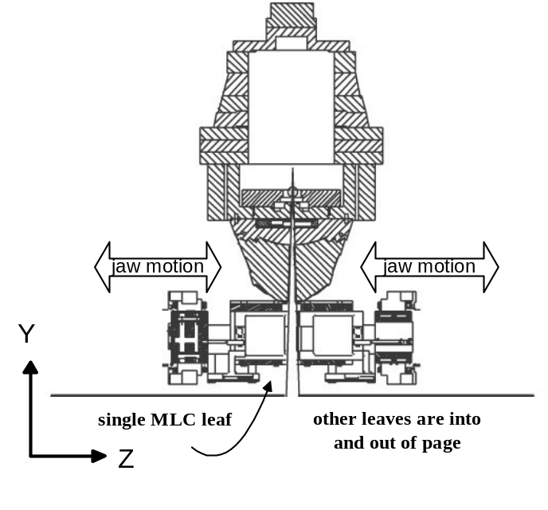
Less loss of dose because….
Linac
Up to 23 cm of Tungsten
In the Primary Collimator.
Primary
Collimator
Leaves are 10 cm of Tungsten.
MLC
Gantry System.
No Field Flattening Filter to
Cause Scatter Outside the Field.
Less Head Scatter from
Narrow Fields.
Detector
12.8 cm Thick Lead Beam Stop
Behind the Radiation Detector.
Beam Stop

Slide 5
Click Here to return
to Overview PowerPoint

