Slide 1
Analysing social behavior (idSocial)

Slide 2
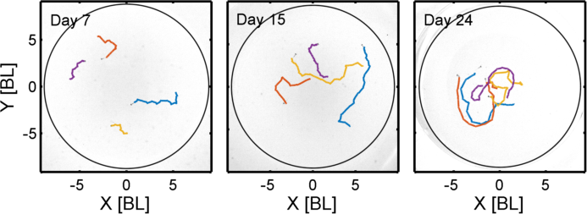
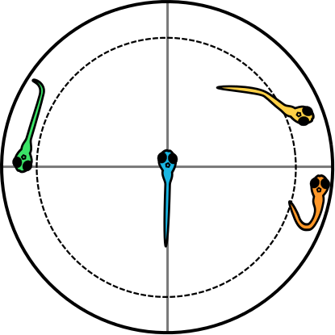
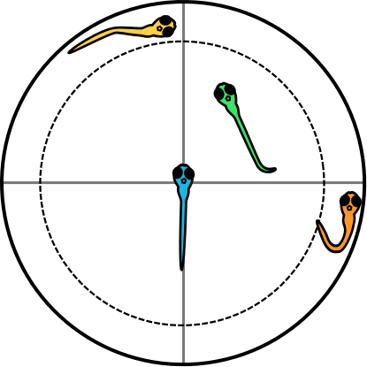
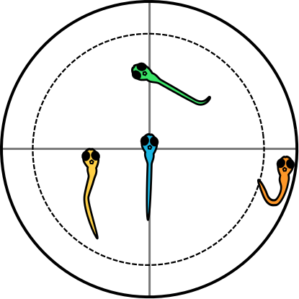
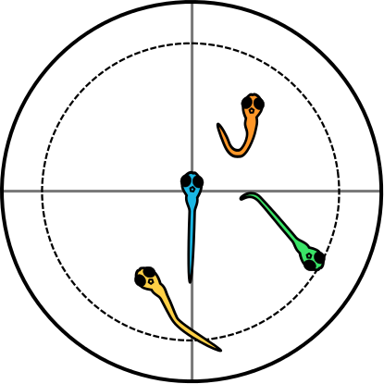
Some trajectories
Notes:
Our motivation and expectation is basically the follwoing:
Looking at the movements of 7-day old larvae, we hardly find any social behavior visible to the naked eye, whereas on day 24 we have clear colleration between the movements of the animals in a group.
The question is: When and how can we detect the first social interactions, and how is the behavior changing between these two extremes?

Slide 3
Some trajectories
Notes:
Our motivation and expectation is basically the follwoing:
Looking at the movements of 7-day old larvae, we hardly find any social behavior visible to the naked eye, whereas on day 24 we have clear colleration between the movements of the animals in a group.
The question is: When and how can we detect the first social interactions, and how is the behavior changing between these two extremes?

Slide 4
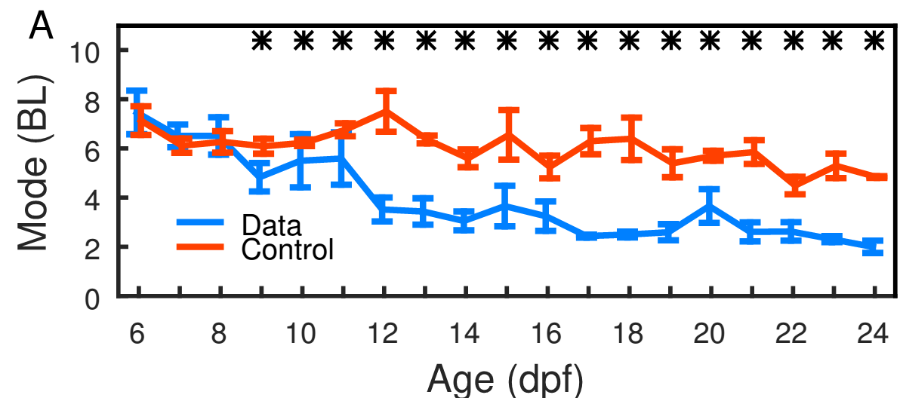
Example: Inter-Individual Distance vs. Age
Ontogeny of collective behavior, Robert C. Hinz, Gonzalo G. de Polavieja
Proceedings of the National Academy of Sciences Feb 2017, 114 (9) 2295-2300; DOI:10.1073/pnas.1616926114

Slide 5
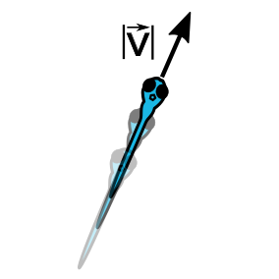
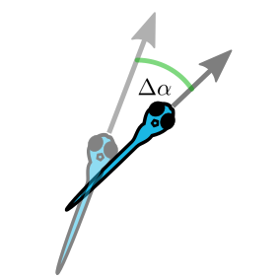
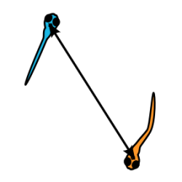
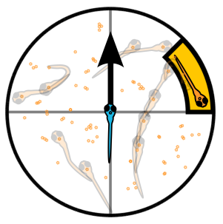
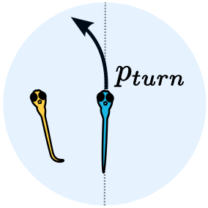
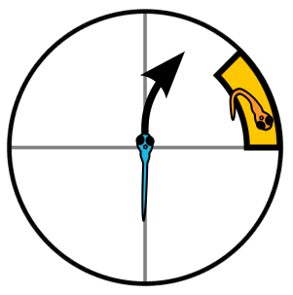
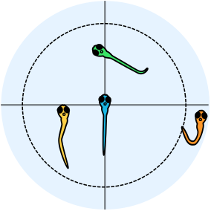
Some methods
Turning angle
Inter-Individual Distance
Relative Positions
Speed
Attraction
(Turning)
Group size

Slide 6
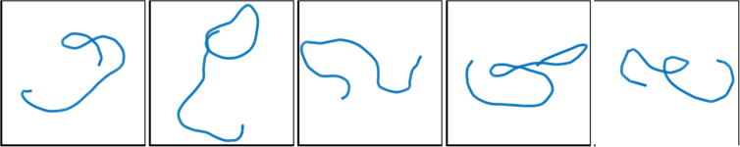
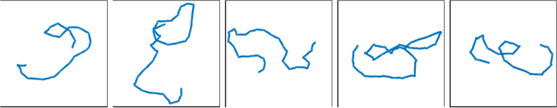
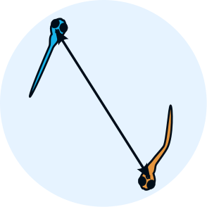
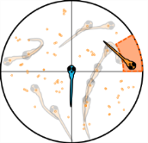
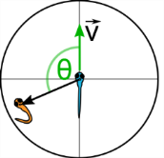
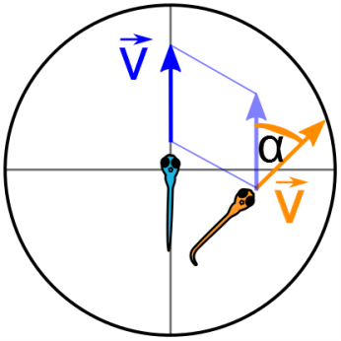
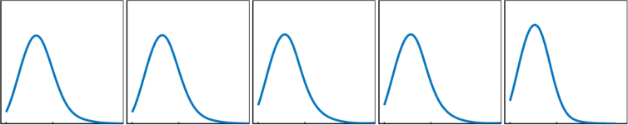
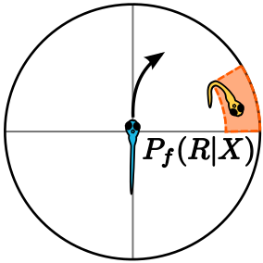

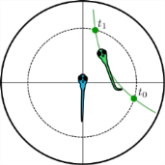
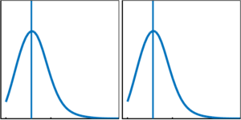
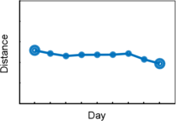
Analysis with idSocial
Trajectory Data
Day 1
Day N
Trial 1
Trial 2
Trial 1
Trial 2
...
Options
Data Preprocessing
Day 1
Day N
(Filtering, smoothing,
randomized controls,...)
Trial 1
Trial 2
Trial 1
Trial 2
...
Options
(Method specific parameters, filters,...)
idSocial Methods
Day 1
Day N
Trial 1
Trial 2
Trial 1
Trial 2
Individual
Calculations
...
Update (parameter change)
Select and filter data
Select statistics
Day 1
Tr. 1,2
Day N
Tr. 1,2
Re-group data &
apply statistics (mean, median, ...)
...
Display Results

Slide 7
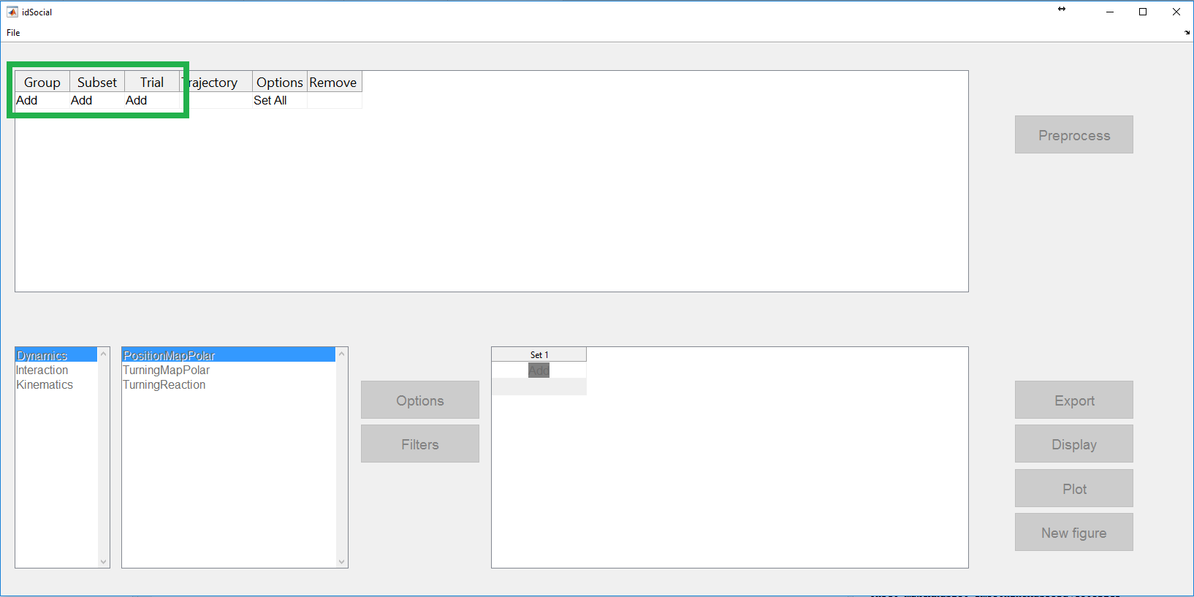
Preprocessing

Slide 8
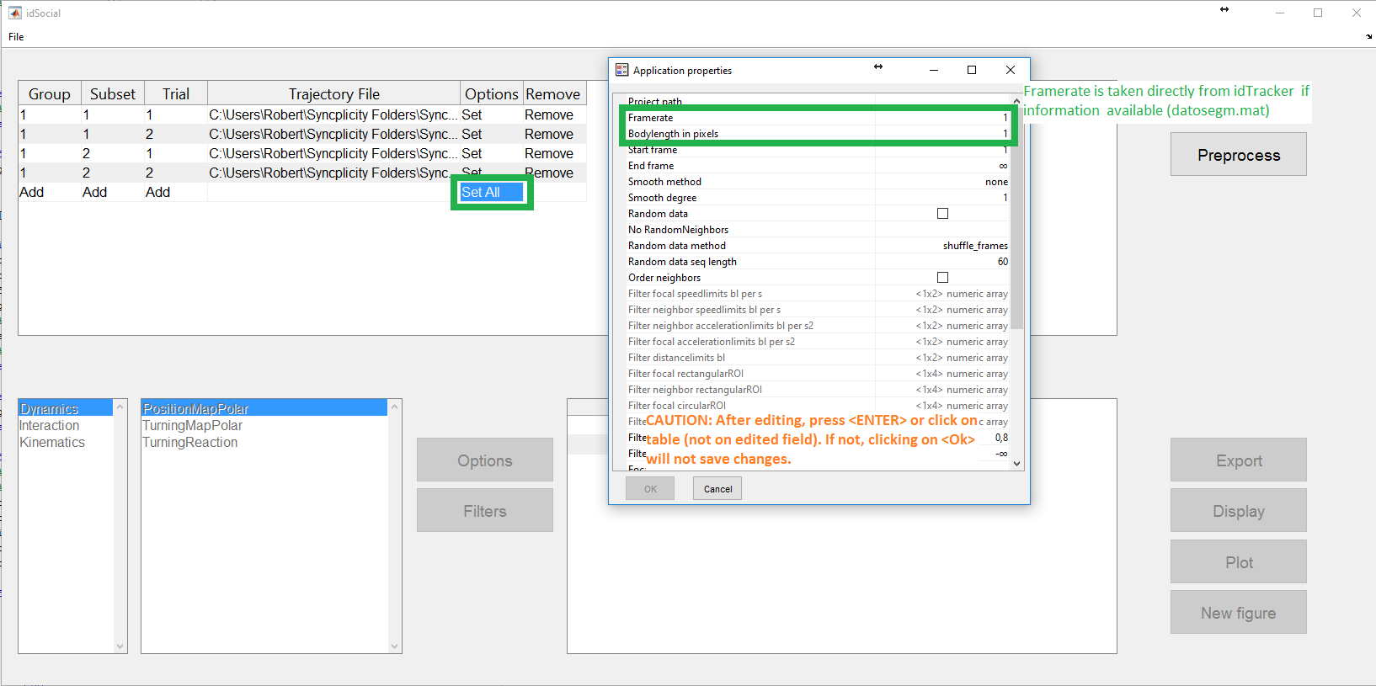
Preprocessing

Slide 9
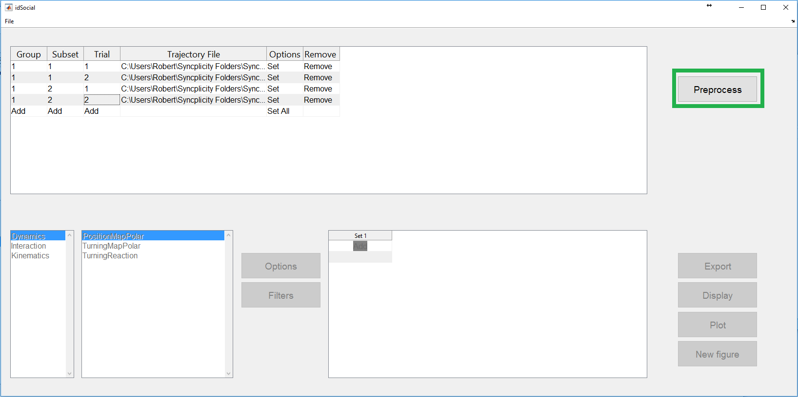
Preprocessing

Slide 10
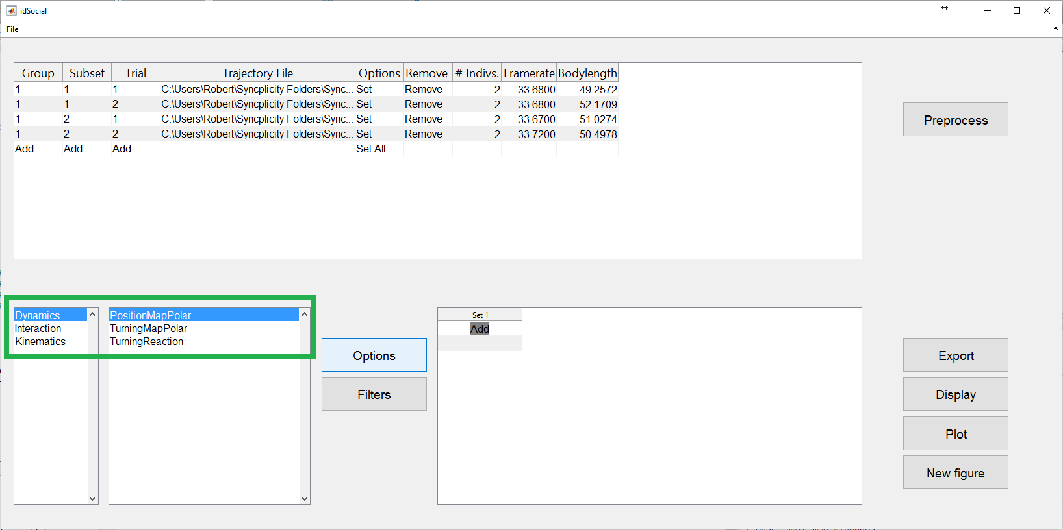
Apply specific analysis

Slide 11
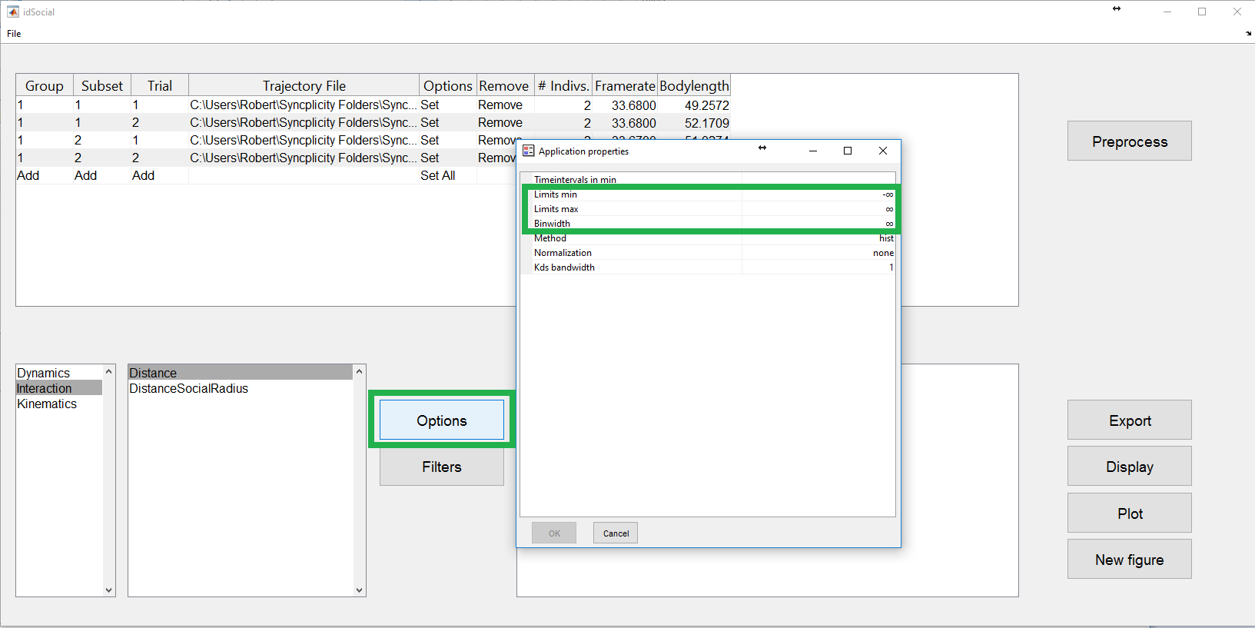
Apply specific analysis

Slide 12
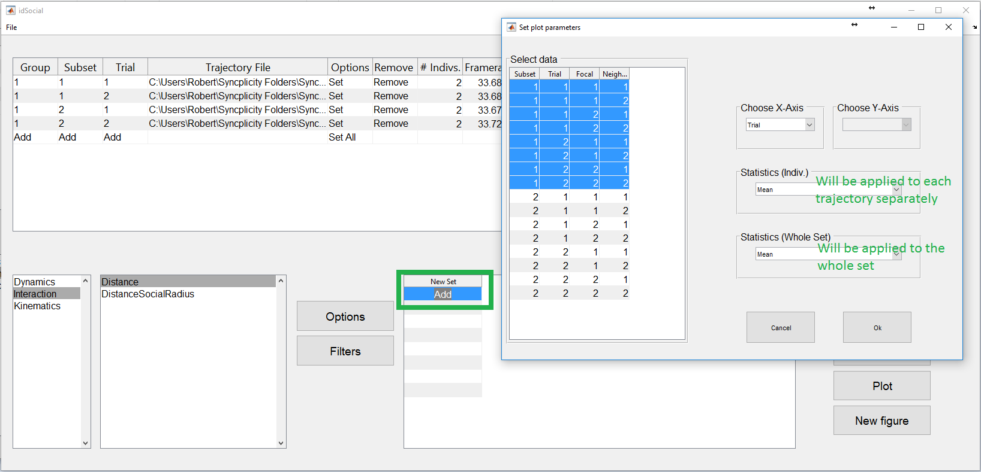
Choose statistics and presentation

Slide 13
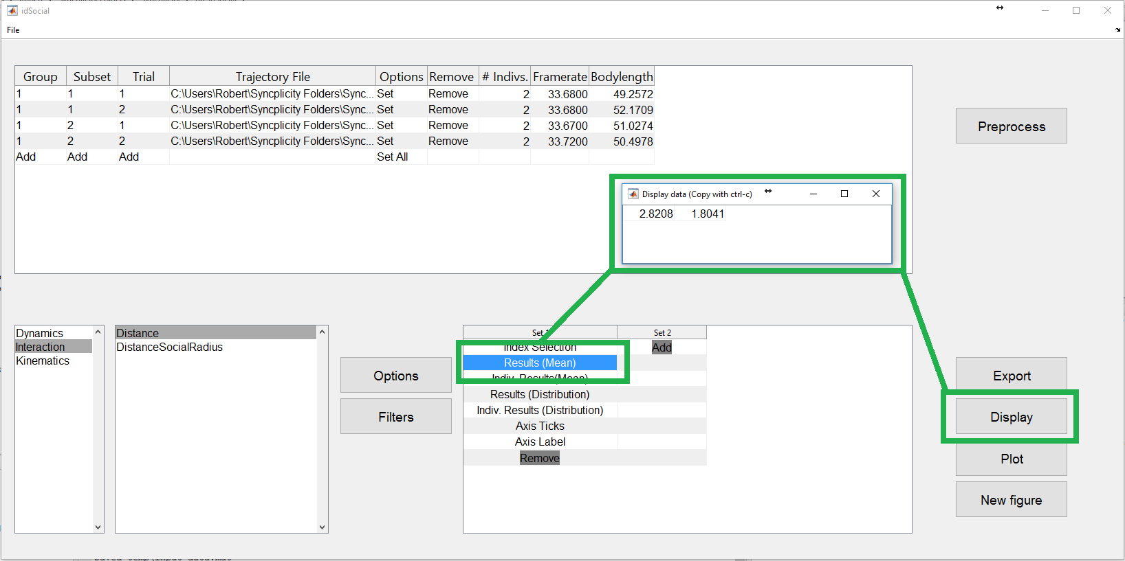
Display results

Slide 14
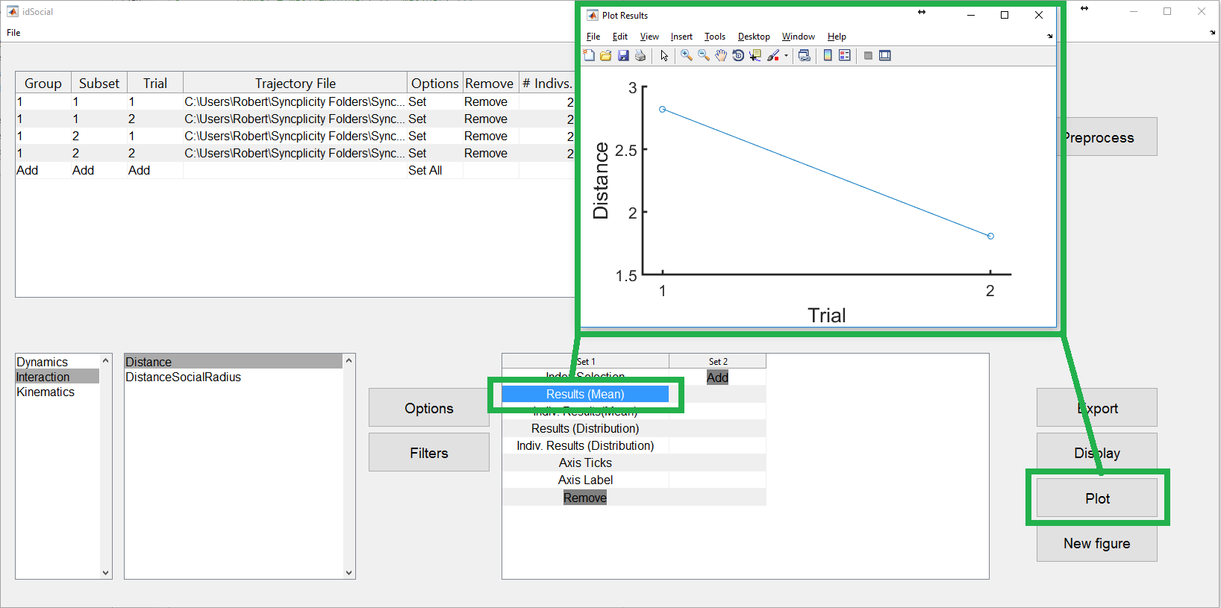
Display results

Slide 15
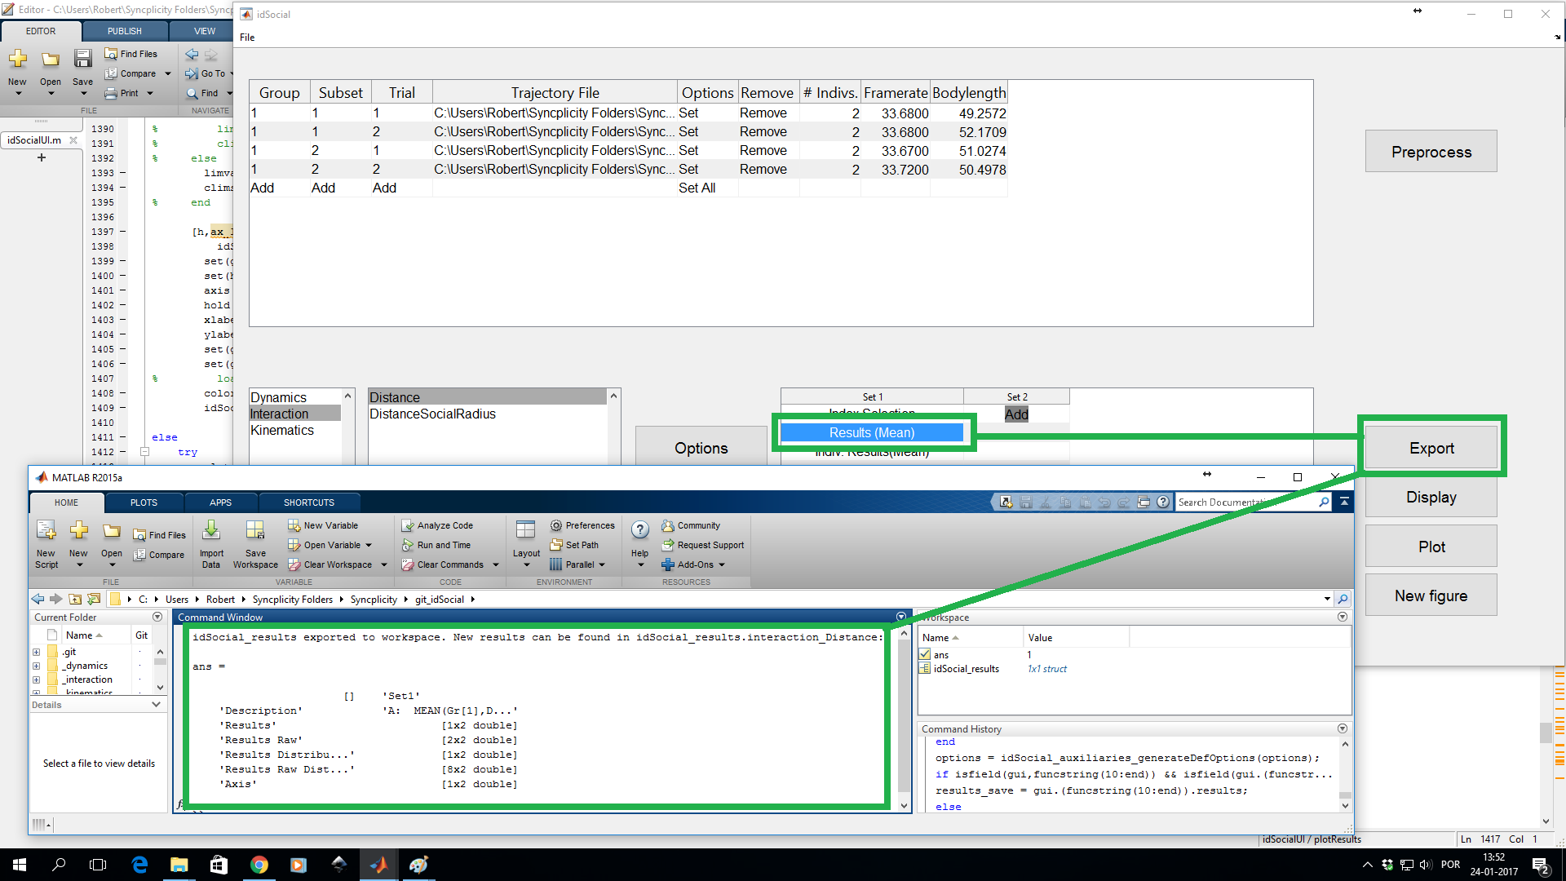

Slide 16
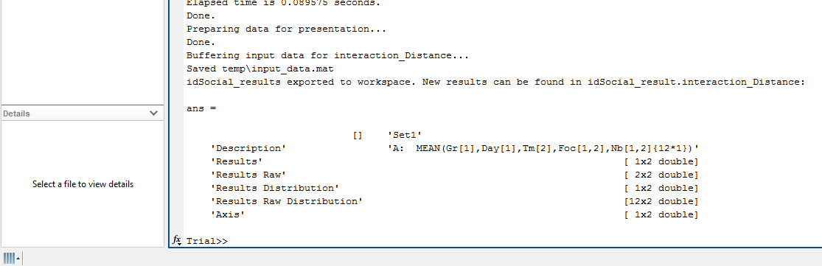
Export results to Matlab workspace

Slide 17
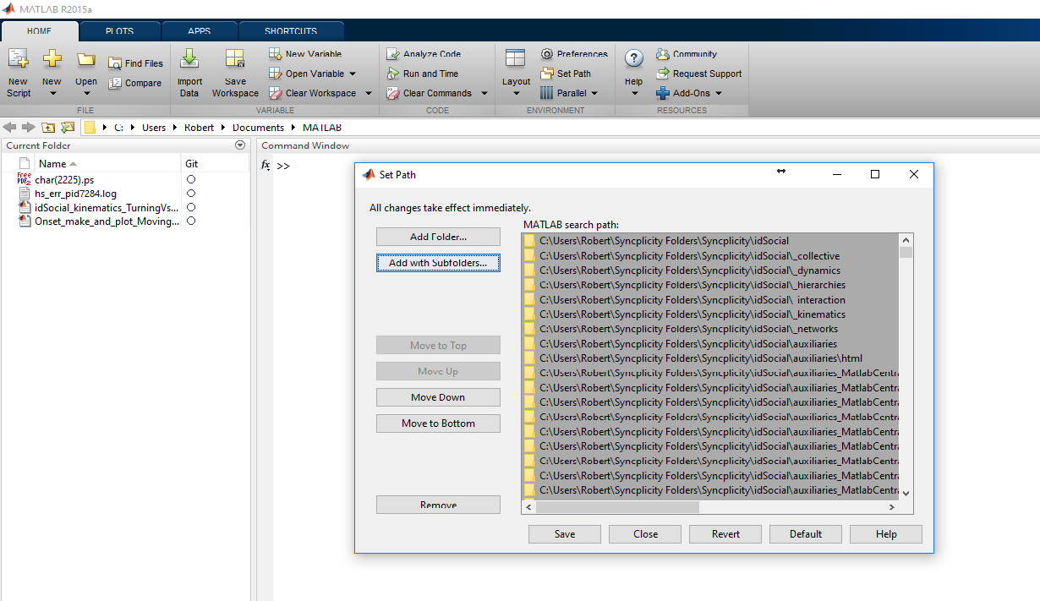
„Install“
...and run „idSocialUI“ from command line.

