Slide 1

BAZY DANYCH
LAB 05 – 05.12.2020
Chwała Paweł <pchwala@student.agh.edu.pl>
Ciałowicz Robert <robcial@student.agh.edu.pl>
Kozaczkiewicz Łukasz <kozaczki@student.agh.edu.pl>
Szpila Magdalena <mszpila@student.agh.edu.pl>
Akademia Górniczo-Hutnicza im. Stanisława Staszica w Krakowie
AGH University of Science and Technology

Slide 2


Technologia

Slide 3
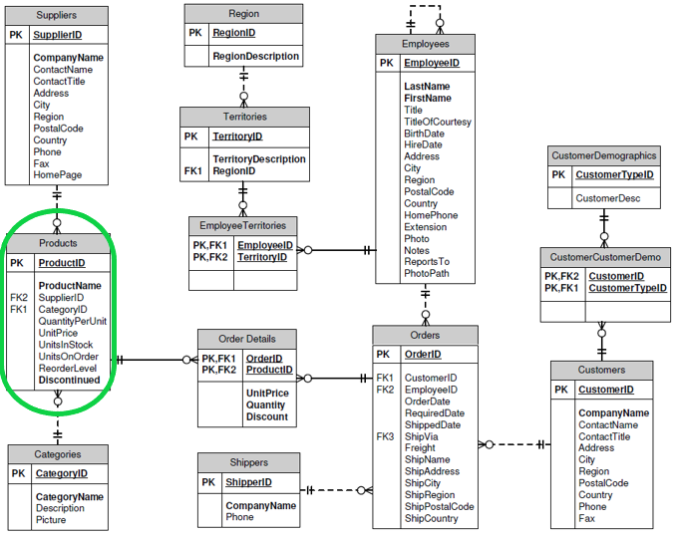
Diagram bazy Northwind

Slide 4
Endpoints
Categories
GET /api/Categories/
POST /api/Categories/
Suppliers
GET /api/Suppliers/
GET /api/Suppliers/{SupplierID}
Products
GET /api/Products/
GET /api/ProductsFull/
GET /api/Categories/{CategoryID}
PUT /api/Categories/{CategoryID}
DELETE /api/Categories/{CategoryID}
POST /api/Suppliers/
PUT /api/Suppliers/{SupplierID}
DELETE /api/Suppliers/{SupplierID}
POST /api/Products/
GET /api/Products/{ProductID}
PUT /api/Products/{ProductID}
DELETE /api/Products/{ProductID}
GET /api/ProductsFull/{ProductID}

