Slide 1


Dashboard for Brigadas de Salud Materna in Conflict-Affected Mexico
University of Virginia – DS 5559
September 2025
Deliverable 2: Data Source Evaluation
Robert Clay Harris — jbm2rt

Slide 2
Introduction
Purpose
This dashboard will integrate conflict event data from ACLED with maternal and infant health vulnerability indicators (e.g., poverty, health facility density, travel distance to obstetric care, displacement trends, and infant birth weights). It will provide a national map of conflict-affected areas, a ranked list of municipalities most in need of brigadas de salud materna, and predictive modeling to anticipate where risks are likely to rise in the next month.
Relevance
Maternal mortality has declined in Mexico over the past three decades, yet localized research shows that violence undermines these gains by reducing access to care and worsening birth outcomes (WHO 2025; Brown 2018). In 2024, ACLED recorded more than 5,000 violent events in Mexico, disproportionately concentrated in states such as Nuevo León, Guanajuato, and Michoacán. Violence disrupts clinics, displaces health workers, and forces women to travel unsafe routes for care. CRS and Caritas Mexico already operate mobile health brigades that provide flexible, community-based services, making them well-suited to respond to these gaps. A real-time dashboard will allow brigades to be deployed where humanitarian need is greatest.
Users
Primary users include CRS senior executives (who require visibility to guide global resource allocation), CRS Mexico country leadership (who need state- and municipal-level insights for planning), and Caritas diocesan chapters (who manage local brigade operations).
Descriptive Questions
Where are conflict events occurring, and how do they overlap with maternal and infant vulnerabilities?
Which municipalities are most at risk of service disruption?
How are risks distributed across states, and where are clusters of acute need?
What are recent trends in conflict and maternal/infant health risks?
Predictive Question
Which states are most likely to face rising violence and maternal/infant risks in the next month, and how should brigadas be allocated among high-risk municipalities?
Sources: WHO (2025); ACLED (2025); Brown (2018); CRS (n.d.); Cáritas Mexicana (n.d.)

Slide 3
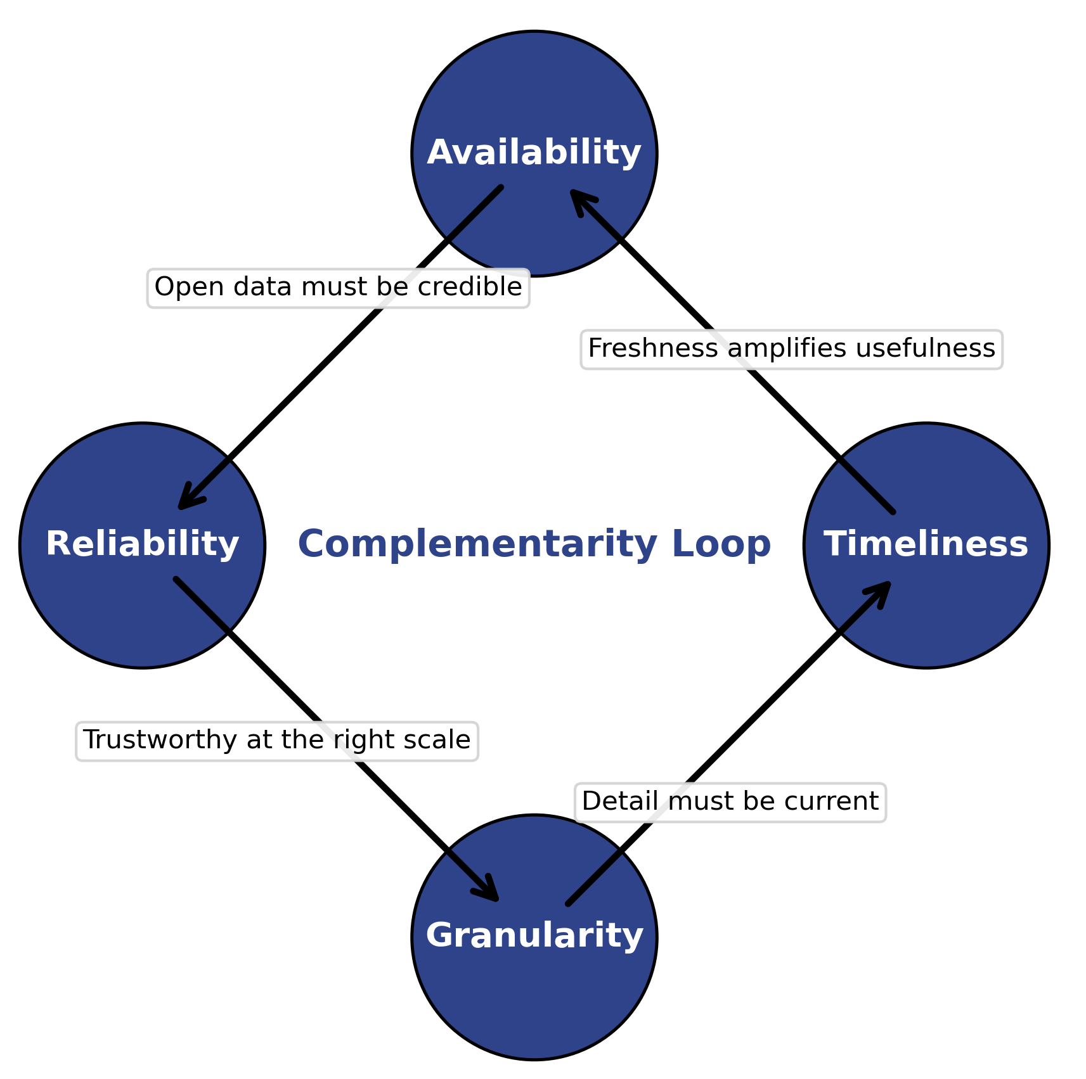
Criteria for Selecting Data Sources
To ensure the dashboard is built on robust foundations, four criteria guide our selection of data sources: Availability, Reliability, Granularity, and Timeliness.
No single criterion is sufficient on its own: each complements the others. For example, highly available data is only useful if it is also reliable, and fine-grained data must also be timely to be actionable.
Together, they create a balanced framework for evaluating which data sources are most appropriate for CRS and Caritas in guiding brigada deployments.

Slide 4
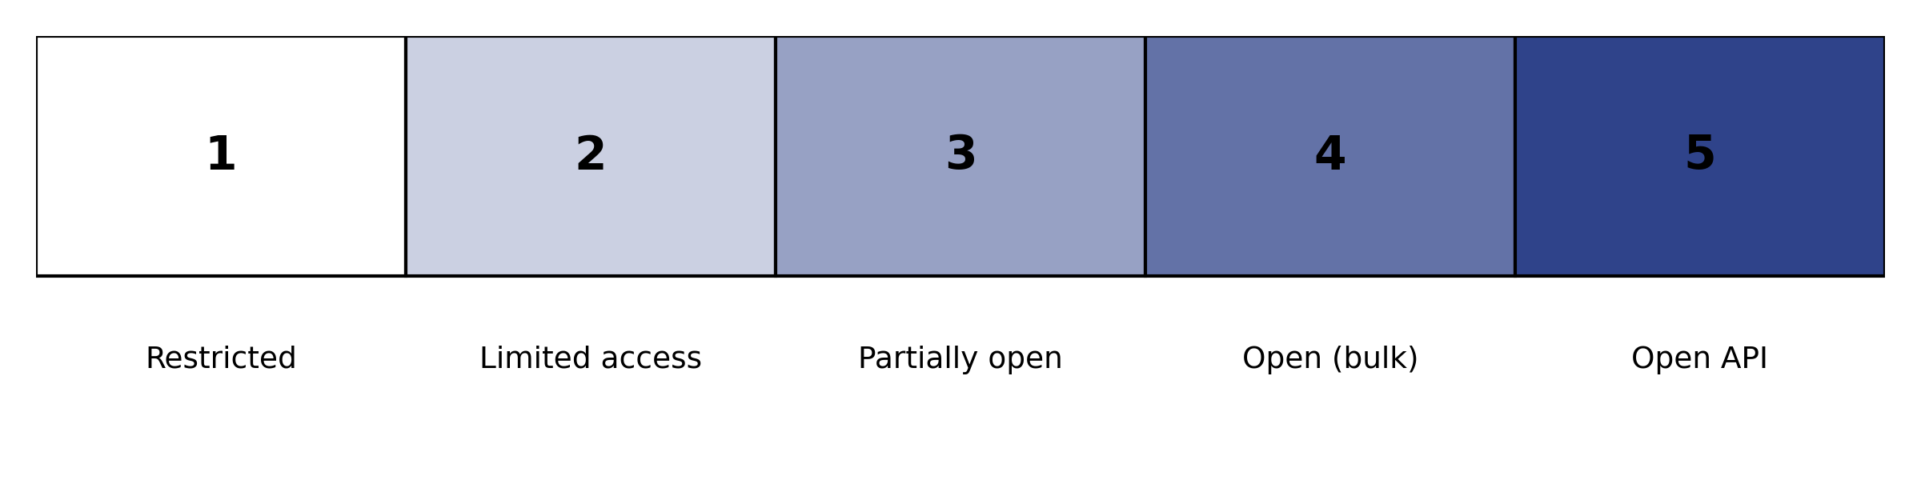
Availability
Question: Is the data free, accessible, and regularly updated?
Benefits: Easy access ensures CRS/Caritas can use the data without restrictions.
Limitations: Some free datasets (e.g., government portals) may lag in updates or require cumbersome downloads.
Complementarity: Pairs with Reliability — availability is only valuable if the data is also credible.

Slide 5

Reliability
Question: Is the source accurate, validated, and trusted by the humanitarian community?
Benefits: Credible data builds trust with CRS leadership and ensures decisions are defensible.
Limitations: Authoritative data may come with strict licenses or access barriers.
Complementarity: Pairs with Granularity — reliable data at the wrong geographic scale may still limit usefulness.

Slide 6
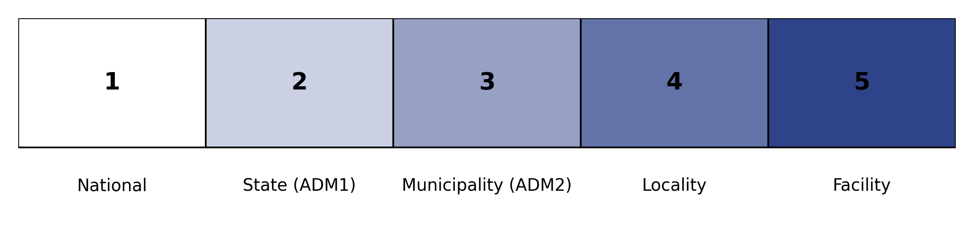
Granularity
Question: Does the data provide insights at the state/municipal level needed for brigada planning?
Benefits: Enables targeting brigadas where they’re most needed.
Limitations: Highly granular data may have missing values or inconsistent reporting across regions.
Complementarity: Works with Timeliness — fine detail must also be up-to-date to remain actionable.

Slide 7
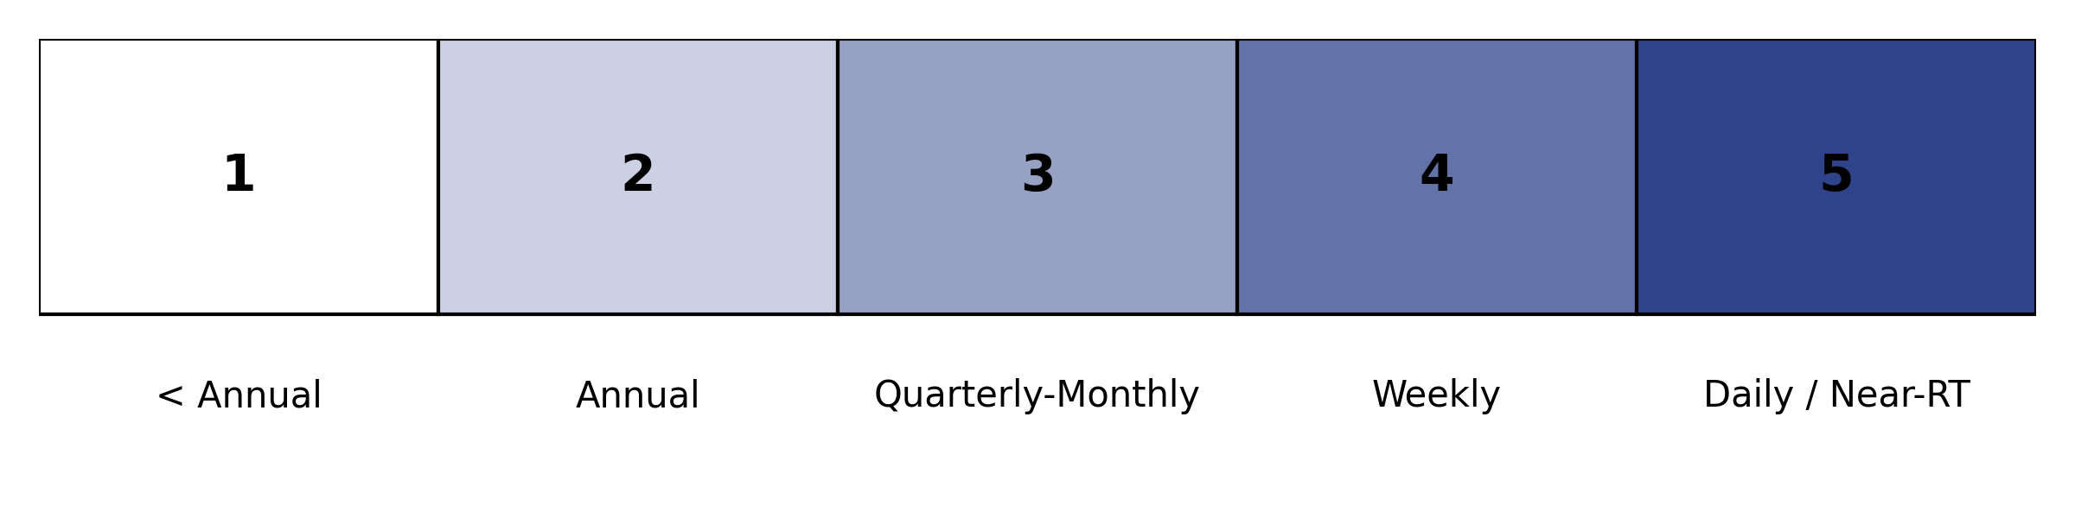
Timeliness
Question: How frequently is the data refreshed and how current are the observations?
Benefits: Near-real-time data allows CRS to anticipate emerging needs.
Limitations: Fast-updating sources (e.g., ACLED) may sacrifice completeness or require post-processing.
Complementarity: Balances Availability — a highly available dataset is less useful if it is months out of date.

Slide 8
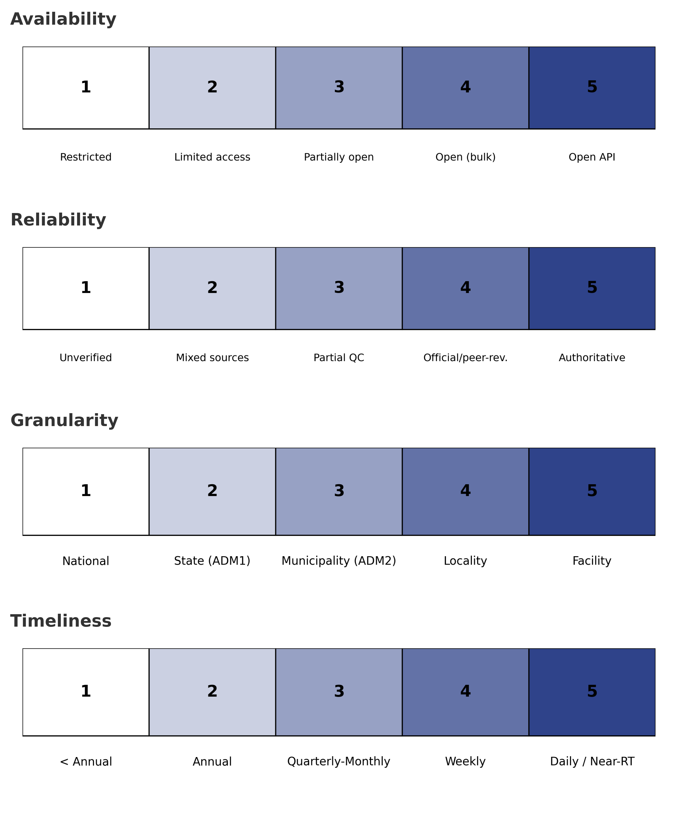
Evaluating Data Sources for the Dashboard
Conflict / Security Data
ACLED (Armed Conflict Location & Event Data)
INEGI Homicide / Mortality Statistics
Health / Maternal-Infant Data
WHO/UNICEF MMEIG Estimates
ENSANUT (National Health & Nutrition Survey, Mexico)
Demographics / Vulnerability
CONEVAL (Social Development Evaluation Council)
INEGI Census
Humanitarian Data Exchange (HDX)
Access to Care
Secretary of Health Facility Registry
OpenStreetMap / Geospatial Layers
Displacement / Migration
IDMC (Internal Displacement Monitoring Centre)

Slide 9
ACLED (Armed Conflict Location & Event Data Project)
Description:
ACLED provides granular, event-level data on political violence, protests, and violence against civilians. Updated daily, the dataset captures location, type, date, and actors involved in violent events.
Citation: Armed Conflict Location & Event Data Project (ACLED). (2025). ACLED dataset. Accessed Sept. 20, 2025. https://acleddata.com
Relevance to Dashboard:
Offers timely, high-resolution conflict data needed to anticipate disruptions to maternal and infant health services.
Allows disaggregation by municipality (ADM2) to align with brigada deployment planning.
Provides standardized methodology, enabling comparability across time and space.

Slide 10
INEGI Homicide & Mortality Statistics
Description:
The Instituto Nacional de Estadística y Geografía (INEGI) provides Mexico’s official demographic and health statistics, including mortality, cause of death, and violent crime (e.g., homicides, suicides). Data are available at national, state (ADM1), and municipal (ADM2) levels depending on the indicator.
Citation: INEGI. (2025). Estadísticas de mortalidad y homicidios. Retrieved September 20, 2025, from https://www.inegi.org.mx
Relevance to Dashboard:
Provides official confirmation of maternal deaths and violent mortality, enhancing credibility with national stakeholders.
Useful for cross-validation with ACLED to distinguish official counts from event-based data.
Subnational detail (state, municipality) makes it directly applicable for brigada deployment planning.

Slide 11
WHO/UNICEF MMEIG Maternal Mortality Estimates
Description:
The UN Maternal Mortality Estimation Inter-Agency Group (MMEIG) — WHO, UNICEF, UNFPA, World Bank, and UNDESA — maintains an online portal hosting maternal mortality estimates (2000–2023). Users can download country profiles, datasets, and trend visualizations.
Source: WHO. (2025). Trends in Maternal Mortality: 2000 to 2023. Retrieved from https://iris.who.int/handle/10665/381012
Relevance to Dashboard:
Provides the globally recognized baseline for maternal mortality.
Important for CRS global executives to compare Mexico’s situation to other countries.
While too coarse for local targeting, it establishes credibility and external validation of maternal health risks.

Slide 12
ENSANUT – Encuesta Nacional de Salud y Nutrición
Description:
ENSANUT is Mexico’s National Health and Nutrition Survey, coordinated by INSP (Instituto Nacional de Salud Pública) and INEGI. The official ENSANUT website provides survey microdata, reports, and dashboards covering maternal and child health, nutrition, and service coverage.
Source: INSP/INEGI. Encuesta Nacional de Salud y Nutrición (ENSANUT). Retrieved from https://ensanut.insp.mx
Relevance to Dashboard:
Provides subnational insights (state-level, some municipal in supplements) into maternal and infant health services.
Covers key indicators: antenatal care, facility-based delivery, child nutrition, immunization coverage.
Critical for CRS Mexico leadership to understand regional disparities in maternal health.

Slide 13
CONEVAL — Municipal Poverty
Description:
CONEVAL’s Pobreza a nivel municipio 2010–2020 provides multidimensional poverty estimates at the municipal (ADM2) level for 2010, 2015, and 2020. The website offers methodological documents, datasets, and interactive tools, enabling comparisons across time and space. These data highlight concentrations of poverty and extreme poverty across municipalities in Mexico.
Source: Consejo Nacional de Evaluación de la Política de Desarrollo Social (CONEVAL). Pobreza a nivel municipio 2010–2020. Retrieved from https://www.coneval.org.mx/Medicion/Paginas/Pobreza-municipio-2010-2020.aspx
Relevance to Dashboard:
Provides municipal-level poverty and extreme poverty estimates to weight maternal and infant health vulnerabilities.
Enables analysis of structural socioeconomic disadvantage underlying higher maternal/infant risk in conflict-affected areas.
Supports CRS and Caritas targeting by identifying municipalities where brigadas de salud materna can have the strongest equity impact.

Slide 14
INEGI Population & Housing Census
Description:
INEGI’s Censo de Población y Vivienda provides comprehensive demographic, social, and housing data at multiple scales, from national down to locality and household. Variables include indigenous language use, household characteristics, access to services, migration, and population structure. Public datasets and interactive tools are accessible through INEGI’s website.
Source: Instituto Nacional de Estadística y Geografía (INEGI). Censo de Población y Vivienda. Retrieved from https://www.inegi.org.mx/programas/ccpv/
Relevance to Dashboard:
Provides demographic and vulnerability indicators (e.g., indigenous populations, service access) critical to maternal and infant health risk analysis.
Enables disaggregation at municipal and locality levels, supporting Caritas diocesan chapters in targeting brigadas.
Essential for understanding structural barriers to care (e.g., geographic isolation, poor housing conditions).

Slide 15
Humanitarian Data Exchange (HDX)
Description:
The Humanitarian Data Exchange (HDX), managed by OCHA’s Centre for Humanitarian Data, is a global platform where organizations publish and share open humanitarian datasets. For Mexico, available datasets include population distribution, displacement, health, and infrastructure. An example is Meta’s High-Resolution Population Density and Demographic Estimates (2019), which provides gridded data on women of reproductive age, children under five, elderly, and other demographic groups.
Source: OCHA Centre for Humanitarian Data. Humanitarian Data Exchange (HDX). Retrieved from https://data.humdata.org
Relevance to Dashboard:
Provides access to multiple datasets relevant for conflict, displacement, demographics, and health.
Example dataset: Meta’s population grids enable mapping women of reproductive age and children under five — key populations for brigadas de salud materna.
HDX serves as a flexible source for supplementary layers, complementing official Mexican statistics (INEGI, CONEVAL).
Reliable access point for humanitarian partners like CRS and Caritas, supporting transparency and reproducibility.

Slide 16
Secretary of Health – CLUES Facility Registry
Description:
The Catálogo de Clave Única de Establecimientos de Salud (CLUES) is Mexico’s official registry of all health establishments. Maintained by the Dirección General de Información en Salud (DGIS), it provides nominal data on facilities including type, institution, location, and responsible authority. Coverage is national across the entire health sector. Updates are made daily, with monthly extracts available.
Source: Secretaría de Salud, DGIS. Catálogo de Clave Única de Establecimientos de Salud (CLUES). Retrieved from http://www.dgis.salud.gob.mx/contenidos/sinais/s_clues.html
Relevance to Dashboard:
Provides the authoritative dataset on the location and classification of health facilities nationwide.
Essential for identifying gaps in service coverage and modeling travel times for maternal and infant care.
Supports Caritas brigada planning by clarifying where fixed services already exist and where gaps remain.

Slide 17
OpenStreetMap (OSM) / Geospatial Layers
Description:
OpenStreetMap (OSM) is a global, community-driven mapping platform providing open-access geospatial data. In Mexico, OSM includes roads, paths, settlement boundaries, and points of interest contributed by volunteers and organizations. Data can be downloaded in bulk or accessed via APIs for integration into GIS workflows.
Source: OpenStreetMap contributors. OpenStreetMap Data. Retrieved from https://www.openstreetmap.org
Relevance to Dashboard:
Provides detailed road networks and settlement data to model travel times to health facilities and brigada service points.
Critical for CRS/Caritas to anticipate accessibility barriers and plan routes for mobile brigadas.
Open license allows unrestricted use and integration with Ministry of Health (CLUES) data for facility accessibility analysis.

Slide 18
IDMC (Internal Displacement Monitoring Centre)
Description:
The Internal Displacement Monitoring Centre (IDMC) produces the Global Internal Displacement Database (GIDD) and annual Global Report on Internal Displacement (GRID). These datasets track displacement due to conflict and disasters, including figures for Mexico. Data are based on national authorities, UN agencies, NGOs, and media reports.
Source: Internal Displacement Monitoring Centre (IDMC). Global Internal Displacement Database (GIDD). Retrieved from https://www.internal-displacement.org
Relevance to Dashboard:
Provides visibility into displacement trends linked to violence, which is critical for anticipating where women and children may lose access to maternal and infant health services.
Highlights intersections between conflict and forced mobility, complementing ACLED event data and CONEVAL vulnerability measures.
Useful for CRS global executives to demonstrate the humanitarian context at the international level.

Slide 19
Summary of Data Source Evaluation and Selection
Category | Source | Availability | Reliability | Granularity | Timeliness | Inclusion
Conflict / Security Data | ACLED | 5 | 4 | 4 | 5 | Yes
 | INEGI Homicide / Mortality Statistics | 5 | 5 | 2 | 2 | Yes
Health / Maternal-Infant Data | WHO/UNICEF MMEIG | 4 | 5 | 1 | 2 | No
 | ENSANUT | 4 | 5 | 2 | 1 | Yes
Demographics / Vulnerability | CONEVAL | 4 | 5 | 3 | 1 | Yes
 | INEGI Census | 4 | 5 | 4 | 1 | Yes
 | HDX | 5 | 3 | 4 | 2 | Yes
Access to Care | Secretary of Health Facility Registry (CLUES) | 4 | 5 | 5 | 3 | Yes
 | OpenStreetMap | 5 | 3 | 5 | 5 | Yes
Displacement / Migration | IDMC | 5 | 4 | 1 | 3 | No
While WHO/UNICEF MMEIG and IDMC data are valuable for understanding national and international trends, their scope is not granular enough for state- or municipal-level decision-making. Since the dashboard is designed to guide regional, state, and municipal deployment of brigadas de salud materna, these sources will remain background context for broader project goals but are not directly included in the dashboard.

Slide 20
References
Armed Conflict Location & Event Data Project (ACLED). (2025). ACLED dataset. https://acleddata.com
Brown, R. (2018). The Mexican Drug War and early-life health: The impact of violent crime on birth outcomes. Demography, 55(1), 319–340. https://doi.org/10.1007/s13524-017-0639-2
Cáritas Mexicana. (n.d.). Pastoral de la Salud. https://caritasmexicana.org/salud.php
Catholic Relief Services. (n.d.). CRS in Mexico. https://www.crs.org/where-we-work/latin-america-caribbean/mexico
Consejo Nacional de Evaluación de la Política de Desarrollo Social (CONEVAL). (n.d.). Pobreza a nivel municipio 2010–2020. https://www.coneval.org.mx/Medicion/Paginas/Pobreza-municipio-2010-2020.aspx
Instituto Nacional de Estadística y Geografía (INEGI). (2025). Mortalidad. https://www.inegi.org.mx
Instituto Nacional de Estadística y Geografía (INEGI). (n.d.). Censo de Población y Vivienda. https://www.inegi.org.mx/programas/ccpv
Instituto Nacional de Salud Pública (INSP) & Instituto Nacional de Estadística y Geografía (INEGI). (n.d.). Encuesta Nacional de Salud y Nutrición (ENSANUT). https://ensanut.insp.mx
Internal Displacement Monitoring Centre (IDMC). (n.d.). Global Internal Displacement Database (GIDD). https://www.internal-displacement.org
OCHA Centre for Humanitarian Data. (n.d.). Humanitarian Data Exchange (HDX). https://data.humdata.org
OpenStreetMap contributors. (n.d.). OpenStreetMap data. https://www.openstreetmap.org
Secretaría de Salud, Dirección General de Información en Salud (DGIS). (n.d.). Catálogo de Clave Única de Establecimientos de Salud (CLUES). http://www.dgis.salud.gob.mx/contenidos/sinais/s_clues.html
World Health Organization, UNICEF, UNFPA, World Bank Group, & United Nations Department of Economic and Social Affairs, Population Division. (2025). Trends in maternal mortality: 2000 to 2023. World Health Organization. https://iris.who.int/handle/10665/381012

