Slide 1


Dashboard for Brigadas de Salud Materna in Conflict-Affected Mexico
University of Virginia – DS 5559
September 2025
Deliverable 2: Data Source Evaluation
Robert Clay Harris — jbm2rt

Slide 2
Introduction
Purpose
This dashboard will integrate conflict event data from ACLED with maternal and infant health vulnerability indicators (e.g., poverty, health facility density, travel distance to obstetric care, displacement trends, and infant birth weights). It will provide a national map of conflict-affected areas, a ranked list of municipalities most in need of brigadas de salud materna, and predictive modeling to anticipate where risks are likely to rise in the next month.
Relevance
Maternal mortality has declined in Mexico over the past three decades, yet localized research shows that violence undermines these gains by reducing access to care and worsening birth outcomes (WHO 2025; Brown 2018). In 2024, ACLED recorded more than 5,000 violent events in Mexico, disproportionately concentrated in states such as Nuevo León, Guanajuato, and Michoacán. Violence disrupts clinics, displaces health workers, and forces women to travel unsafe routes for care. CRS and Caritas Mexico already operate mobile health brigades that provide flexible, community-based services, making them well-suited to respond to these gaps. A real-time dashboard will allow brigades to be deployed where humanitarian need is greatest.
Users
Primary users include CRS senior executives (who require visibility to guide global resource allocation), CRS Mexico country leadership (who need state- and municipal-level insights for planning), and Caritas diocesan chapters (who manage local brigade operations).
Descriptive Questions
Where are conflict events occurring, and how do they overlap with maternal and infant vulnerabilities?
Which municipalities are most at risk of service disruption?
How are risks distributed across states, and where are clusters of acute need?
What are recent trends in conflict and maternal/infant health risks?
Predictive Question
Which states are most likely to face rising violence and maternal/infant risks in the next month, and how should brigadas be allocated among high-risk municipalities?

Slide 3
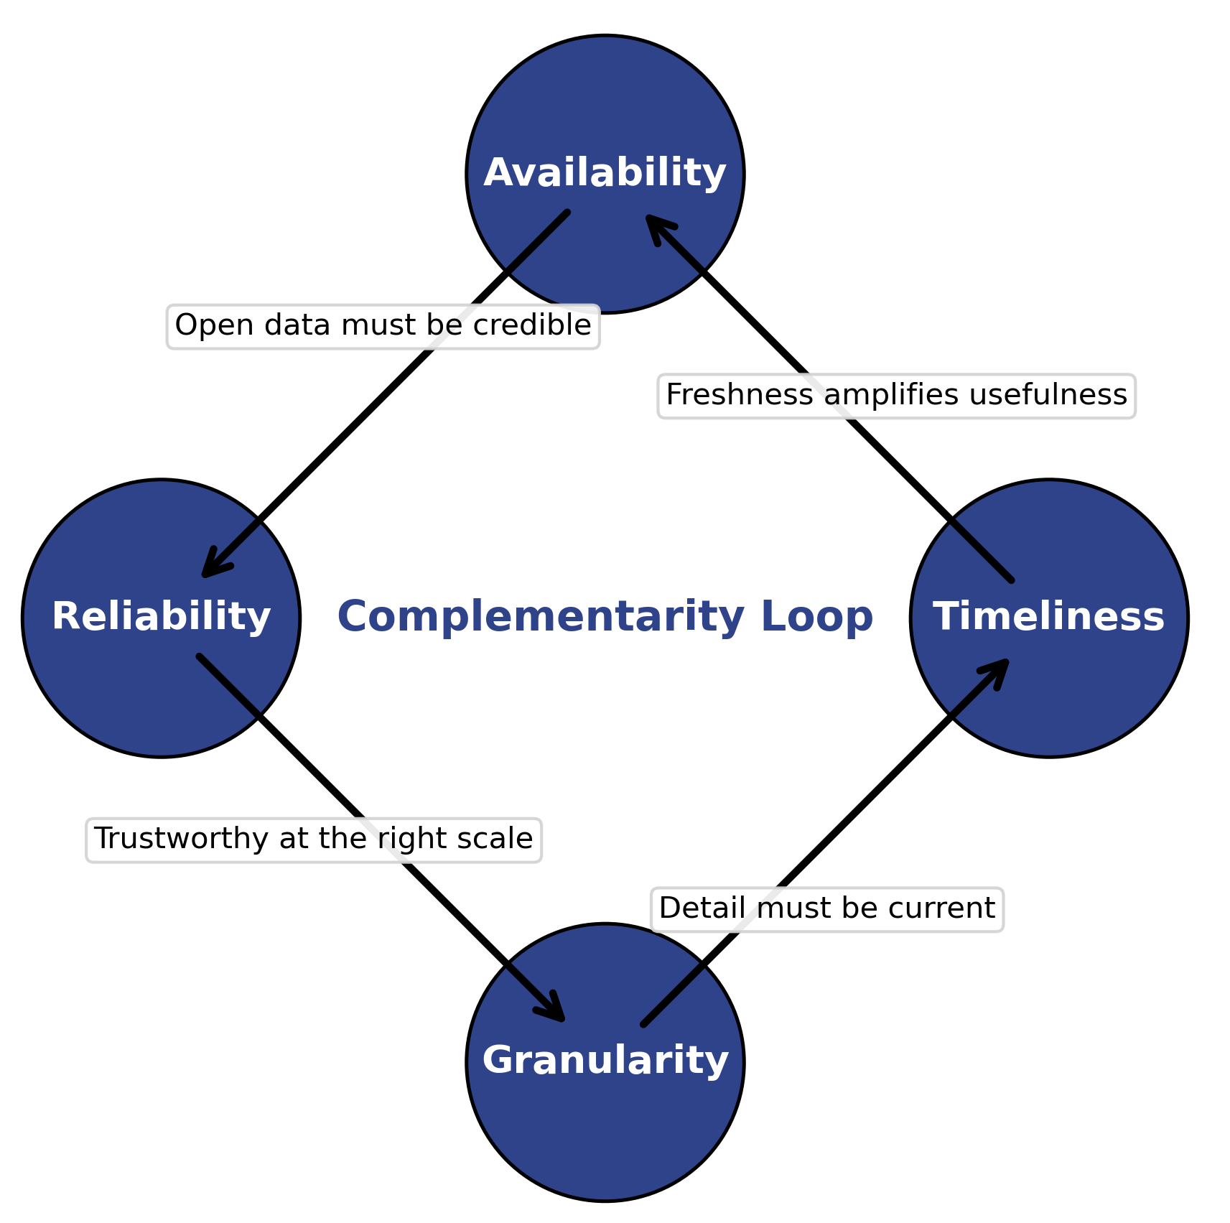
Criteria for Selecting Data Sources
To ensure the dashboard is built on robust foundations, four criteria guide our selection of data sources: Availability, Reliability, Granularity, and Timeliness.
No single criterion is sufficient on its own: each complements the others. For example, highly available data is only useful if it is also reliable, and fine-grained data must also be timely to be actionable.
Together, they create a balanced framework for evaluating which data sources are most appropriate for CRS and Caritas in guiding brigada deployments.

Slide 4
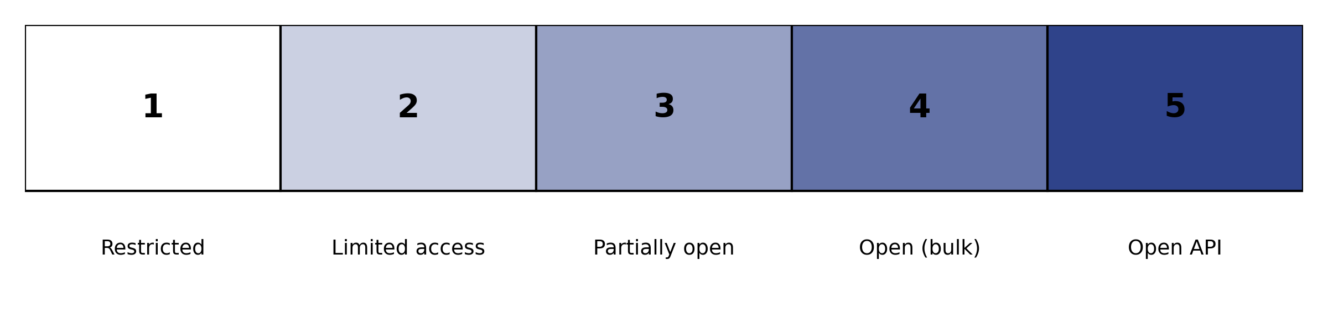
Availability
Question: Is the data free, accessible, and regularly updated?
Benefits: Easy access ensures CRS/Caritas can use the data without restrictions.
Limitations: Some free datasets (e.g., government portals) may lag in updates or require cumbersome downloads.
Complementarity: Pairs with Reliability — availability is only valuable if the data is also credible.

Slide 5
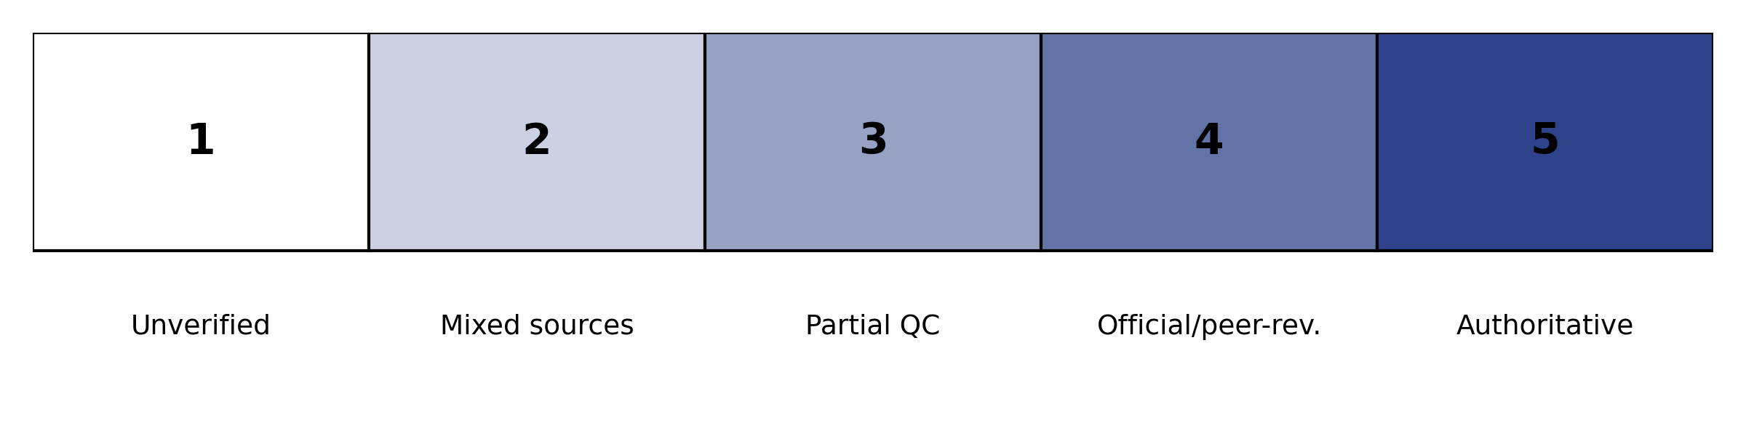
Reliability
Question: Is the source accurate, validated, and trusted by the humanitarian community?
Benefits: Credible data builds trust with CRS leadership and ensures decisions are defensible.
Limitations: Authoritative data may come with strict licenses or access barriers.
Complementarity: Pairs with Granularity — reliable data at the wrong geographic scale may still limit usefulness.

Slide 6
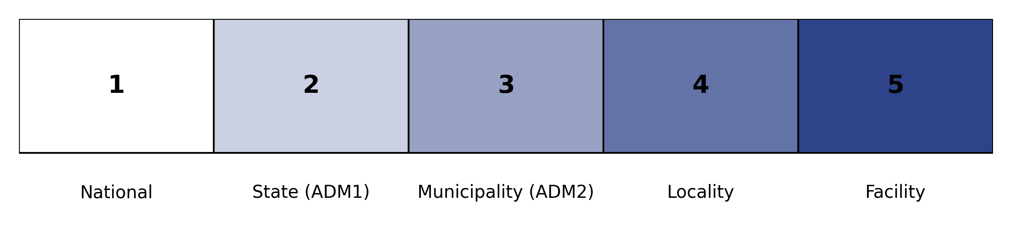
Granularity
Question: Does the data provide insights at the state/municipal level needed for brigada planning?
Benefits: Enables targeting brigadas where they’re most needed.
Limitations: Highly granular data may have missing values or inconsistent reporting across regions.
Complementarity: Works with Timeliness — fine detail must also be up-to-date to remain actionable.

Slide 7
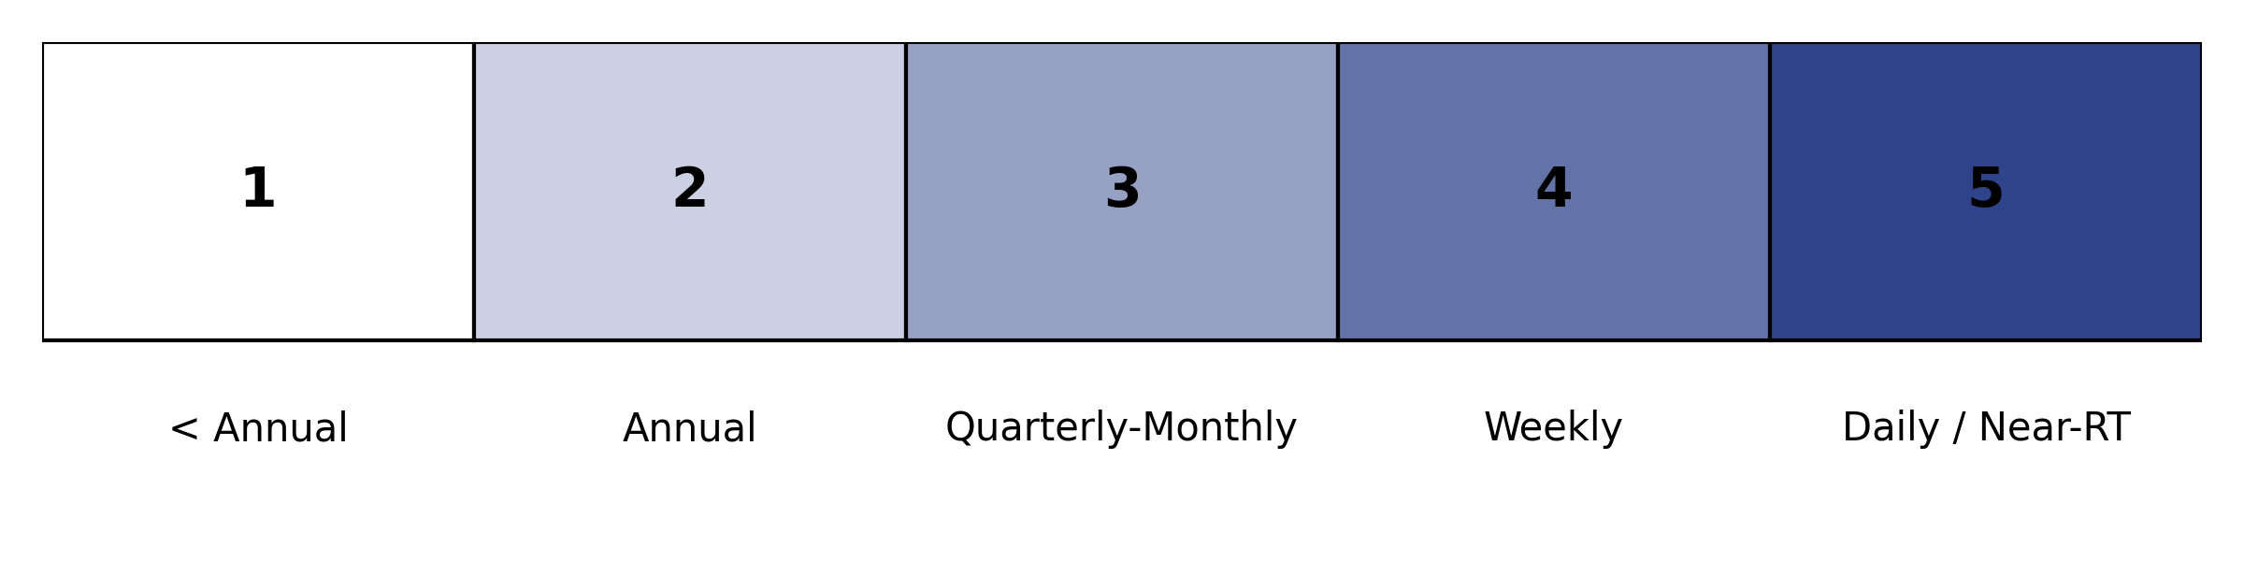
Timeliness
Question: How frequently is the data refreshed and how current are the observations?
Benefits: Near-real-time data allows CRS to anticipate emerging needs.
Limitations: Fast-updating sources (e.g., ACLED) may sacrifice completeness or require post-processing.
Complementarity: Balances Availability — a highly available dataset is less useful if it is months out of date.

Slide 8
Criteria for Evaluating Data Sources
Availability Question: Is the data free, accessible, and regularly updated? Benefits: Easy access ensures CRS/Caritas can use the data without restrictions. Limitations: Some free datasets (e.g., government portals) may lag in updates or require cumbersome downloads. Complementarity: Pairs with Reliability — availability is only valuable if the data is also credible. | Reliability Question: Is the source accurate, validated, and trusted by the humanitarian community? Benefits: Credible data builds trust with CRS leadership and ensures decisions are defensible. Limitations: Authoritative data may come with strict licenses or access barriers. Complementarity: Pairs with Granularity — reliable data at the wrong geographic scale may still limit usefulness.
Granularity Question: Does the data provide insights at the state/municipal level needed for brigada planning? Benefits: Enables targeting brigadas where they’re most needed. Limitations: Highly granular data may have missing values or inconsistent reporting across regions. Complementarity: Works with Timeliness — fine detail must also be up-to-date to remain actionable. | Timeliness Question: How frequently is the data refreshed and how current are the observations? Benefits: Near-real-time data allows CRS to anticipate emerging needs. Limitations: Fast-updating sources (e.g., ACLED) may sacrifice completeness or require post-processing. Complementarity: Balances Availability — a highly available dataset is less useful if it is months out of date.

Slide 9
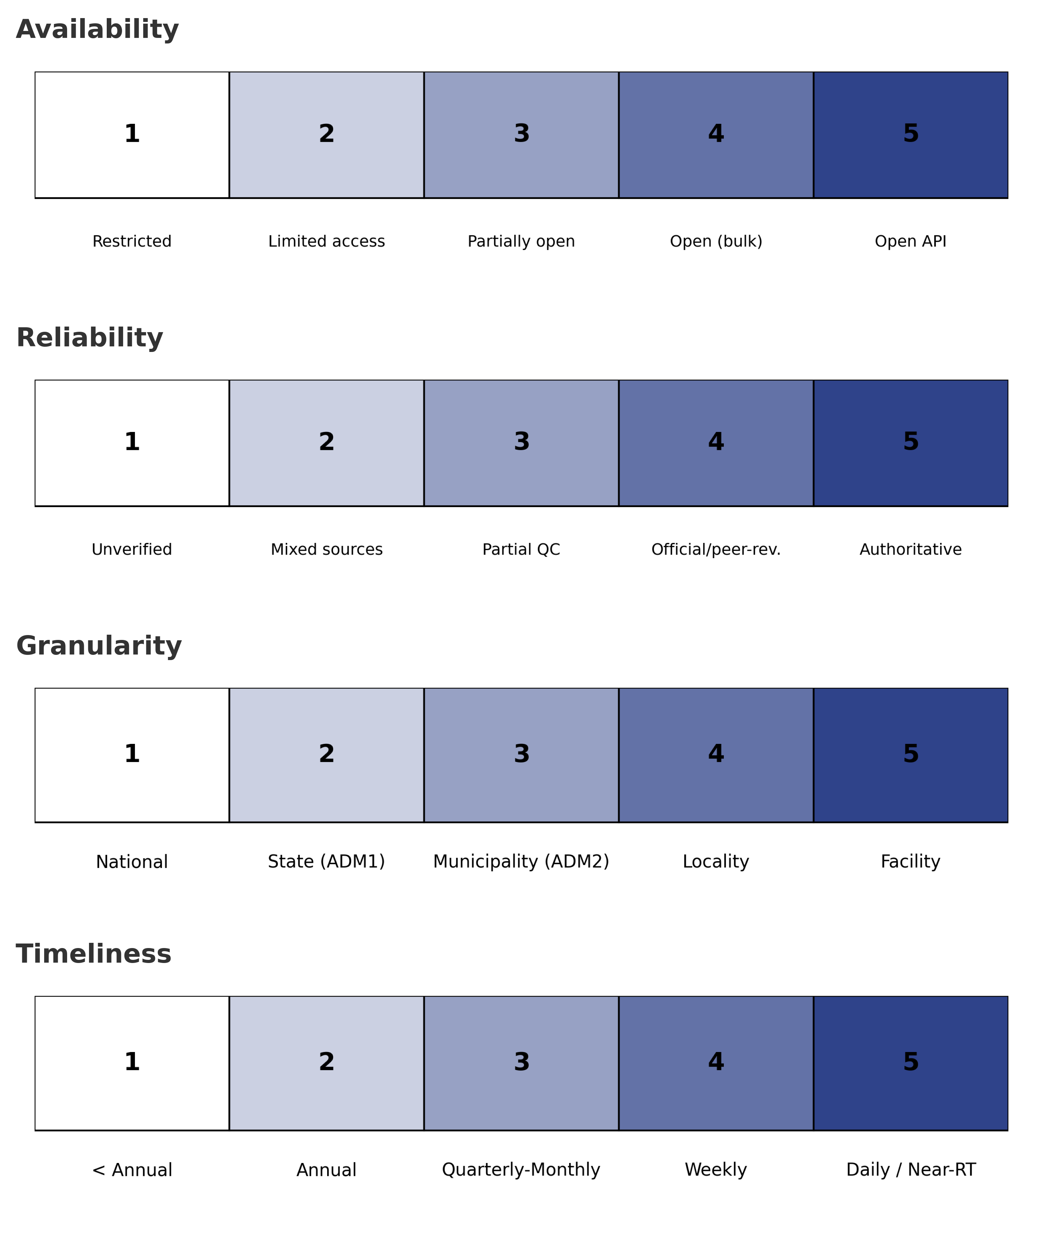
ACLED

