Slide 1


Dashboard for Brigadas de Salud Materna in Conflict-Affected Mexico
University of Virginia – DS 5559
September 2025
Deliverable 3: Predictive Metric and Data Source Evaluation and Documentation
Robert Clay Harris — jbm2rt

Slide 2
What CRS and Cáritas Need to Predict
CRS and Cáritas Mexico require forward-looking insights to guide both immediate humanitarian response and long-term program planning.
Predictive metrics can help decision makers anticipate where maternal and infant health outcomes may worsen—whether from chronic vulnerabilities or acute disruptions linked to insecurity.

Slide 3
Translating Prediction into Action
Guiding Question:
How can predictive metrics help CRS and Cáritas anticipate where mothers and infants are most at risk—whether from chronic conditions or emerging crises?
Decision Context:
Predictions will inform:
Strategic planning: allocating health and development resources to high-risk regions.
Operational deployment: directing mobile health brigades and supplies to areas facing acute disruptions.

Slide 4
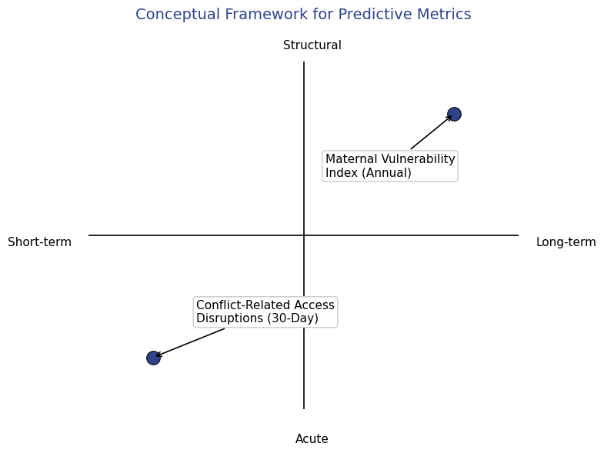
Criteria for Selecting a Predictive Metric
Conceptual Framework for Predictive Metrics:
Predictive metrics can be understood along two conceptual dimensions:
Time Horizon — whether they anticipate change over weeks, months, or years.
Type of Risk — whether they capture acute disruptions (e.g., conflict-related access loss) or structural vulnerabilities (e.g., poverty, weak infrastructure).
Both perspectives are essential for humanitarian decision-making.
Short-term, acute metrics support operational response, while long-term, structural metrics inform strategic planning and program design.

Slide 5
Operational Evaluation Criteria
While both conceptual approaches are valuable, this dashboard’s focus on real-time humanitarian decision-making requires metrics that can be updated frequently and act as near-term predictors of service disruption.
To evaluate each metric’s suitability for this purpose, six operational criteria were applied:

Slide 6
Operational Evaluation Criteria
Criteria | Explanation | 1 (Low) | 2 (Moderate) | 3 (High)
Predictive Horizon | How far into the future the metric anticipates change. | Days | Months | Year or more
Lead Time | How quickly it provides an actionable signal before disruption occurs. | Reactive | Short notice | Early warning
Temporal Sensitivity | How frequently the metric updates to reflect changing conditions. | Annual | Quarterly | Monthly or real-time
Spatial Resolution | Geographic granularity of the data. | National | State | Municipal
Predictive Value | Strength of empirical relationship between metric behavior and observed disruptions. | Weak | Moderate | Strong
Relevance to Program | Alignment with CRS/Cáritas operational planning and deployment cycles. | Indirect | Partial | Direct operational use

Slide 7
Predictive Metric Options Considered
Evaluate at least two potential metrics and make a selection for your project.
To anticipate disruptions to maternal and infant health services, two predictive approaches were considered. Each reflects a different time horizon and type of risk.
Metric 1: Conflict-Related Access Disruptions (30-Day) — short-term, acute risk derived from conflict and access data.
Metric 2: Maternal Vulnerability Index (Annual) — long-term, structural risk derived from socio-demographic indicators.

Slide 8
Metric 1 — Conflict-Related Access Disruptions (30-Day)
Evaluate at least two potential metrics and make a selection for your project.
Integrates conflict forecasts from ACLED CAST (Conflict Alert System) with recent event data to predict municipalities at risk of maternal and infant health service disruption. CAST projects political violence 1–6 months ahead at the state (ADM1) level. Within high-risk states, the previous 60 days of ACLED event data are used to identify active conflict zones and model road travel routes to health facilities (CLUES / OSM network).
Municipalities whose access routes intersect these zones are classified as likely disrupted within 30 days.
Primary Data Sources:
ACLED CAST (Conflict Alert System) – forecasts subnational political violence risk (1–6 months ahead)
ACLED (Event Data) – historical and recent conflict incidents (daily updates)
Secretaría de Salud, DGIS – CLUES Registry (2025) – national health facility database
OpenStreetMap – road network for travel-time modeling

Slide 9
Metric 2 — Maternal Vulnerability Index (Annual)
Evaluate at least two potential metrics and make a selection for your project.
A composite indicator capturing chronic maternal and infant vulnerability based on poverty, health access, and demographic variables. Built from annual and multi-year datasets (CONEVAL, ENSANUT, INEGI), the index identifies municipalities where structural conditions make mothers and infants persistently at risk of poor outcomes. Because its underlying sources update annually, the index forecasts long-term vulnerability rather than short-term shocks.
Primary Data Sources:
CONEVAL (2010–2020) – Municipal poverty and social deprivation indicators
ENSANUT (INEGI / INSP) – National Health and Nutrition Survey on maternal and child health access
INEGI Census (2020) – Population and household characteristics by municipality

Slide 10
Comparative Evaluation of Predictive Metrics
Category | Predictive Metric | Predictive Horizon | Lead Time | Temporal Sensitivity | Spatial Resolution | Predictive Value | Relevance to Program | Inclusion
Short-term / Acute | Conflict-Related Access Disruptions (30-Day) | 3 | 3 | 3 | 3 | 3 | 3 | Yes
Long-term / Structural | Maternal Vulnerability Index (Annual) | 1 | 1 | 1 | 3 | 2 | 2 | No
While both metrics have predictive value, only the Conflict-Related Access Disruptions metric provides the temporal precision and operational relevance required for real-time deployment of maternal health brigades.

Slide 11
References
Armed Conflict Location & Event Data Project (ACLED). (2025). ACLED dataset. https://acleddata.com
Consejo Nacional de Evaluación de la Política de Desarrollo Social (CONEVAL). (n.d.). Pobreza a nivel municipio 2010–2020. https://www.coneval.org.mx/Medicion/Paginas/Pobreza-municipio-2010-2020.aspx
Instituto Nacional de Estadística y Geografía (INEGI). (2025). Mortalidad. https://www.inegi.org.mx
Instituto Nacional de Estadística y Geografía (INEGI). (n.d.). Censo de Población y Vivienda. https://www.inegi.org.mx/programas/ccpv
Instituto Nacional de Salud Pública (INSP) & Instituto Nacional de Estadística y Geografía (INEGI). (n.d.). Encuesta Nacional de Salud y Nutrición (ENSANUT). https://ensanut.insp.mx
OpenStreetMap contributors. (n.d.). OpenStreetMap data. https://www.openstreetmap.org
Secretaría de Salud, Dirección General de Información en Salud (DGIS). (n.d.). Catálogo de Clave Única de Establecimientos de Salud (CLUES). http://www.dgis.salud.gob.mx/contenidos/sinais/s_clues.html

