Slide 1
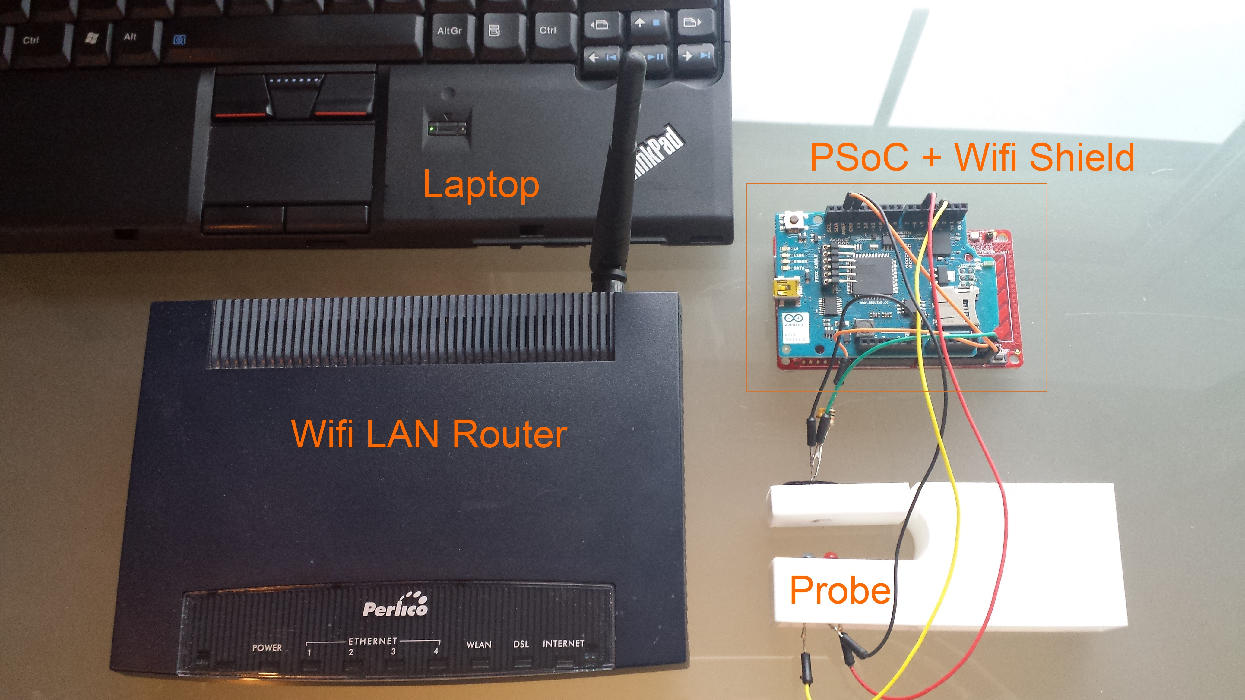
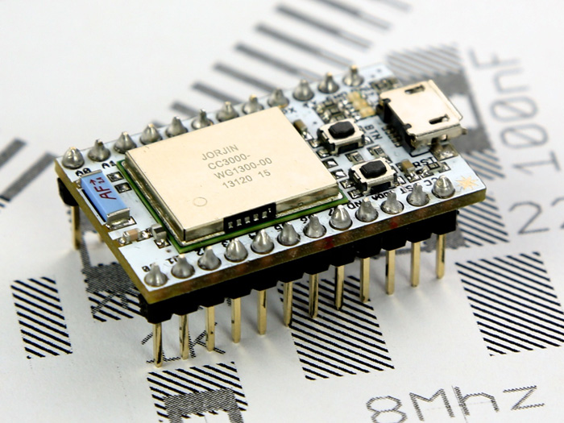
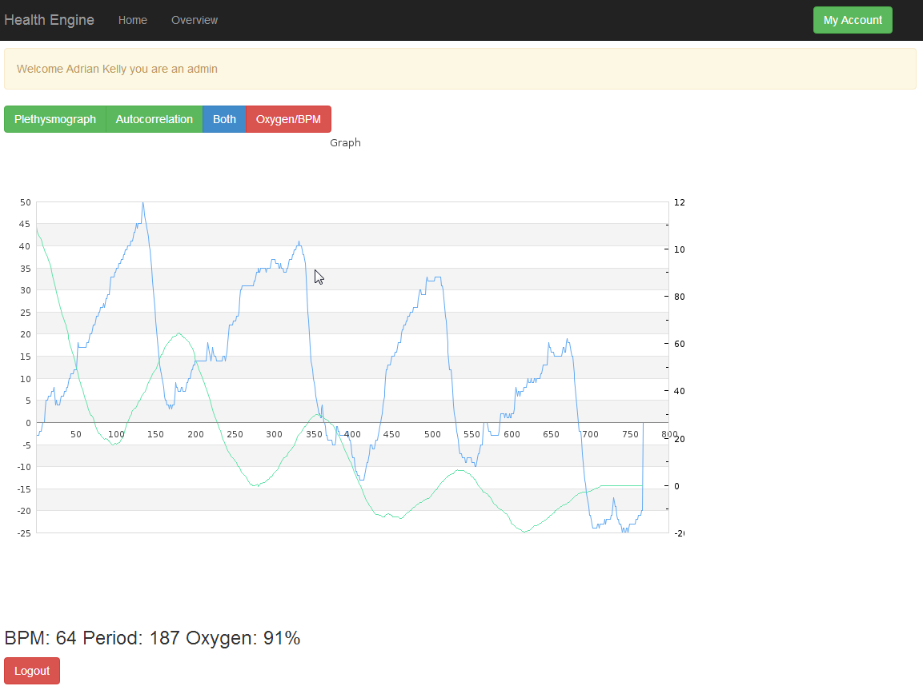
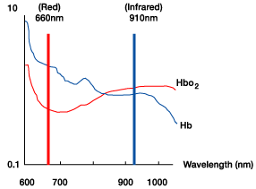
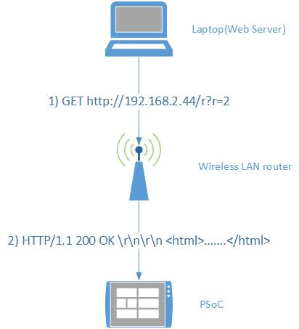
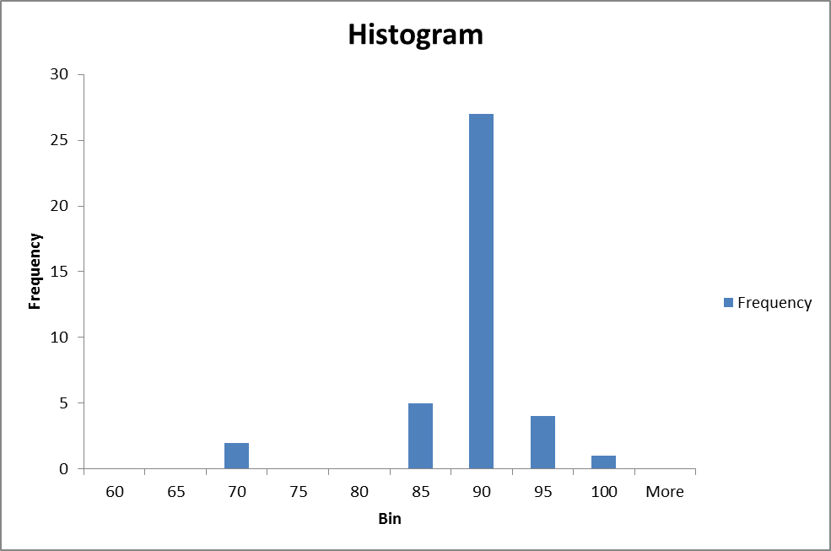
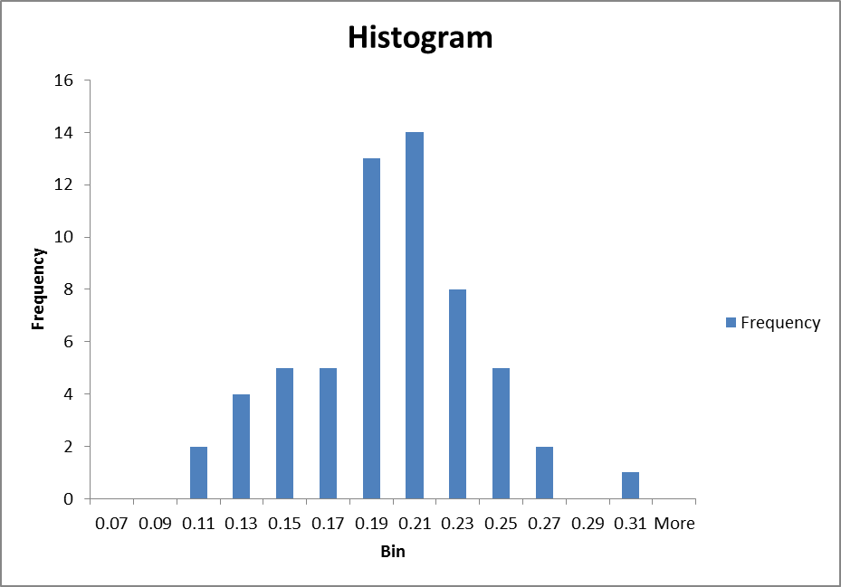

Pulse Oximeter
Introduction
Once a patient starts losing oxygen, a doctor has less than three minutes to prevent risk of brain damage, heart failure and death. In sub Saharan Africa up to 70% of operating theatres don't have access to pulse oximeters that could help minimise this by alerting doctors to the low oxygen levels.
Our project is to design build a pulse oximetry system which can help people in developing countries who can die from hypoxia where hospitals and doctors often cannot afford proper monitoring equipment.
What is a Pulse Oximeter ?
Pulse oximeters are medical devices that monitor the level of oxygen in a patient's blood and alert the health-care worker if oxygen levels drop below safe levels, allowing rapid intervention. These devices are essential in any setting in which a patient's blood oxygen levels requires monitoring like operations, emergency and intensive care, and treatment and recovery in hospital wards. (source: WHO)
Principles of Pulse Oximetry
The oxygen saturation is taken by measuring the transmission of light through the finger. This is based on Beer’s law. Beer’s law explains how light is absorbed by materials. The equation of Beers law:
$A=log10(\frac{Io}{I})$
Where $A$ is the absorbance, $I$ is the intensity of light transmitted, and $Io$ is the original intensity of light.
In a pulse oximeter the calculation of the level of oxygen in the blood is based on measuring of the absorption of light by body tissue, which depends on how much oxyhaemoglobin is in the blood. This is calculated as the ratio of red AC to the infrared AC.
Web Platform
The aim of our web platform is to allow doctors to easily check their patients pulse and oxygen levels while keeping the probe small and removing the need for a screen or monitor as the doctor can check the results on any device.
This graph shows how light of different wavelengths is absorbed by the different types of haemoglobin in the blood.
A Spark Core
Our Pulse Oximetry system consists of a probe, electronics and a local web server running on a laptop. By using the laptops battery power and a local area network, this makes it suitable for a region where electricity and internet access are limited.
Existing clinical pulse oximeters are large and expensive and generally lack wireless connectivity.
The leading edge in this technology is from The University of British Columbia who have invented their own pulse oximeter which can connect to an iPhone. This proves that our project is also cutting edge.
Our system uses a microcontroller SOC to perform the signal processing and wireless communication. The final product would use the Spark Core platform to make a smaller and cheaper version.
For prototyping we used a Programmable System on Chip(PSoC) and an Arduino wifi shield.
Microcontroller SOC
Our project uses a client-server model to communicate between the PSoC and the web server. According to Wikipedia “The client-server relationship describes the relation between the client and how it makes a service request from the server, and how the server can accept these requests, process them, and return the requested information to the client.”
The graphs are plotted on our website by using a PHP charting library. When the user clicks a button on the page, we get the data from the PSoC to the PHP page by getting the button to link to a PHP web crawler script which sends a GET request to the PSoC telling it to serve up a new page with specific data according to which button the user has pressed by using the REST protocol. We use a parameter/value pair which changes according to which button was pressed. When the PSoC detects the value it sends out a different set of data according to the value received. The web crawler script then uses another library to take the tags out of the PSoCs page and saves them into a file. We then load in these files and graph them on a line plot.
Results & Conclusions
Shown above is a block diagram of how the PSoC runs our program. Firstly the phototransistor picks up the light transmitted through the finger then amplifies it, then it is read in the ADC and repeats until 256 readings have been taken. The ADC then averages these readings and sends them to be separated into red data and infrared data. The ADC sample rate is set to 200Hz to reject interference from mains lighting. These then go through various filters(band pass filter, low pass filter, autocorrelation) to get the AC and DC values for oxygen % calculation and BPM. Finally the values are sent to the web server to be sent back to the web page to be displayed on a graph.
We tested our pulse oximeter on several different people. The 2 graphs above show a persons beats per minute(left) and their ratio of red AC to the infrared AC. This shows that the beats per minute are consistent with a persons pulse over the 5 minute period of the test. The ratios show an average of ~0.2 but a larger spread. This shows that the readings are more easily affected by movement and the fingers placement in the probe. We modified the probe design to attempt to fix this problem.
The Client-Server model
Adrian Kelly
Robert Corby
Salesian Secondary College, Limerick

