Slide 1
TRIP Screen Workflow aka the “Mutant Aligner” R script
as of 18-Nov-2022
Bob Morrison
https://github.com/robertdouglasmorrison/TRIP_Screen

Slide 2
Overview Context
Started by Tige Rustad @ SBRI Sherman lab ~2015
Called variously: TFOE, Mutant Pools, TRIP, etc.
~207 mutant strains, each with an inducible promoter (“anchor plasmid”) spliced in to control one transcription regulator
induction with ATC drives over-expression of that one TR operon
Novel library prep gives Illumina read pairs that capture both the anchor plasmid and its TR gene
Count of valid read pairs is a proxy of how fit (actively replicating) each mutant is
Follow samples over time, comparing Induced vs Uninduced, to measure the growth impact of each TR under various conditions
Published: Shuyi Ma, et.al. Nature Microbiology (2021)
https://doi.org/10.1038/s41564-020-00810-x

Slide 3
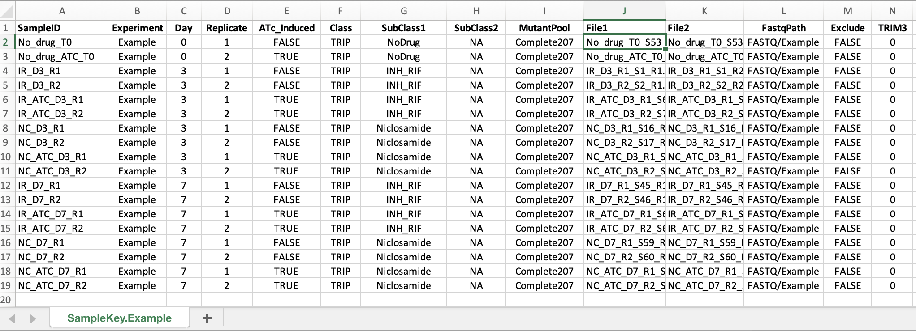
Overview of the “Sample Key” file
Every fact about how to interpret, group, and compare, for every sample...

Slide 4
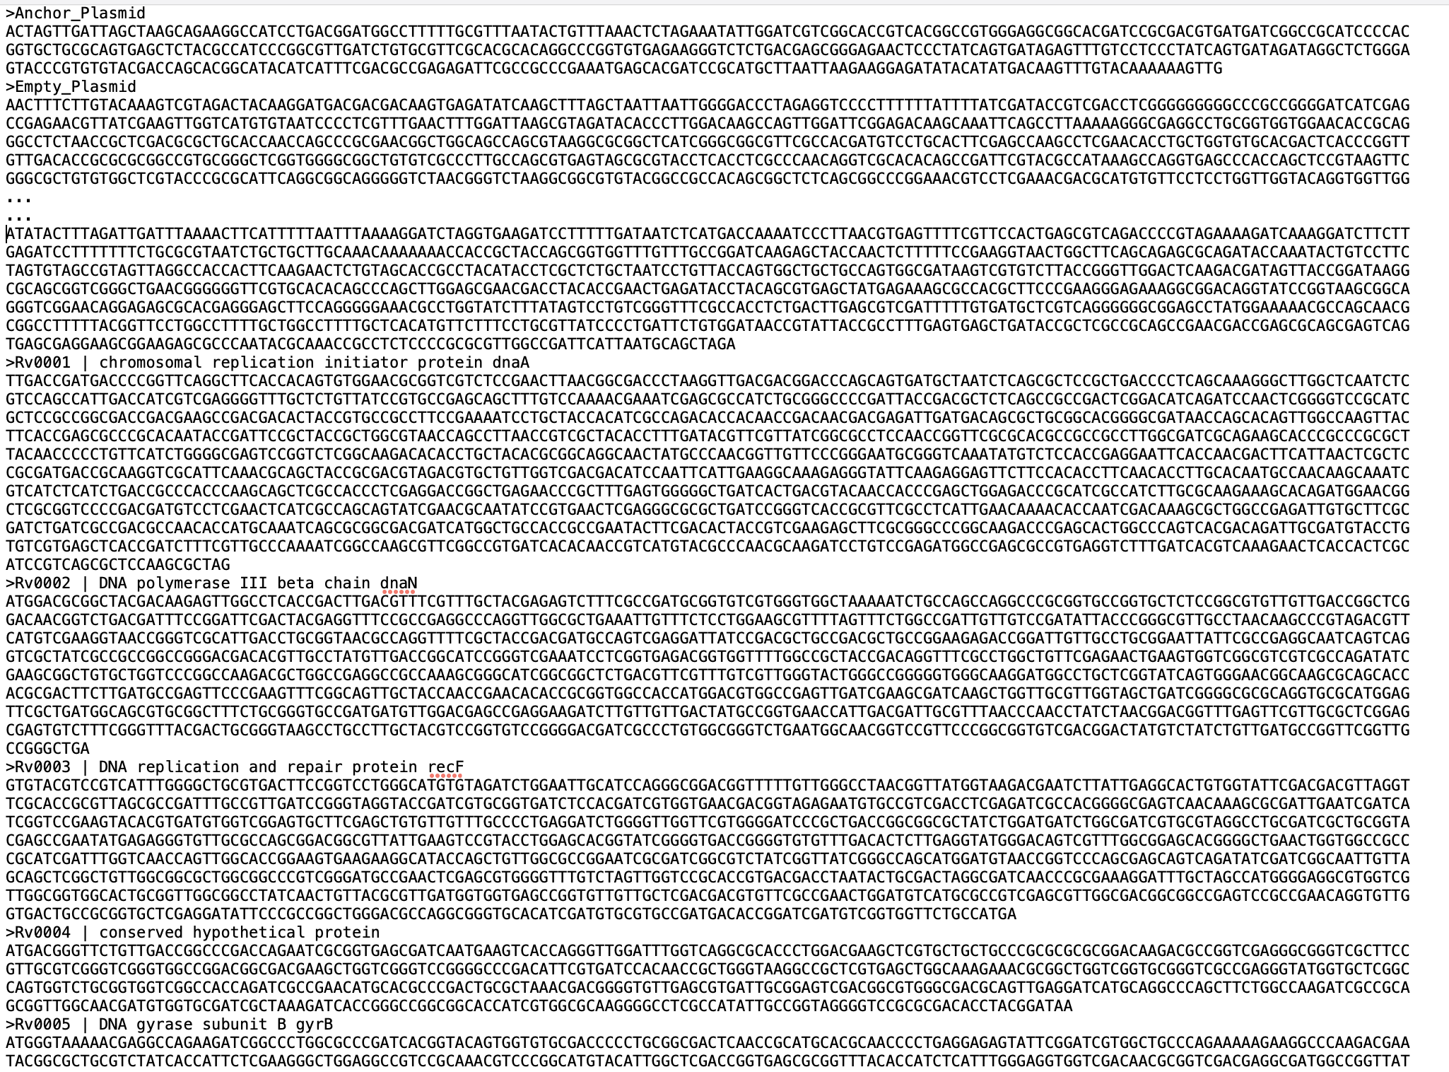
Overview of the “Mutant Genome” alignment target
Every gene and plasmid is named its own separate ‘chromosome’, so the alignment results map reads exactly to individual genes.

Slide 5
Bowtie2: ‘Local’ alignment of each FASTQ file separately: Then combine the 2 results to find valid “mate pairs” -- where one mate aligned to anchor plasmid and the other mate aligned to a gene.
ReadID Mate1 Mate2 Status Pos1 Pos2
1 NS500317:374:H3553BGXM:1:11101:10017:1044 Rv2136c Rv2136c GENE.GENE 414 216
2 NS500317:374:H3553BGXM:1:11101:18189:1076 NoHit NoHit NOHIT.NOHIT 0 0
3 NS500317:374:H3553BGXM:1:11101:3847:1083 Rv0022c Rv0023 GENE.GENE 1 1
4 NS500317:374:H3553BGXM:1:11101:7385:1090 Anchor_Plasmid Rv0903c ANCHOR.GENE 286 1
5 NS500317:374:H3553BGXM:1:11101:24507:1097 Rv3050c Anchor_Plasmid GENE.ANCHOR 2 286
6 NS500317:374:H3553BGXM:1:11101:10686:1116 Anchor_Plasmid Rv0485 ANCHOR.GENE 286 10
7 NS500317:374:H3553BGXM:1:11101:24622:1117 Rv2779c Rv2779c GENE.GENE 79 157
8 NS500317:374:H3553BGXM:1:11101:16161:1126 Anchor_Plasmid Rv0827c ANCHOR.GENE 286 1
9 NS500317:374:H3553BGXM:1:11101:26492:1130 Rv0792c Anchor_Plasmid GENE.ANCHOR 10 286
10 NS500317:374:H3553BGXM:1:11101:10717:1164 Rv1152 Rv1151c GENE.GENE 1 1
11 NS500317:374:H3553BGXM:1:11101:8344:1185 Anchor_Plasmid Rv1287 ANCHOR.GENE 286 1
12 NS500317:374:H3553BGXM:1:11101:17890:1186 Rv0022c NoHit GENE.NOHIT 1 0
13 NS500317:374:H3553BGXM:1:11101:19374:1203 Rv2516c Rv2516c GENE.GENE 229 72
14 NS500317:374:H3553BGXM:1:11101:5071:1214 Rv0023 Rv0022c GENE.GENE 1 1
15 NS500317:374:H3553BGXM:1:11101:16063:1230 Anchor_Plasmid Rv3405c ANCHOR.GENE 286 1
16 NS500317:374:H3553BGXM:1:11101:21749:1244 Rv3416 Anchor_Plasmid GENE.ANCHOR 1 286
17 NS500317:374:H3553BGXM:1:11101:20694:1249 Rv1874 Rv1874 GENE.GENE 9 111
18 NS500317:374:H3553BGXM:1:11101:9689:1249 Rv1167c Anchor_Plasmid GENE.ANCHOR 8 369
19 NS500317:374:H3553BGXM:1:11101:14205:1254 Anchor_Plasmid Rv1956 ANCHOR.GENE 286 1
20 NS500317:374:H3553BGXM:1:11101:11175:1272 Anchor_Plasmid Rv1453 ANCHOR.GENE 286 1
21 NS500317:374:H3553BGXM:1:11101:3609:1310 Anchor_Plasmid Rv3597c ANCHOR.GENE 371 6
22 NS500317:374:H3553BGXM:1:11101:9284:1314 Rv1151c Rv1152 GENE.GENE 1 1

Slide 6
PIE.Plots: folder of diagnostic images about mate pair success
Only valid “Anchor-Gene” read pairs
go forward to gene abundance steps.

Slide 7
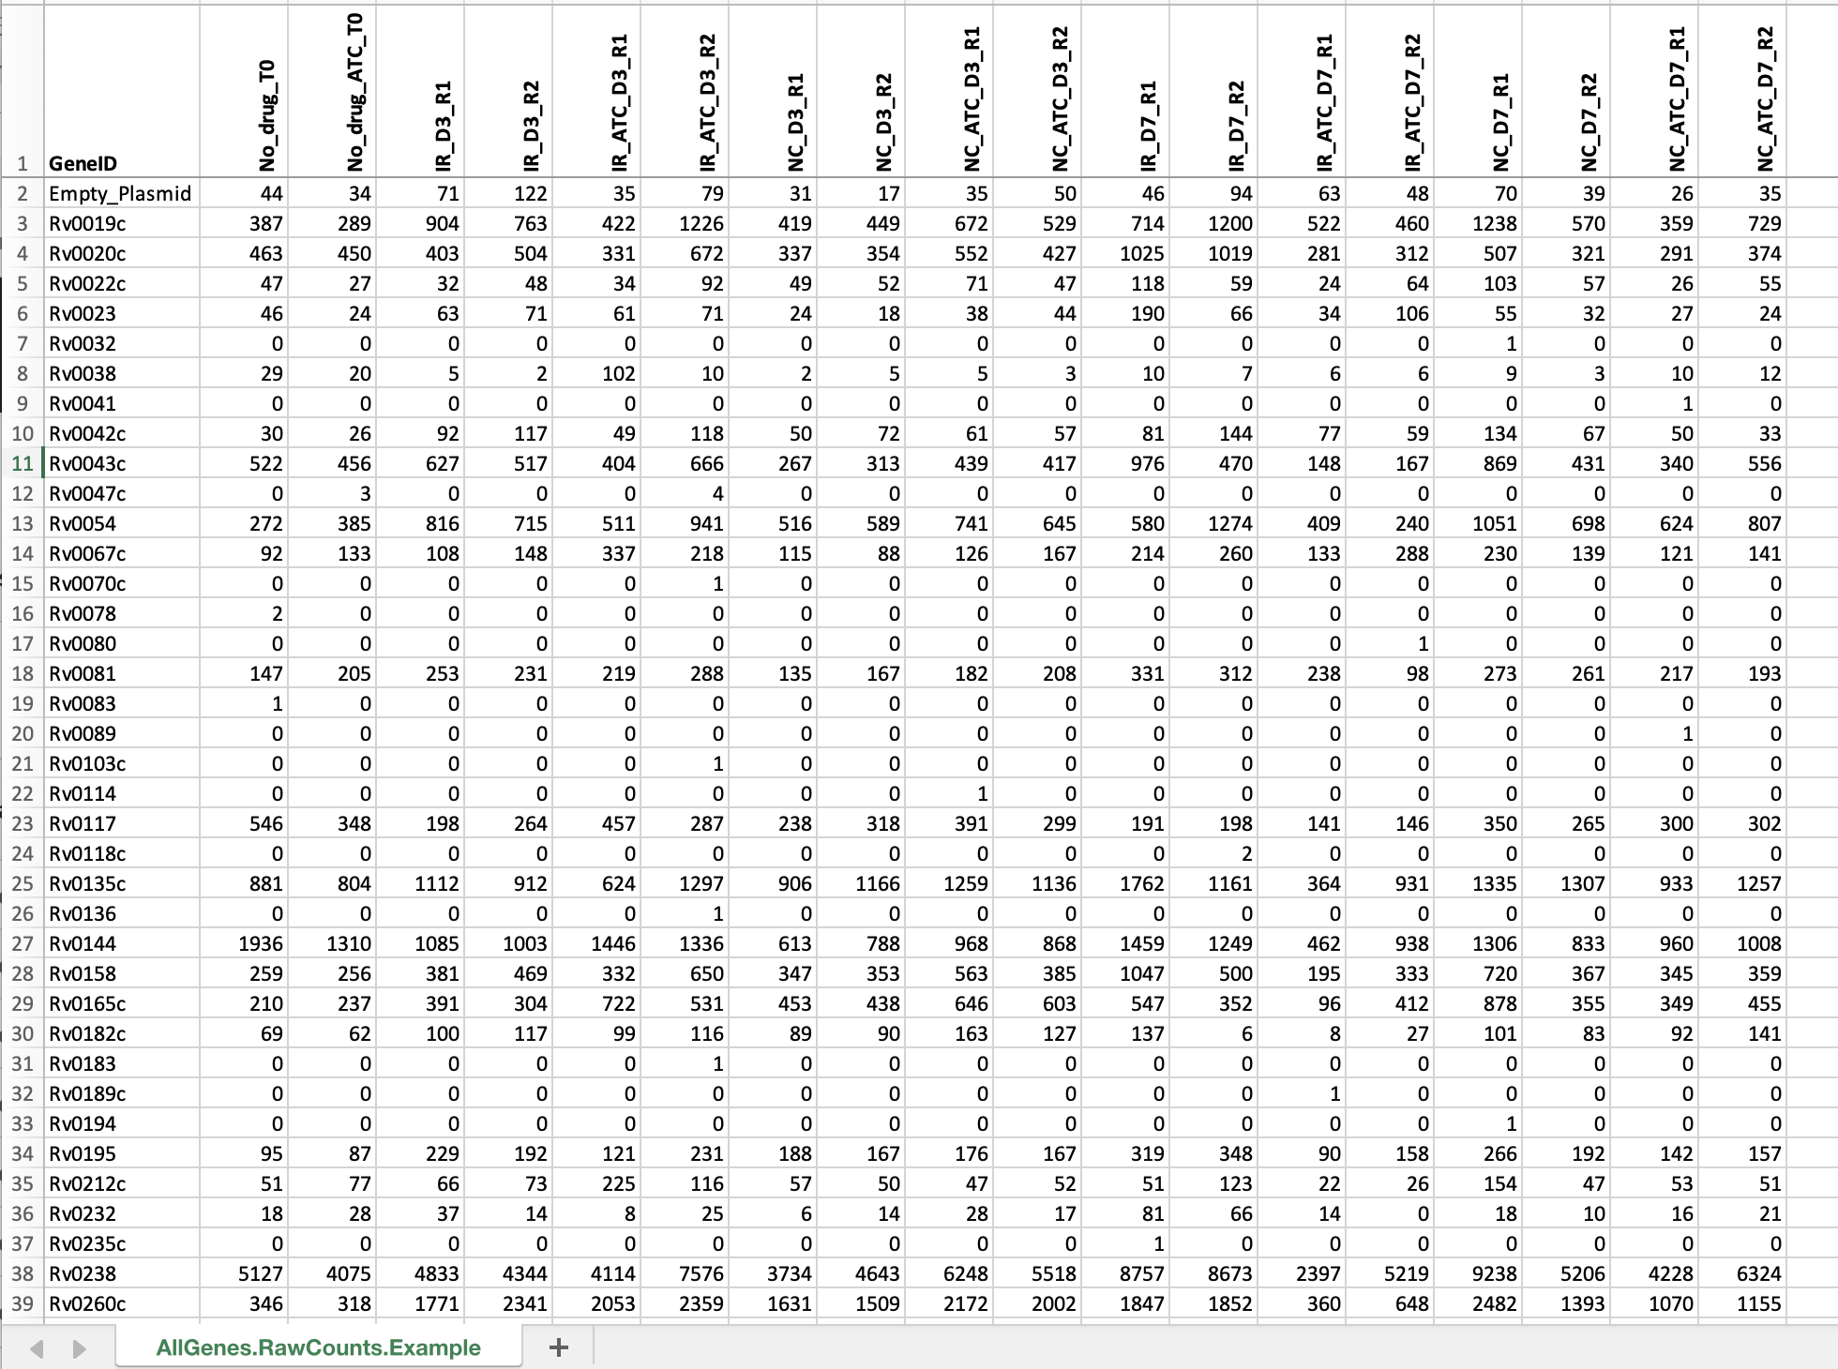
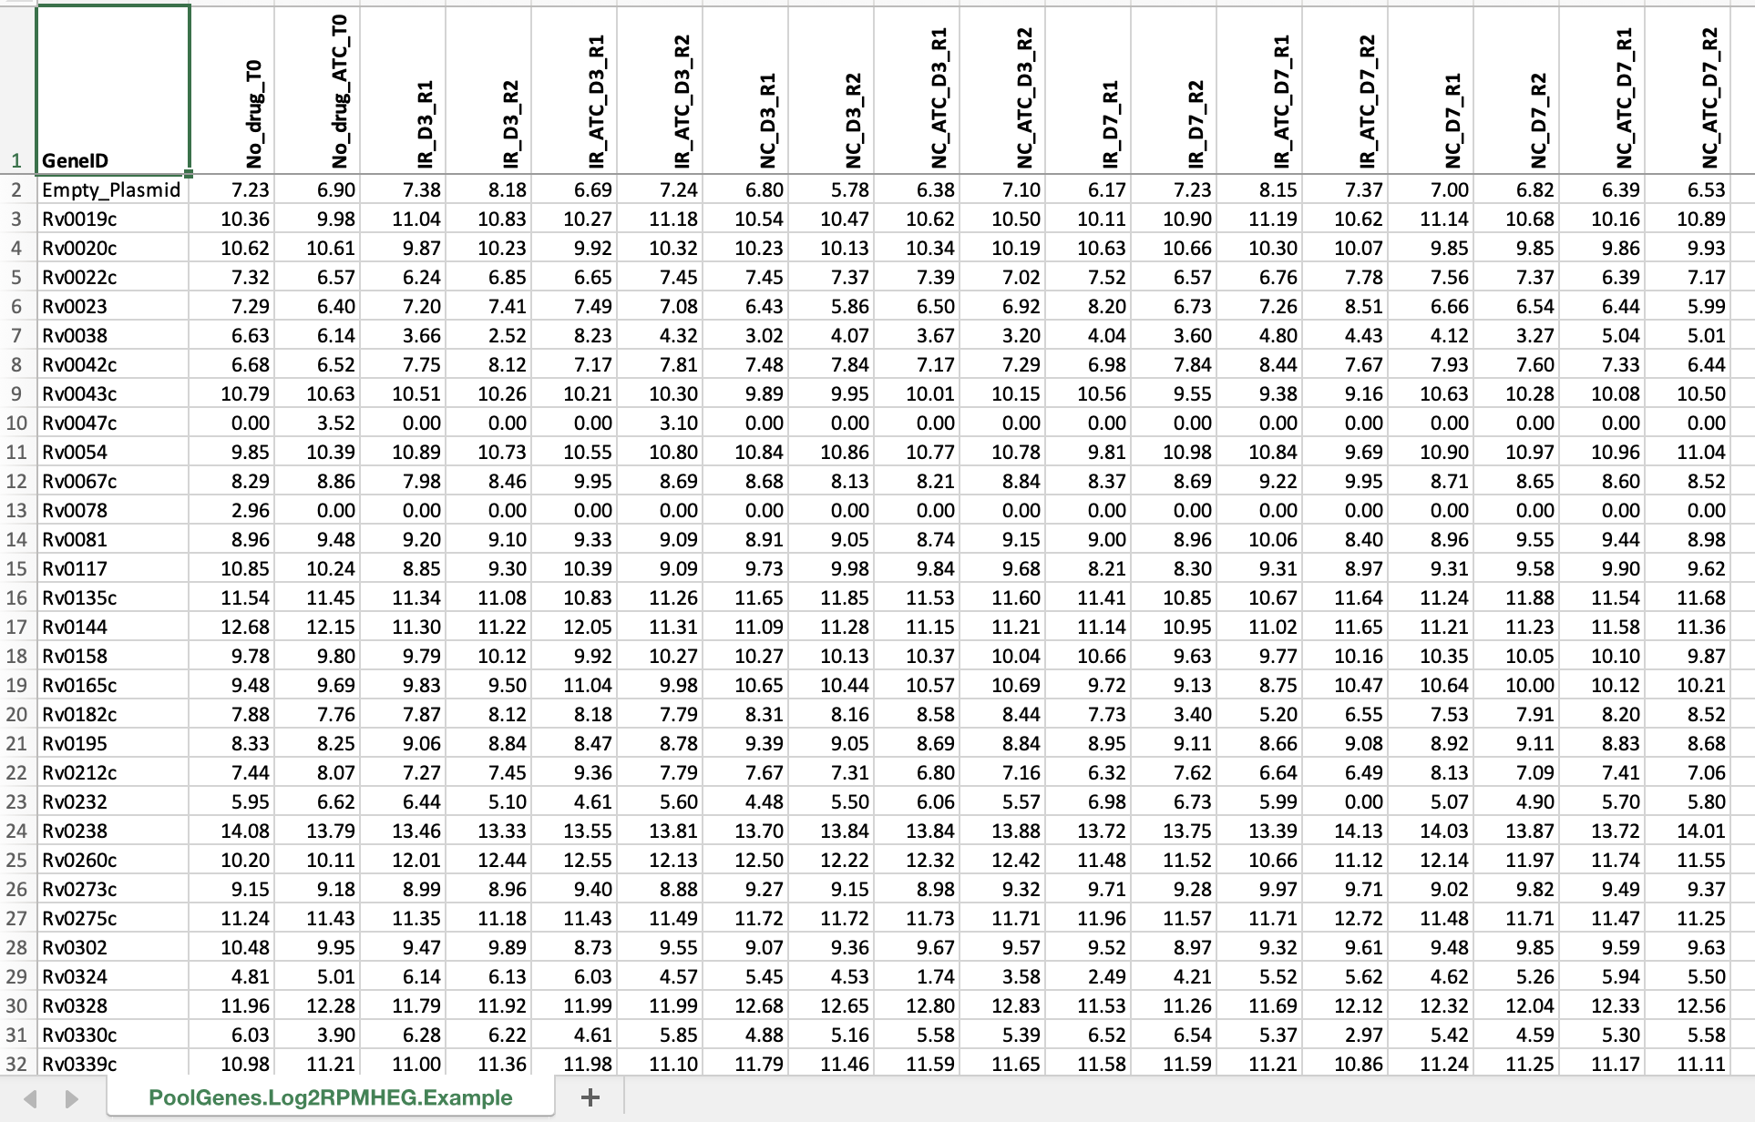
Read Counts per Gene: Raw & Normalized
RPMHEG = Reads Per Million per Hundred Expected Genes
Note on use of “Log2” Transform:
turns the expression data into units
more analogous to CFU “doublings”

Slide 8
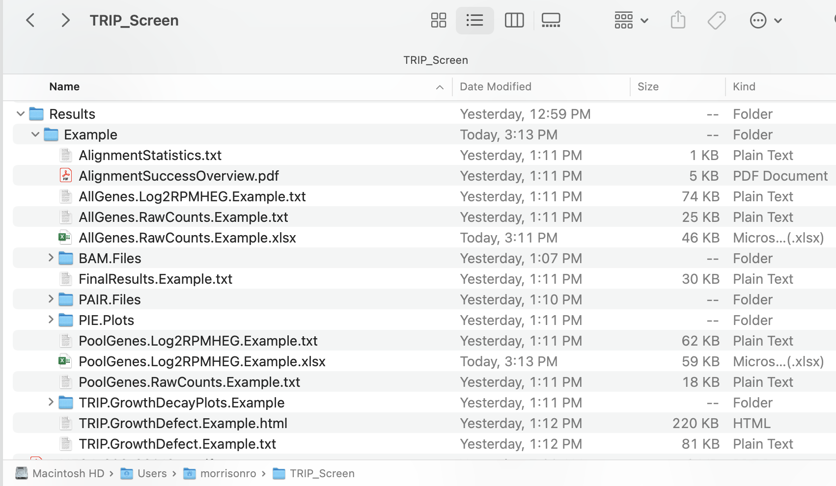
Overview of Results
Separate Folder of results for each “Experiment”
Image of ”Alignment Success” to identify bad samples to exclude
File of final abundance values for each mutant & sample
File of final comparison results for each mutant & condition

Slide 9
AlignmentSuccessOverview.pdf: plot of ‘Valid Mate Pairs’ vs ‘Number of Mutants Detected’
Samples falling in this region are candidates for exclusion...

Slide 10
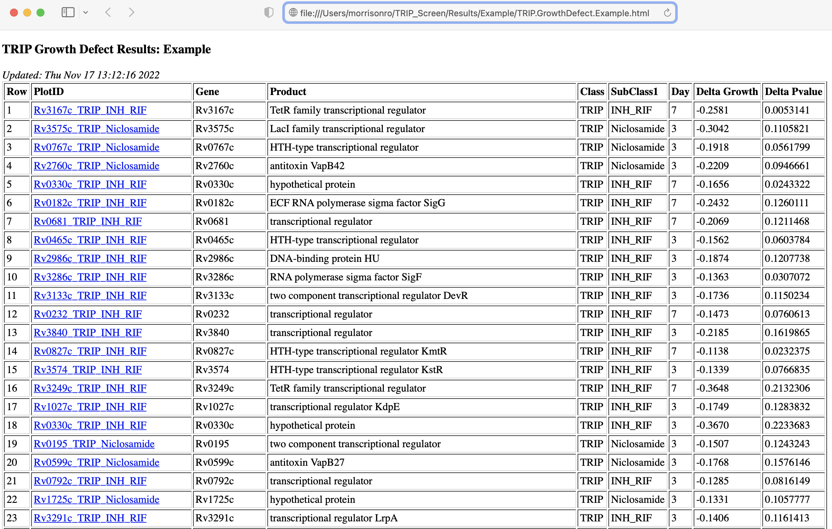

Slide 11
Calculate the linear model ‘Best Fit Line’ for each Group & Time Point
Ask “Do the Induced & Uninduced Lines Differ?”
‘Delta Growth’ = ‘Change in Slope’
(i.e. how much change in ‘doublings per day’)

Slide 12
Details of “Delta Growth” and “Delta P-value”
`lmSlopeDifference` <- function( lmAns1, lmAns2, coef1=2, coef2=2, nCoefObjects=1) {
# Two different citations for the identical formula:
# formula for the test statistic: Z = (b1-b2) / sqrt( SEb1^2 + SEb2^2)
# for 2 slopes 'b1, b2' with standard errors 'SEb1, SEb2'
#
# 1) http://stats.stackexchange.com/questions/55501/test-a-significant-difference-between-two-slope-values
# cites: Paternoster, R., Brame, R., Mazerolle, P., & Piquero, A. R. (1998).
# Using the Correct Statistical Test for the Equality of Regression Coefficients. Criminology, 36(4), 859–866.
#
# 2) http://www.real-statistics.com/regression/hypothesis-testing-significance-regression-line-slope/
# comparing-slopes-two-independent-samples/
# cites: David Howells textbook entitled Statistical Methods for Psychology, Wadsworth CENGAGE Learning, 2010.

