Slide 1
NEW FINANCE MODEL TRAINING
Communications and Publishing Services
Flexibility with accountability

Slide 2


Publishing 10-year plan
Global publishing
Localize for impact
Scale capacity
Simplify and organize publishing work at HQ and in Areas to create a global publishing network.
Localize Church messages and materials to meet the needs of leaders and members worldwide.
Expand outsourcing to deliver approved work.
Use AI and automation to improve efficiency.

Slide 3
Intended Outcomes from this Meeting
*New – Product Limits vs. Product Funding
Understand basics of the finance model
Your role and how others participate
Reports to help you manage the financial health of your product
How projects will work with the new model

Slide 4
Balancing work between HQ and Areas
Today
The Future
HQ initiates most
of the work
A more balanced mix
across HQ and Areas
Simpler processes make this shift possible.

Slide 5


Simplifying production accountability
Simpler finances mean fewer data inputs and more accurate production data
Current challenge
Why simplify
Today's model is complex and does not scale to a global operation. Too many inputs, too much admin.
Fewer, simpler inputs give us more accurate data on the effort behind every piece of content.

Slide 6



What must the new process deliver?
Flexibility
Accountability
Global Alignment
Hyper-detailed tracking of product and project work isn’t sustainable or useful for small teams.
Leaders need an accurate view of key metrics to make informed business decisions.
One global process — the same for HQ and Areas — so metrics and workflows compare across the organization.

Slide 7
Financial responsibility
Product Manager
Production Manager
Area Director
Owns product budget and approves the project bid
Owns project budget and manages the cost pool
Owns health of the entire organization

Slide 8
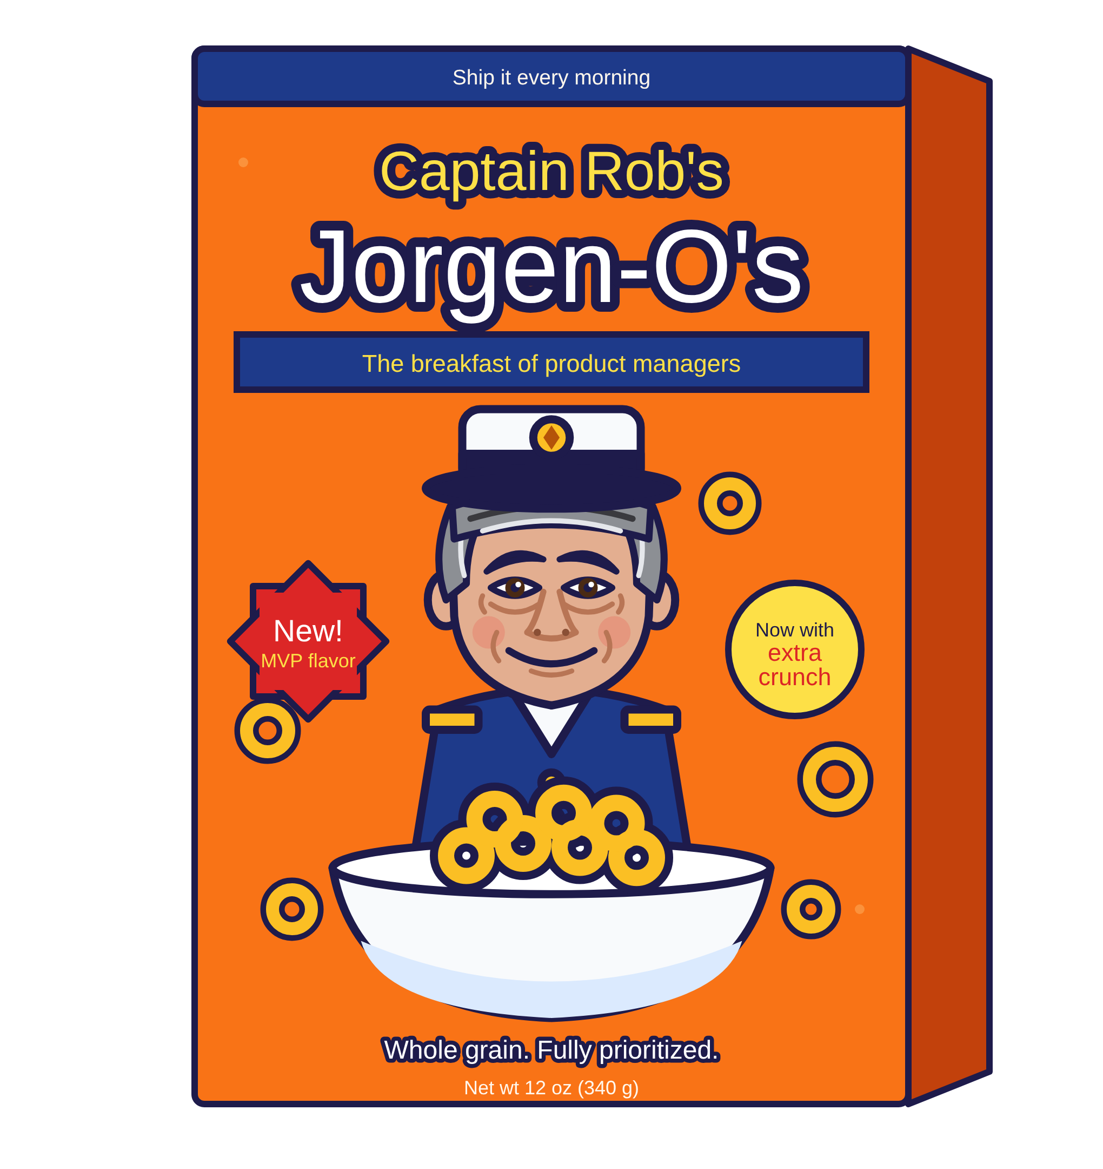
New Product Request
Welfare and Self-Reliance has a new cereal that they are developing to provide a nutritious breakfast around the world
They would like CPD support in promoting this in your area in 2027
The product is aligned with the area plan, and the Area President has approved moving forward
They have called the new product
      Captain Rob’s Jorgen-O’s

Slide 9
Create a Product Plan
Product Strategy |  | Production Outputs
Problem and opportunity |  | Package Design
Target audience |  | Social Media Posts
Vision and strategy |  | Brand Book Creation
Goals and success metrics |  | Launch Event Broadcast
Scope and requirements |  | Promotion Video
 |  | Email

Slide 10
Create a Product Plan
Production Estimates |  |  | Production Outputs
$ | 10,000 |  | Package Design
$ | 10,000 |  | Social Media Posts
$ | 20,000 |  | Brand Book Creation
$ | 30,000 |  | Launch Event Broadcast
$ | 20,000 |  | Promotion Video
$ | 10,000 |  | Email
Total Plan $ | 100,000

Slide 11

Create a Product Plan
Production Estimates |  |  | Production Outputs
$ | 10,000 |  | Package Design
$ | 10,000 |  | Social Media Posts
$ | 20,000 |  | Brand Book Creation
$ | 30,000 |  | Launch Event Broadcast
$ | 20,000 |  | Promotion Video
$ | 10,000 |  | Email
Total Plan $ | 100,000

Slide 12


Product Limit
Captain Rob’s Jorgen-O’s
Product Limit
Product Limit
The amount a product is approved for and cannot be exceeded.
$100,000
$100,000

Slide 13

Product Funding
Captain Rob’s Jorgen-O’s
Product Limit
Funded Product
Captain Rob’s Jorgen-O’s
$100,000
$100,000

Slide 14
Product Funding
Captain Rob’s Jorgen-O’s
Product Limit
Captain Rob’s Jorgen-O’s
Funded Product
$100,000
$100,000
$0
$100,000

Slide 15
Product Funding
Captain Rob’s Jorgen-O’s
Product Limit
Captain Rob’s Jorgen-O’s
Funded Product
$100,000
$80,000
$20,000
$80,000

Slide 16
Product Limit vs. Product Funded Amount
$100,000
$80,000
$20,000
$100,000
Product Limit
Product Funded Amount
Remaining available to fund
$80,000
Product Limit
The amount a product is budgeted for and cannot be exceeded.
The total amount comes from Correlation Product Plan Manager
Product Funded Amount
The amount allocated as ready to be spent
Product Funded Amount is set by the Product Manager in coordination with the Project Manager
Product Limit
Product Funded Amount

Slide 17
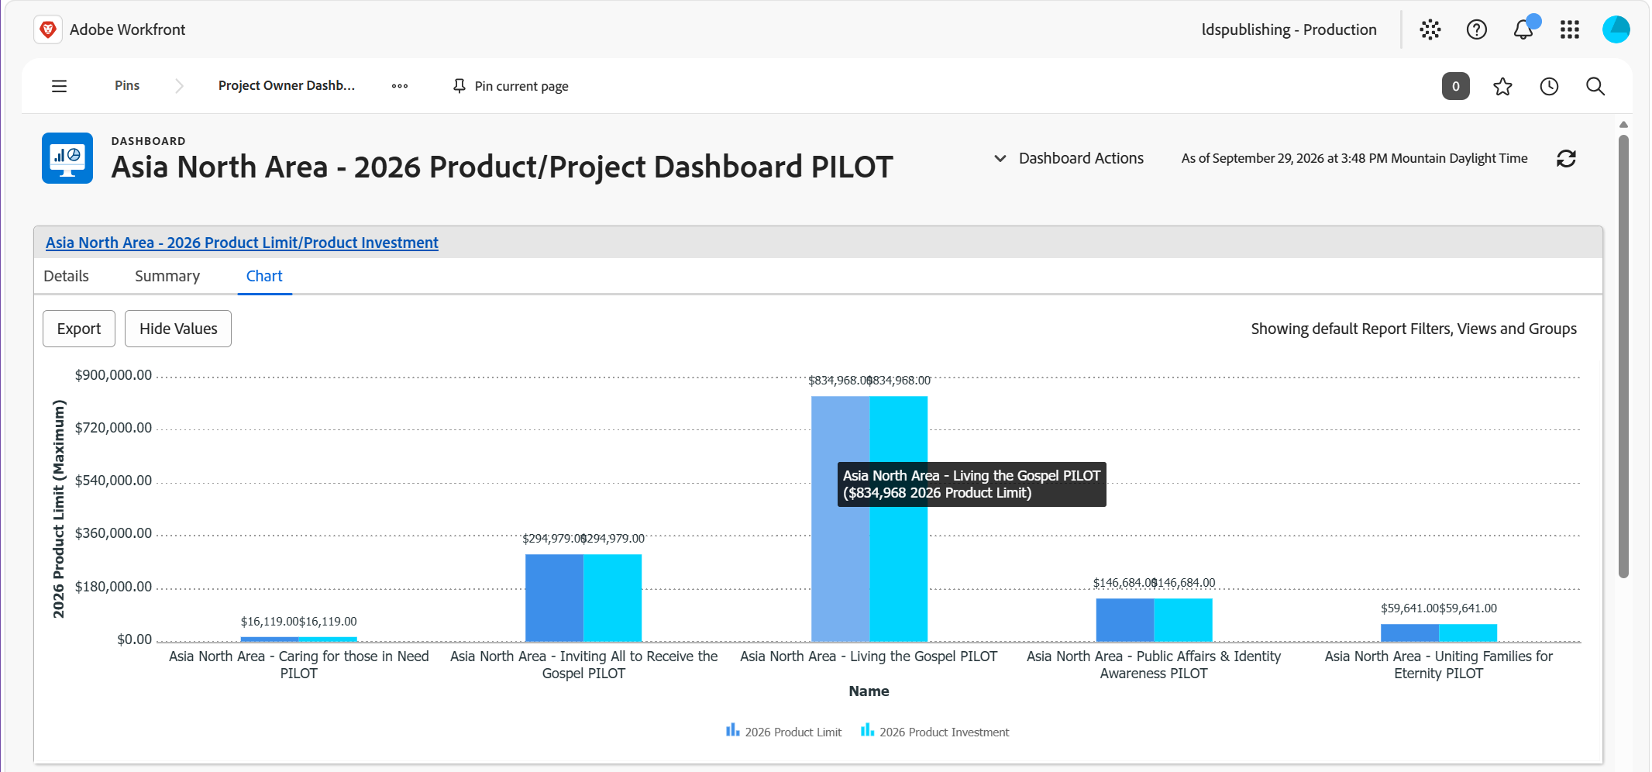
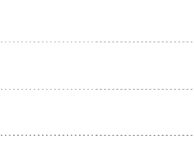

Reports to help with Accountability
12

Slide 18
Project Funding
Captain Rob’s Jorgen-O’s
Funded Product
$80,000

Slide 19
Production Project Estimates
Production Estimates |  |  | Production Outputs
$ | 10,000 |  | Package Design
$ | 10,000 |  | Social Media Posts
$ | 20,000 |  | Brand Book Creation
$ | 30,000 |  | Launch Event Broadcast
$ | 20,000 |  | Promotion Video
$ | 10,000 |  | Email
Move from estimate to Fixed Bid

Slide 20
Fixed Project Bid
A fixed bid project is an agreement where the total cost is set up front, regardless of how much time or effort the work ends up taking
Set price: The product manager and project manager agree on one total price before work begins.
Defined scope: Deliverables, requirements, and timelines are specified in detail in advance, and the price is tied to that scope.
Production bears the risk: If the work takes longer or costs more than estimated, production absorbs the overrun. If it comes in under budget, production keeps the extra margin.
Changes require a change order: Any work outside the agreed scope triggers a formal change request, with adjusted cost and timeline.

Slide 21

Project Funding
Captain Rob’s Jorgen-O’s
Funded Product
Updated Fixed Bid Project
Product Manager
Approved
Package Design
$10,000
$6,000
Product Manager
Approved
Brand Book
$20,000
$22,000
$80,000

Slide 22

Project Funding
Captain Rob’s Jorgen-O’s
Funded Product
Production Cost Pool
“Bank Account”
$80,000
$28,000
$52,000
Funded
Projects
Funded
$28,000
$80,000

Slide 23

Project Funding
Vendor Payments
Production Cost Pool
“Bank Account”
$28,000
$22,000
$6,000
$0
Cost Pool
Brand Book
Design
$6,000
$28,000
$0
Net Zero is the Goal!

Slide 24
Projects in the new model
Bill on intervals
Adjust
Product is billed over the life of the project but not to exceed the approved bid
Project budget change orders can be made with Product Manager approval
Flexibility: budget changes do not need to go to Finance every time if the Product Manager approves.
Notes:
.

Slide 25
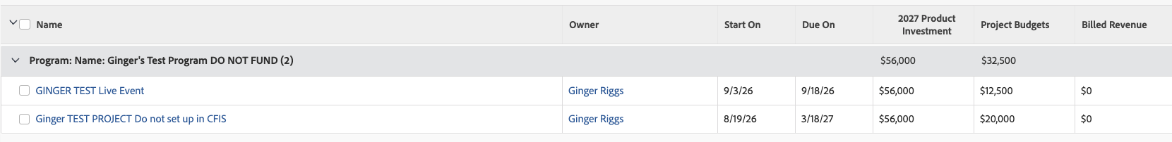
Projects overview summary
Projects in the program
Individual budgets
Billed revenue
Lists every project individually
$12,500 and $20,000 combine into the $32,500 budget total.
Billed Revenue shows $0 until billing begins

Slide 26
Overview
Approved
Product
Product
Limit
Product
Funded
Project
Funded
Vendor
Payments
Approved product that has a Product limit assigned
“Safe” Amount that can be used but not exceeded
Funds in “Wallet” that are available to spend
Funds in ”Cost Pool” that are allocated to approved projects
Payments made from the “Cost Pool”

Slide 27

Summary
Old Model
New Model

