Slide 1
Supervising SE Research
The tale of Case Studies in Software Engineering
Hans-Martin Heyn, Universitetslektor
heyn@chalmers.se

Slide 2
Learning Objectives
Know what a case study in SE is
Be able to decide what a case study in SE is not
Guide students towards defining and conducting case studies in SE
Most content of this seminar bases on
[1]: Wohlin, C., & Rainer, A. (2022). Is it a case study?—A critical analysis and guidance. Journal of Systems and Software, 192
[2]: Runeson, P., & Höst, M. (2009). Guidelines for conducting and reporting case study research in software engineering. Empirical software engineering, 14, 131-164. (A classic ☺)

Slide 3
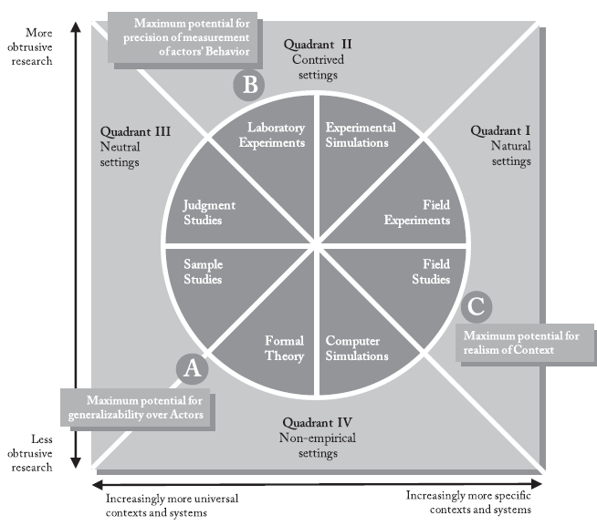
Why case studies? [2]
We want to study “phenomena in their context”.
We study an object in its environment.
Case studies can help to increase knowledge about “individuals, groups, and organisations”
Stol et Fitgerald (2018), The ABC of SE Research

Slide 4
What is a case study? [2]
It is a flexible research approach, because it must cope with unexpected dynamics and complexities of a contemporary real world™ problems.
It aims at building a chain of evidence, qualitative and/or quantitative, in a planned and consistent manner
It supports established theories, or it supports building new theories.

Slide 5
How to conduct a case study? [2]
Case study design: Define objectives and plan case study.
Preparation for data collection: Define procedures and protocols for data collection.
Collecting evidence: Execute data collection on the studied case.
Analysis of collected data.
Reporting

Slide 6
How to conduct a case study? [2]
Case study design: Define objectives and plan case study.
Preparation for data collection: Define procedures and protocols for data collection.
Collecting evidence: Execute data collection on the studied case.
Analysis of collected data.
Reporting
OK, that’s true for basically any empirical method. So what is it that makes a case study a case study?

Slide 7
What is not a case study? [1]
Lack of real-life context
A case that actually does not occur in a real-life™ context.
What is a real-life context? => Depends on research objective.
Example: We want to study the behaviour of professional programmers tackling a programming problem in a commercial software. It is not a real-life case to observe / study student programmer tackling the problem.
Case studies require direct contact with people in projects / problems that are being studied.

Slide 8
What is not a case study? [1]
Lack of real-life context examples:
Historical data analysis / data mining in historical data: This is not a study of a contemporary phenomenon and there is a lack of contact to people involved in the problem.
Laboratory experiments: By definition, a laboratory is not a real-life™ environment. It’s a lab, a synthetic world under our control.
Re-analysis or reproducing a previously conducted case study is (probably) not anymore a study of a contemporary problem.

Slide 9
What is not a case study? [1]
Lack of multiple sources of evidence / triangulation:
Multiple instances of one method of data collection, e.g., multiple interviews.
HM: (I tend to disagree here, because I think triangulation is possible with a series of multiple interviews with different stakeholders / from different perspectives => see within-method triangulation, Flick 2000).
A primary method (e.g., interviews) and a complementary method (e.g., workshops) where the latter is not for data collection.
HM: (I tend to disagree here too, because why would a researcher organise a workshop and not collect any data?)

Slide 10
What is not a case study? [1]
Small-scale evaluations:
Use of a constructed environment (e.g., simulation or simplified examples).
Evaluation of “an artifact” on a small artificial example.
HM: Toy examples / “academic” problems.
HM: Benchmarking without context-relation.

Slide 11
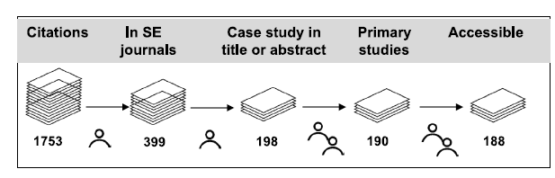
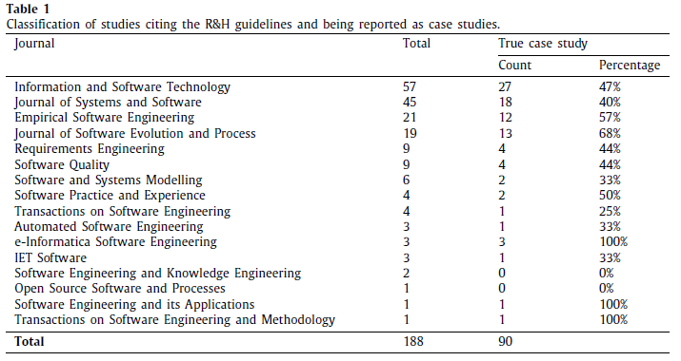
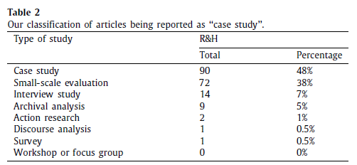
What is not a case study? [1]

Slide 12
How to guide students towards a case study?
What is the case?
Identify what it is the students are going to study. Be careful to find the “right” scope, do not overdo it.
What is the “real-life™” context of the study?
Argue why the problem is an authentic problem. Describe the context in which the problem is studied.
How is triangulation supported?
I would recommend (for ease of argumentation) to use at least two different methods of data collection. A popular combination are interviews and document analysis or interview and focus groups / workshops.

Slide 13
How to guide students towards a case study?
Is the problem under investigation occurring at the time of the study (is it contemporary?)?
Try to describe a “chain of events” that lead to the current situation that is being studied.
Are the students observing or are they “actively involved in implementing change based on the research” [1]?
The latter would indicate it is not a case study but action research.
I saw a few theses in the past where the student is e.g., already employed / involved in the company.

Slide 14
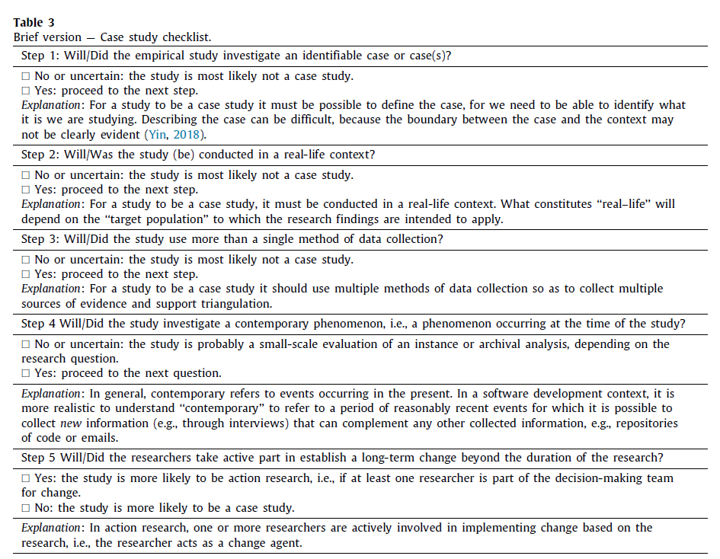
Checklist [1] ☺

Slide 15
Some advice on supervising case studies
Help students in defining a clear, crisp scope and context of the case study. Students might struggle in finding a “good” scope.
Remind students about the scope and context regularly.
Ideal situation is that you as supervisor are involved in a research project (often with a clear scope) with a company (having a clear context of operation) that provides interview partners or other material.
Be careful if students say they can organise interview partners. It might work…or not. Have a Plan B: E.g., change the context of the study to “emerging / young SE”.
Don’t start too late with secondary research methods / triangulation.

