Slide 1
Supervising SE Research
My experience in
providing feedback to master thesis students
Hans-Martin Heyn, Universitetslektor
heyn@chalmers.se

Slide 2
Learning Objectives
Learn about different dimensions of feedback.
Hear about first-hand experience in providing feedback during master theses.
Know that it is important to balance the feedback content and the way feedback is given along a set of different dimensions.
Some content of this seminar bases on
[1]: Chugh, R., Macht, S., & Harreveld, B. (2022). Supervisory feedback to postgraduate research students: a literature review. Assessment & Evaluation in Higher Education, 47(5)

Slide 3
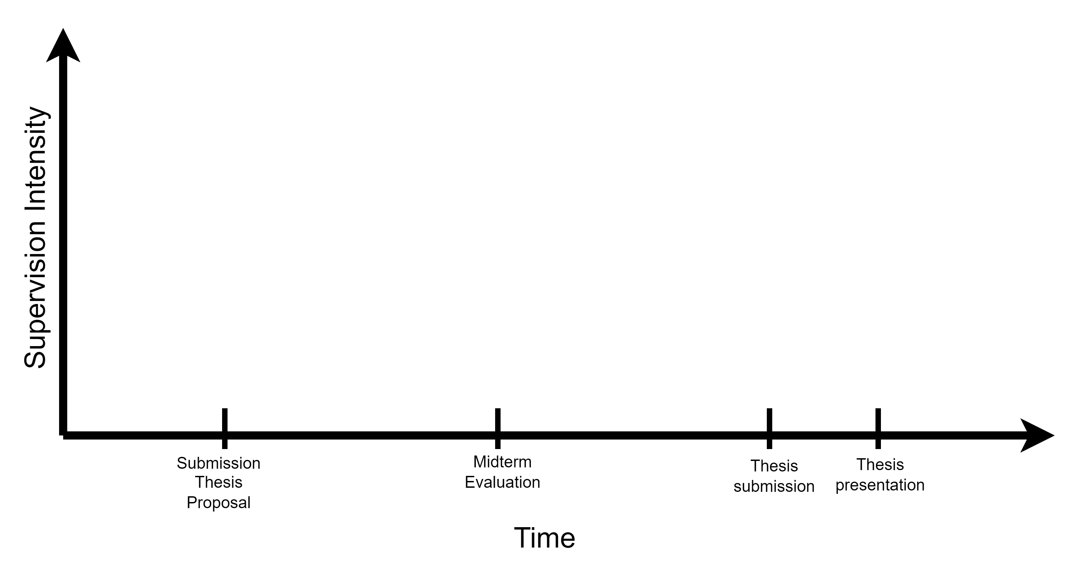
The Supervision Intensity Stratification

Slide 4
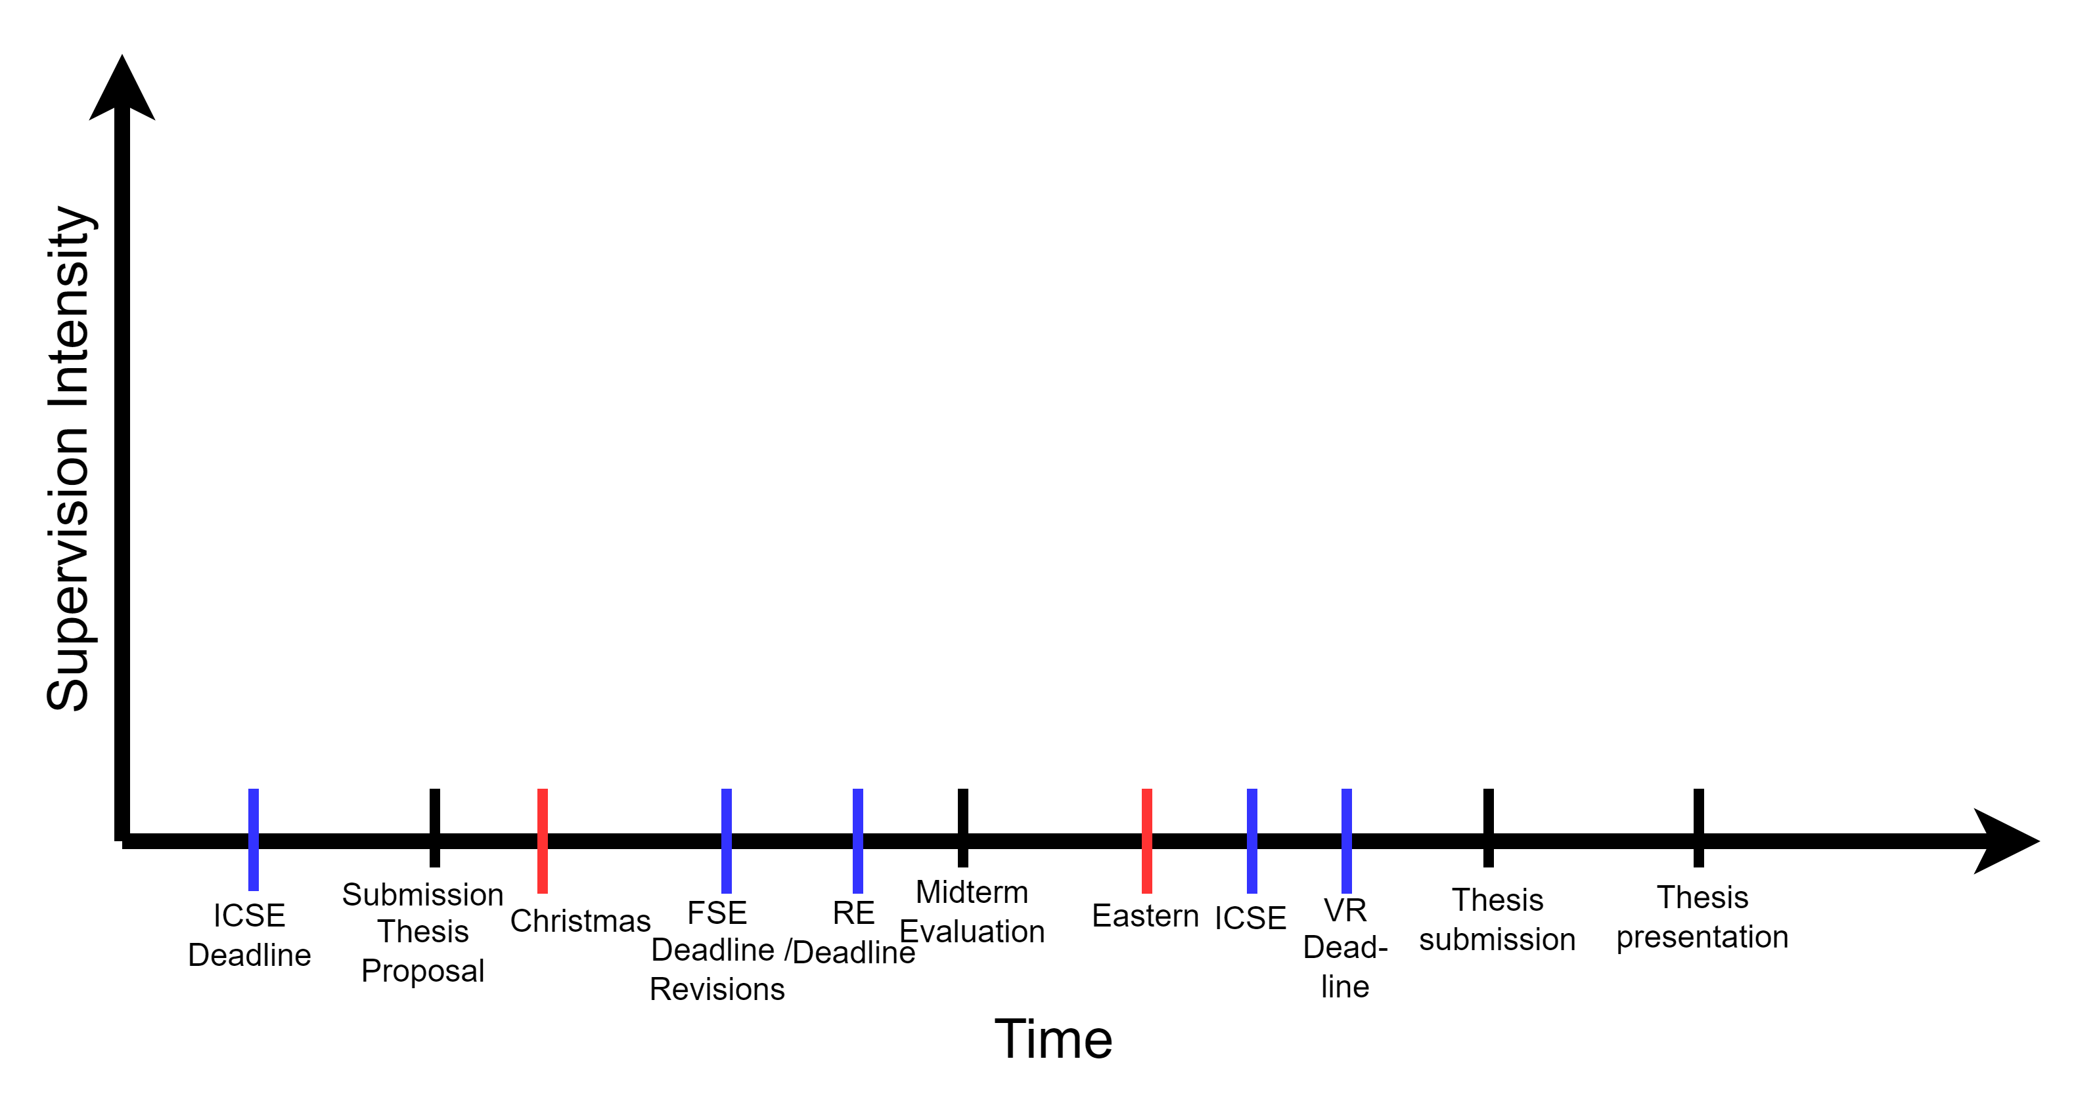
The Supervision Intensity Stratification

Slide 5
Supervision has many dimensions [1]
The feedback content (what feedback should be given?)
How the feedback is given (what is the best communication medium with the students?)
The student (students are individual persons and have individual expectations for receiving feedback)
The supervisor (supervisor are individual persons and have individual expectations for giving feedback)

Slide 6
Feedback content [1]
Vague, generic, non-specific and unclear feedback as a result of not (fully) reading the students’ work vs. suggestions to improve.
“rephrase this…”, “rewrite this…”, “no…”, “??” – patterns
Ratio between “pretty remarks” (comments on writing style, grammar, language, figure design…) and “big picture comments”.
Guiding feedback vs. prescriptive feedback
Consistency of feedback

Slide 7
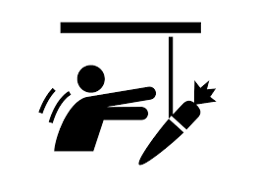
The way in which feedback is given [1]
Written (e-Mails) vs. verbal (meetings)
Online vs. in-person
Timeliness of the feedback
Immediate feedback vs. time for students to find their own solutions
Tone of feedback
Between commanding and good buddy?

Slide 8
How students handle feedback [1]
Proactive “pulling” feedback vs. waiting for a “push”
Supervisor considered a figure of authority that cannot be questioned (not so much a problem in Sweden).
Feedback can be misunderstood as personal criticism. Students become defensive or non-responsive.

Slide 9
How supervisor handle feedback [1]
Supervisor might not be keenly interested in the project, or lack relevant subject knowledge.
They might “write off” a thesis after a while if the student does not show good progress.
Supervisor can become overwhelmed in their role and responsibility towards the student.
This can be amplified by excessive workload and/or over-acceptance of students.

Slide 10
Divergent expectations to feedback [1]
Different cultural or linguistic backgrounds can cause an expectation mismatch.
Unclear expectations towards the role of the supervisor: How much feedback is expected?
Student: Supervisor is a directive support person telling me what to do.
Supervisor: Student is an independent, self-sufficient individual.
“Provision of feedback is a balancing act for the supervisor”.

Slide 11
Some positive examples
Have a clear picture of what you hope can be an outcome of the thesis. But ask the student what they expect as an outcome of the thesis.
Mix group supervision and individual supervision.
Regular meetings with pull possibility. Clearly tell students that and when you are available for them.
Weekly “digest”-mail.
Early start with paper writing. It helps you provide feedback and you still have access to the students.

Slide 12
Some negative examples
Accepting too many students.
Over-scoping a thesis.
Creating submarine-students: they appear 2-3 times, and suddenly submit a thesis.
Being ghosted by students however is a special problem…
Neglecting feedback to industry theses (these can go terribly wrong if not properly supervised).

Slide 13
My recommendation to feedback
Ask early students about their expectations on the thesis and feedback mechanisms. Adopt to the students and your needs.
Give more feedback in the beginning, but give students some slack to think for themselves. Provide more feedback again in the final phase.
Make use of group supervision sessions for “common” thesis issues.
But have regular individual feedback sessions with an agenda.
Use students’ weekly digest mail to prepare for individual sessions.
Offer “open office” hours.
Provide always constructive feedback! Be kind! Even if you are stressed.
Give continuous feedback on written thesis. Let the student write continuously.

Slide 14
Recommendation in early phase of thesis
Students often struggle with finding a clear Software Engineering perspective (especially in ML/AI related theses).
Provide early feedback on the scope and context of the thesis (see case study slides before).
Even if it is not a case study, try to “control” the students towards a path that relates to a SE problem investigation. Show / discuss examples.
Students have a tendency of overthinking the problem. They don’t need to have a solution, just an idea and a method.
Have a discussion about methods with several groups together in a workshop format. Students can help / inspire each other. ☺

Slide 15
