Slide 1

Shape your infrastructure
with Terraform
Robert Firek

Slide 2



Slide 3




Slide 4

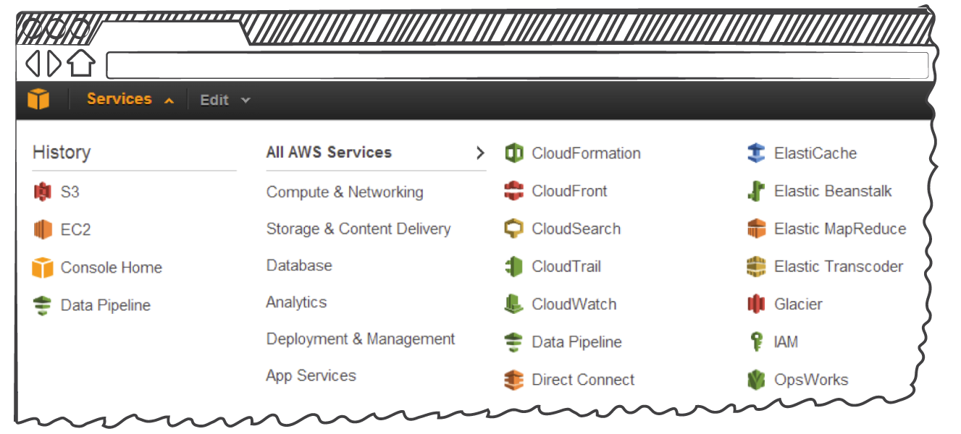

Slide 5

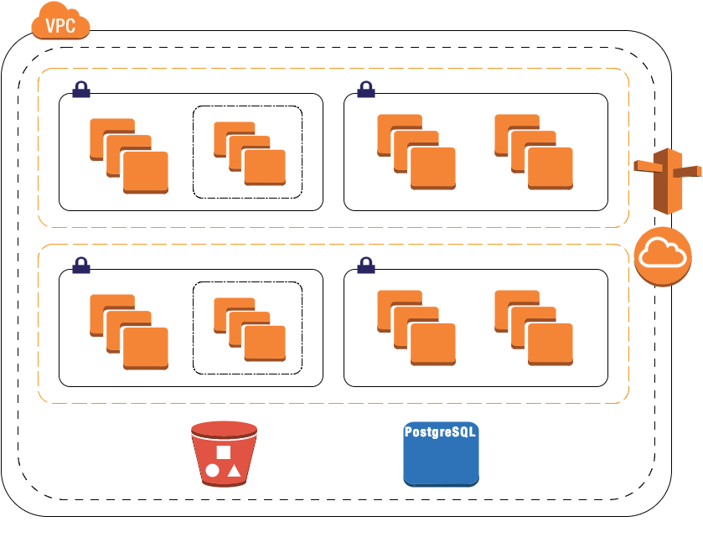

Slide 6

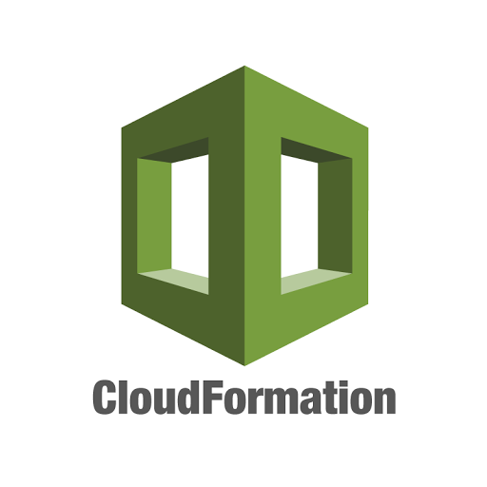


Slide 7


Slide 8
Questions

