Slide 1


Basic-block vectorization
for graphics compilers
Robert Foss

Slide 2
About vectorization
Vectorization 101
load
load
load
load
add
add
add
add

Slide 3
About vectorization
Vectorization 101
load
load
load
load
2 x add
add
add

Slide 4
More about vectorization
Techniques
Several techniques exist
Loop-based vectorization
Basic-block vectorization
Superword Level Parallelism vectorization

Slide 5
Basic-block vectorization
Control Flow Graph
Entry
Entry
a = 1
Basic-block
a += 1
if a < 9
Basic-block
Exit

Slide 6
Basic-block vectorization
Basic-block
const1 = constant <1 x u32> 0x1
const2 = constant <1 x u32> 0x2
a = add <1 x u32> a const1
b = add <1 x u32> b const2
c = add <1 x u32> a b
const3 = constant <1 x u32> 0x9
bool = icmp _ult c c3
br bool dest1 dest2
a += 1
b += 2
c = a + b
if c < 9

Slide 7
Basic-block vectorization
a
const1
b
const2
add
add
add
icmp
br

Slide 8
Basic-block vectorization
a
const1
b
const2
add
add
add
icmp

Slide 9
Basic-block vectorization
a
b
const1
const2
move
2 x add
move
add
icmp

Slide 10
Basic-block vectorization
a
b
const1
const2
move
2 x add
move
move
move
add

Slide 11
Basic-block vectorization
Alternatives
Two algorithms were implemented
LLVM-based basic-block vectorization
Pair-based basic-block vectorization

Slide 12
LLVM-based vectorization
Steps involved:
Find potential pairs
Find connections between pairs
Pair selection
Pair fusing
Fixed-point iteration

Slide 13
LLVM-based vectorization
Find potential pairs
add#1, #2
add#2, #3
add#1
add#2
add#3
add#1, #3
mul#1
mul#2
mul#1, #2
cmp#1, #2
cmp#2, #3
cmp#1
cmp#2
cmp#3
cmp#1, #3

Slide 14
LLVM-based vectorization
Find potential pairs
Steps involved:
add#1, #2
add#2, #3
add#1, #3
mul#1, #2
cmp#1, #2
cmp#2, #3
cmp#1, #3

Slide 15
LLVM-based vectorization
Find potential pairs
Steps involved:
add#1, #2
add#2, #3
add#1, #3
Remove intradependent pairs
mul#1, #2
cmp#1, #2
cmp#2, #3
cmp#1, #3

Slide 16
LLVM-based vectorization
Find potential pairs
Steps involved:
add#1, #2
add#2, #3
add#1, #3
Remove intradependent pairs
Remove illegal pairs
mul#1, #2
cmp#1, #2
cmp#2, #3
cmp#1, #3

Slide 17
LLVM-based vectorization
Find pair connections
add#1, #2
add#2, #3
mul#1, #2
mul#1, #2
cmp#1, #2
cmp#2, #3
cmp#1, #2
cmp#2, #3

Slide 18
LLVM-based vectorization
Pair selection
add#1, #2
add#2, #3
mul#1, #2
mul#1, #2
cmp#1, #2
cmp#2, #3
cmp#1, #2
cmp#2, #3

Slide 19
LLVM-based vectorization
Pair selection
add#1, #2
add#2, #3
mul#1, #2
mul#1, #2
cmp#1, #2
cmp#2, #3
cmp#1, #2
cmp#2, #3

Slide 20
Pair-based vectorization
Steps involved:
Find potential pairs
Pair selection
Pair fusing

Slide 21
LLVM-based vectorization
Find potential pairs
add#1, #2
add#2, #3
add#1
add#2
add#3
add#1, #3
mul#1
mul#2
mul#1, #2
cmp#1, #2
cmp#2, #3
cmp#1
cmp#2
cmp#3
cmp#1, #3

Slide 22
LLVM-based vectorization
Find potential pairs
Steps involved:
add#1, #2
add#2, #3
add#1, #3
mul#1, #2
cmp#1, #2
cmp#2, #3
cmp#1, #3

Slide 23
LLVM-based vectorization
Find potential pairs
Steps involved:
add#1, #2
add#2, #3
add#1, #3
Remove intradependent pairs
mul#1, #2
cmp#1, #2
cmp#2, #3
cmp#1, #3

Slide 24
LLVM-based vectorization
Find potential pairs
Steps involved:
add#1, #2
add#2, #3
add#1, #3
Remove intradependent pairs
Remove illegal pairs
mul#1, #2
cmp#1, #2
cmp#2, #3
cmp#1, #3

Slide 25
Pair-based vectorization
Pair selection
add#1, #2
add#2, #3
mul#1, #2
cmp#1, #2
cmp#2, #3

Slide 26
Pair-based vectorization
Pair selection
add#1, #2
add#2, #3
mul#1, #2
cmp#1, #2
cmp#2, #3
Fuse most profitable pair

Slide 27
Pair-based vectorization
Pair selection
add#1, #2
add#2, #3
mul#1, #2
cmp#1, #2
cmp#2, #3
Fuse most profitable pair
Remove already fused operations

Slide 28
Pair-based vectorization
Pair selection
add#1, #2
add#2, #3
mul#1, #2
cmp#1, #2
cmp#2, #3
Fuse most profitable pair
Remove already fused operations
Remove intradependent pairs

Slide 29
Pair-based vectorization
Pair selection
add#1, #2
add#2, #3
mul#1, #2
cmp#1, #2
cmp#2, #3
Fuse most profitable pair
Remove already fused operations
Remove intradependent pairs
Fixed-point iteration

Slide 30
Heuristics
What? Why?
Are used to determine profitability

Slide 31
Heuristics
What? Why?
Are used to determine profitability
Avoid NP-complete problems like
Longest path / Hamiltonian path

Slide 32
Heuristics
What? Why?

Slide 33
Heuristics
Which? How?
a
b
const1
const2
move
2 x add
move
move
move
add

Slide 34
Heuristics
Which? How?
a
b
const1
const2
move
2 x add
move
No need to move data
move
move
add

Slide 35
Heuristics
Which? How?
a
b
const1
const2
move
2 x add
move
move
add

Slide 36
Heuristics
Which? How?
a
b
const1
const2
move
2 x add
move
Can often be done
for free with the
swizzle modifier
move
add

Slide 37
Heuristics
Which? How?
a
b
const1
const2
move
2 x add
move
add

Slide 38
Heuristics
Which? How?
a
b
const1
const2
Constants can be
~freely combined into
new vector constants
move
2 x add
move
add

Slide 39
Heuristics
Which? How?
a
b
const1, const2
move
2 x add
add

Slide 40
Heuristics
Which? How?
If the operation a
is the same operation
as b
a
b
const1, const2
move
2 x add
add

Slide 41
Heuristics
Which? How?
If the operation a
is the same operation
as b
a==b
const1, const2
move
2 x add
add

Slide 42
Heuristics
Which? How?
If the operation a
is the same operation
as b
a==b
const1, const2
Can often be done
for free with the
swizzle modifier
move
2 x add
add

Slide 43
Heuristics
Which? How?
a==b
const1, const2
2 x add
add

Slide 44
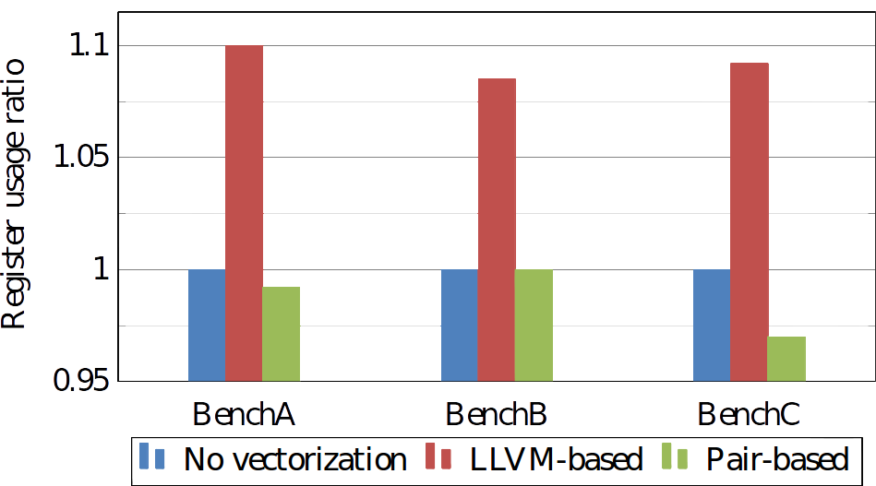
Results
Work Register Usage

Slide 45
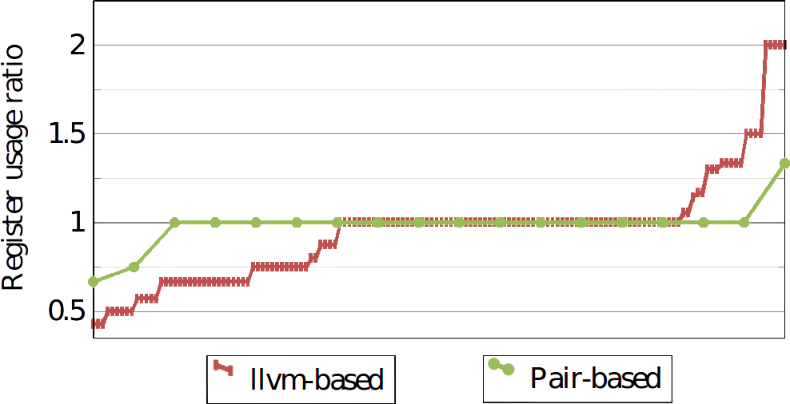
Results
Work Register Usage

Slide 46
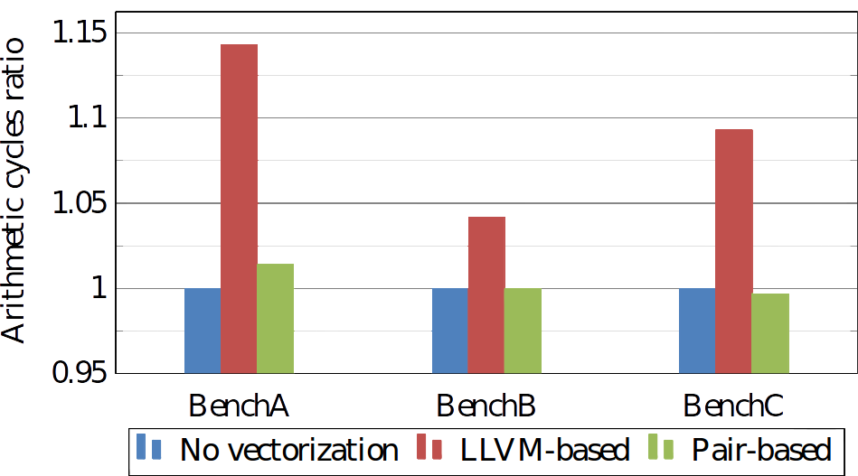
Results
Arithmetic Cycles

Slide 47
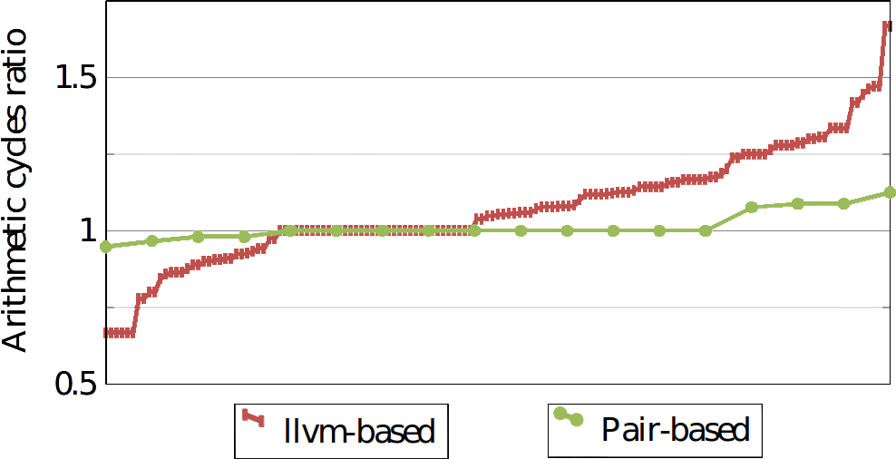
Results
Arithmetic Cycles

Slide 48
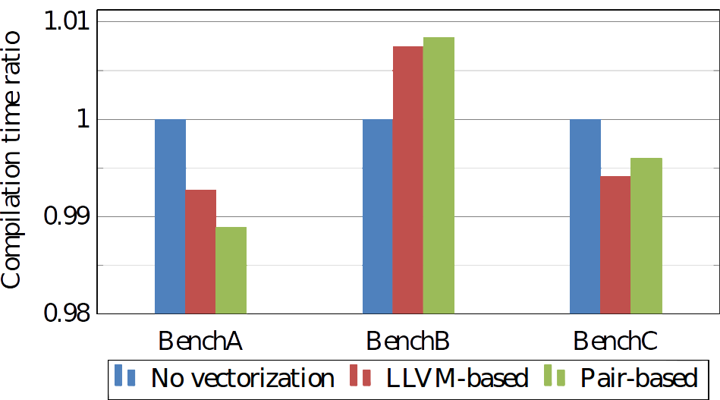
Results
Compilation Time

Slide 49
Results
Why?

Slide 50
Results
Why?
Increased register pressure

Slide 51
Results
Why?
Increased register pressure
Increased scheduling tightness
The cost of moving data around

