Slide 1
Panfrost: Liberating ARM GPUs
Robert Foss
@memcpy_io
http://memcpy.io

Slide 2
$ whoami
Robert Foss
- Based in Berlin
- Work in Open Source
- Specialize in Linux Graphics
Notes:
graphics takes me to all places in the stack
---
Foss is my mothers name

Slide 3
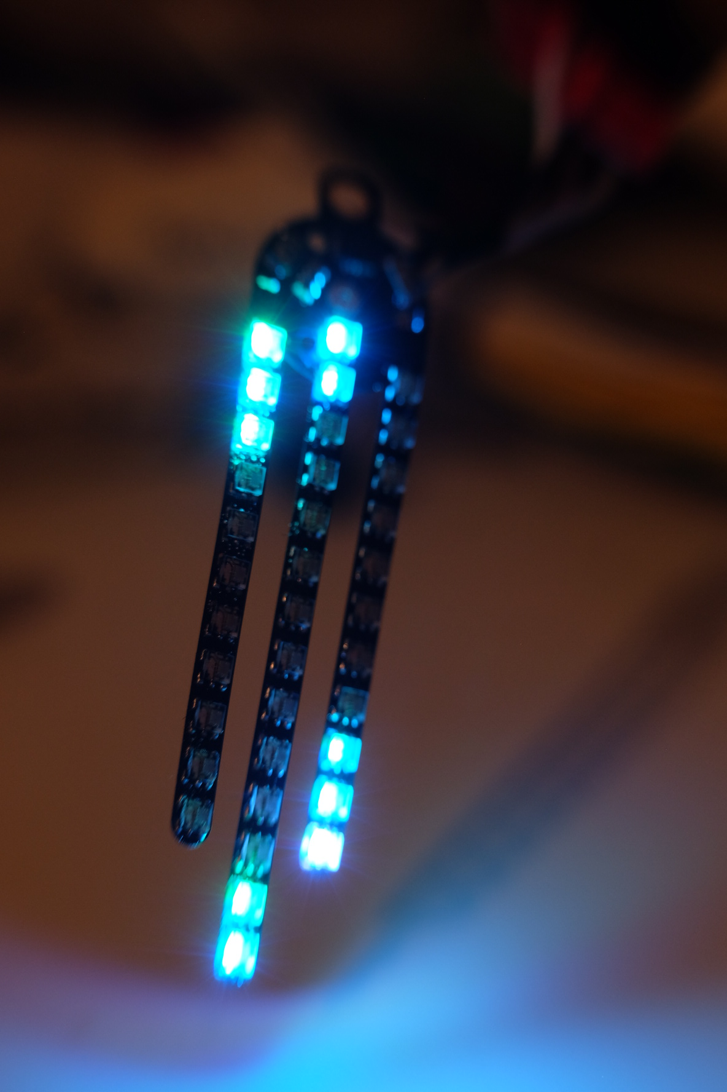
$ whoami
Robert Foss
- Based in Berlin
- Work in Open Source
- Specialize in Linux Graphics
Notes:
Make terrible electronics
---
This is LED earring
---
Rgb leds
---
Coincell battery

Slide 4
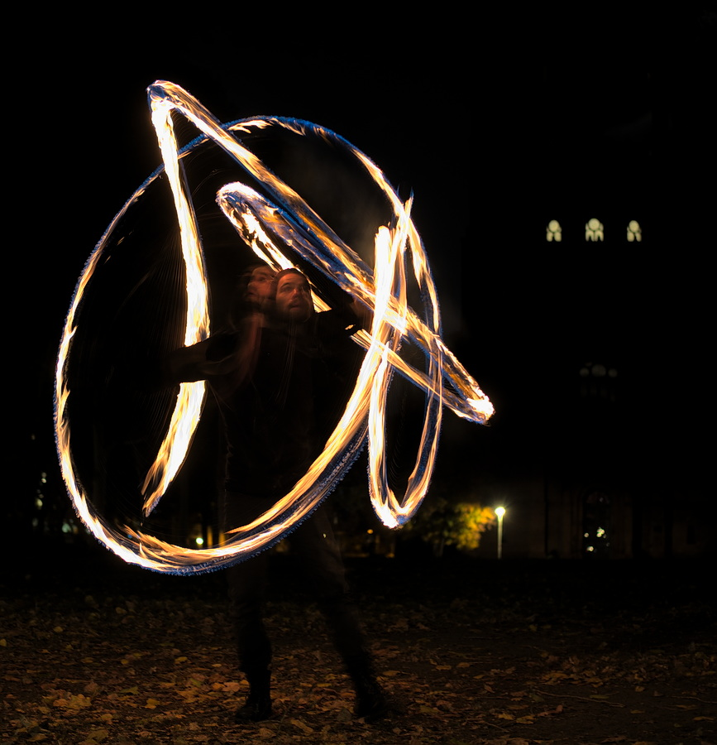
$ whoami
Robert Foss
- Based in Berlin
- Work in Open Source
- Specialize in Linux Graphics
Notes:
Sometimes do circus-y things
---
Spinning fire poi
---
kinda fun, until you hit yourself in face

Slide 5
ARM GPUs
Notes:
ARM has lots of GPUs
---
From very low end to high end
---
Some targeted by panfrost

Slide 6
Mali 2/3/4XX
- Codenamed Utgard
- Supported by Lima driver
- Supports OpenGL ES <= 2.0
- Acquired with Phalanx
Notes:
Physically small GPU
---
Cheap to build
---
Cheap to license
---
Probably in the order of a few cents
---
Depending on configuration
---

Slide 7
Mali T-XXX
- Codenamed Midgard
- Supported by Panfrost driver
- Supports OpenGL ES <= 3.1
- Supports Vulkan <= 1.0
- Design targeted OpenCL heavily
Notes:
First high end arch
---
Designed with opencl in mind
---
Opencl driver was charged extra for
---
Have you ever seen opencl on a phone?

Slide 8
Mali G-XX
- Codenamed Bifrost
- Supported by Panfrost driver
- Supports OpenGL ES <= 3.2
- Supports Vulkan <= 1.1
- Partial re-design of Midgard
Notes:
2nd high end arch
---
Based on Midgard
---
Targeting higher perf / watt
---
Scalar instead of VLIW
---
This means warps/ thread groups
---
Warp size 4-8, desktop 32 / 64

Slide 9
Mali G-YY
- Codenamed Valhall
- Supports OpenGL ES <= 3.2
- Supports Vulkan <= 1.1
- New ISA & Compute core
Notes:
3rd high end arch
---
Not available for purchase yet
---
Next gen phones
---
Warp size 16

Slide 10
Driver History
Notes:
Up until 2017, no credible way forward
---
Stuck with proprietary drivers on old kernels
---
Arm only offers 5year support, as far as I know
---
Problematic for automotive space for example

Slide 11
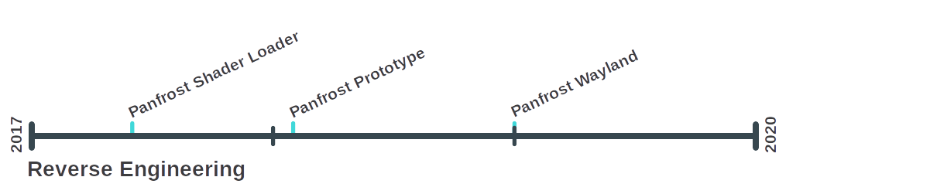
Driver History
Notes:
Panfrost 2017
---
Lyude Paul – started & tooling
---
Alyssa Rosenzweig – leading the effort
---
Connor Abbot – ISA & Compiler RE
---
Midgard & Bifrost ISA fully REd
---
Tool use, inspect what the blob sends to kernel

Slide 12
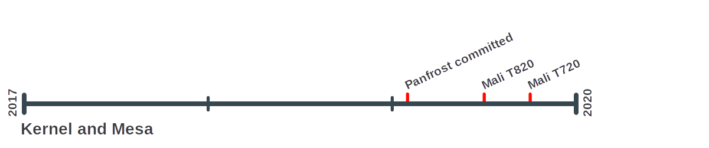
Driver History
Notes:
More contributors
---
Tomeu Vizoso – kernel & mesa, winsys
---
Rob Herring – kernel
---
ARM – kernel
---

Slide 13
Panfrost Today

Slide 14
Panfrost Today
- Deployed on Mali T720, T820 & T860
Notes:
T860 first dev. target due to rk3399
---
Since it is otherwise well supported upstream
---
Due google & being shipped in chromebooks

Slide 15
Panfrost Today
- Deployed on Mali T720, T820 & T860
- Runs normal Desktop Environments
Notes:
I’ve brought up debian+wayland
---
It just works

Slide 16
Panfrost Today
- Deployed on Mali T720, T820 & T860
- Runs normal Desktop Environments
- Supports OpenGL ES <= 2.0
Notes:
OpenGL ES 2.0 is old
---
but often the lowest requirement

Slide 17
Panfrost Today
- Deployed on Mali T720, T820 & T860
- Runs normal Desktop Environments
- Supports OpenGL ES <= 2.0
- OpenGL ES 3.0 soon, with 3.1 & 3.2 coming

Slide 18
Panfrost Today
- Deployed on Mali T720, T820 & T860
- Runs normal Desktop Environments
- Supports OpenGL ES <= 2.0
- OpenGL ES 3.0 soon, with 3.1 & 3.2 coming
- Vulkan not started yet
Notes:
Vulkan driver quite separate from OpenGL

Slide 19
What is a driver?
Notes:
You probably know what a driver does
---
But maybe not how it is built
---
Has many parts
---
Linux this means many codebases

Slide 20

Overview
Notes:
Simplified view
---
Two parts, userspace & kernelspace
---
Drivers are huge, don’t want that in kernel

Slide 21

Kernel
Notes:
Provides userspace APIs
---
Abstracts HW for us

Slide 22

Kernel
Notes:
DRM – direct rendering manager
---
Subsystem in kernel
---
Handles GPU & Display hardware
---
memory allocation
---
interrupts
---
GPU job submissions

Slide 23

Userspace
Notes:
Large codebase, does many things
---
compiles shaders
---
builds command stream
---
submits jobs to the kernel
---
Supports many GPUs
---
Much code is shared between them

Slide 24
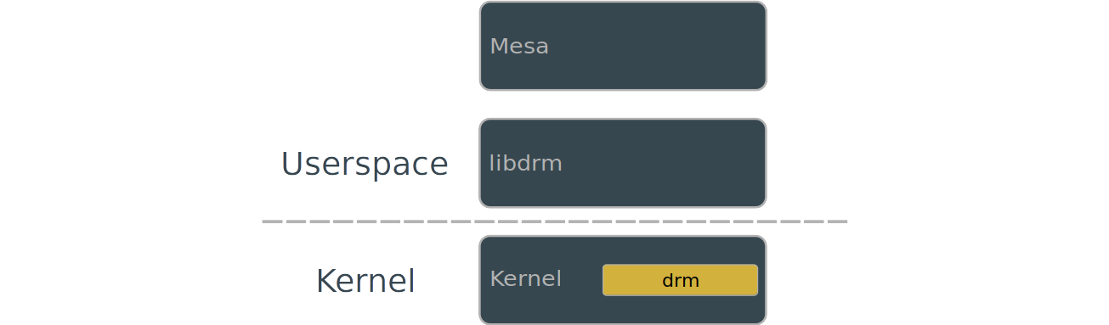
Userspace
Notes:
a library for accessing the drm subsystem
---
Provides more convenient ways to access HW
---
Doing everything through IOCTLS is no fun
---
Prevents re-implementation of functionality

Slide 25
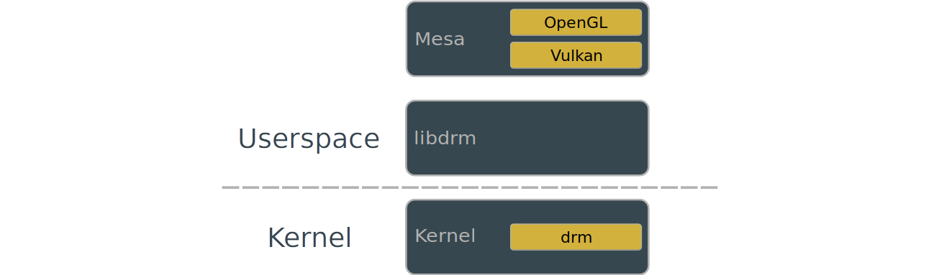
Userspace
Notes:
Implements common APIs for applications
---
implementations shared between drivers
---
Very true for OpenGL
---
Less true for Vulkan since it is very low level
---
And therefore hardware specific

Slide 26
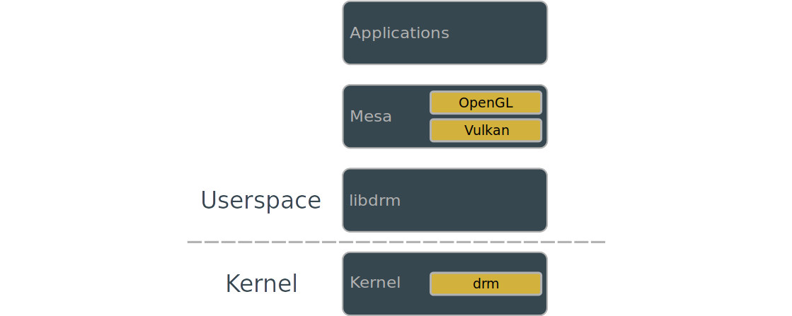
Userspace
Notes:
Lastly we have the applications
---
The good stuff
---
The only thing that actually matters to users

Slide 27
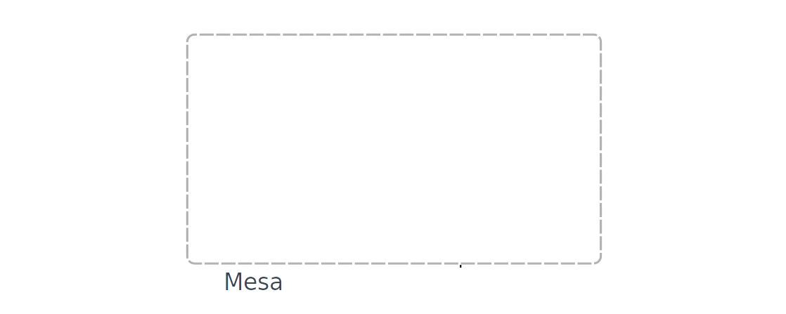
Mesa - Overview
Notes:
Mesa does a lot of things
---
let’s look inside

Slide 28
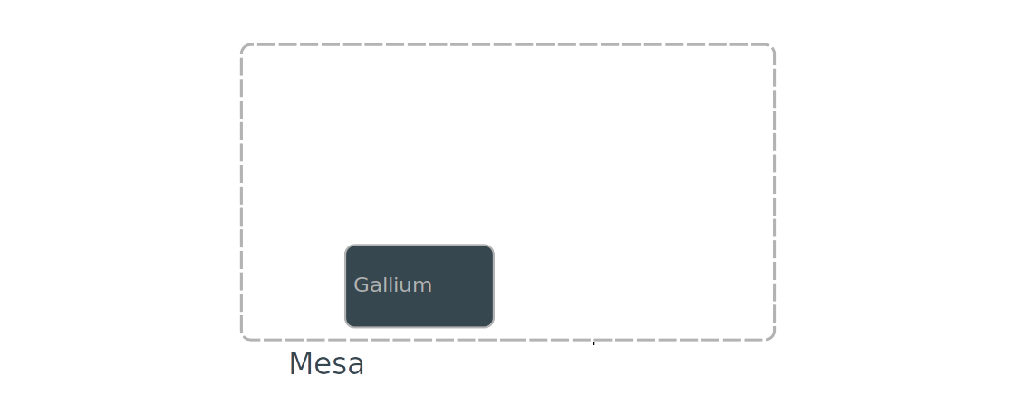
Mesa – Gallium
Notes:
Very important part
---
Gallium is a driver writing framework
---
Allows code to be shared between drivers
---
If 2 or more drivers implement a thing, move it
---
Take step back, it allows vendors to cooperate

Slide 29
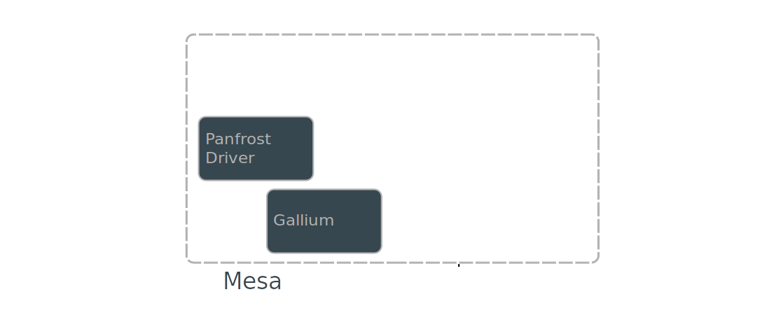
Mesa – Gallium
Notes:
Panfrost implemented using Gallium
---
Driver calls out to other parts we’ll get to

Slide 30
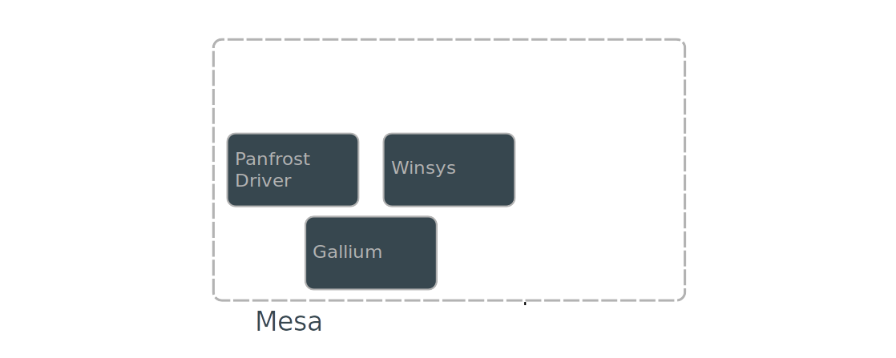
Mesa – Winsys
Notes:
Sometimes you hear of winsys
---
Window system
---
Sets up & allocates buffers from the kernel

Slide 31
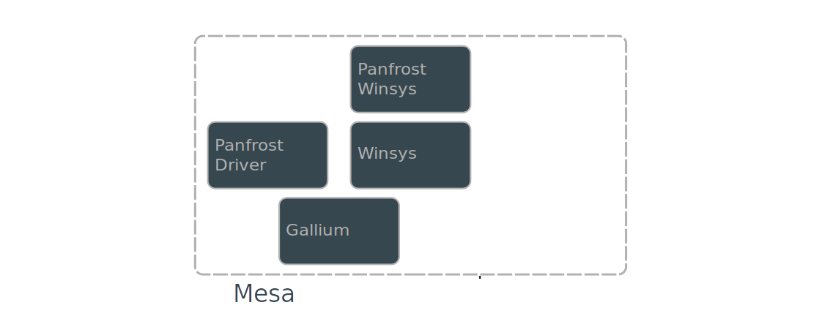
Mesa – Winsys

Slide 32
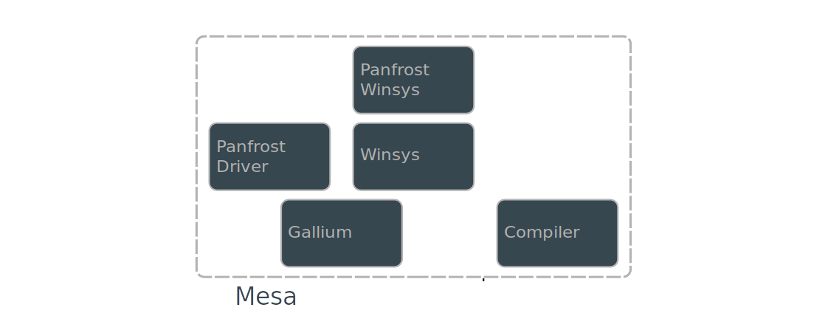
Mesa – Compiler
Notes:
A compiler framework exists
---
Used by most of the drivers
---
radeonsi used llvm until recently

Slide 33
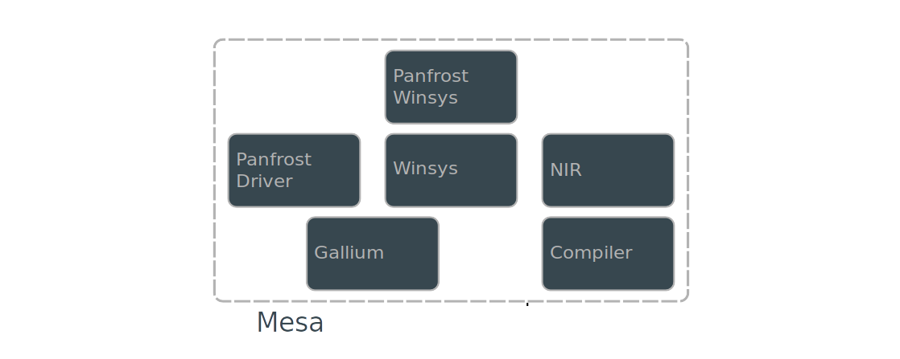
Mesa – Compiler
Notes:
NIR - new intermediate representation
---
Connor abbot
---
SSA based
---
Compiler middle end
---
Implements some common optimizations
---
Dead code elimination
---
common subexpression elimination

Slide 34
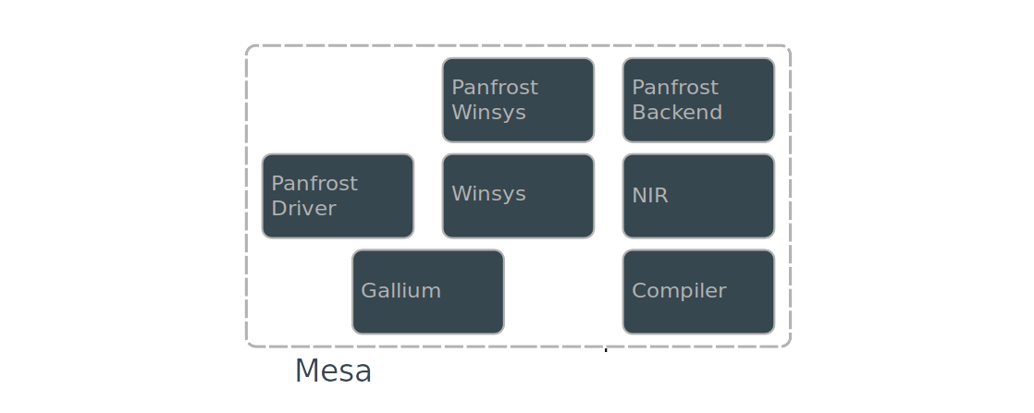
Mesa – Compiler

Slide 35
Who contributes?
Notes:
If we take a step BACK

Slide 36
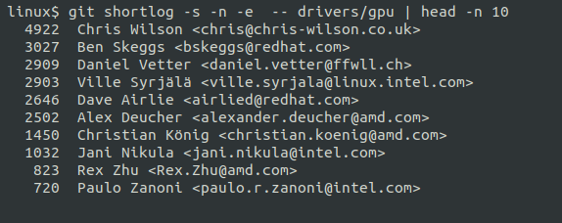
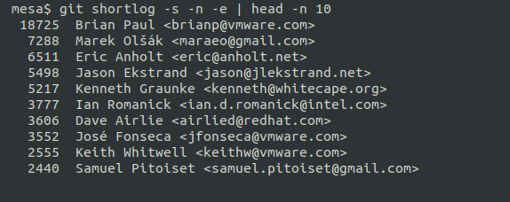
Who contributes?
Notes:
Intel since 2009
---
Shows well shared codebase → cooperation

Slide 37
Contribution Process
- Kernel uses Mailing list
- Mesa uses Mailing list & Gitlab Merge Requests
Notes:
Mesa move from ML to gitlab has been good
---
Still allow ML submissions
---
ML more focused on discussion

Slide 38
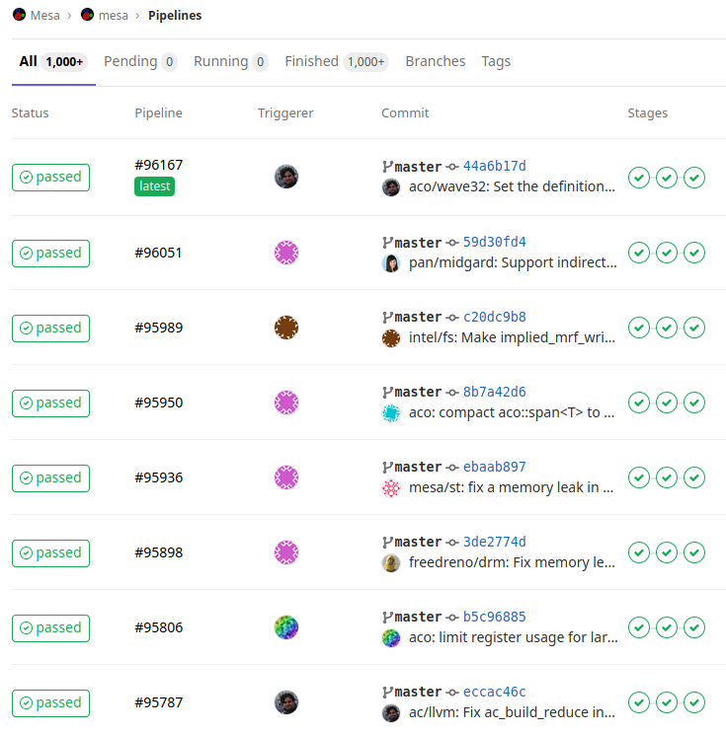
Continuous Integration
- Kernel CI
https://kernelci.org/
- Mesa CI
https://gitlab.freedesktop.org/mesa/mesa/
Notes:
KernelCI is rather established now
---
MesaCI is a work in progress
---
Testing software only drivers is ~easy
---
Testing HW requires labs

Slide 39
Thanks!
Robert Foss
@memcpy_io
http://memcpy.io

