Slide 1
News from the Embedded GPU Space
Notes:
Hey
---
This talk – overview – gpu space
---
Specifically – OSS gpu space
---
But first

Slide 2
Robert
Foss
@memcpy_io
Notes:
Who am i?
---
Robert – live in Berlin, Germany
---
Software engineer @ collabora
---
Work in OSS graphics space
---
Linux kernel, drivers, android, wayland

Slide 3
Vendors
Notes:
Let’s have a look at the different vendors

Slide 4
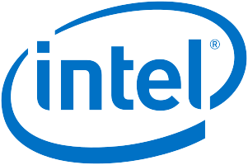
Vendors
Notes:
Long history
---
i915 2004
---
Very good citizen
---
- OpenGL 4.5
- Vulkan 1.1
---

Slide 5
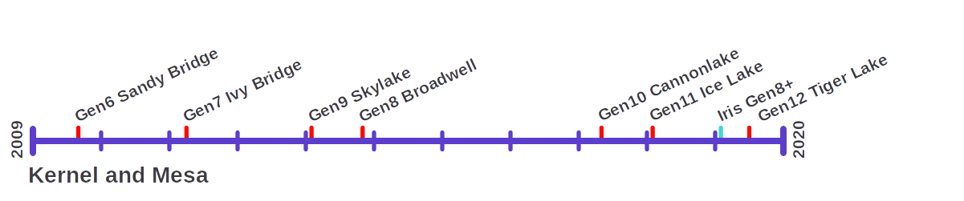
Vendors
Intel
Notes:
Timeline very much cut short
---
2004 i915 – Tungsten
---
No RE, Internally at intel the Win driver sometimes REd
---
Gen 12 dedicated GPU
---
Switched driver to Gallium

Slide 6

Vendors
Notes:
Radeon 2009: long history
---
Also a good citizen
---
Lots of drivers
---
- OpenGL 4.5
- Vulkan 1.1
---
Documentation provided since r600

Slide 7
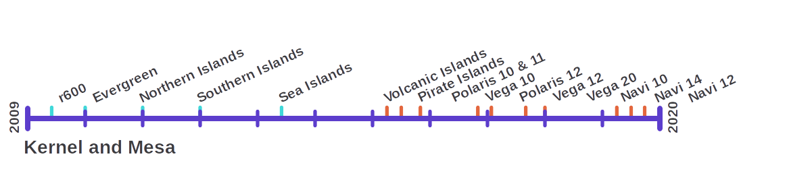
Vendors
AMD
Notes:
R600 start of vendor support
---
Has many drivers
---
Kernel: radeon, amdgpu
---
Kernel-radeon: r100-Sea Islands
---
Kernel-amdgpu: Volcanic Islands – Navi
---
Mesa: r600, radeon, radeonsi
---
And non mesa ones, amdgpu & amdvlk

Slide 8
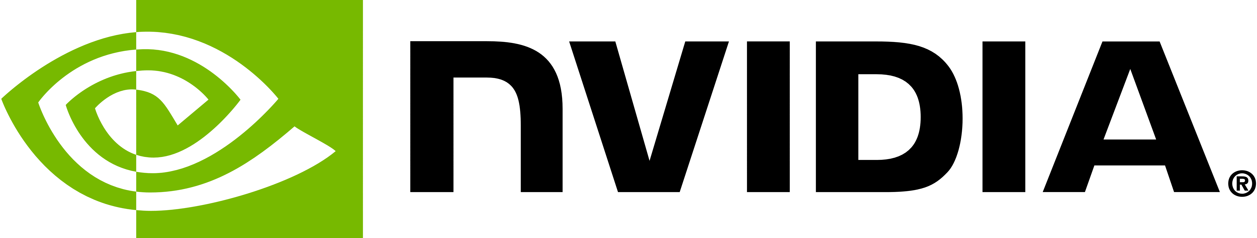
Vendors
Notes:
Nouveau 2010, Relatively long history
---
Maybe not the best citizen
---
OpenGL 4.5
---
Tegra RE done in part by Eric Faye-Lund
---
Some tegra support upstreaming by aircraft supplier

Slide 9
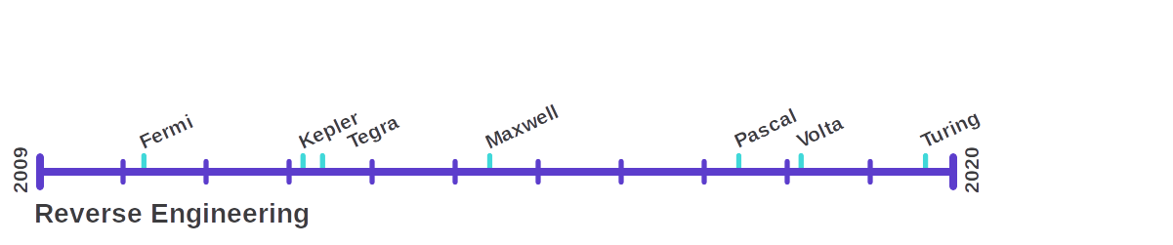
Vendors
NVidia
Notes:
Rather complete GPU support
---

Slide 10
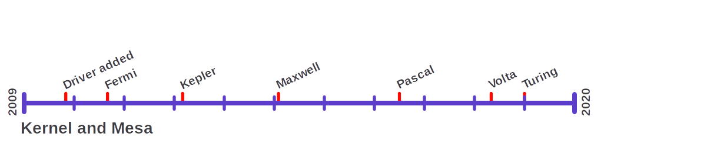
Vendors
NVidia
Notes:
But nvidia disallows firmware from being shipped
---
No GPU re-clocking
---

Slide 11

Vendors
Notes:
Has kernel patches floating around
---
Not upstreamable
---
Has mesa patches floating around, but no 3D support

Slide 12

Vendors
Notes:
Msm/freedreno 2013, not such long history
---
New citizen
---
All hardware supported
---
Funfact, Qcom bought the amd mobile handset division 2009, including gpu
---
radeon -> adreno

Slide 13
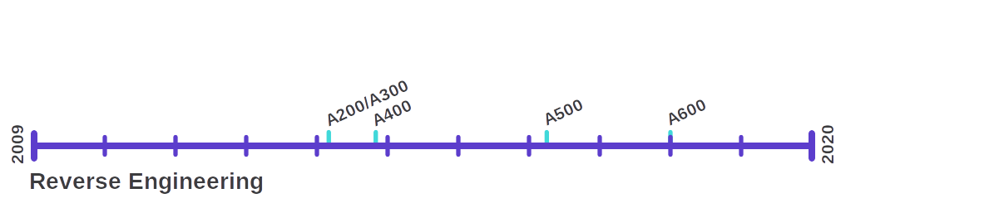
Vendors
Qualcomm
Notes:
RE 2013
---
RE by Rob Clark, Ilia Mirkin and others
---
Adreno -> Radeon

Slide 14
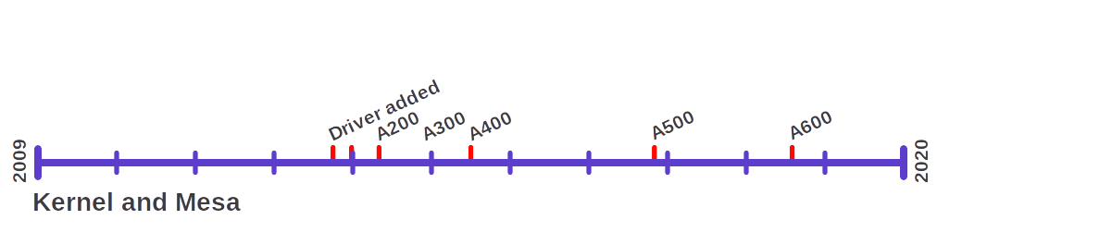
Vendors
Qualcomm
Notes:
Very mature & complete
---
Partially supported by Qualcomm
---
Snapdragon 855 uses Adreno 640

Slide 15

Vendors
Notes:
Vc4 2015, not so long history
---
Good citizen
---
Also no RE, since development is done by the vendor
---
Or Eric Anholt to be precise

Slide 16
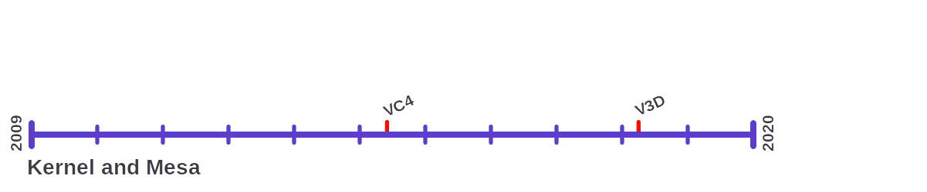
Vendors
Broadcom
Notes:
2015 vc4
---

Slide 17

Vendors
Notes:
Etnaviv 2015, not so long history
---
RE ongoing since 2012
---
RE & dev sponsored by another aircraft supplier

Slide 18
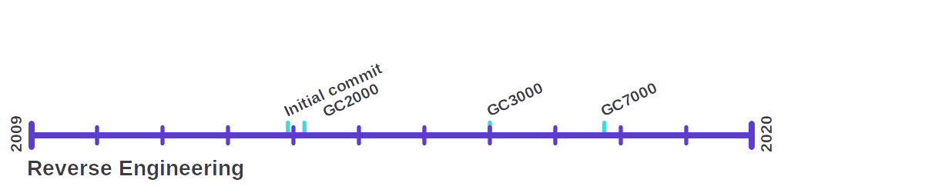
Vendors
Vivante

Slide 19
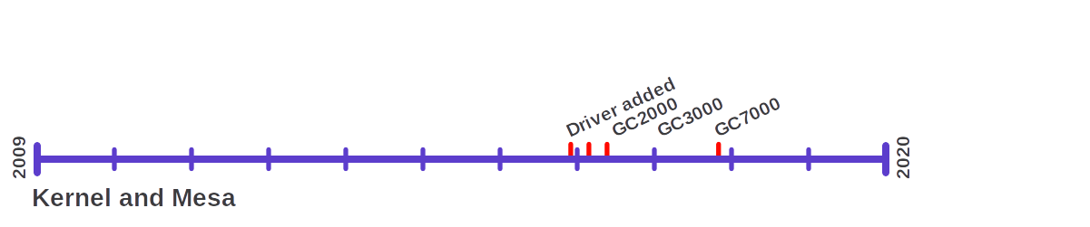
Vendors
Vivante

Slide 20
Vendors
Vivante

Slide 21

Vendors
Notes:
---
Arm contributes to display driver, but not GPU yet
---
Not yet supported
---
Has seen some reverse engineering
---

Slide 22
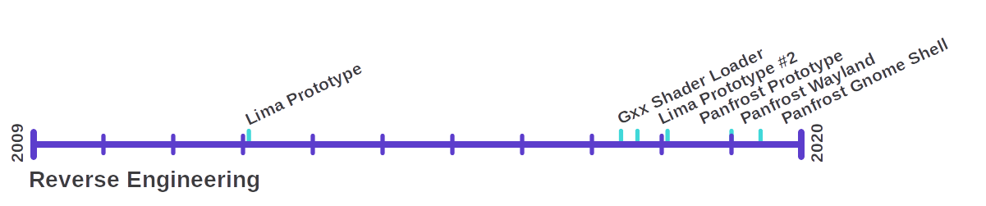
Vendors
ARM
Notes:
Early 2/400 prototype
---
2012- lima- Luc Verhaagen
---
2017-lima- Qiang Yu
---
2018- Panfrost- Alyssa Rosenzweig, Connor abbot

Slide 23
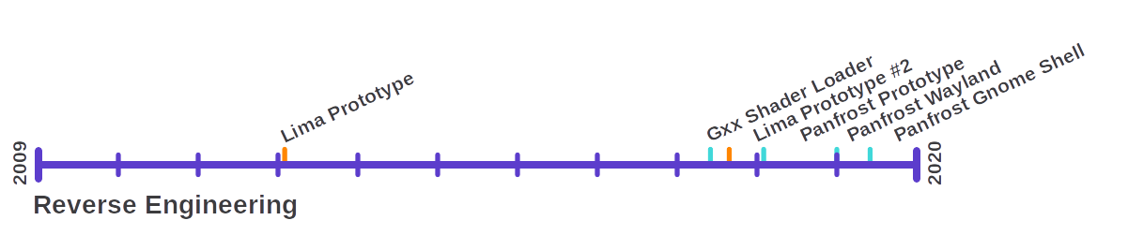
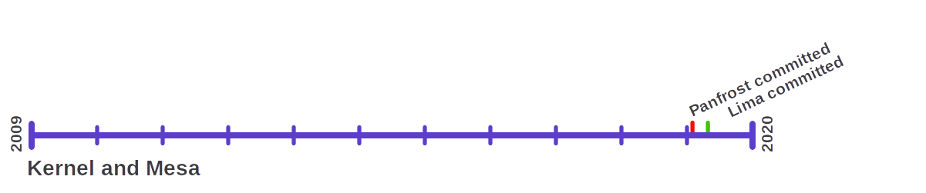
Vendors
ARM
Notes:
This driver is hot off the presses
---
We’ve been working a lot with pushing it forward
---
Runs simple Wayland, 3D apps
---
DEMO at our booth

Slide 24
What Comes Next

Slide 25
Compute
OpenCL

Slide 26
Compute
OpenCL
  Qualcomm & freeedreno support in progress
  NVidia & nouveau support in progress
  Vivante & etnaviv support in progress

Slide 27
Compute
OpenCL
  Qualcomm & freeedreno support in progress
  NVidia & nouveau support in progress
  Vivante & etnaviv support in progress
Vulkan Compute
  Supported by Intel and AMD

Slide 28
Compute
OpenCL
  Qualcomm & freeedreno support in progress
  NVidia & nouveau support in progress
  Vivante & etnaviv support in progress
Vulkan Compute
  Supported by Intel and AMD
SYCL
  High level & built on top of OpenCL

Slide 29
Big Picture

Slide 30
Big Picture
Some drivers are very mature

Slide 31
Big Picture
Some drivers are very mature
Community drivers share common codebase

Slide 32
Big Picture
Some drivers are very mature
Community drivers share common codebase
Reverse engineering takes 0-7 years

Slide 33
Big Picture
Some drivers are very mature
Community drivers share common codebase
Reverse engineering takes 0-7 years
Compute still on the way

Slide 34
Why Open Source?

Slide 35
Why Open Source?
Long-term support

Slide 36
Why Open Source?
Long-term support
  Up to 20 year old drivers currently supported

Slide 37
Why Open Source?
Long-term support
  Up to 20 year old drivers currently supported
High performance & conformance
Notes:
Google shipped freedreno on Pixel3

Slide 38
Why Open Source?
Long-term support
  Up to 20 year old drivers currently supported
High performance & conformance
Much simpler debugging

Slide 39
Why Open Source?
Long-term support
  Up to 20 year old drivers currently supported
High performance & conformance
Much simpler debugging
Old hardware receives new features

Slide 40
Thank you!

