Slide 1
Panfrost
Open Source Meets Arm GPUs
Notes:
Hey
---
This talk – OSS ARM GPU drivers
---
Specifically – Panfrost
---
But first

Slide 2
Robert
Foss
@memcpy_io
Notes:
Who am i?
---
Robert – live in Germany
---
Software engineer @ collabora
---
Work in OSS graphics space
---
Linux kernel, drivers, android

Slide 3
Hardware
Notes:
Quick look at
--
What hardware is out there

Slide 4
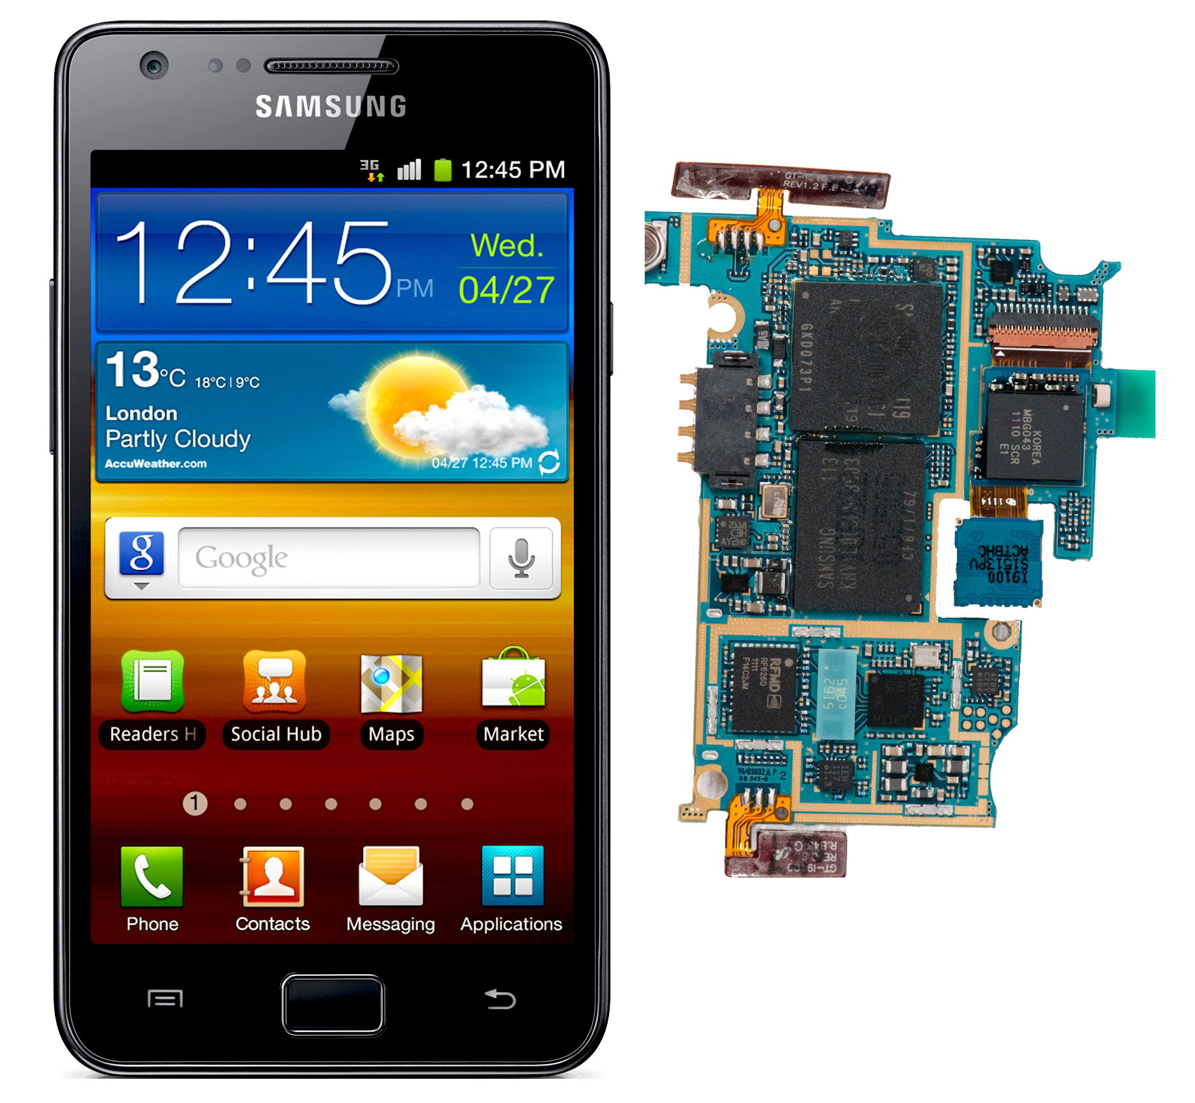
Architectures
Utgard
Mali 2/4XX GPUs
Launched 2007
OpenGL ES 2.0
Found in Samsung S2
Notes:
Utgard arch
–--
Launched 2007
---
OpenGL ES 2.0
---
Samsung S2

Slide 5
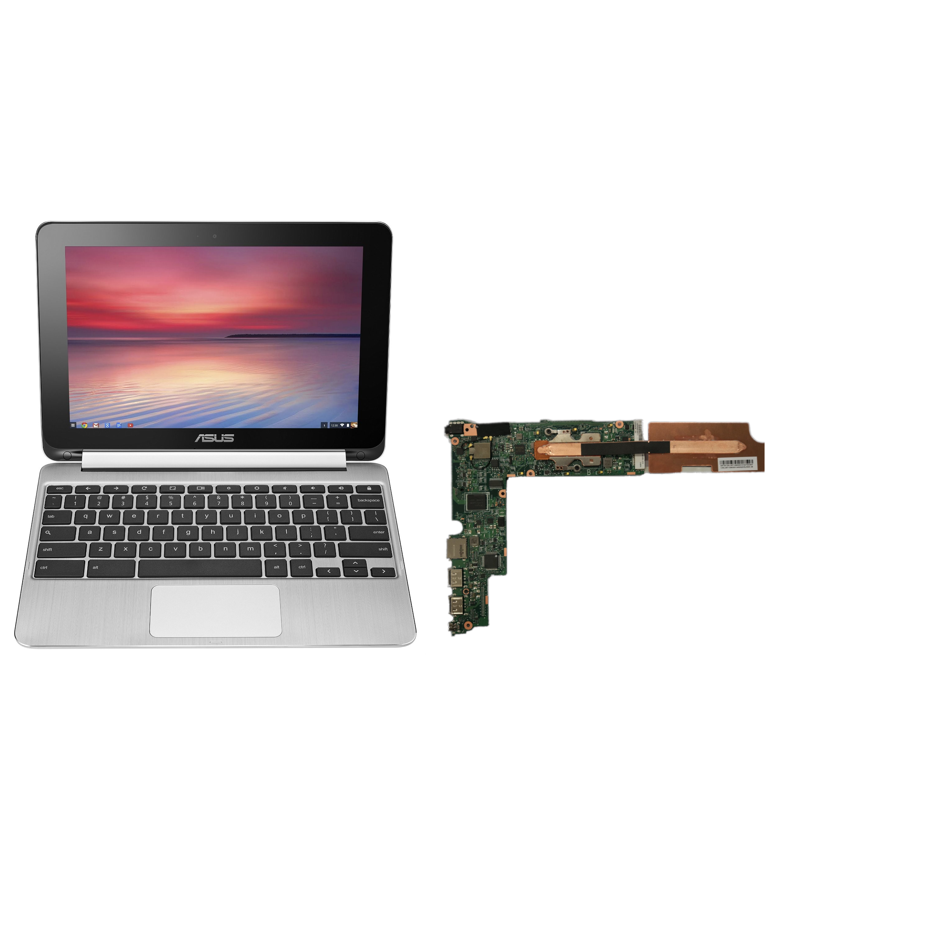
Architectures
Midgard
Mali TXXX GPUs
Launched 2012
OpenGL ES 3.2
OpenCL 1.2
Vulkan 1.1
Found in Asus C100
Notes:
Midgard arch
–--
Launched 2012
---
OpenGL ES 3.2 / OpenCL 1.2 Vulkan 1.1
---
Chromebook Asus C100

Slide 6
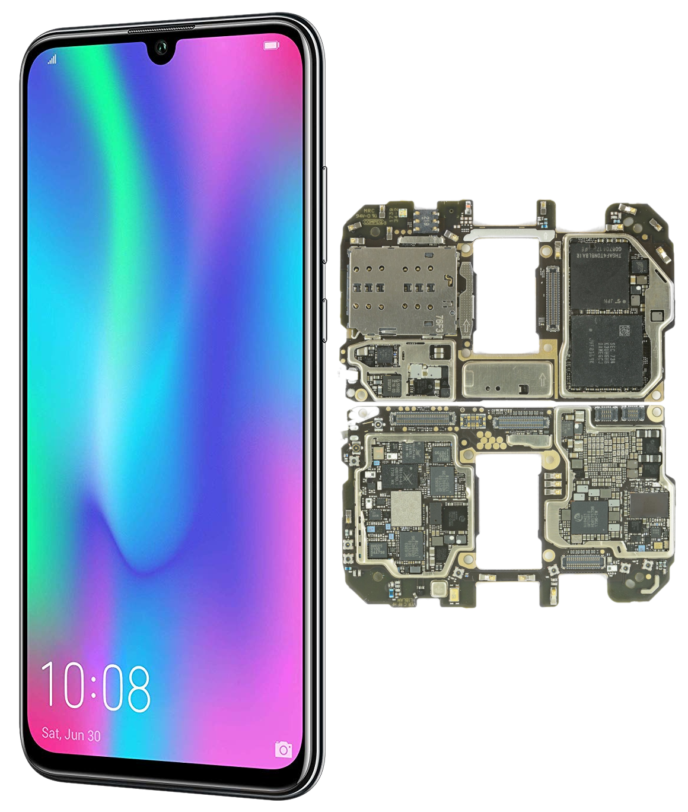
Architectures
Bifrost
Mali GXX GPUs
Launched 2016
OpenGL ES 3.2
OpenCL 2.0
Vulkan 1.1
Found in Huawei Honor 10
Notes:
Bifrost arch
–--
Launched 2016
---
OpenGL ES 3.2 / OpenCL 2.0 Vulkan 1.1
---
Huawei Honor 10

Slide 7
Architectures
Valhall
Mali G77 GPU
Launched 2019
OpenGL ES 3.2
OpenCL 2.0
Vulkan 1.1
Found in ???
???
Notes:
Valhall arch
–--
Launched 2019
---
OpenGL ES 3.2 / OpenCL 2.0 Vulkan 1.1
---

Slide 8
Drivers
Notes:
Let’s have a look at the different drivers
---

Slide 9
Drivers
Proprietary
Supports all GPUs
Notes:
Not for GPUs no longer being sold
---
Not for older than ~5yrs

Slide 10
Drivers
Proprietary
Supports all GPUs
Proprietary userspace driver
Notes:
Userspace driver libmali/the DDK
---
Is proprietary

Slide 11
Drivers
Proprietary
Supports all GPUs
Proprietary userspace driver
Open Source kernel driver
Notes:
Mali kbase
---
Open source
---
Used as reference for panfrost kernel

Slide 12
Drivers
Proprietary
Supports all GPUs
Proprietary userspace driver
Open Source kernel driver
Kernel driver not upstreamable
Notes:
Due to no OSS userspace driver

Slide 13
Drivers
Lima
Supports Utgard
Notes:
Targets Mali 4xx

Slide 14
Drivers
Lima
Supports Utgard
Open Source userspace driver
Notes:
Lima, a part of Mesa project

Slide 15
Drivers
Lima
Supports Utgard
Open Source userspace driver
Open Source kernel driver
Notes:
Lima, part of Linux Kernel

Slide 16
Drivers
Lima
Supports Utgard
Open Source userspace driver
Open Source kernel driver
Both upstreamed to Kernel & Mesa
Notes:
Both are fully upstreamed

Slide 17
Drivers
Panfrost
Supports Midgard
Notes:
Mainly developed against Mali T860
---
Currently supports Midgard GPUs

Slide 18
Drivers
Panfrost
Supports Midgard
Targets adding Bifrost support
Notes:
Targets supporting Bifrost GPUs
---
Currently not well tested with bifrost
---
Much is shared with Midgard, but not compiler

Slide 19
Drivers
Panfrost
Supports Midgard
Targets adding Bifrost support
Open Source userspace driver
Notes:
Panfrost, part of mesa

Slide 20
Drivers
Panfrost
Supports Midgard
Targets adding Bifrost support
Open Source userspace driver
Open Source kernel driver
Notes:
Panfrost, part of kernel

Slide 21
Drivers
Panfrost
Supports Midgard
Targets adding Bifrost support
Open Source userspace driver
Open Source kernel driver
Both upstreamed to Kernel & Mesa
Notes:
Both fully upstreamed

Slide 22
History
Notes:
A lot has happened
---
Lets have a look at what

Slide 23
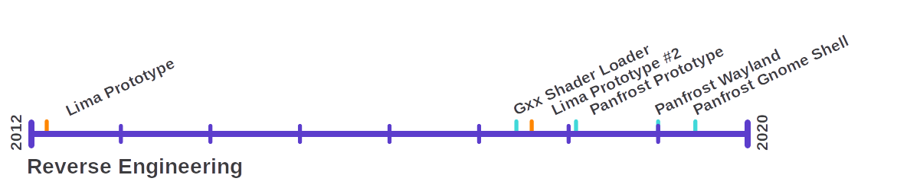
History
Notes:
Early 2/400 prototype
---
2012- lima- Luc Verhaagen
---
2017-lima- Qiang Yu
---
2017- Panfrost- Alyssa Rosenzweig, Connor abbot, Lyude Paul

Slide 24
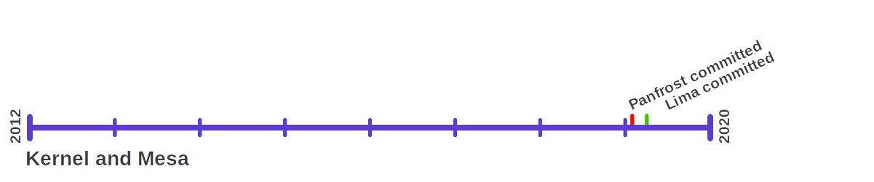
History
Notes:
Both lima kernel/mesa driver upstreamed
---
Both panfrost kernel/mesa driver upstreamed

Slide 25
Demo

Slide 26
What Comes Next

Slide 27
What Comes Next
Improved OpenGL support
  Desktop OpenGL, OpenGL ES 3.X

Slide 28
What Comes Next
Improved OpenGL support
Wider hardware support
  Currently Mali T860 best tested
  More GPUs need enabling

Slide 29
What Comes Next
Improved OpenGL support
Wider hardware support
Improved performance

Slide 30
What Comes Next
Notes:
Just an example
---
More complicated shaders, better prop.

Slide 31
What Comes Next
Improved OpenGL support
Wider hardware support
Improved performance
  Currently faster in some tests
  Compiler intense tests often slower

Slide 32
What Comes Next
Improved OpenGL support
Wider hardware support
Improved performance
OpenCL

Slide 33
What Comes Next
Improved OpenGL support
Wider hardware support
Improved performance
OpenCL
Vulkan

Slide 34
Why Open Source?

Slide 35
Why Open Source?
Long-term support

Slide 36
Why Open Source?
Long-term support
High performance & conformance
Notes:
Google shipped freedreno on Pixel3

Slide 37
Why Open Source?
Long-term support
High performance & conformance
Much simpler debugging

Slide 38
Why Open Source?
Long-term support
High performance & conformance
Much simpler debugging
Old hardware receives new features

Slide 39
Why Open Source?
Long-term support
High performance & conformance
Much simpler debugging
Old hardware receives new features
No vendor lock-in

Slide 40
Thank you!

