Slide 1
Status of the
Open Source GPU Space
2018 Q2
Robert Foss
Software Engineer
@memcpy_io
Notes:
Hi.
---
My name is Robert Foss.
---
I work for Collabora,
as you may have guessed.
---
Which means that I work on open source for a living.
---
I mostly do Linux graphics work.

Slide 2
Agenda
Overview
Upstream Support
What Comes Next
The Big Picture
Notes:
These are the things we’re going to cover.
---
If you’ve made a GPU in your garage, we’re not going to talking about it
---

Slide 3
Overview

Slide 4
The Graphics Stack
Subtitle Karla regular
28pt
Apps
libdrm
mesa
DRM
Kernel
Notes:
On top of course,
We have the apps

Slide 5
The Graphics Stack
Subtitle Karla regular
28pt
Apps
The Really Good Stuff ™
libdrm
mesa
DRM
Kernel
Notes:
On top of course,
We have the apps

Slide 6
The Graphics Stack
Subtitle Karla regular
28pt
Apps
The Really Good Stuff ™
- No really, this is the whole point!
libdrm
mesa
DRM
Kernel
Notes:
On top of course,
We have the apps

Slide 7
The Graphics Stack
Subtitle Karla regular
28pt
Apps
The Graphics driver
libdrm
mesa
DRM
Kernel
Notes:
On top of course,
We have the apps

Slide 8
The Graphics Stack
Subtitle Karla regular
28pt
Apps
The Graphics driver
- The the non-Kernel part
libdrm
mesa
DRM
Kernel
Notes:
On top of course,
We have the apps

Slide 9
The Graphics Stack
Subtitle Karla regular
28pt
Apps
Mesa implements APIs
- OpenGL, Vulkan, OpenCL
libdrm
mesa
DRM
Kernel
Notes:
On top of course,
We have the apps

Slide 10
The Graphics Stack
Subtitle Karla regular
28pt
Apps
Graphics drivers subsystem
libdrm
mesa
DRM
Kernel
Notes:
On top of course,
We have the apps

Slide 11
The Graphics Stack
Subtitle Karla regular
28pt
Apps
Graphics drivers Kernel
libdrm
mesa
DRM
Kernel
Notes:
On top of course,
We have the apps

Slide 12
The Graphics Stack
Subtitle Karla regular
28pt
Apps
The Linux Kernel
libdrm
mesa
DRM
Kernel
Notes:
On top of course,
We have the apps

Slide 13
Upstream Support

Slide 14
Upstream Support
NVidia
Notes:
First out NVidia

Slide 15
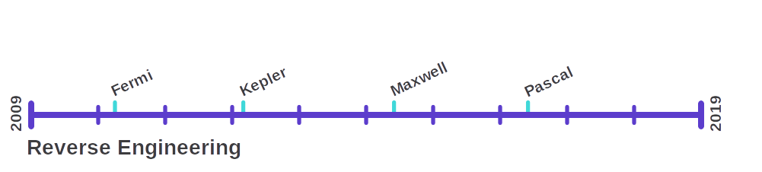
Upstream Support
NVidia

Slide 16
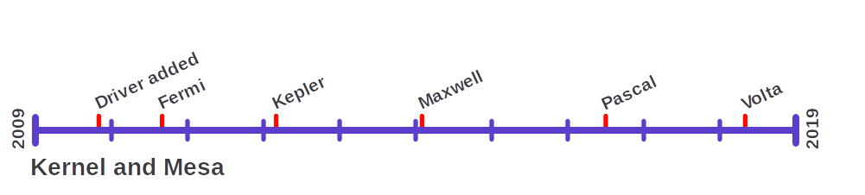
Upstream Support
NVidia

Slide 17
Upstream Support
Intel
Notes:
No reverse engineering timeline
---
Internally at intel the Win driver sometimes REd
---
Due to mediocre documentation

Slide 18
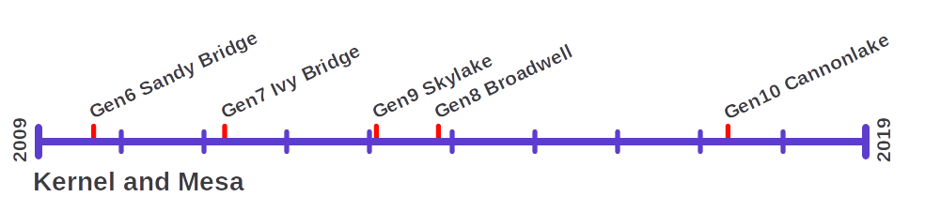
Upstream Support
Intel
Notes:
Timeline very much cut short
---
2004 i915 -- Tungsten

Slide 19
Upstream Support
AMD
Notes:
No RE timeline here either
---
Documentation provided since r600

Slide 20
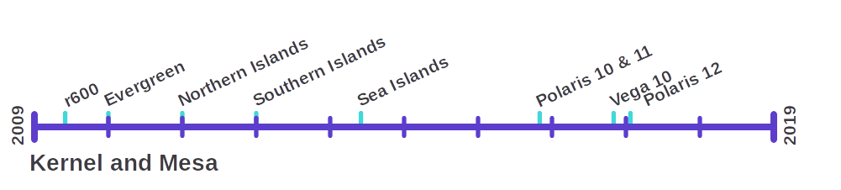
Upstream Support
AMD
Notes:
R600 start of vendor support
---
Has many drivers
---
Kernel: radeon, amdgpu
---
Mesa: r600, radeon, radeonsi
---
And non mesa ones like amdvlk

Slide 21
Upstream Support
Broadcom
Notes:
Also no RE, since development is done by the vendor
---
Or Eric Anholt to be precise

Slide 22
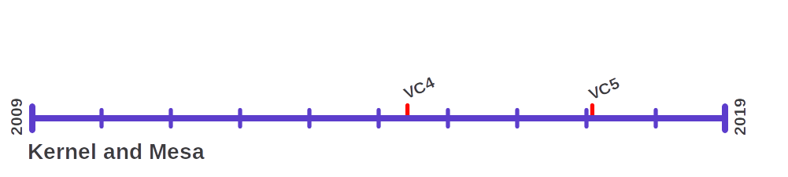
Upstream Support
Broadcom

Slide 23
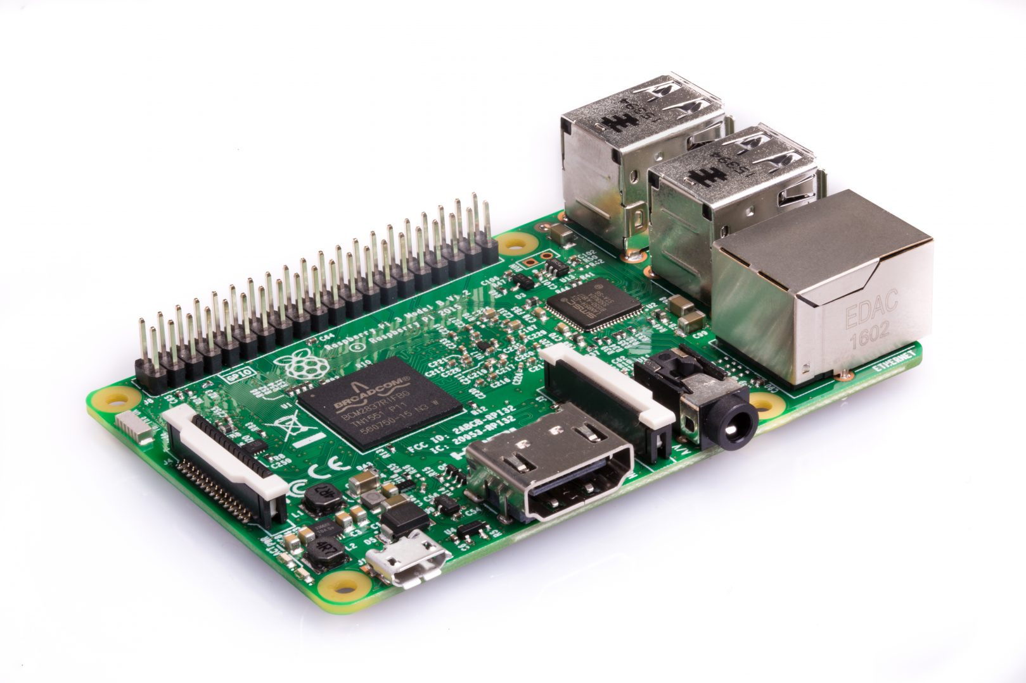
Upstream Support
Broadcom VC4
Board: Raspberry Pi 3
SOC: Broadcom BCM2837

Slide 24
Upstream Support
Broadcom VC5
???
Board: ???
SOC: Broadcom BCM7268

Slide 25
Upstream Support
Qualcomm

Slide 26
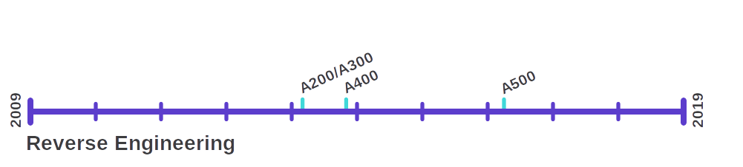
Upstream Support
Qualcomm

Slide 27
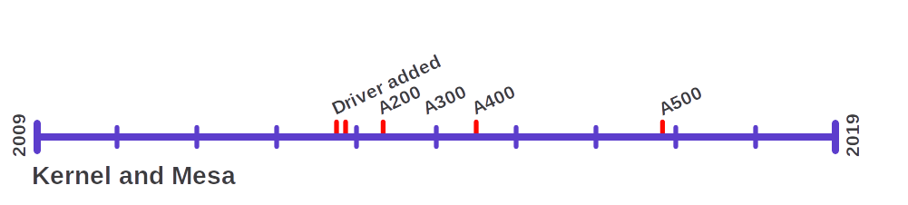
Upstream Support
Qualcomm

Slide 28
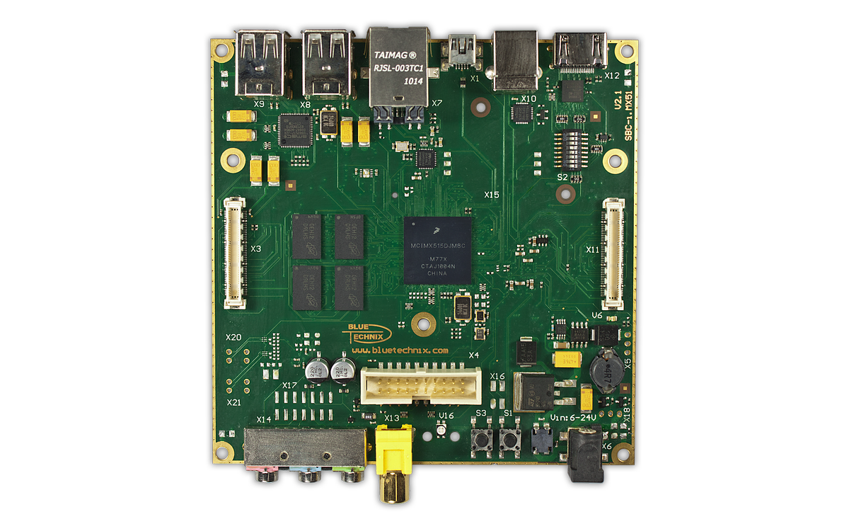
Upstream Support
Qualcomm Adreno A200
Board: iMX 53 Devkit
SOC: NXP iMX 53

Slide 29
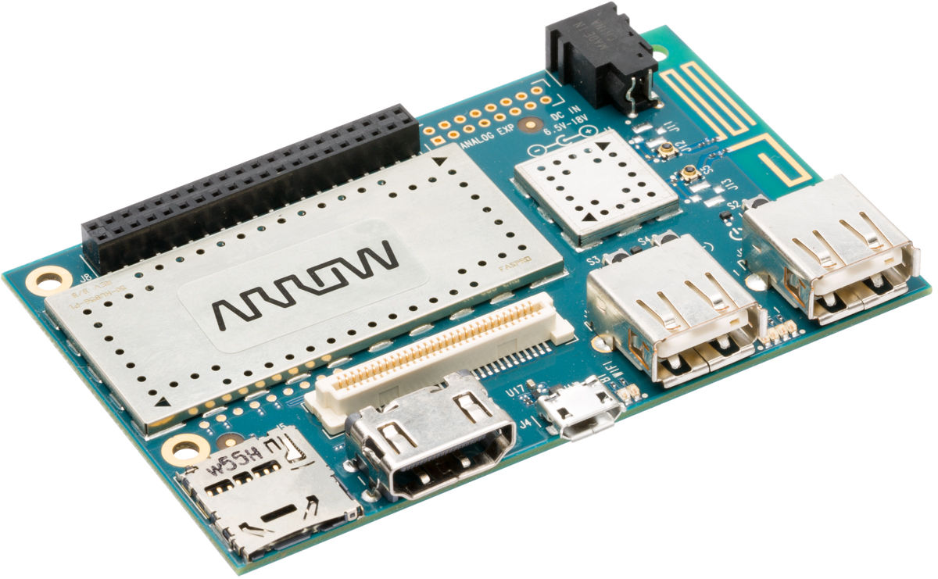
Upstream Support
Qualcomm Adreno A300
Board: Dragonboard 410C
SOC: Qualcomm 410E

Slide 30
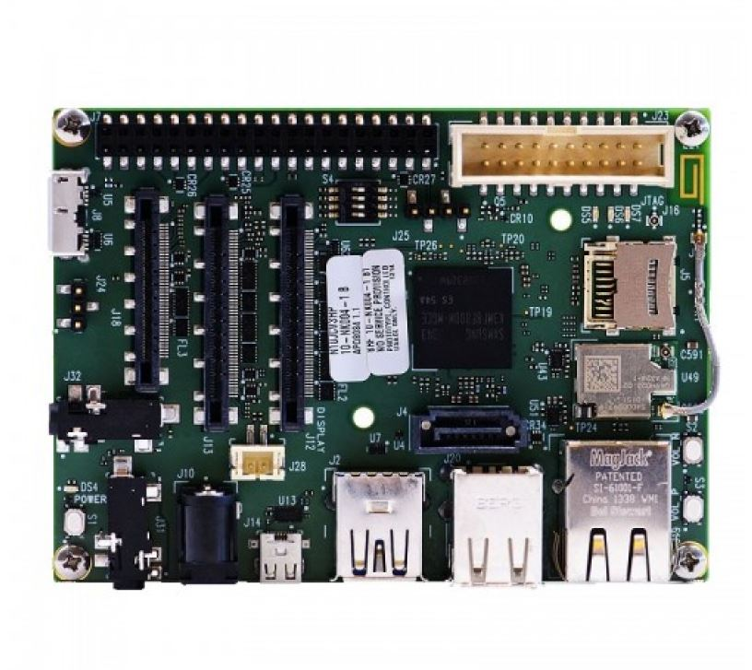
Upstream Support
Qualcomm Adreno A400
Board: Inforce 6540
SOC: Qualcomm 805

Slide 31
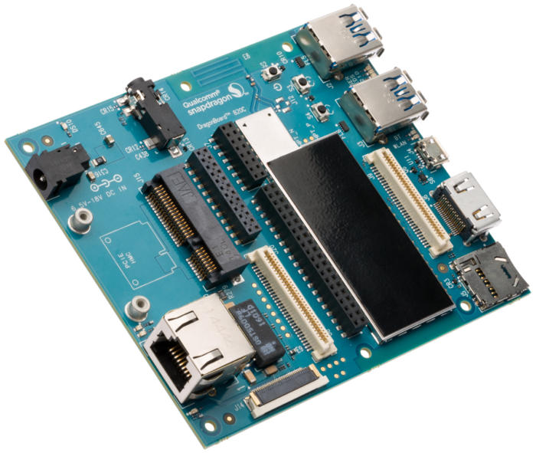
Upstream Support
Qualcomm Adreno A500
Board: Dragonboard 820C
SOC: Qualcomm 820E

Slide 32
Upstream Support
Vivante

Slide 33
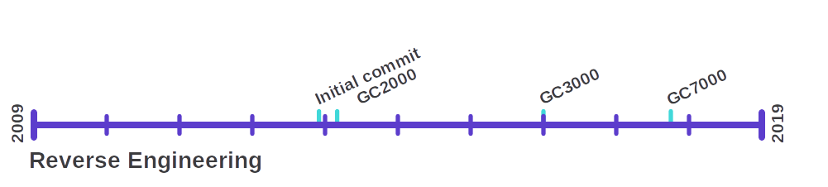
Upstream Support
Vivante
Notes:
Additionally long term support runs the risk of a vendor disappearing.
---
Or ending their support for a product for any number of reasons.
---
Like promoting a newer product or going out of business.

Slide 34
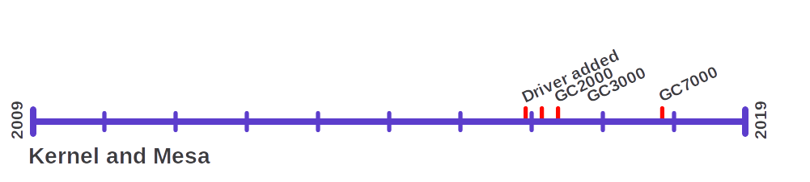
Upstream Support
Vivante

Slide 35
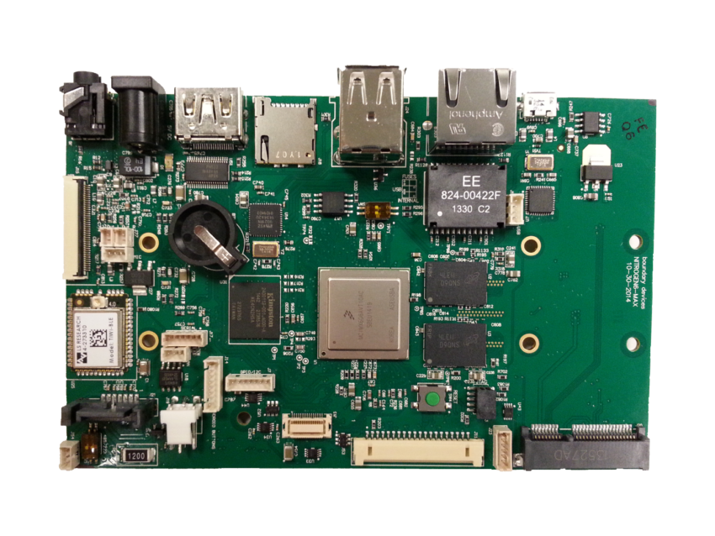
Upstream Support
Vivante GC2000
Board: iMX 6 Sabre
SOC: NXP iMX6q

Slide 36
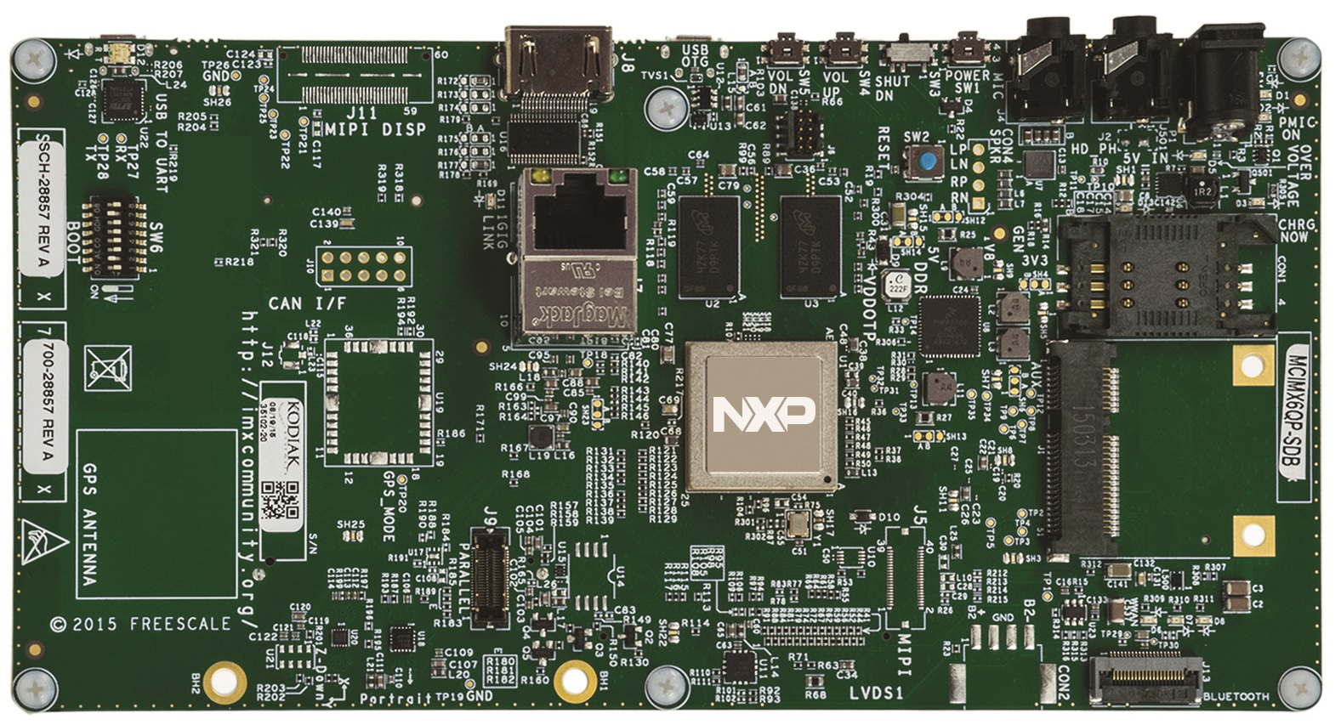
Upstream Support
Vivante GC3000
Board: iMX 6 QP Sabre
SOC: NXP iMX6qp

Slide 37
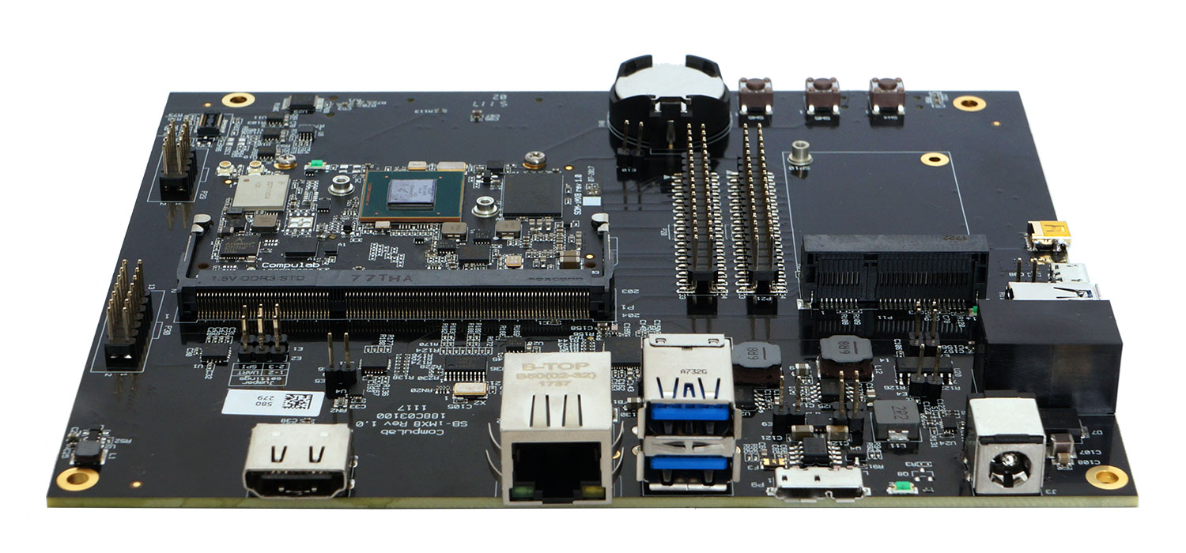
Upstream Support
Vivante GC7000
Board: iMX 8 Devkit
SOC: NXP iMX8

Slide 38
Upstream Support
ARM

Slide 39
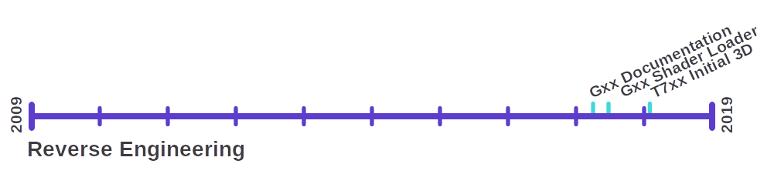
Upstream Support
ARM

Slide 40
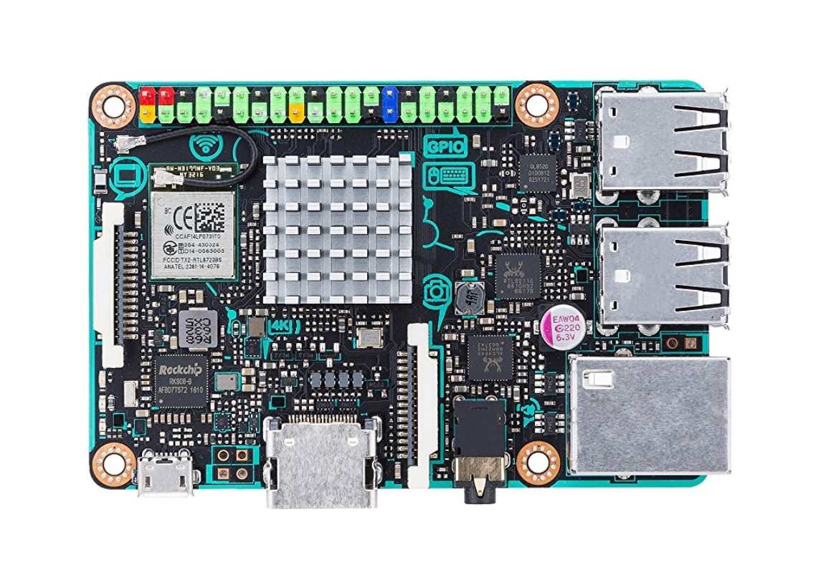
Upstream Support
ARM Mali Txxx
Board: Asus Tinkerboard
SOC: Rockchip RK3288

Slide 41
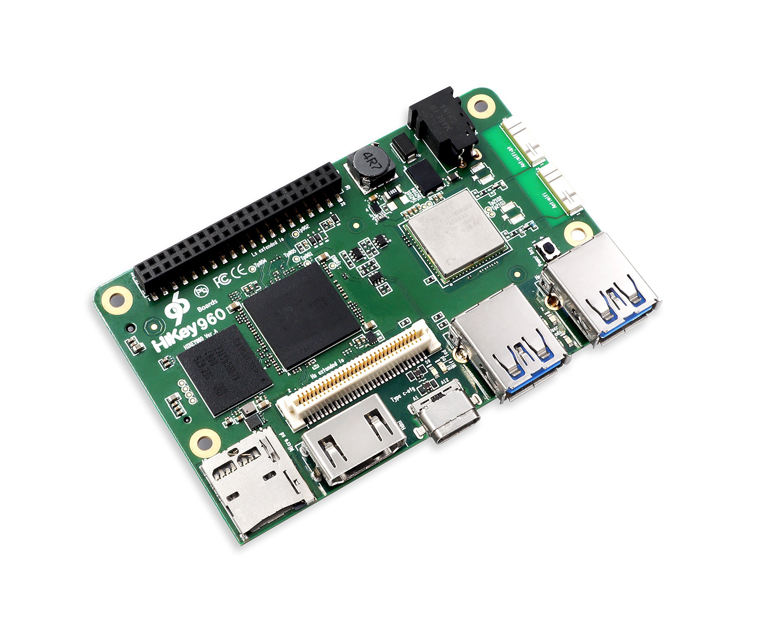
Upstream Support
ARM Mali Gxx
Board: HiKey 960
SOC: HiSilicon Kirin 960

Slide 42
Upstream Support
Imagination

Slide 43
Upstream Support
Imagination
???
Notes:
No major RE
---
No patches landed in upstream
---
Not going to recommend any devkits

Slide 44
What comes next

Slide 45
What Comes Next
OpenGL improvements
Notes:
OpenGL 4.6 still out of reach
---
Some drivers at 4.5

Slide 46
What Comes Next
OpenGL improvements
OpenCL support

Slide 47
What Comes Next
OpenGL improvements
OpenCL support
  Intel OpenCL Neo

Slide 48
What Comes Next
OpenGL improvements
OpenCL support
  Intel OpenCL Neo
  AMD ROCm

Slide 49
What Comes Next
OpenGL improvements
OpenCL support
  Intel OpenCL Neo
  AMD ROCm
  In progress: nouveau

Slide 50
What Comes Next
OpenGL improvements
OpenCL support
  Intel OpenCL Neo
  AMD ROCm
  In progress: nouveau
  In progress: freedreno
Notes:
Currently what is lacking is
---
LLVM OpenCL/spirv support
--
Khronos is involved
---
Mesa drivers support NIR/TGSI
---
Moving to NIR
----
---
Anecdote: ARM Bet heavy on OpenCL
---
Anecdote: ARM OpenCL faster on CPU than Txx
---
Anecdote: ARM Charges for SW and HW

Slide 51
What Comes Next
OpenGL improvements
OpenCL support

Slide 52
What Comes Next
OpenGL improvements
OpenCL support
Vulkan support
Notes:
Vulkan support is more limited

Slide 53
What Comes Next
OpenGL improvements
OpenCL support
Vulkan support
  AMD RADV & AMDVLK
Notes:
Has two implementations
---
RADV being the community one
---
AMDVLK being AMDs non-mesa implementation
---
Vulkan 1.1

Slide 54
What Comes Next
OpenGL improvements
OpenCL support
Vulkan support
  AMD RADV & AMDVLK
  Intel ANV
Notes:
ANV lives in mesa
---
Vulkan 1.1

Slide 55
What Comes Next
OpenGL improvements
OpenCL support
Vulkan support

Slide 56
The Big Picture

Slide 57
The Big Picture
Development

Slide 58
The Big Picture
Development
Some drivers are very mature

Slide 59
The Big Picture
Development
Some drivers are very mature
Non-supported drivers use more common code

Slide 60
The Big Picture
Development
Some drivers are very mature
Non-supported drivers use more common code
Reverse engineering to driver takes 0-3 years

Slide 61
The Big Picture
Development
Some drivers are very mature
Non-supported drivers use more common code
Reverse engineering to driver takes 0-3 years
Vendors support APIs outside usual codebases

Slide 62
The Big Picture
Development
Some drivers are very mature
Non-supported drivers use more common code
Reverse engineering to driver takes 0-3 years
Vendors support APIs outside usual codebases
OpenCL is hard.

Slide 63
The Big Picture
Vendors

Slide 64
The Big Picture
Vendors
Some vendor support is really good

Slide 65
The Big Picture
Vendors
Some vendor support is really good
Open Source drivers come in different shapes

Slide 66
The Big Picture
Vendors
Some vendor support is really good
Open Source drivers come in different shapes
  Vendor supported or not

Slide 67
The Big Picture
Vendors
Some vendor support is really good
Open Source drivers come in different shapes
  Vendor supported or not
  Small vendor teams or not

Slide 68
The Big Picture
Vendors
Some vendor support is really good
Open Source drivers come in different shapes
  Vendor supported or not
  Small vendor teams or not
  Control motivated vendor or not

Slide 69
The Big Picture
Vendors
Some vendor support is really good
Open Source drivers come in different shapes
  Vendor supported or not
  Small vendor teams or not
  Control motivated vendor or not
  NVidia

Slide 70
The Big Picture
Manufacturers

Slide 71
The Big Picture
Manufacturers
Some industries need Open Source

Slide 72
The Big Picture
Manufacturers
Some industries need Open Source
  Surprisingly the Aircraft industry
Notes:
Support for Nvidia Tegra & Vivante platforms sponsored by Aircraft companies

Slide 73
The Big Picture
Manufacturers
Some industries need Open Source
  Surprisingly the Aircraft industry
  Anyone planning for >1year product support

Slide 74
Thank you!

Slide 75
Upstream Support
ARM
Notes:
Additionally long term support runs the risk of a vendor disappearing.
---
Or ending their support for a product for any number of reasons.
---
Like promoting a newer product or going out of business.

Slide 76
Upstream Support
ARM Mali Txxx
Board: Asus Tinkerboard
SOC: Rockchip RK3288
Notes:
Additionally long term support runs the risk of a vendor disappearing.
---
Or ending their support for a product for any number of reasons.
---
Like promoting a newer product or going out of business.

Slide 77
Upstream Support
ARM Mali Gxx
Board: HiKey 960
SOC: HiSilicon Kirin 960
Notes:
Additionally long term support runs the risk of a vendor disappearing.
---
Or ending their support for a product for any number of reasons.
---
Like promoting a newer product or going out of business.

Slide 78
Upstream Support
Broadcom
Notes:
Additionally long term support runs the risk of a vendor disappearing.
---
Or ending their support for a product for any number of reasons.
---
Like promoting a newer product or going out of business.

Slide 79
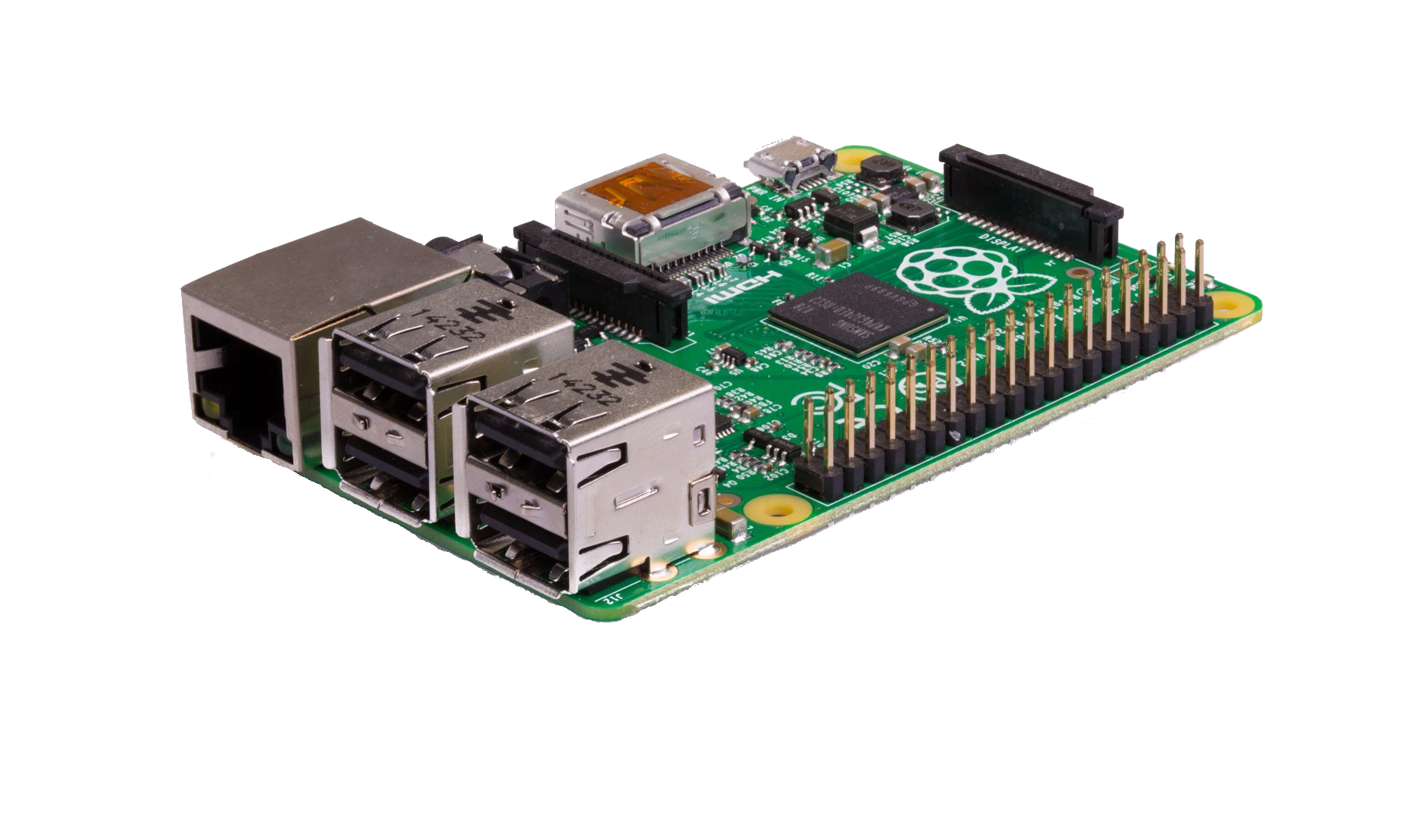
Upstream Support
Broadcom
VC4
Raspberry Pi Model B
Notes:
Additionally long term support runs the risk of a vendor disappearing.
---
Or ending their support for a product for any number of reasons.
---
Like promoting a newer product or going out of business.

Slide 80
Upstream Support
Broadcom
VC4
VC5
BCM7268
???
Notes:
Additionally long term support runs the risk of a vendor disappearing.
---
Or ending their support for a product for any number of reasons.
---
Like promoting a newer product or going out of business.

Slide 81
Upstream Support
Imagination
Notes:
Additionally long term support runs the risk of a vendor disappearing.
---
Or ending their support for a product for any number of reasons.
---
Like promoting a newer product or going out of business.

Slide 82
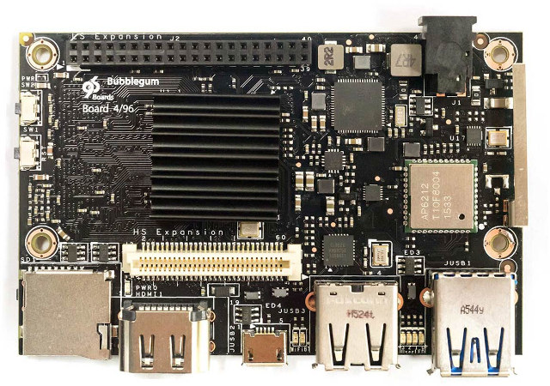
Upstream Support
Imagination
Rogue
Bubblegum 96
Notes:
Additionally long term support runs the risk of a vendor disappearing.
---
Or ending their support for a product for any number of reasons.
---
Like promoting a newer product or going out of business.

Slide 83
Upstream Support
NVidia
Notes:
Additionally long term support runs the risk of a vendor disappearing.
---
Or ending their support for a product for any number of reasons.
---
Like promoting a newer product or going out of business.

Slide 84
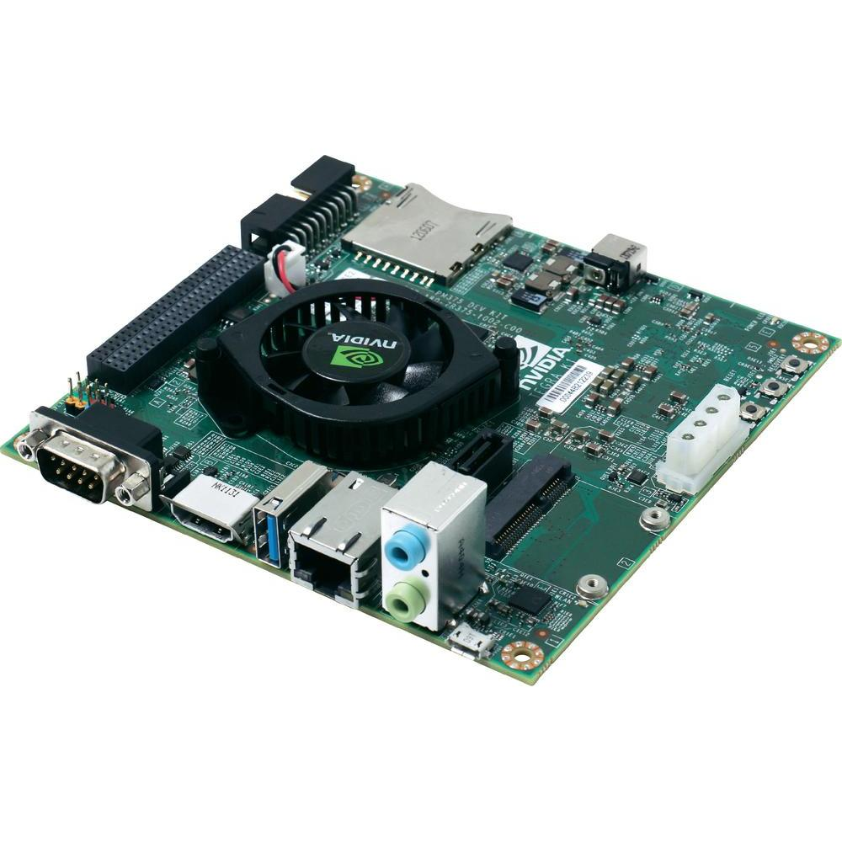
Upstream Support
NVidia
Kepler
Tegra K1
Notes:
Additionally long term support runs the risk of a vendor disappearing.
---
Or ending their support for a product for any number of reasons.
---
Like promoting a newer product or going out of business.

Slide 85
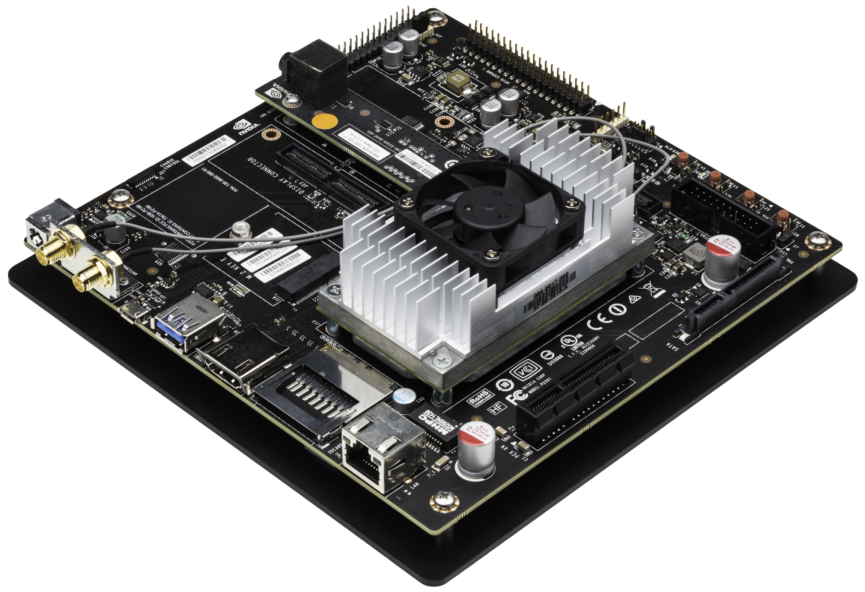
Upstream Support
NVidia
Kepler
Maxwell
Tegra X1
Notes:
Additionally long term support runs the risk of a vendor disappearing.
---
Or ending their support for a product for any number of reasons.
---
Like promoting a newer product or going out of business.

Slide 86
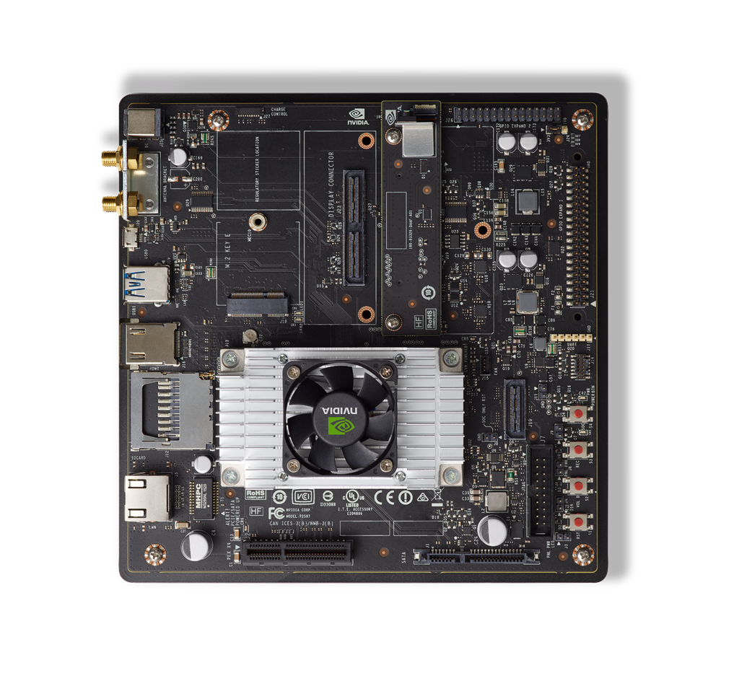
Upstream Support
NVidia
Kepler
Maxwell
Pascal
Tegra X2
Notes:
Additionally long term support runs the risk of a vendor disappearing.
---
Or ending their support for a product for any number of reasons.
---
Like promoting a newer product or going out of business.

Slide 87
Upstream Support
Qualcomm
Notes:
Additionally long term support runs the risk of a vendor disappearing.
---
Or ending their support for a product for any number of reasons.
---
Like promoting a newer product or going out of business.

Slide 88
Upstream Support
Qualcomm
Adreno 2xx
i.MX53
Notes:
Additionally long term support runs the risk of a vendor disappearing.
---
Or ending their support for a product for any number of reasons.
---
Like promoting a newer product or going out of business.

Slide 89
Upstream Support
Qualcomm
Adreno 2xx
Adreno 3xx
Dragonboard 410c
Notes:
Additionally long term support runs the risk of a vendor disappearing.
---
Or ending their support for a product for any number of reasons.
---
Like promoting a newer product or going out of business.

Slide 90
Upstream Support
Qualcomm
Adreno 2xx
Adreno 3xx
Adreno 4xx
Inforce 6540
Notes:
Additionally long term support runs the risk of a vendor disappearing.
---
Or ending their support for a product for any number of reasons.
---
Like promoting a newer product or going out of business.

Slide 91
Upstream Support
Qualcomm
Adreno 2xx
Adreno 3xx
Adreno 4xx
Adreno 5xx
Dragonboard 820c
Notes:
Additionally long term support runs the risk of a vendor disappearing.
---
Or ending their support for a product for any number of reasons.
---
Like promoting a newer product or going out of business.

Slide 92
Upstream Support
Vivante
Notes:
Additionally long term support runs the risk of a vendor disappearing.
---
Or ending their support for a product for any number of reasons.
---
Like promoting a newer product or going out of business.

Slide 93
Upstream Support
Vivante
GC2000
i.MX6 Sabre
Notes:
Additionally long term support runs the risk of a vendor disappearing.
---
Or ending their support for a product for any number of reasons.
---
Like promoting a newer product or going out of business.

Slide 94
Upstream Support
Vivante
GC2000
GC3000
i.MX6 QP Sabre
Notes:
Additionally long term support runs the risk of a vendor disappearing.
---
Or ending their support for a product for any number of reasons.
---
Like promoting a newer product or going out of business.

Slide 95
Upstream Support
Vivante
GC2000
GC3000
GC7000
i.MX8 Devkit
Notes:
Additionally long term support runs the risk of a vendor disappearing.
---
Or ending their support for a product for any number of reasons.
---
Like promoting a newer product or going out of business.

