Slide 1
Update
Robert Foster
07.11.18

Slide 2
Outline
Single IFUs vs Multifits
  Method of Comparison
  Result
Model vs Data
  Method of Comparison
  Extremity of Variations
  Over- vs Under- Estimation
Comparison Program

Slide 3
Single IFUs vs Multifits – Method
Wanted to be able to compare the same data directly
Compared data from the same day that were reduced once by me and once in the multifits form
Normalized both (as values were very different)
Took the absolute value of the difference between the two

Slide 4
Single IFUs vs Multifits - Result
It should be noted that this processes was not checked on very many different days or sets of data
However, the information I did check was promising
The average difference between the single IFU values and the multifits ones was 1.537%
There was, however, a standard deviation of 4.078% seen
Overall, I felt that these values meant that the multifits data could be used, without double checking with the single
So, the following were calculated only with the multifits reduced data

Slide 5
Model vs Data – Method of Comparison
It is slightly difficult to compare the model to what the data is actually seeing, due to the fact that the model can be asked for a single moment, while the actual data is a sum of a long term view
So, model values had to be collected for many moments along the path of travel of the exposure, and then integrated to get an actual value that could be compared to the seen data
Once this was done, the values were compared in a similar way to what was explained above: the absolute value of the differences of the normalized matrices

Slide 6
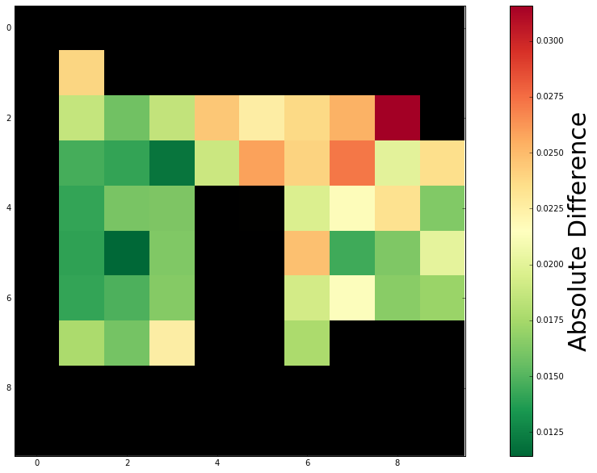
Model vs Data – Extremity of Variations
One of the first things checked was how extreme the differences between the model and data was
This graph was produced with data from Sept. 10. Each IFU was compared with the model
As can be seen, the left side of the focal plane is consistently the most accurately described by the model
The upper right part of the plane is the least accurately modelled
For the entire plane an average difference of 1.893% was found, with a standard deviation of 0.446%

Slide 7
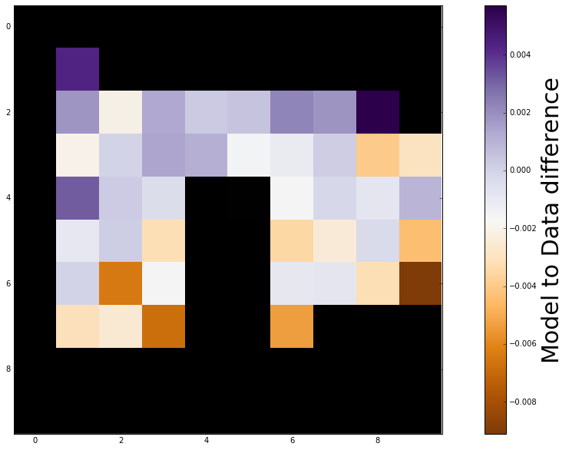
Model vs Data – Over- vs Under-prediction
A similar calculation was carried out, but to see where the model over predicted the data, and where it under predicted
The graph shows that the upper-left portion was mostly over-predicted, while the lower-right was mostly under-predicted
The total average for the field is -0.090%, with a standard deviation of 0.283%

Slide 8
Comparison Program
I have completed a program that will allow someone to compare the values of different IFUs
Currently, one would provide a list of IFUs, which would then be processed, producing a comparative matrix and errors
  matrix, errors = multifits_output_error(files)
Once this is done, a list of IFUs and exposures can be provided, along with the IFU that one would like to compare them to
  ifu_multi_compare(matrix,ifus,exps,'045','0')

Slide 9
Conclusion
A quick overview of the steps completed have been given
Actual data, examples, and the programs used can be given upon request
If there are any changes or additions you would like to see done, I would be happy to work on them

