Slide 2
Question.

Slide 3
Can we deliver

Slide 4
more functionality

Slide 5
faster

Slide 6
with fewer defects

Slide 7
today

Slide 8
with our code in its current state?

Slide 9
Let’s look at an example

Slide 10
************.java
An example from our system

Slide 11
51 commits
Over four months
Across 3 different pods

Slide 12
Initial commit = 276 lines

Slide 13
Current LOC = 859 lines

Slide 14
Initial coverage = 0%

Slide 15
Highest Cyclomatic Complexity = 25

Slide 16
Code reviews = 9

Slide 17
Reverts = 3

Slide 18
Bug “fixes” = 20
(based on commit comments)

Slide 19
How did this happen?
51 commits
859 LOC
0% Coverage
9 Reviews
2 Reverts
20 Bug Fixes

Slide 20
Our code is getting more complex

Slide 21
More difficult to change
Notes:
Image Source: http://cdn.techi.com/wp-content/uploads/2010/06/smashedComputer-1024x799.jpg

Slide 22
Making it easier to introduce new defects

Slide 23
Defect cycles get longer…

Slide 24
Delaying releases

Slide 25
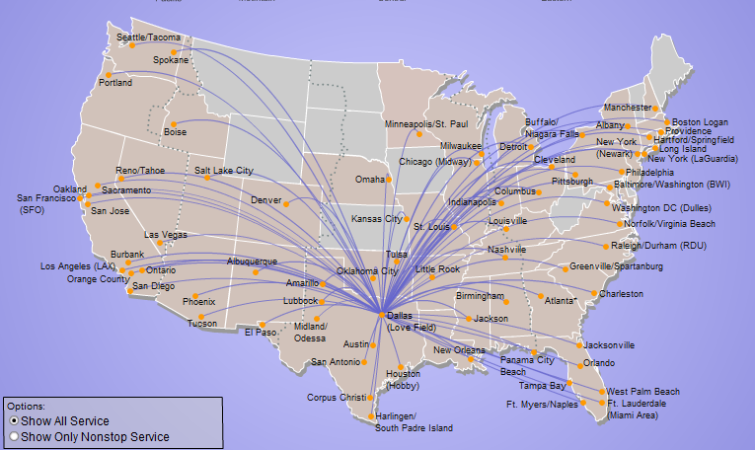
Which keeps us from this…

Slide 26
Why does this happen?

Slide 27
Many of our check-ins create additional risk that we will not deliver quality software on time in the future.

Slide 28
What can we do about it?

Slide 29
Big-bang rewrite?

Slide 30
We already did this once
(and it’s really expensive)

Slide 31
Large refactoring effort?

Slide 32
What do we do about turnover?

Slide 33
We’d end up right here again in a year or two

Slide 34
We need to improve incrementally

Slide 35
while adding value to our Customers

Slide 36
How?

Slide 37
Incremental Improvement

Slide 38
Each commit should not make the system worse

Slide 39
Each commit to a risky area, should make the area better

Slide 40
Why focus on risky areas?

Slide 41
Risky areas breed defects

Slide 42
What does a risky class look like?

Slide 43
PurchaseController
“I wouldn’t touch it with a 10-foot pole!”

Slide 44
High-cyclomatic Complexity

Slide 45
Low Code Coverage

Slide 46
High Code Churn
How much has the file changed recently?

Slide 47
High Contributor Diversity
How many different teams are working in the same places?

Slide 48
Lots of defects logged…

Slide 49
PurchaseController is 1681LOC
What about the rest of the system?

Slide 50
Where do we start?
*

Slide 51
Continuous quality improvement

Slide 52
In areas most likely to impact the business.

Slide 53
What does that look like?

Slide 54
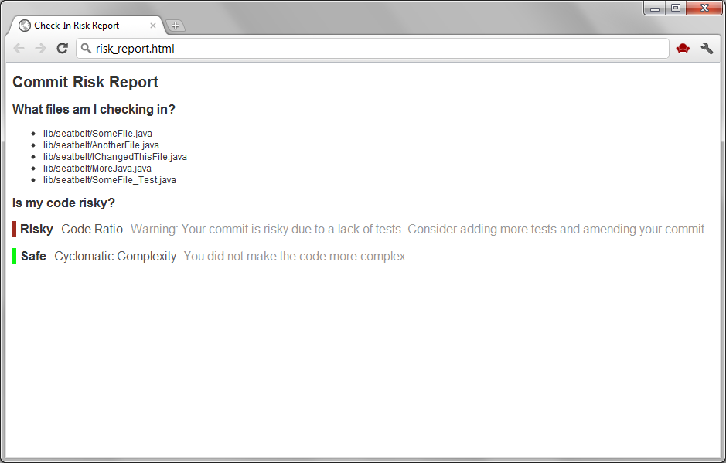

Slide 55
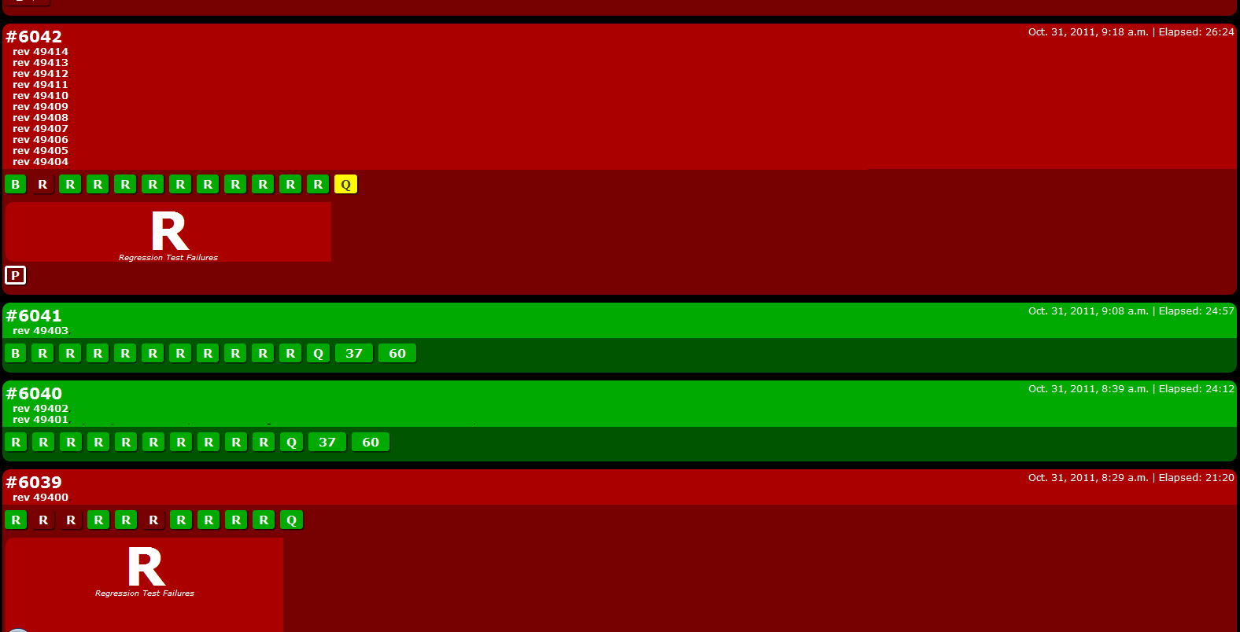

Slide 56
Churn Complexity Coverage Contributor Diversity

Slide 57
Each commit should not make the system worse

Slide 58
Each commit to a risky area, should make the area better

Slide 59
How does this affect me?

Slide 60
A typical developer workflow

Slide 61
A developer is ready to commit code changes

Slide 62
Run check-in script

Slide 63
Build and run tests
(we already do this)

Slide 64
Calculate risk locally
(this is new)

Slide 65
Static quality analysis
(also new)

Slide 66
View report
Risk
Quality

Slide 68
Improve your code!
Use the report as guidance

Slide 69
Re-run check-in script
Verify your new changes helped

Slide 70
Commit!

Slide 71
If your commit is risky
(Risky code doesn’t always mean bad code.)

Slide 72
A code review is generated automatically using Gerrit.
(coming soon)

Slide 73
and assigned randomly to someone who has previously modified the file.

Slide 74
or to a trusted verifier

Slide 75
Make improvements based on code review feedback.

Slide 76
Rinse and repeat

Slide 77
What’s next?
Roadmap

Slide 78
Now

Slide 79
Add “Q” to the Radiator

Slide 80
Check-in script
Know what you are getting in to before you commit!

Slide 81
Detailed Risk/Quality Report

Slide 82
Weeks

Slide 83
Automated code reviews

Slide 84
Add additional heuristics to Radiator

Slide 85
Are we turning enough Qs yellow?

Slide 86
Months

Slide 87
Are our code reviews effective?

Slide 88
Sonar
Are we getting better from a static analysis standpoint?

Slide 89
Fine tune heuristics

Slide 90
Long term

Slide 91
Did defects decrease?

Slide 92
Are we releasing on time?

Slide 93
Questions?
Comments?
Concerns?

