Slide 1
Testing JavaScript
with Jasmine

Slide 2

Why should we test JavaScript?

Slide 3
How many times have you changed something in JavaScript

Slide 4

Only to break something else?

Slide 5
JavaScript = Production Code!

Slide 6
Which means, we need to treat it with respect

Slide 7
And, preserve the ability to

Slide 8
change

Slide 9
fix

Slide 10
clean

Slide 11
and refactor our JavaScript code

Slide 12
Without fear of breaking something

Slide 13
Testing is especially important when external factors can affect how our code functions

Slide 14
What makes a good test?

Slide 15
Think F.I.R.S.T

Slide 16
Fast

Slide 17
Independent
Tests should not depend on each other.

Slide 18
Repeatable
Always the same results, regardless of environment.

Slide 19
Self-Validating
Pass or Fail
No manual evalutation.

Slide 20
Timely
Write tests before production code.

Slide 21
Let’s look at an example.
A random function for rolling a die.

Slide 22
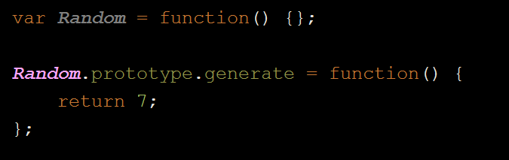
What’s wrong here?

Slide 23
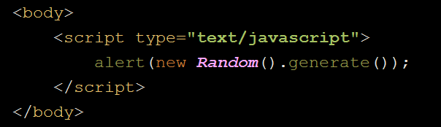
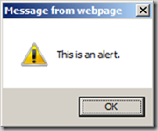
How do we normally debug JavaScript?

Slide 24

Let’s forget we even mentioned that…

Slide 26
So… we have this buggy code.

Slide 27

What do we do about it?

Slide 28
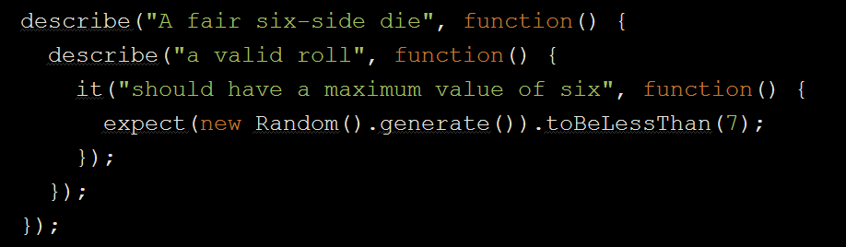
Write a failing test

Slide 29
And put it with our other Jasmine tests
commerce-project/web/src/
test/javascript_jasmine/spec/
jsName.spec.js

Slide 30
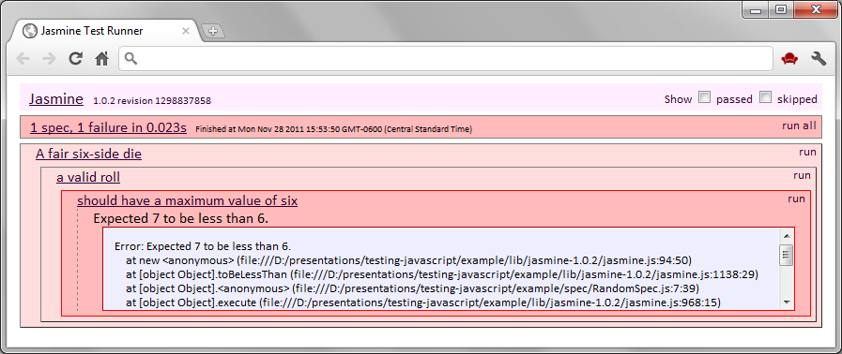

Then Run the test to see it fail
This is SpecRunner.html

Slide 31
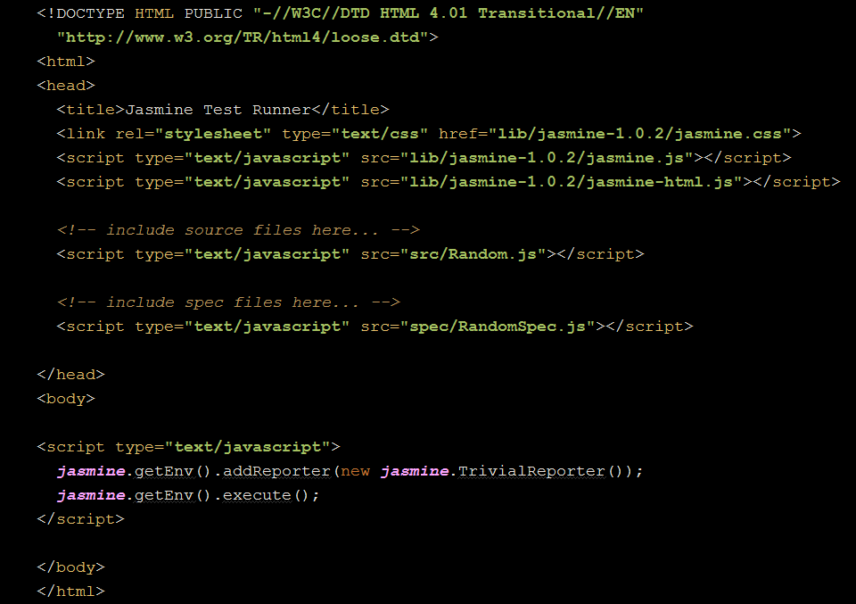
SpecRunner.html

Slide 32
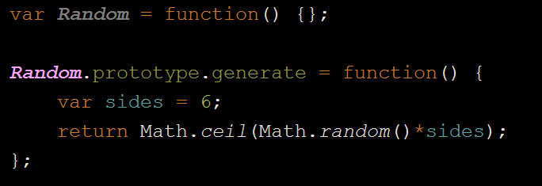
Squash the bug

Slide 33
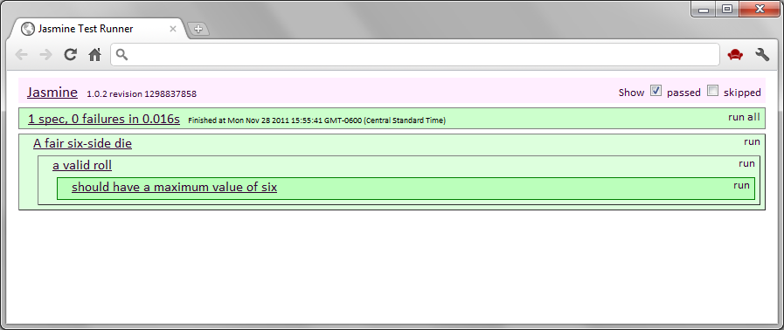
Success!

Slide 34
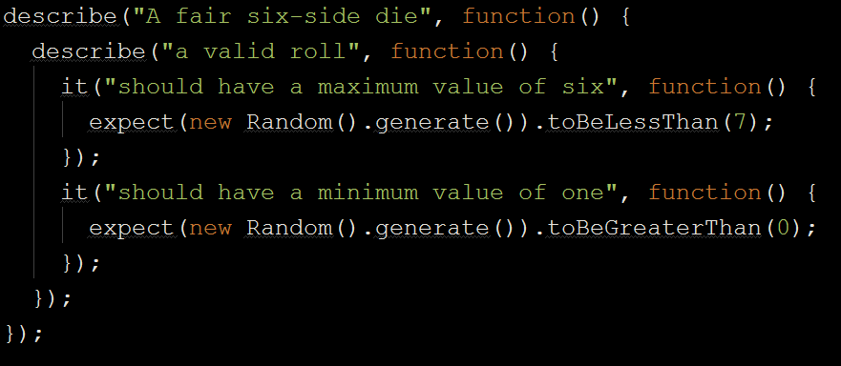
Add more tests

Slide 35
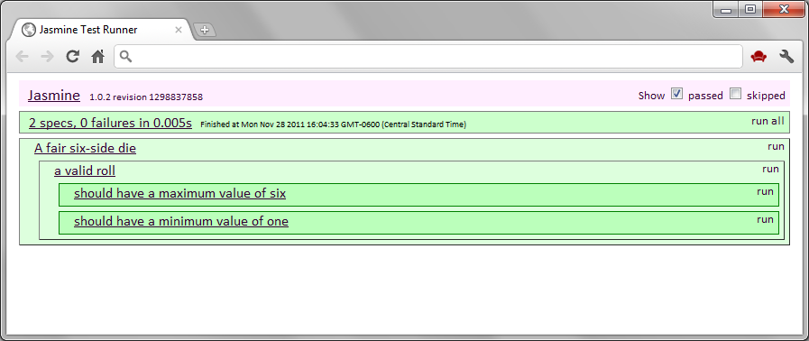

Win!
Testing = Documentation!

Slide 36

Remember…

Slide 37

When you find yourself wanting to do this.

Slide 38

Write a test instead!

Slide 39

Questions?

