Slide 1
Testing JavaScript
with Jasmine

Slide 2
Why should we test JavaScript?

Slide 3
How many times have you changed something in JavaScript

Slide 4

Only to break something else?

Slide 5
JavaScript = Production Code!

Slide 6
Which means, we need to be able to…

Slide 7
change

Slide 8
fix

Slide 9
clean

Slide 10
and refactor our JavaScript code

Slide 11
Without fear of breaking something

Slide 12
Testing is especially important when external factors can affect how our code functions

Slide 13
What makes a good test?

Slide 14
Think F.I.R.S.T

Slide 15
Fast

Slide 16
Independent
Tests should not depend on each other.

Slide 17
Repeatable
Always the same results, regardless of environment.

Slide 18
Self-Validating
Pass or Fail
No manual evalutation.

Slide 19
Timely
Write tests before production code.

Slide 20
Let’s look at an example.
A random function for rolling a die.

Slide 21
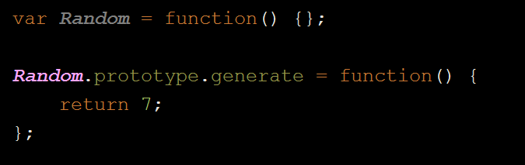
What’s wrong here?

Slide 22
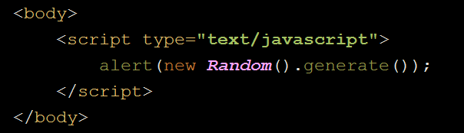
How do we normally debug JavaScript?

Slide 23

Let’s forget we even mentioned that…

Slide 25
So… we have this buggy code.

Slide 26

What do we do about it?

Slide 27
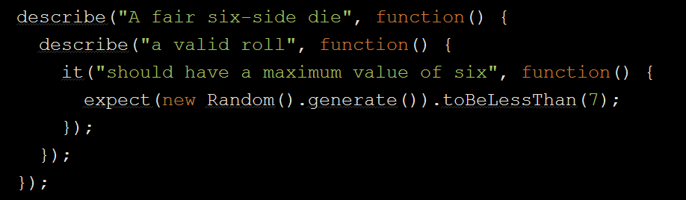
Write a failing test

Slide 28
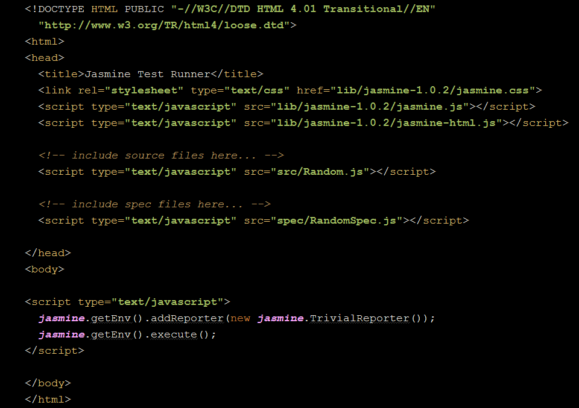
SpecRunner.html

Slide 29
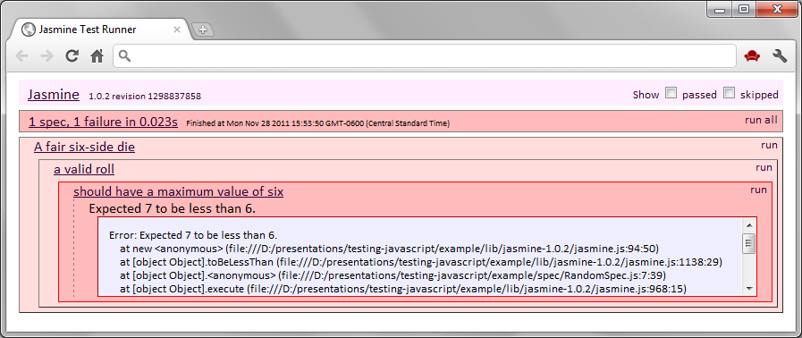
Yay!

Slide 30
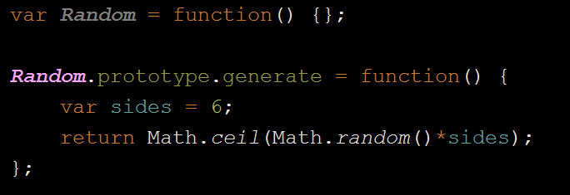
Squash the bug

Slide 31
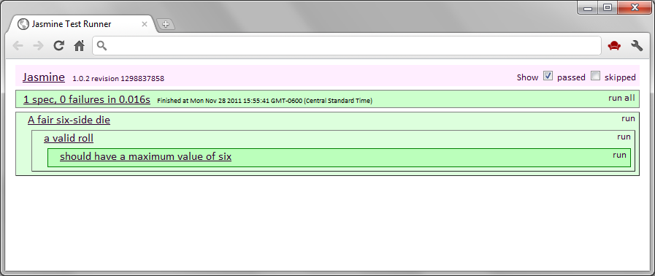
Success!

Slide 32
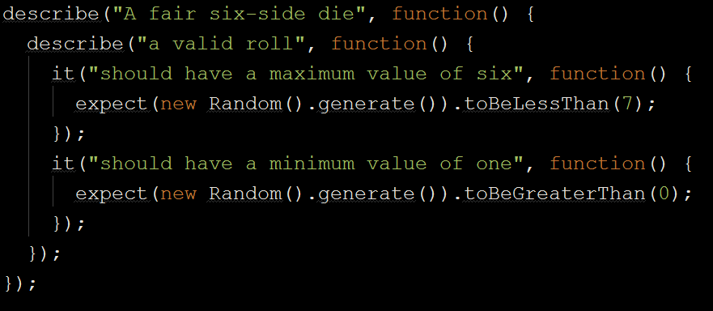
Add more tests

Slide 33
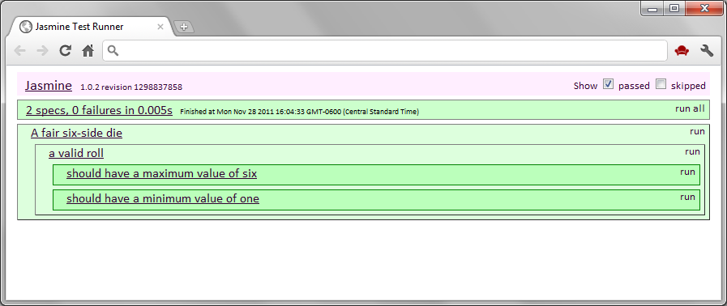

Win!
Testing = Documentation!

Slide 34

Remember…

Slide 35

When you find yourself wanting to do this.

Slide 36

Write a test instead!

Slide 37

Questions?

