Slide 1
Testing JavaScript
with Jasmine

Slide 2

Why should we test JavaScript?

Slide 3
How many times have you changed something in JavaScript

Slide 4

Only to break something else?

Slide 5
JavaScript = Production Code!

Slide 6
Which means, we need to treat it with respect

Slide 7
And, preserve the ability to

Slide 8
change

Slide 9
fix

Slide 10
clean

Slide 11
and refactor our JavaScript code

Slide 12
Without fear of breaking something

Slide 13
Testing is especially important when external factors can affect how our code functions

Slide 14
What makes a good test?

Slide 15
Think F.I.R.S.T

Slide 16
Fast

Slide 17
Independent
Tests should not depend on each other.

Slide 18
Repeatable
Always the same results, regardless of environment.

Slide 19
Self-Validating
Pass or Fail
No manual evalutation.

Slide 20
Timely
Write tests before production code.

Slide 21
Let’s look at an example.
A random function for rolling a die.

Slide 22
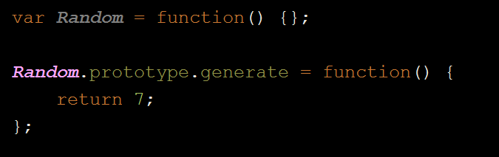
What’s wrong here?

Slide 23
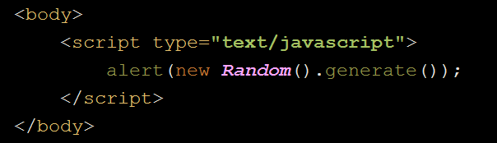
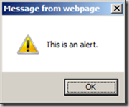
How do we normally debug JavaScript?

Slide 24

Let’s forget we even mentioned that…

Slide 26
So… we have this buggy code.

Slide 27

What do we do about it?

Slide 28
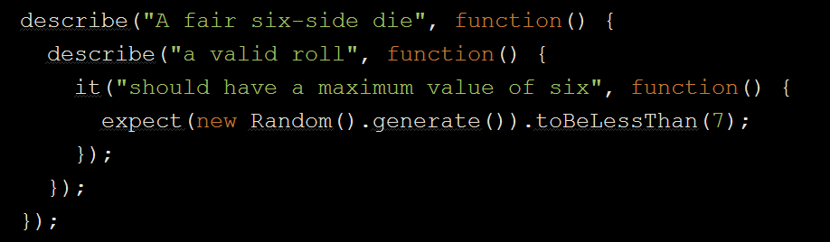
Write a failing test

Slide 29
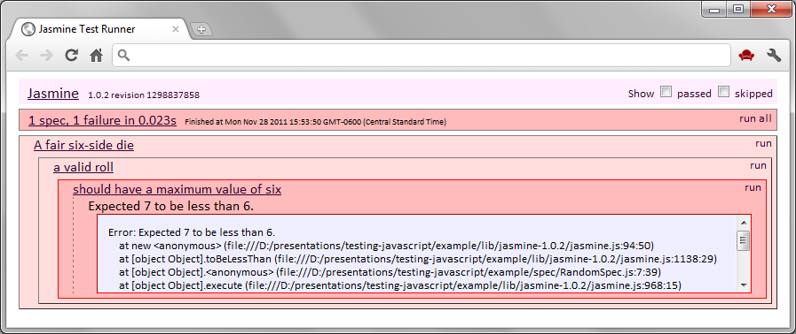
Then Run the test to see it fail

Slide 30
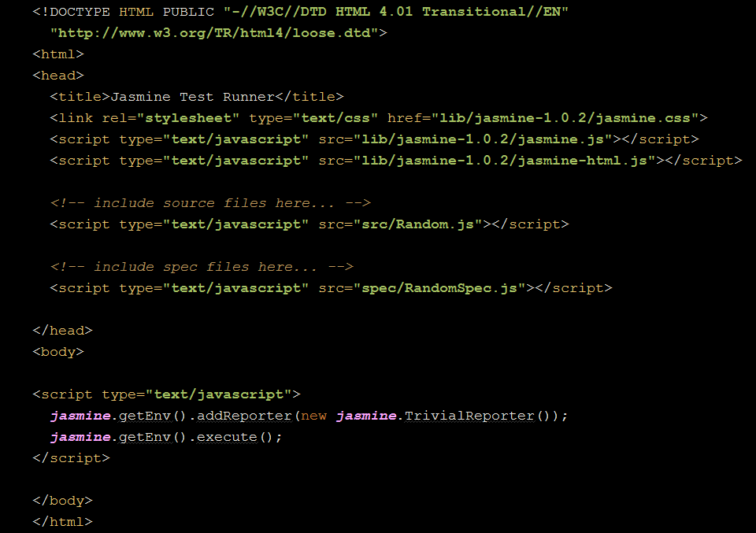

SpecRunner.html

Slide 31
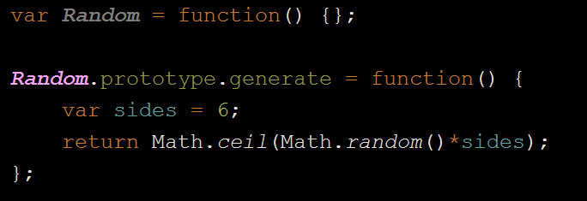
Squash the bug

Slide 32
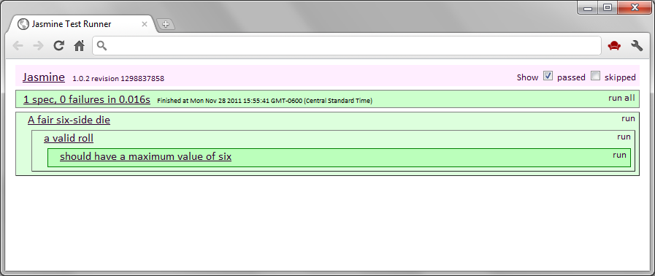
Success!

Slide 33
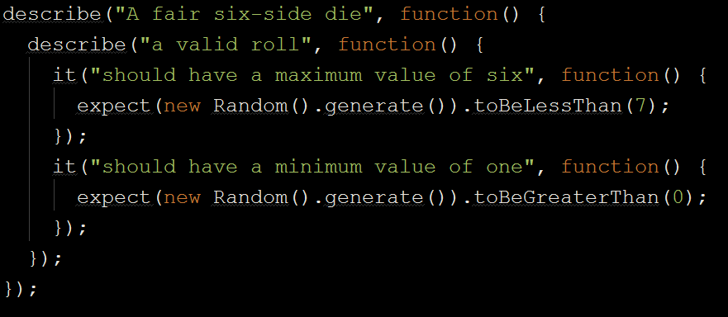
Add more tests

Slide 34
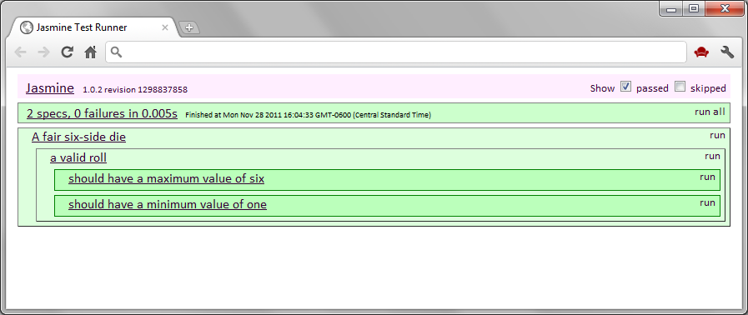

Win!
Testing = Documentation!

Slide 35

Remember…

Slide 36

When you find yourself wanting to do this.

Slide 37

Write a test instead!

Slide 38

Questions?

