Slide 1
Testing JavaScript
with Jasmine

Slide 2
Why should we test JavaScript?

Slide 3
JavaScript = Production Code!

Slide 4
How many times have you changed something in JavaScript

Slide 5
Only to break something else un-related?

Slide 6
Which means, we need to be able to…

Slide 7
change

Slide 8
fix

Slide 9
clean

Slide 10
and refactor our JavaScript code

Slide 11
Without fear of breaking something

Slide 12
Testing is especially important when external factors can affect how our code functions

Slide 13
What makes a good test?

Slide 14
Think F.I.R.S.T

Slide 15
Fast

Slide 16
Independent
Tests should not depend on each other.

Slide 17
Repeatable
Always the same results, regardless of environment.

Slide 18
Self-Validating
Pass or Fail
No manual evalutation.

Slide 19
Timely
Write tests before production code.

Slide 20
Let’s look at an example.

Slide 21

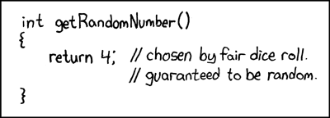
A function to test

Slide 22
Fail!!
Alert()

Slide 23
When you find yourself wanting to use alert()

Slide 24
Write a test!

Slide 25
Fix the random function

Slide 26
Set Up

Slide 27
SpecRunner stuff here
TODO

Slide 28
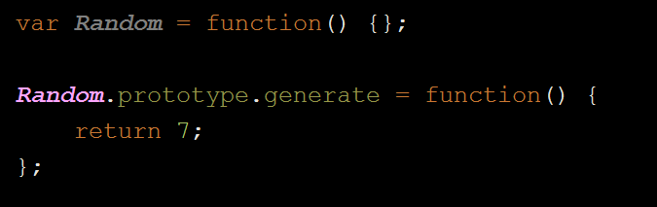
Buggy code

Slide 29
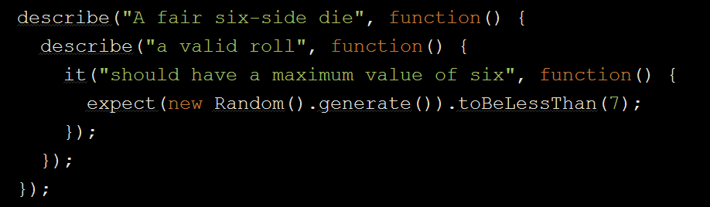
Write a failing test

Slide 30
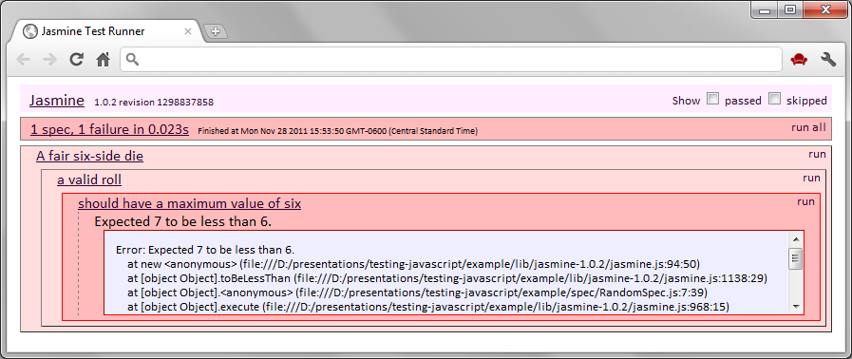
Yay!

Slide 31
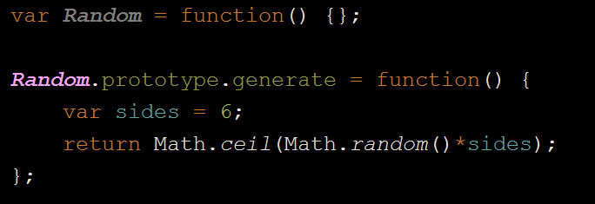
Squash the bug

Slide 32
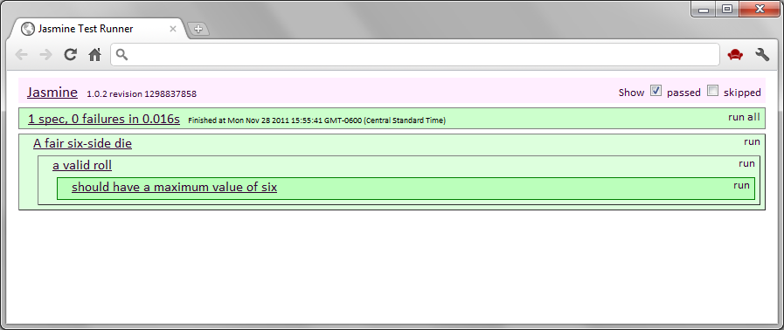
Success!

Slide 33
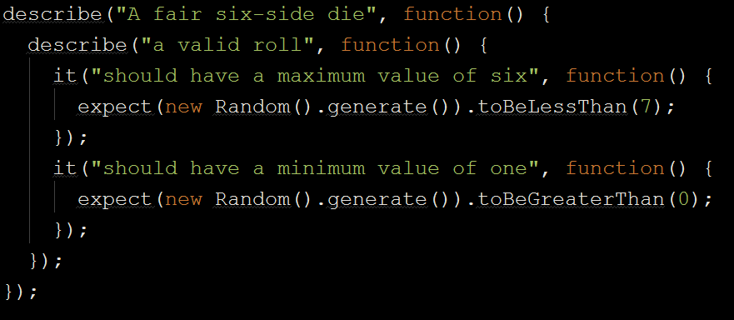
Add more tests

Slide 34
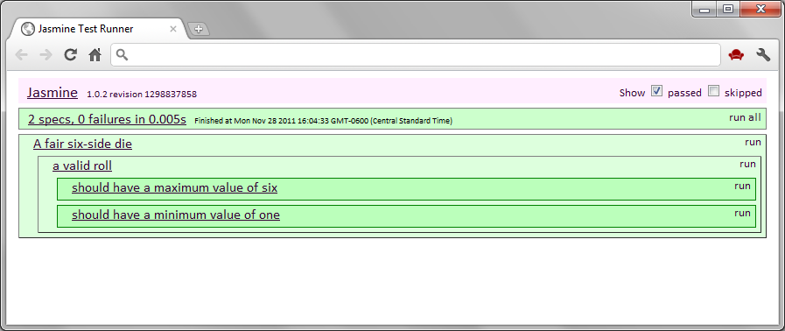

Win!
Testing = Documentation!

