Slide 1
We’re here to make you think about code and get sad and stuff

Slide 2
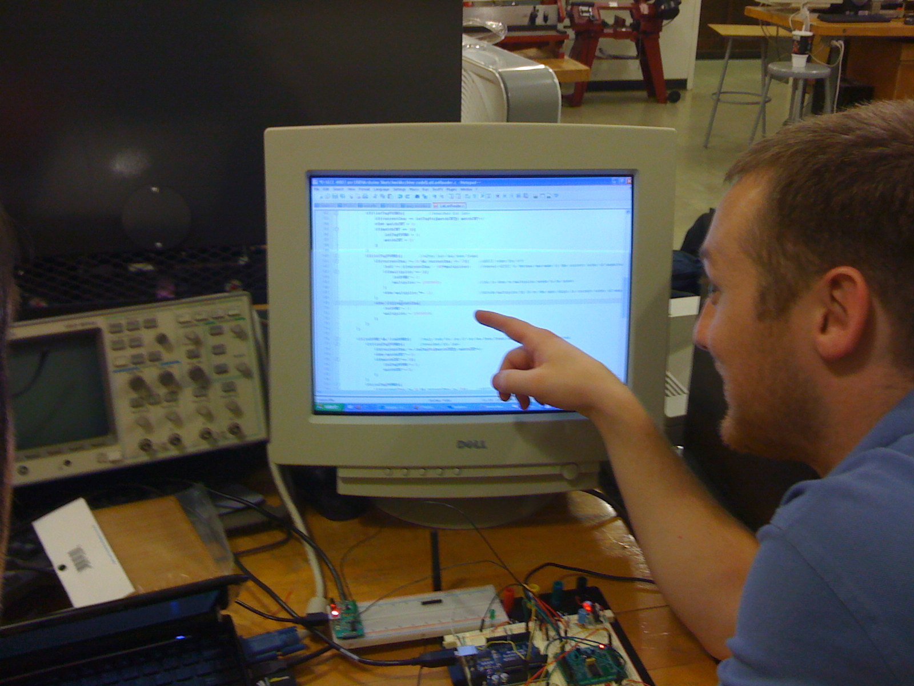
So, I was hanging out in production
Notes:
So, I was hanging out in production

Slide 3
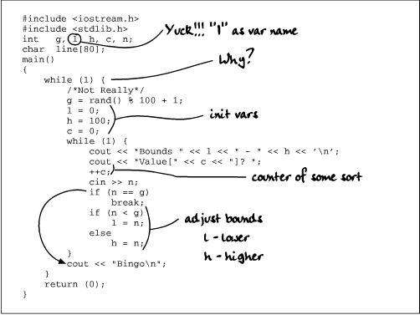
Notes:
Fixing code and stuff

Slide 4
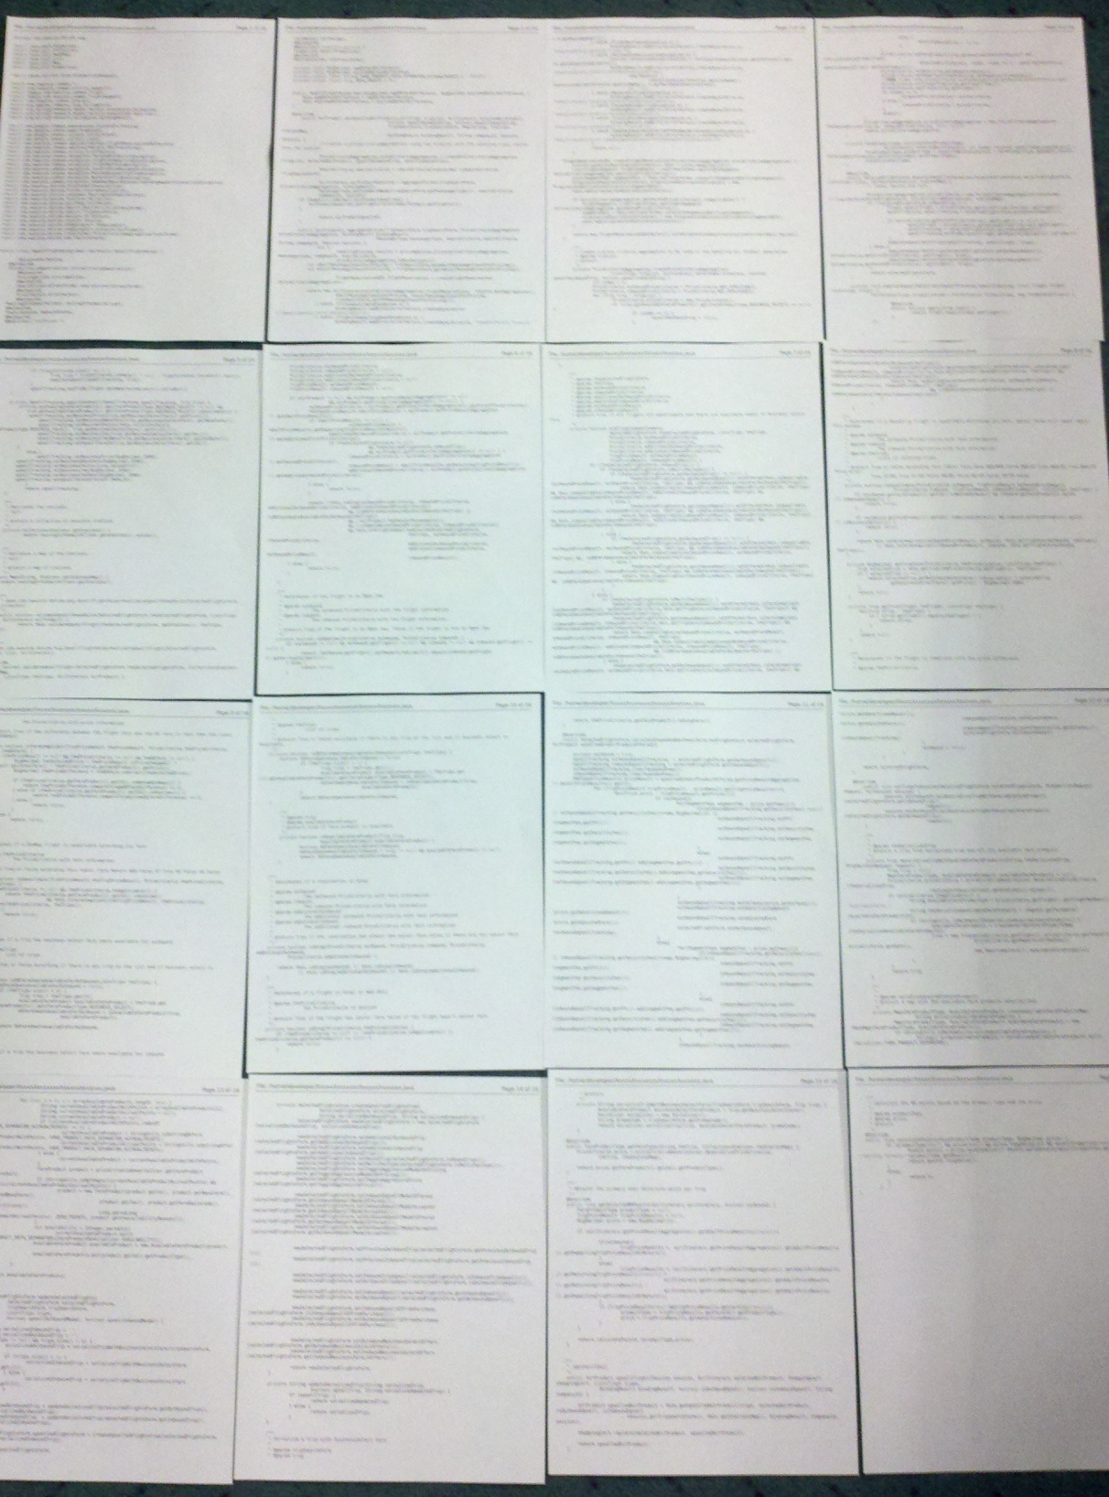
Notes:
When I came across this file, yes, that’s really the file.

Slide 5
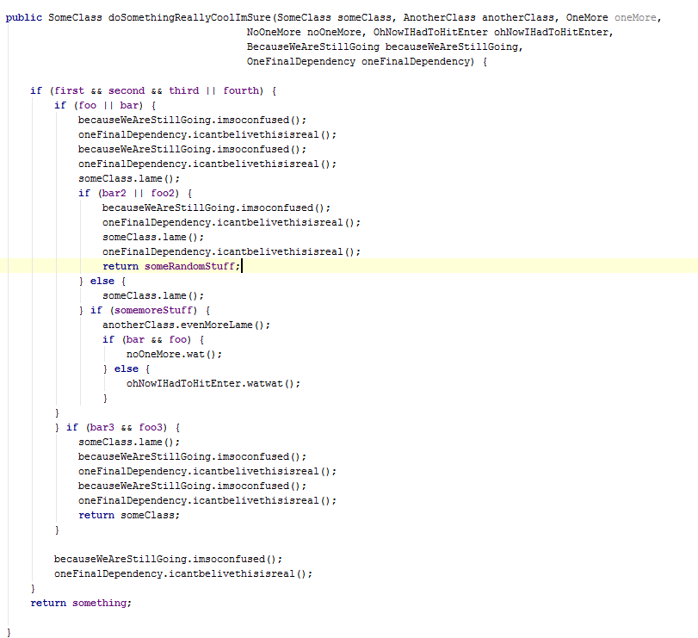
Notes:
And it had stuff like this in it.

Slide 6
Notes:
And this

Slide 7
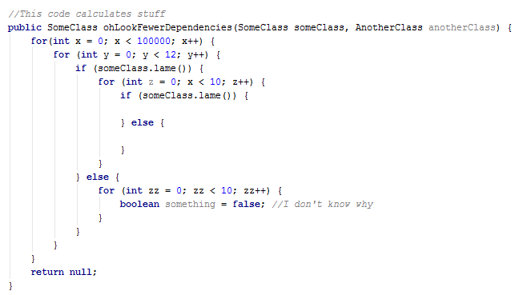
Notes:
Which is actually this

Slide 8
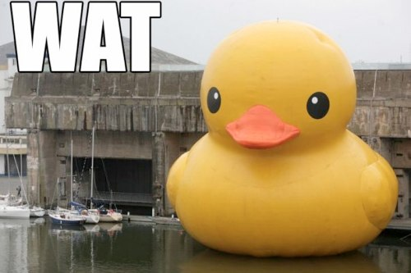

Slide 9
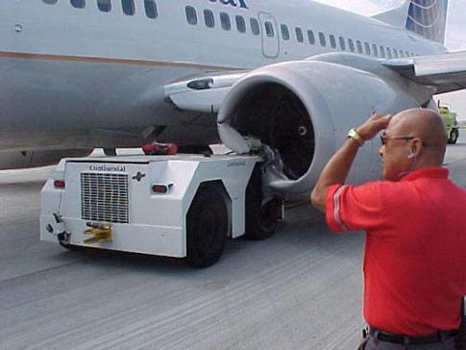

Slide 10

Notes:
Let’s look at some stats and try to get to the bottom of this?

