Slide 1
Notes:
Quality Logo

Slide 2
Notes:
So, I was hanging out at work one day

Slide 3
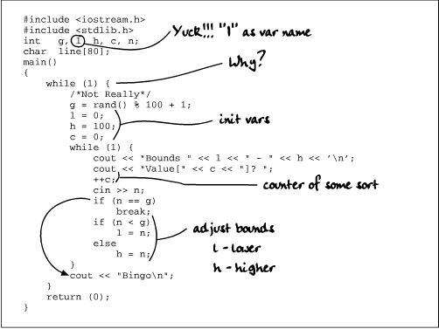
Notes:
Fixing code and stuff

Slide 4
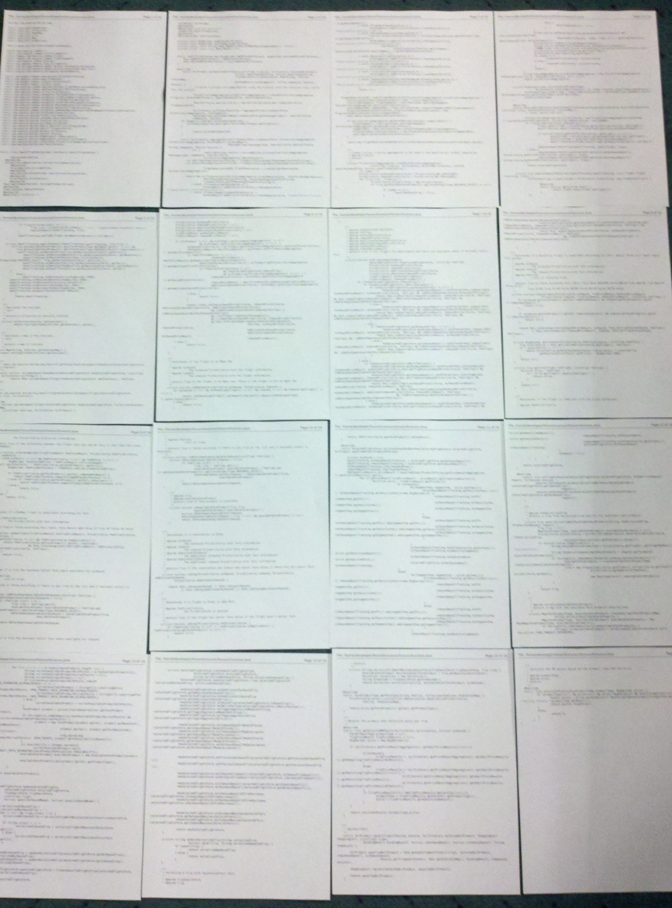
Notes:
When I came across this file, yes, that’s really the file.

Slide 5

Notes:
Wat!?

Slide 6
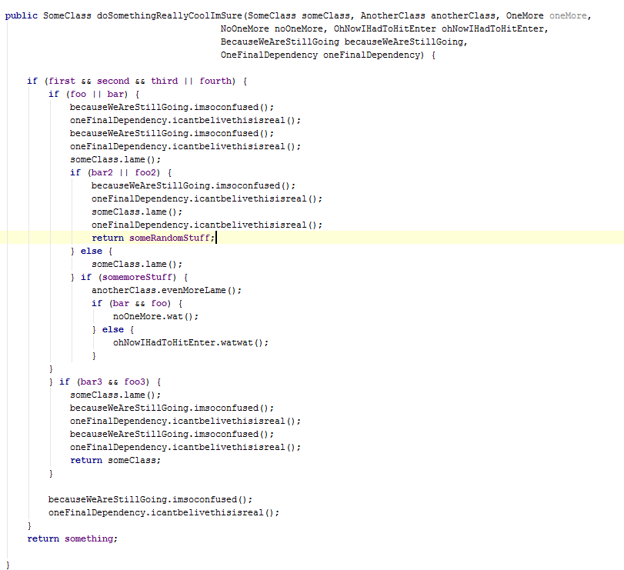
Notes:
This was the first method I saw

Slide 7
Notes:
And this… wait… that’s not so bad

Slide 8
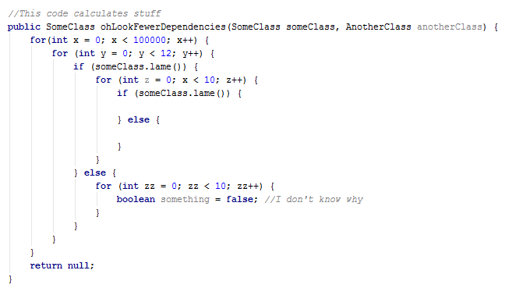
Notes:
Nevermind….

Slide 9
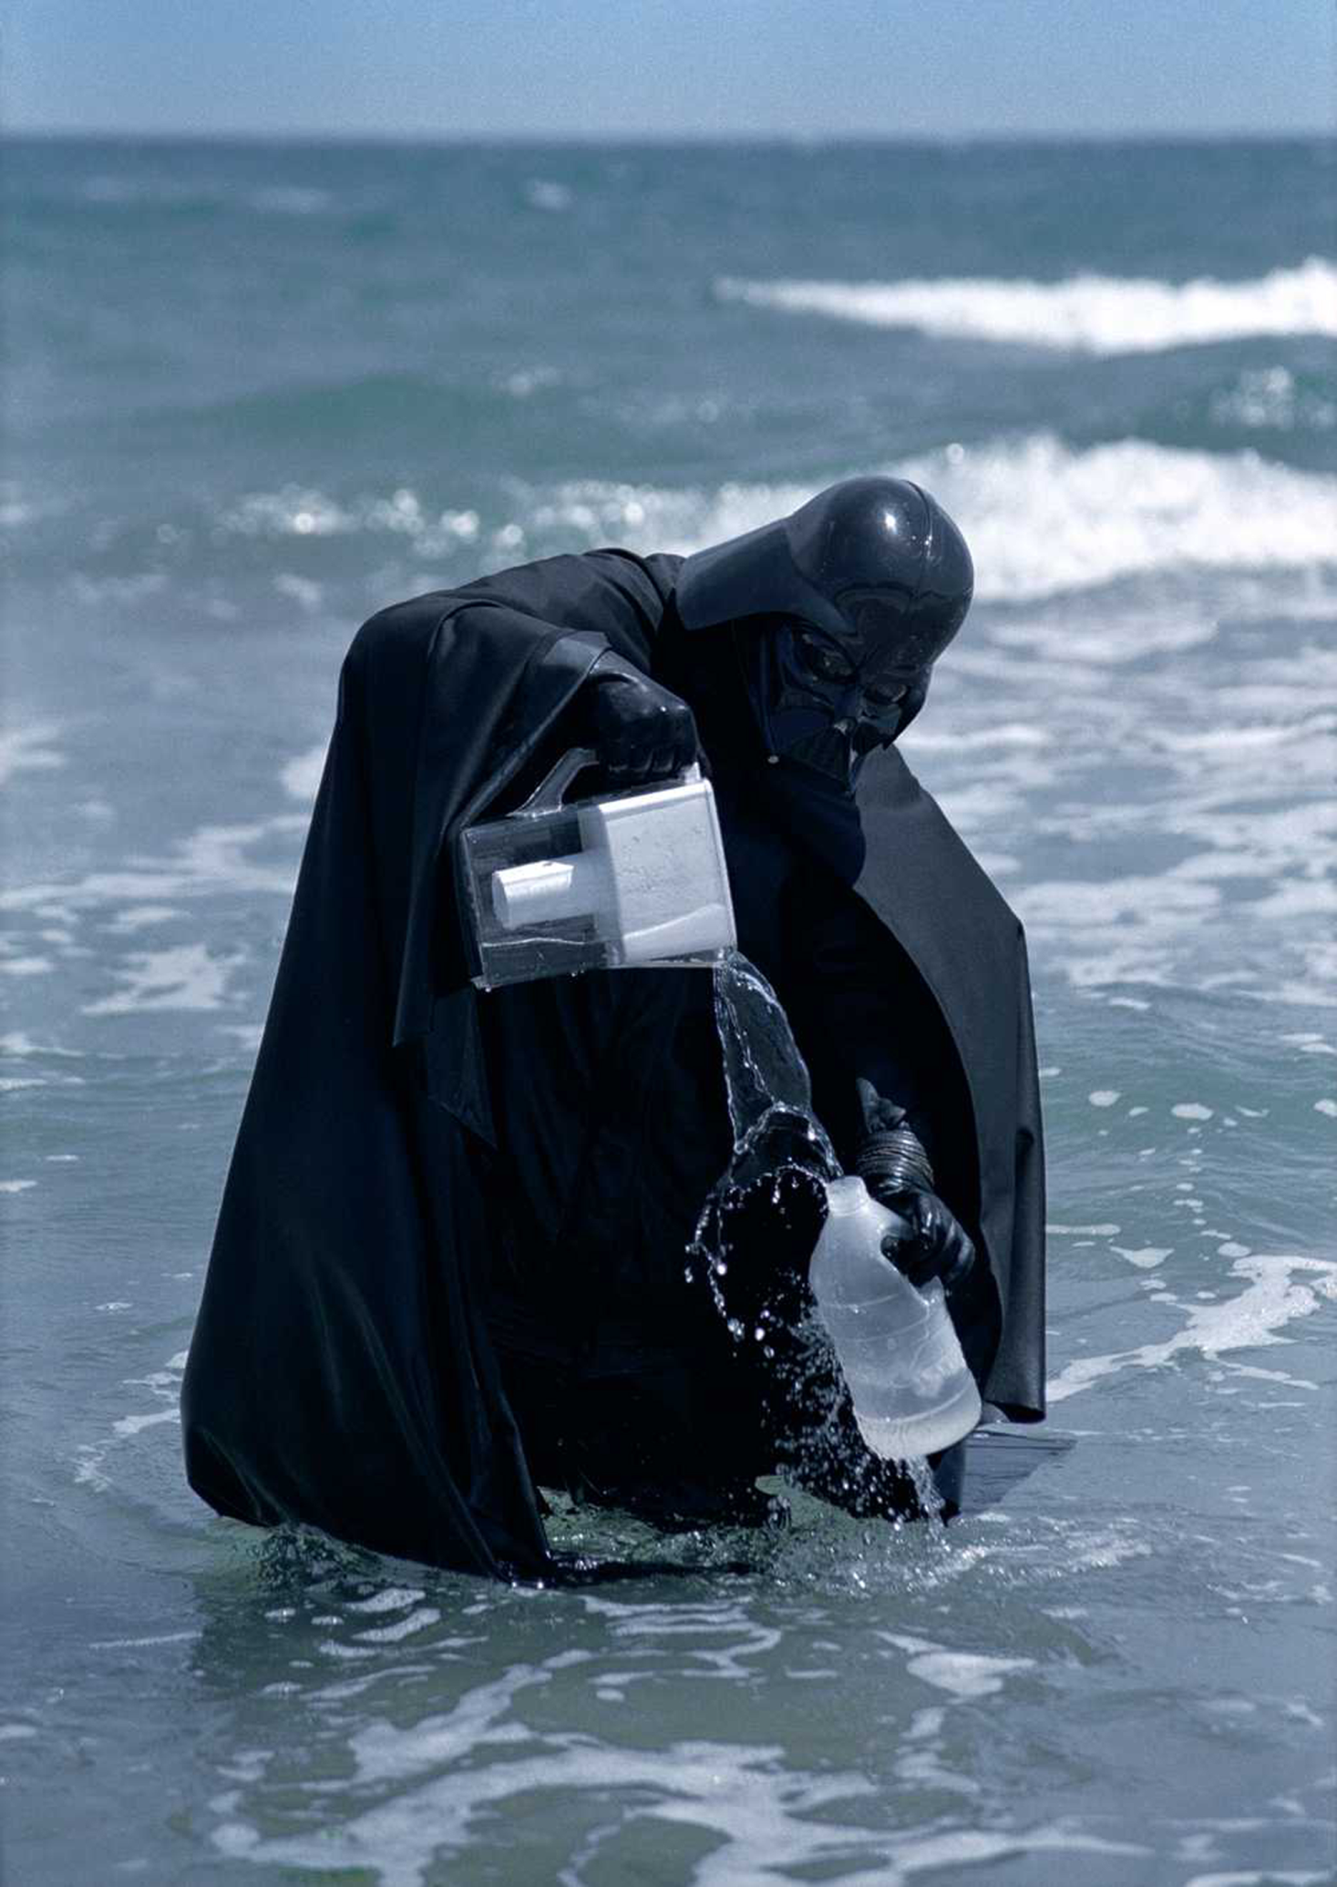
Notes:
Now, nothing in this world is making sense

Slide 10
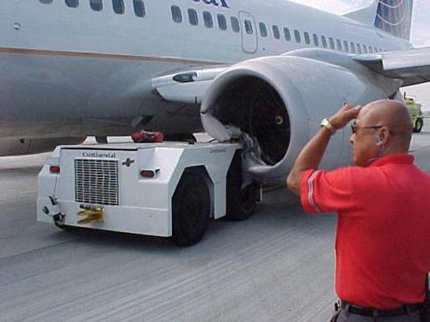
Notes:
And, I just keep thinking… How did this happen?

Slide 11

Notes:
Let’s try to get to the bottom of this

