Slide 1
Notes:
Quality Logo

Slide 2
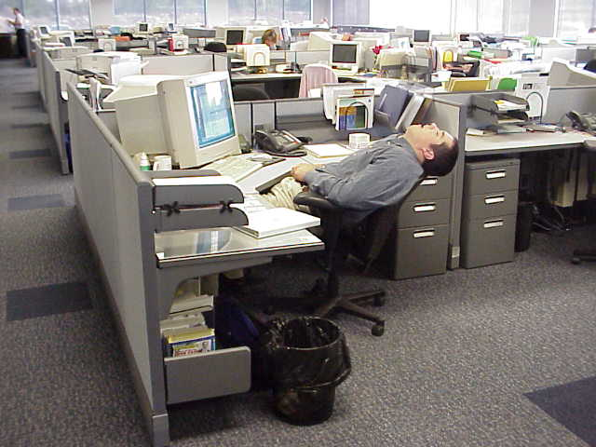
Notes:
So, I was hanging out at work one day

Slide 3
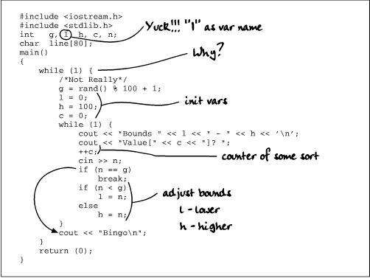
Notes:
Fixing code and stuff

Slide 4
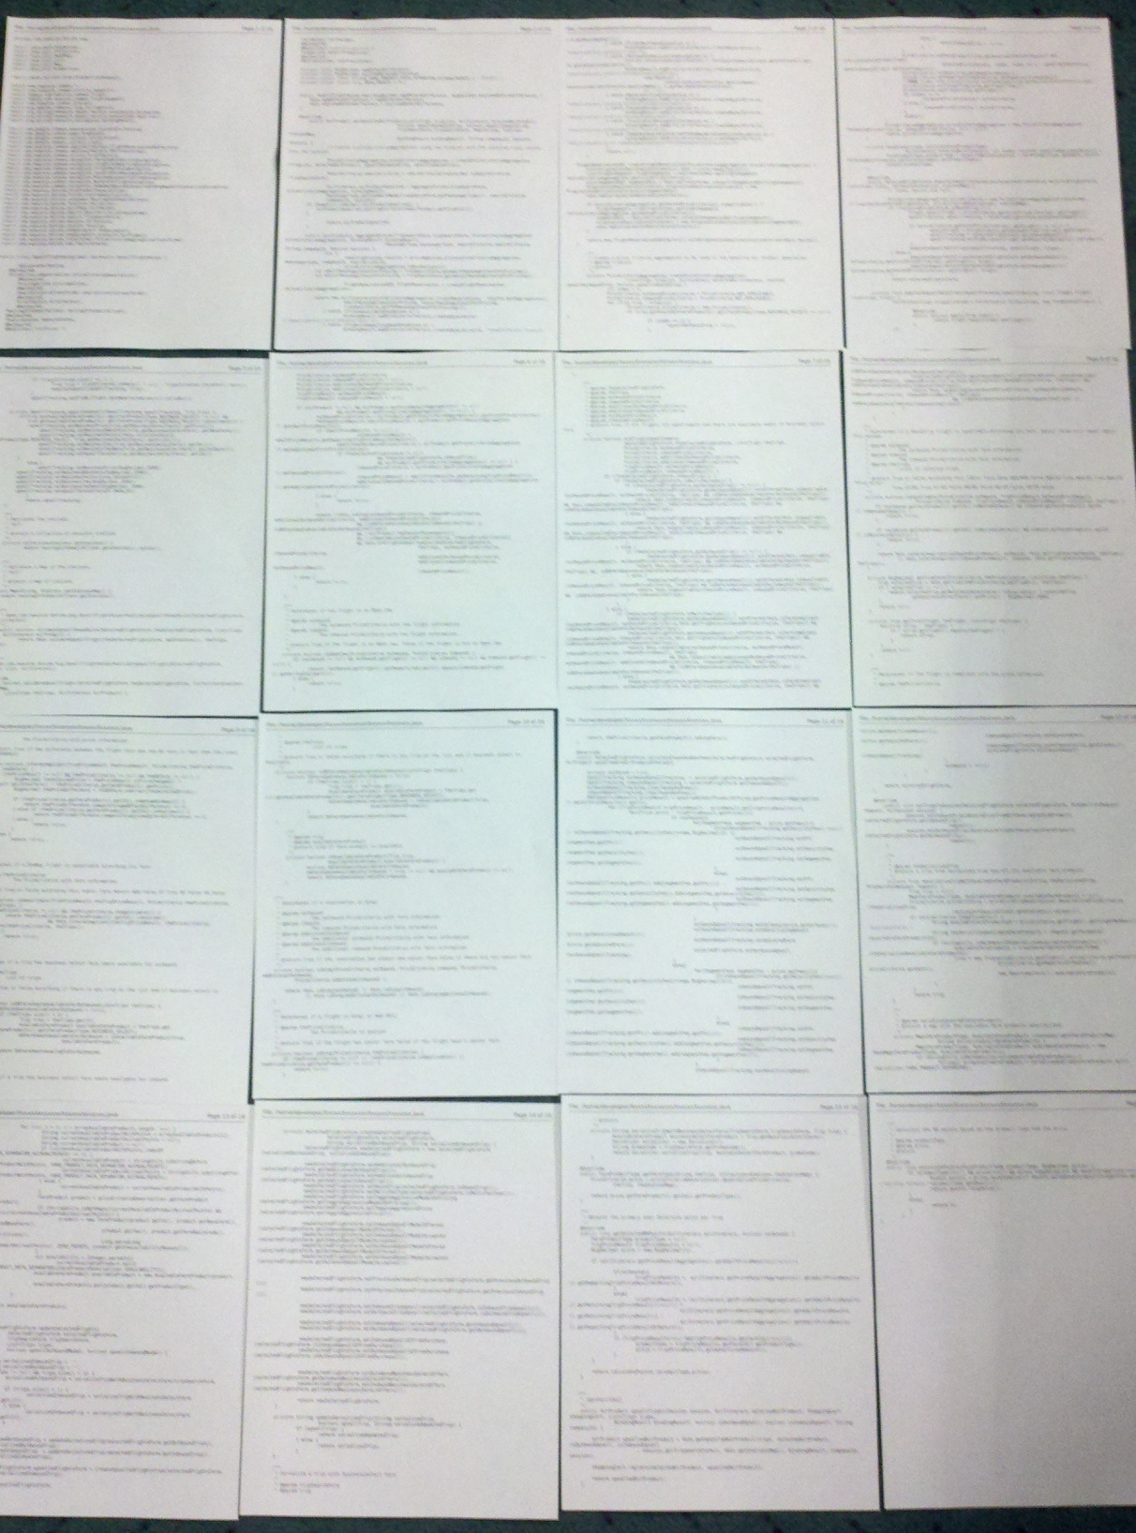
Notes:
When I came across this file, yes, that’s really the file.

Slide 5
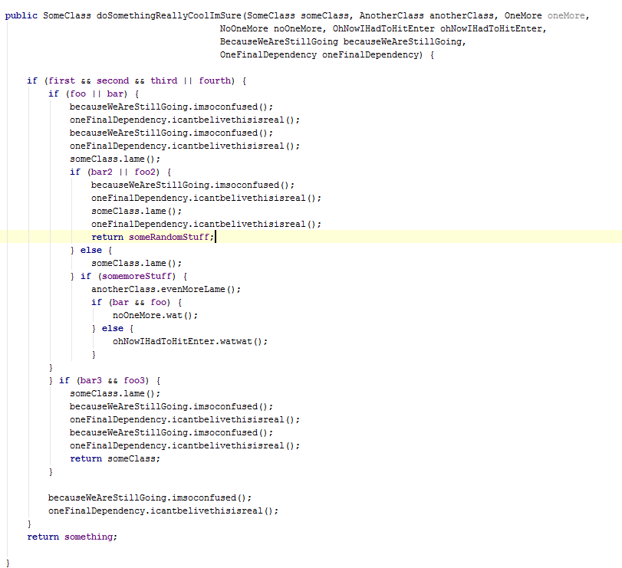
Notes:
And it had stuff like this in it.

Slide 6
Notes:
And this… wait… that’s not so bad

Slide 7
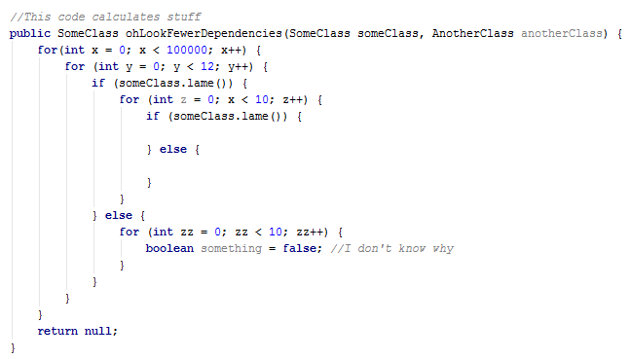
Notes:
Nevermind….

Slide 8

Notes:
Wat!?

Slide 9
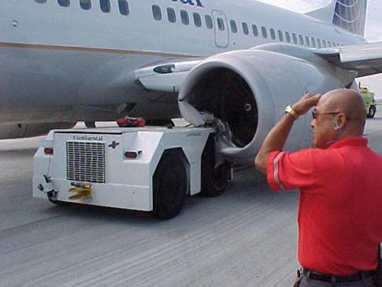
Notes:
How did this happen?

Slide 10

Notes:
Let’s try to get to the bottom of this

