Slide 1
UCAP Methodology
Proposal 1. Evaluating Unforced Capacity (UCAP or Unforced Capacity-Light for Thermal Resources and Battery Storage
November 3, 2025
Presented by Robert Hansen
Senior Utilities Engineer
Resource Modeling Team

Slide 2
Outline
Key Changes since Previous Proposal
Resource Applicability
Data Sources
CAISO Curtailment Reports
NOAA Weather Data
Methodology
Filtering
Aggregating
Formulas
Ongoing Coordination with CAISO
Questions

Slide 3
Key Changes since Previous Proposal
Highlighting major updates

Slide 4
Key Changes since Previous Proposal
New Data Sources
No longer use NERC’s GADS
Rely on CAISO’s Prior Trade-Day Curtailment data set
New Formulation
Adapt the GADS’ definition of Equivalent Forced Outage Rates during Demand (EFORd) using CAISO’s data
Apply CPUC’s approved Availability Assessment Hours (AAH) as demand hours
Seasonal and Hourly Differentiation
Evaluate EFORd across Two seasons: June-October and November-May
AAH hours are defined using different seasons

Slide 5
Key Changes since Previous Proposal
Each Resource’s best 3 in most recent 4 years used in EFORd calculation
Only 3 years of historic curtailment data is currently available
We will update results in early 2026 to reflect 4 years of historic data
Evaluate UCAP based on each resource’s own seasonal EFORd values wherever possible
Use group-averaged EFORd values to replace missing seasons of data
Especially important for new resources
Presented results show two sets of UCAP values, evaluated on an individual and group-averaged basis

Slide 6
Applicability
Which Resources will be Subject to UCAP

Slide 7
Resource Applicability
UCAP would apply to thermal resources (gas and steam turbines, and diesel generators), as well as battery electric storage systems
UCAP would not apply to resources subject to probabilistic QC methodologies, including wind and storage
Hybrid resources, e.g., solar and storage, require further consideration
Curtailment data does not distinguish between outages attributed to solar vs. storage component

Slide 8
Data Sources
Publicly Available and Independently Verifiable

Slide 9
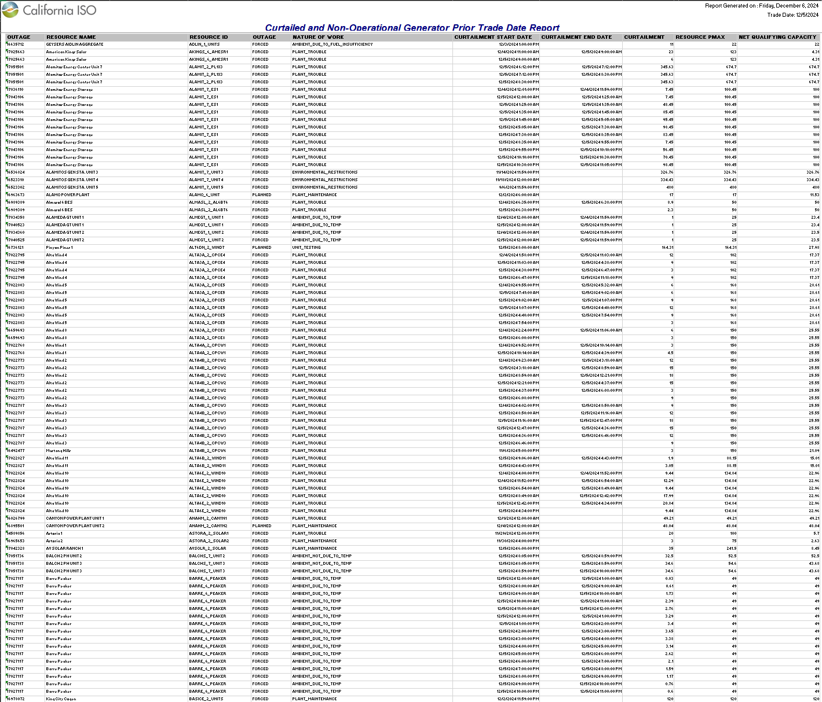
Data Sources
CAISO’s Prior Trade Day Curtailment Reports
Key data fields:
Resource ID
Outage Type
Nature-of-Work
Start/End Date and Time
Curtailment Amount

Slide 10
Data Sources
CAISO’s Prior Trade-Day Curtailment Reports
Each daily report file shows all ongoing or recently ended outages from all resources, including an outage type and a nature-of-work code
Individual outages may span multiple days, and can be reported without an end datetime until the outage actually ends
Individual outage codes (MRIDs) can be reused for multiple time-blocks
Use the four most recent full years of data when evaluating UCAP
Source: https://www.caiso.com/library/curtailed-and-non-operational-generator-reports

Slide 11
Data Sources
NOAA Weather Data
Used only for curtailments due to ambient temperatures
Pair each resource with nearest weather station
Source: https://www.ncei.noaa.gov/data/global-hourly

Slide 12
Methodology
Updated Definitions and Calculations

Slide 13
Methodology
UCAP in four steps:
Evaluate outage energy (MWh) for each resource during demand hours
Exclude certain Nature-of-Work codes and set aside Nature-of-Work “AMBIENT_DUE_TO_TEMP” for weather normalization
Calculate overlap in hours between each outage and demand hours in each season
Multiply overlap by outage MW to determine outage energy in MWh

Slide 14
Methodology
UCAP in four steps:
Evaluate outage energy (MWh) for each resource during demand hours
Calculate total possible energy (MWh) for each resource during demand hours
Use Commercial Operation Date (COD) to constrain demand hours
Multiply the total demand hours after COD by Pmax or NDC

Slide 15
Methodology
UCAP in four steps:
Evaluate outage energy (MWh) for each resource during demand hours
Calculate total possible energy (MWh) for each resource during demand hours
Divide outage energy by total possible energy to determine EFORd
EFORd values for each season may be calculated for individual resources or aggregated across groups
Use weighted averages to replace missing data where needed, e.g., new resources

Slide 16
Methodology
UCAP in four steps:
Evaluate outage energy (MWh) for each resource during demand hours
Calculate total possible energy (MWh) for each resource during demand hours
Divide outage energy by total possible energy to determine EFORd
UCAP = (1-EFORd) * Pmax or NDC

Slide 17
Methodology
Best 3-in-4 Years:
Evaluate EFORd on an annual basis for each resource
Apply weighted averages across similar resources to replace missing seasons
Determine the highest annual EFORd value and exclude source data from final seasonal EFORd calculation

Slide 18
Methodology
Outage Filtering:
Using Availability Assessment Hours
Exclude outage reports prior to Commercial Operation Date

Slide 19
Methodology
Aggregation:
Any missing data for a given resource is replaced with UCAP evaluated on a class-wide basis
For example, new resources would receive the group UCAP for the applicable resource type put into service within the last ten years

Slide 20
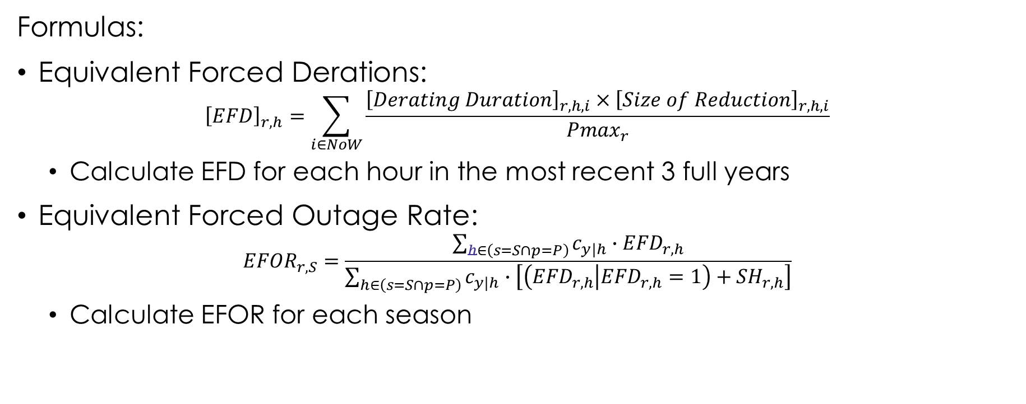
Methodology
Formulas:
Equivalent Forced Derations: ${\left[EFD\right]}_{r,h}=\sum_{i∈NoW}{\frac{{\left[Derating Duration\right]}_{r,h,i}×{\left[Size of Reduction\right]}_{r,h,i}}{{Pmax}_{r}}}$
Calculate EFD for each hour in the most recent 3 full years
Equivalent Forced Outage Rate: ${EFOR}_{r,S}=\frac{\sum_{h∈\left(s=S∩p=P\right)}{c_{y|h}∙{EFD}_{r,h}}}{\sum_{h∈\left(s=S∩p=P\right)}{c_{y|h}∙\left[\left({EFD}_{r,h} | {EFD}_{r,h}=1\right)+{SH}_{r,h}\right]}}$
Calculate EFOR for each season

Slide 21
Methodology
Natures-of-Work to include in UCAP (forced outages only):
PLANT_TROUBLE
METERING_TELEMETRY
TRANSMISSION_INDUCED
TECHNICAL_LIMITATIONS_NOT_IN_MARKET_MODEL
TRANSITIONAL_LIMITATION
ENVIRONMENTAL_RESTRICTIONS
ICCP
RTU_RIG
AMBIENT_DUE_TO_TEMPERATURE*
Each outage with matching nature-of-work code contributes toward EFD
*Outages due to ambient temperatures are modeled before adding to EFD

Slide 22
Methodology
Derates due to Ambient Temperatures:
Develop deration curves for each resource based on three years of historic curtailments and weather data from nearest NOAA weather station
Apply deration curve to normalized weather year to determine outages
Include modeled outages to calculate EFD

Slide 23
Ongoing CAISO Coordination
Aligning sources and methodologies

Slide 24
Ongoing CAISO Coordination
CPUC and CAISO have continued to communicate while developing their respective UCAP frameworks
The goal is a largely consistent methodology, while accommodating distinct requirements and use cases of both organizations
Main points of coordination include:
Selecting new data source for reported plant outages
Defining “demand hours” for EFORd
Coordination on many other aspects of this proposal
Anticipating further collaboration

Slide 25
Questions?

Slide 26
For more information:
robert.hansen@cpuc.ca.gov

