Slide 1
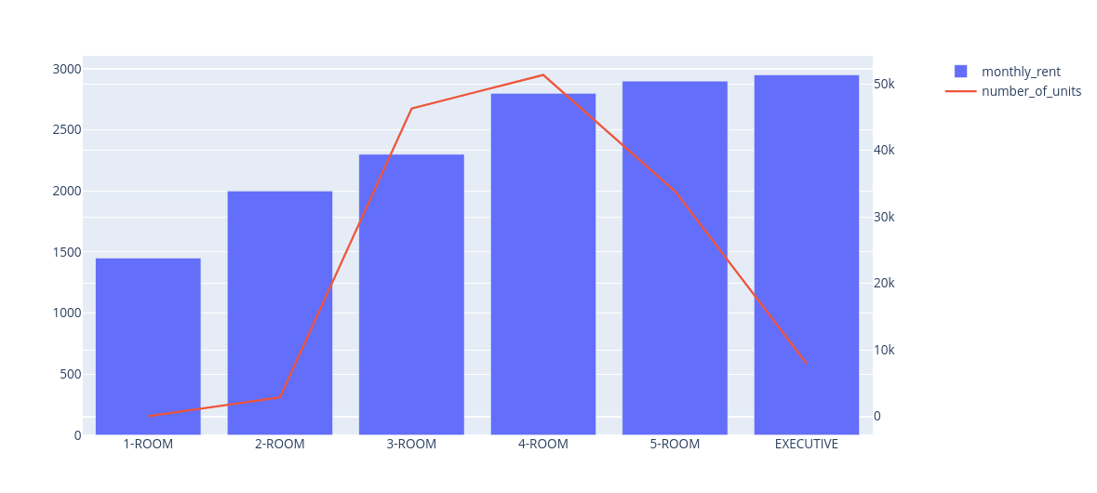
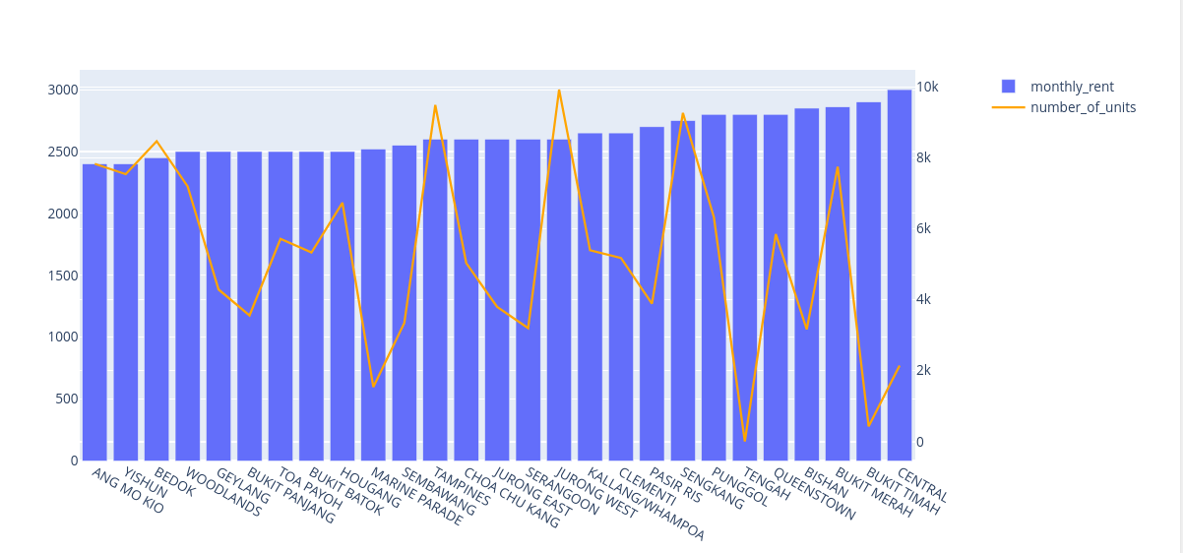
What Factors affects rent prices?
Town, flat_type and rent_approval_date are factors that affect rent prices for HDB flats in Singapore.
The more rooms or more premium the flats, the more expensive the median rent. Some towns has more expensive rents than others

Slide 2
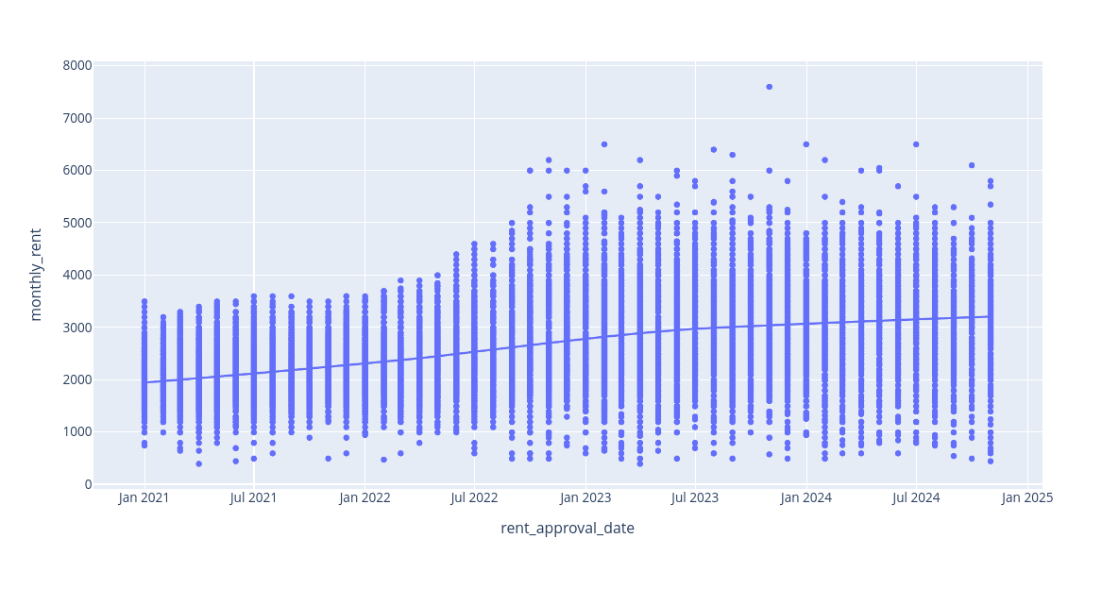
What Factors affects rent prices?
Same linear relationship for town rent_approval_date vs monthly_rent.

Slide 3
What Factors affects rent prices?
Hypothesis testing using StatsModel’s OLS the inferences as mentioned where these factors are all statistically significant at 0.00 (alpha=0.05).
Feature importances using sklearn’s RandomForestRegressor as shown in the table on the rightseems to partially back the importances of these three factors.
OneHotEncoding from sklearn has been used for hypothesis testing and feature importances.
feature | importance
"rent_approval_date" | 0.592
"flat_type_3-ROOM" | 0.167
"flat_type_2-ROOM" | 0.064
"town_BUKIT MERAH" | 0.025
"town_QUEENSTOWN" | 0.024
"town_CENTRAL" | 0.020
"flat_type_4-ROOM" | 0.019
"town_CLEMENTI" | 0.011
"town_KALLANG/WHAMPOA" | 0.010
"town_TOA PAYOH" | 0.0062

