Slide 1
Linear Reversible Circuit Synthesis and Optimization
2021-01-20
Presenter:黃彥翔
National Taiwan University
Taipei 106, Taiwan

Slide 2
Outline
Introduction and previous work
Implementation and Contribution
Experimental Results
Observation and Discussion

Slide 3
Outline
Introduction and previous work
Implementation and Contribution
Experimental Results
Observation and Discussion

Slide 4
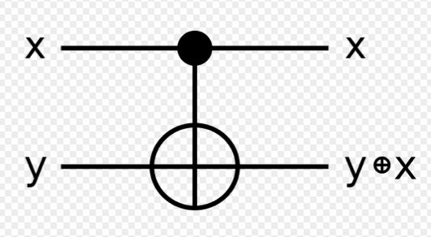
C-NOT gates and linear reversible circuit
A circuit consists of only C-NOT gates is linear and reversible.
It is linear because of the output functions are linear functions
It is reversible because there is a simple way of construct a reverse function: reverse the sequence of the C-NOT gates

Slide 5
Gaussian elimination and synthesis
Given the output functions, we can use Gaussian elimination to synthesis a circuit
A row operation is the addition of one row to another. In the view of a circuit, it is equivalent to the addition of one output to another.
Thus, if we can use Gaussian elimination to make the output matrix become a identity matrix, we can obtain a circuit with inverse function.
With the reverse circuit, we can obtain the circuit with the original function.

Slide 6
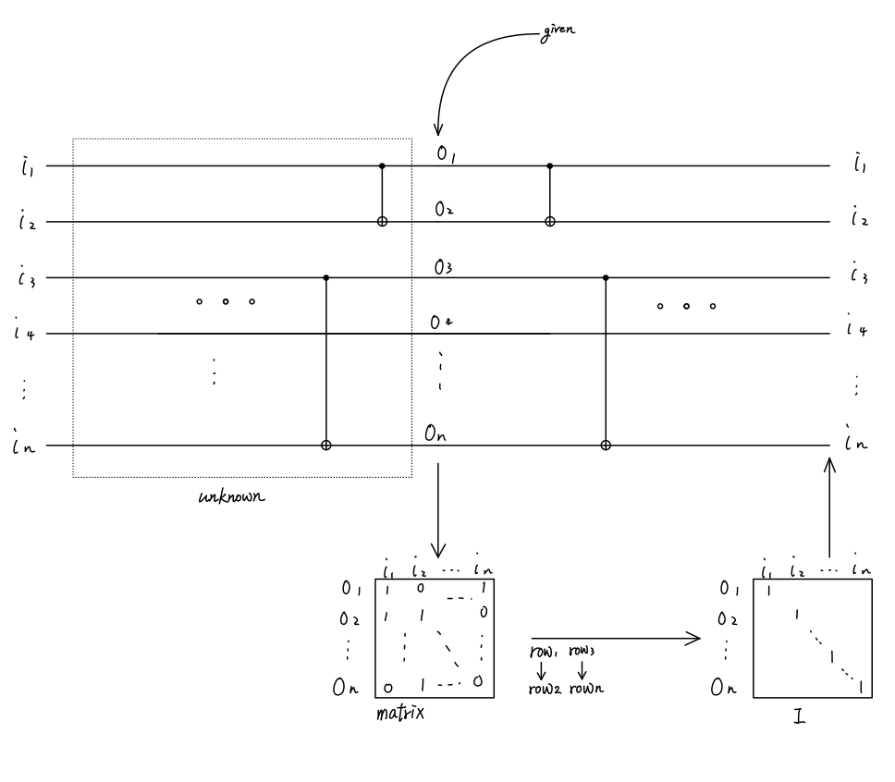
Gaussian elimination and synthesis

Slide 7
Gaussian elimination and synthesis
Defect:
Complexity is O(n^2), however the complexity of reducing a matrix to identity using row operations is proven as O(n^2/log(n))

Slide 8
Previous Work
Ketan N. Patel, Igor L. Markov and John P. Hayes has proposed a algorithm in 2003, with complexity of O(n^2/log(n)) to reduce a matrix to a identity matrix using only row operation if possible

Slide 9
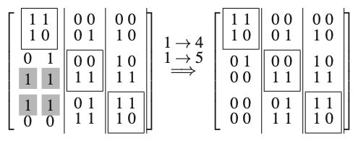
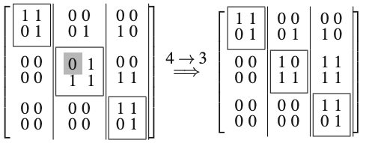
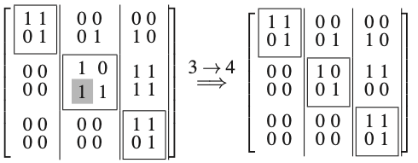
Previous Work
Proposed algorithm:
Lwr_CNOT_Synth:
Partition matrix into ”sections”, which consists m columns.
For each sections, do these three steps:
step A: eliminate duplicate sub-rows
step B: make the section diagonal
step C: remove remaining ones( same approach as Gaussian elimination)
A B C

Slide 10
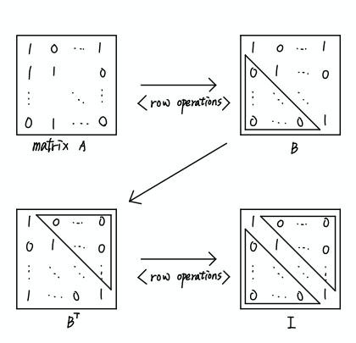
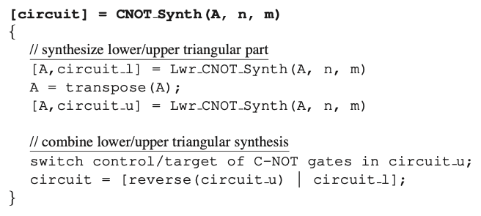
Previous Work
Proposed algorithm:
CNOT_Synth:

Slide 11
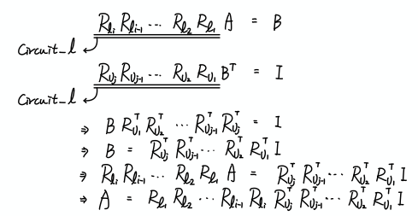
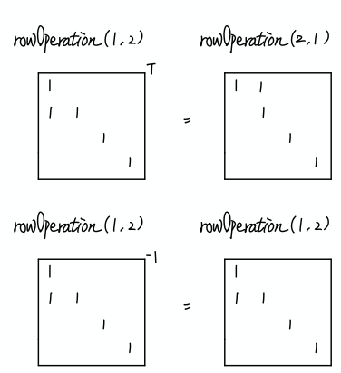
Previous Work

Slide 12
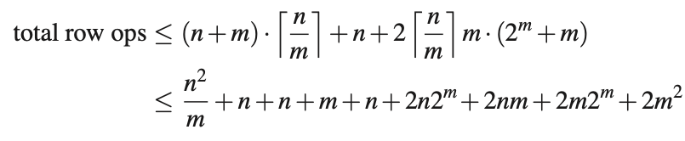
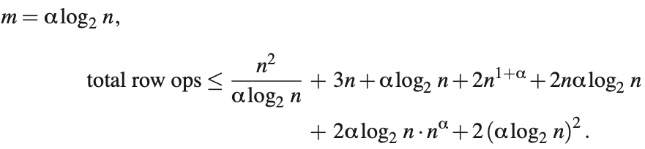
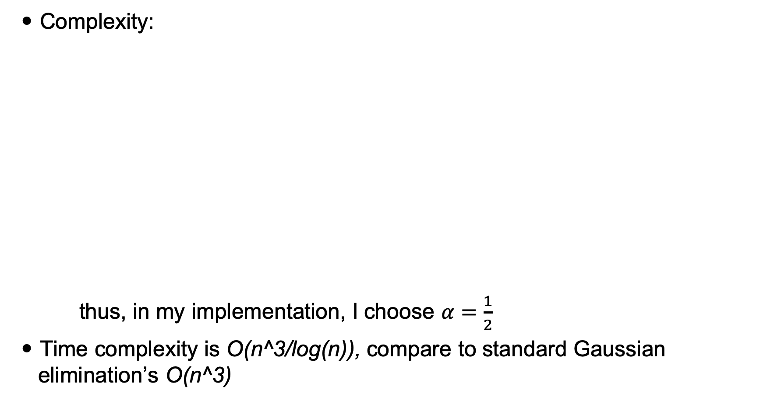
Previous Work
Complexity:
thus, in my implementation, I choose $α=\frac{1}{2}$
Time complexity is O(n^3/log(n)), compare to standard Gaussian elimination’s O(n^3)

Slide 13
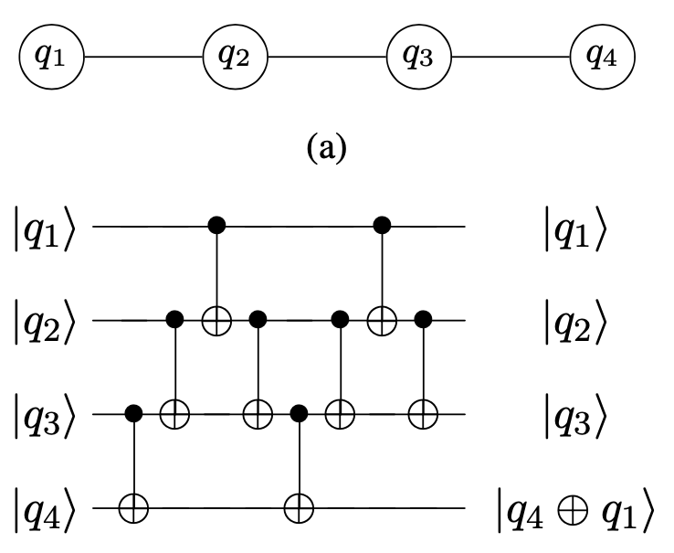
Matrix Reducing with Connectivity
Connectivity limits CNOT gate to be only apply on neighbor physical qubits
Any row operation ( or qubit addition) can be performed using the template, however it is very gate consuming.
To use the method just mentioned, it increase the complexity from O(n^2/log(n)) to O(n^3/log(n))
A algorithm of complexity of O(n^2) is
proposed.
BeatriceNash,VladGheorghiu,MicheleMosca,
Quantum circuit optimizations for NISQ architectures,2020
Notes:
selection of the weights or bounds. High weights of fixed bounds on a set of critical nets may create excessive delays in other nets, This will result in an unexpected oscillation.

Slide 14
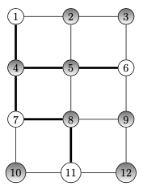
Matrix Reducing with Connectivity
Problem: Given a set of rows to be reduced, how to determine the row operation sequence with the least operations.
The problem can be reduces to the Steiner tree problem on the connectivity graph.
Some nodes need to be reduce(terminals),
but the others didn’t( Steiner nodes).
A algorithm is proposed to handle this situation.
Notes:
selection of the weights or bounds. High weights of fixed bounds on a set of critical nets may create excessive delays in other nets, This will result in an unexpected oscillation.

Slide 15
Proposed algorithm
Construct a tree:
Perform BFS search from the terminals, when two terminals collide, combine them and treat them as a new terminal.( somewhat like a Multi-source Maze router)
Don’t use partitioning
Notes:
selection of the weights or bounds. High weights of fixed bounds on a set of critical nets may create excessive delays in other nets, This will result in an unexpected oscillation.

Slide 16
Proposed algorithm
Construct subtrees:
Perform BFS search from the root, when arriving a terminal, stop and build a new sub-tree for the terminal.
Thus, every tree has terminals at root and leaves.
Notes:
say the

Slide 17
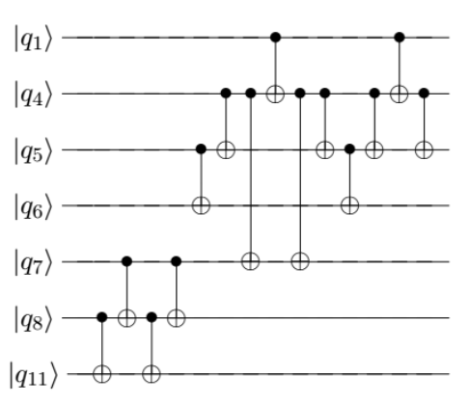
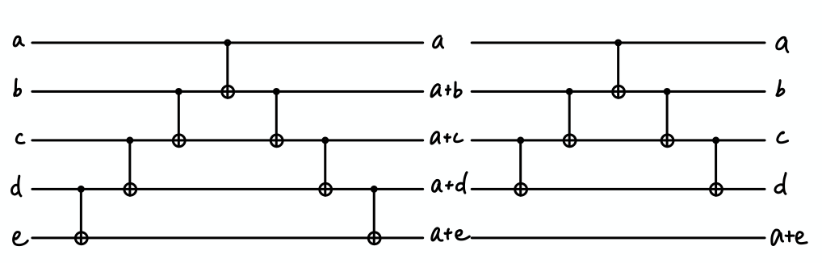
Proposed algorithm
Construct circuit(before transpose):
Start from the last sub-tree constructed.
Perform DFS for each sub tree from the root. When visit a edge (u, v), append (u, v) into the CNOT-gate sequence R
R’ = R-R[j], R* = (R+R’)/(gate with terminal as target)
Circuit = R+R’+R*
Notes:
selection of the weights or bounds. High weights of fixed bounds on a set of critical nets may create excessive delays in other nets, This will result in an unexpected oscillation.

Slide 18
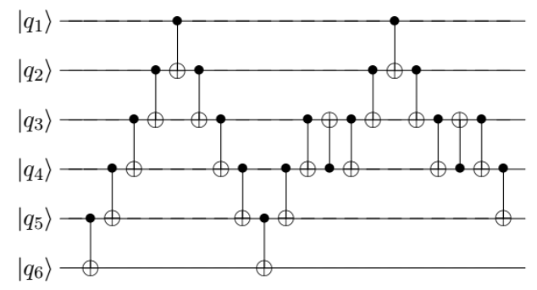
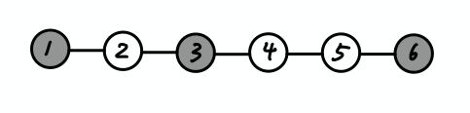
Proposed algorithm
Construct circuit(after transpose):
Don’t use the sub-trees. Since it may ruin the lower-triangular form.
Traverse the whole Steiner tree and build R and R’ as usual.
Build R* the same as the step before transpose, however, perform a “swap gate” when arriving a terminal that is not a leaf.
Notes:
selection of the weights or bounds. High weights of fixed bounds on a set of critical nets may create excessive delays in other nets, This will result in an unexpected oscillation.

Slide 19
Complexity
Each tree: #gate = O(n) time = O(d*(|E|+|V|)), where d is #terminal
Overall: #gate = O(n^2) time = O(n^2*(|E|+|V|))
Notes:
selection of the weights or bounds. High weights of fixed bounds on a set of critical nets may create excessive delays in other nets, This will result in an unexpected oscillation.

Slide 20
Outline
Introduction and previous work
Implementation and Contribution
Experimental Results
Observation and Discussion

Slide 21
Implementation and Contribution
Language: c++17
Os: ubuntu20.04

Slide 22
Implementation and Contribution
For the circuit synthesis without connectivity, I had implement it and verify the gate complexity using some experiment, the result will be shown later.
For the circuit synthesis with connectivity,

Slide 23
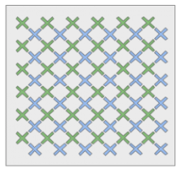
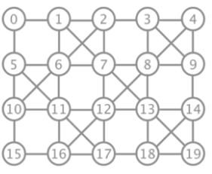
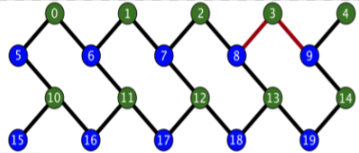
Implementation and Contribution
For the circuit synthesis with connectivity, I found that the connectivity graph they used, such as Google’s Bristlecone72, IBM’s Tokyo20, and Rigetti’s Acorn19, are not that complicated.
There may be another good mays for build a Steiner tree, instead of applying a general but time consuming and inaccurate method.
Bristlecone72 IBM’s Tokyo20 Rigetti’s Acorn19

Slide 24
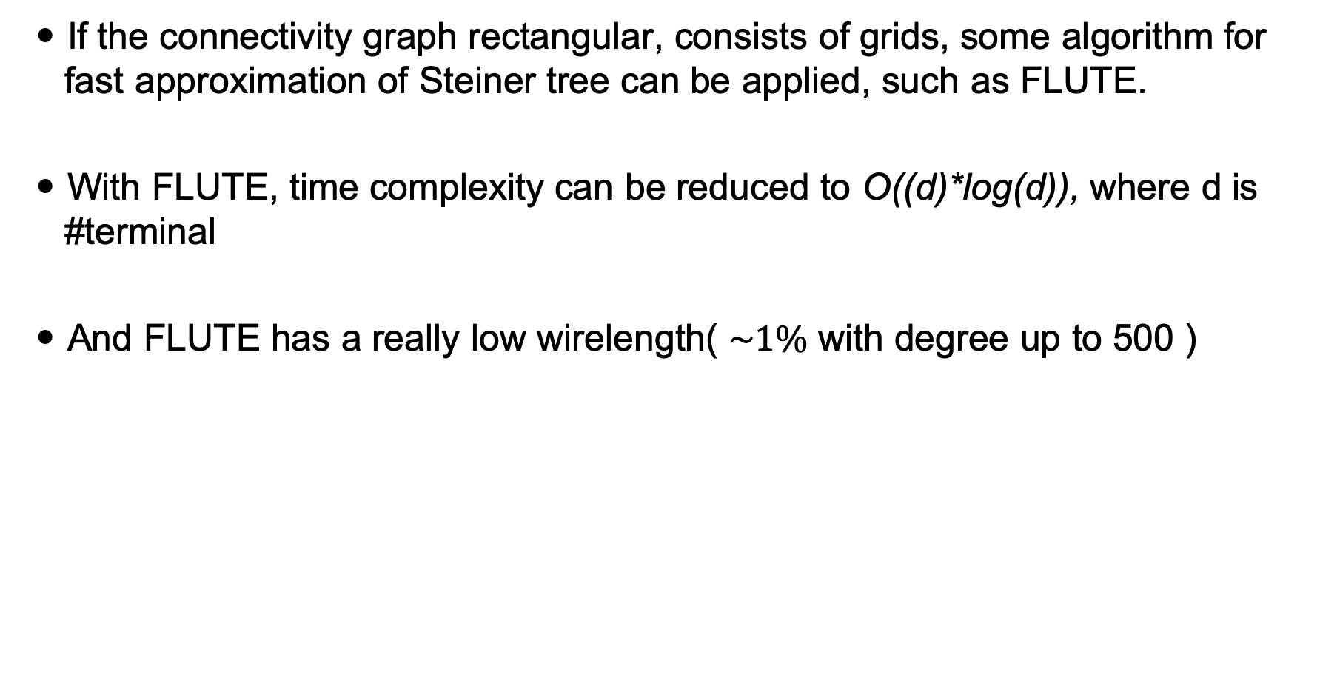
Implementation and Contribution
If the connectivity graph rectangular, consists of grids, some algorithm for fast approximation of Steiner tree can be applied, such as FLUTE.
With FLUTE, time complexity can be reduced to O((d)*log(d)), where d is #terminal
And FLUTE has a really low wirelength( $\sim 1\%$ with degree up to 500 )

Slide 25
Implementation and Contribution
Some visualization tools to draw the circuit and connectivity graph.

Slide 26
Outline
Introduction and previous work
Implementation and Contribution
Experimental Results
Observation and Discussion

Slide 27
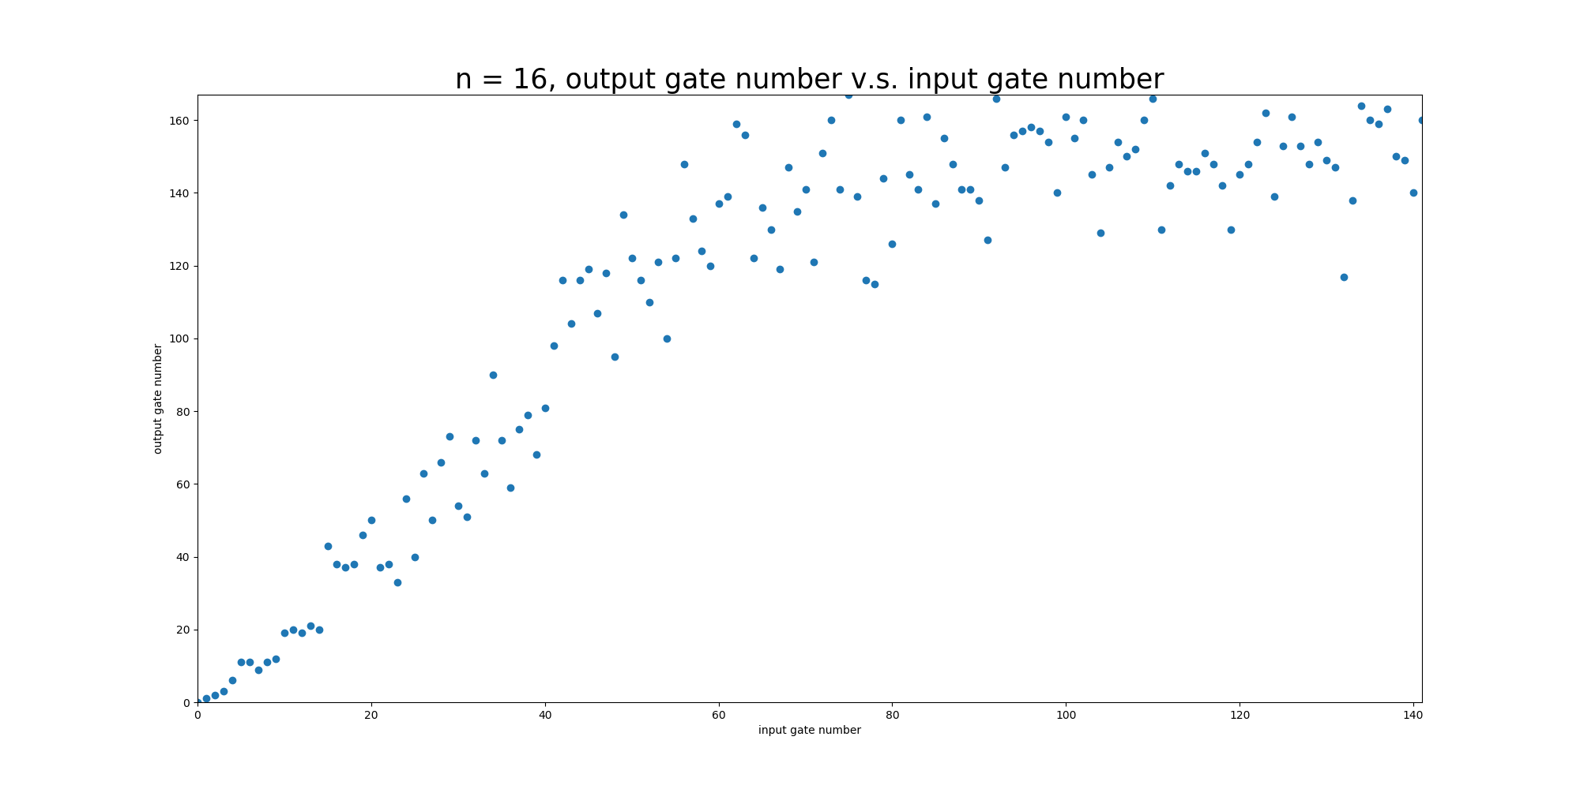
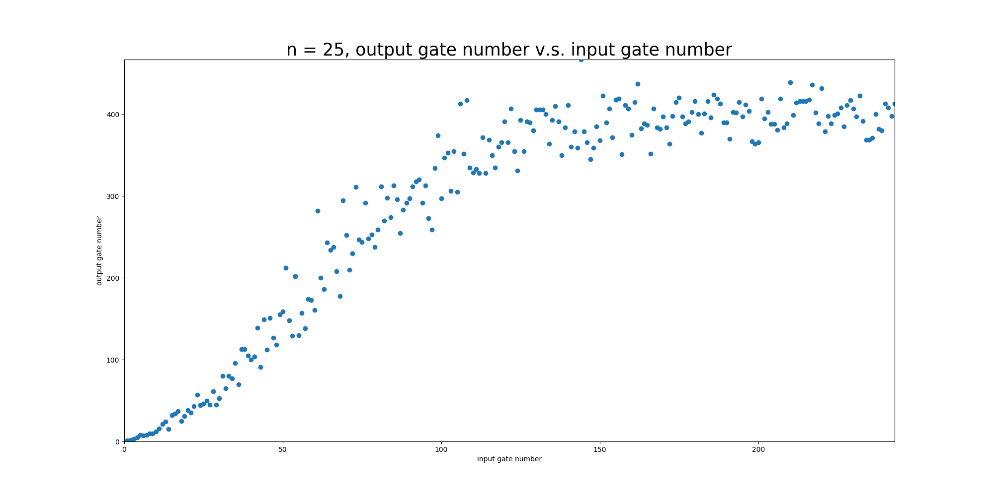
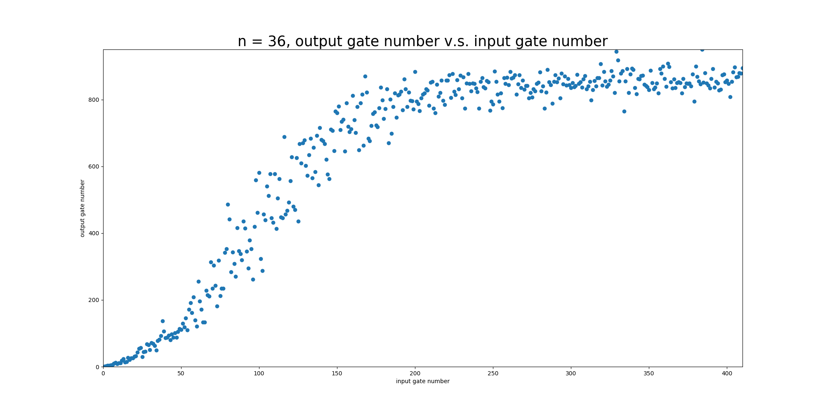
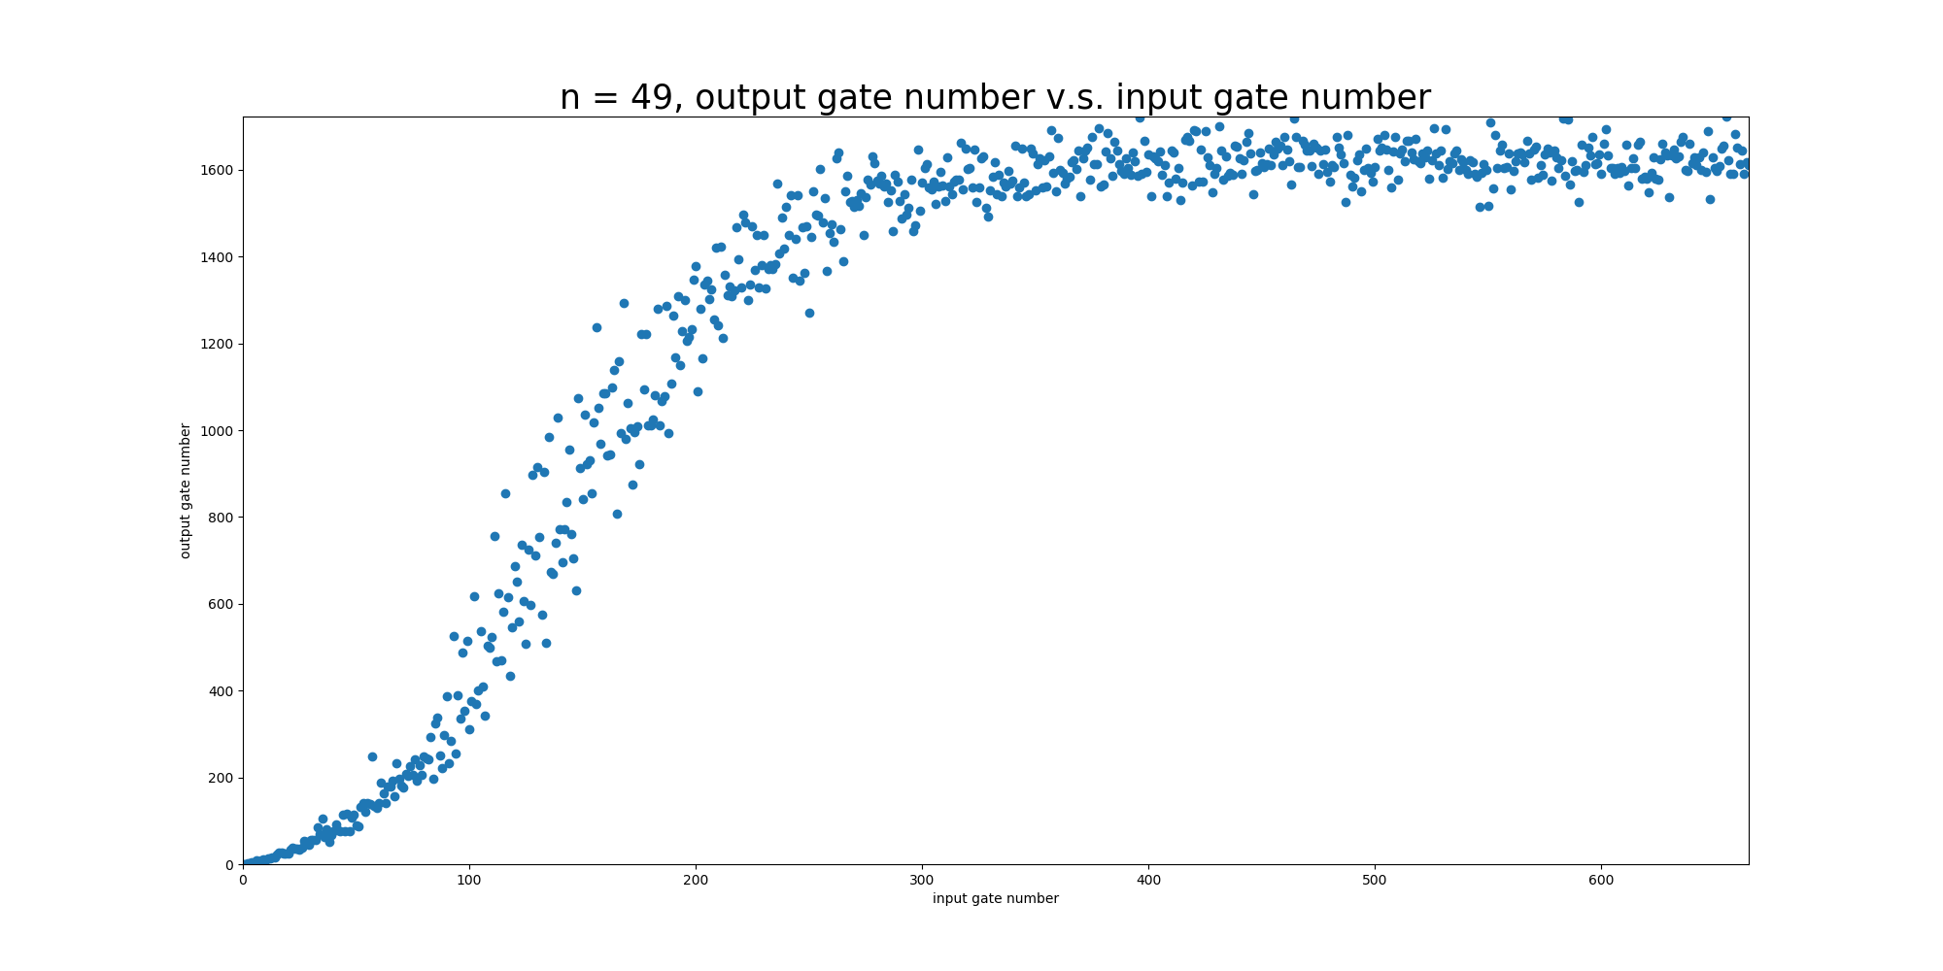
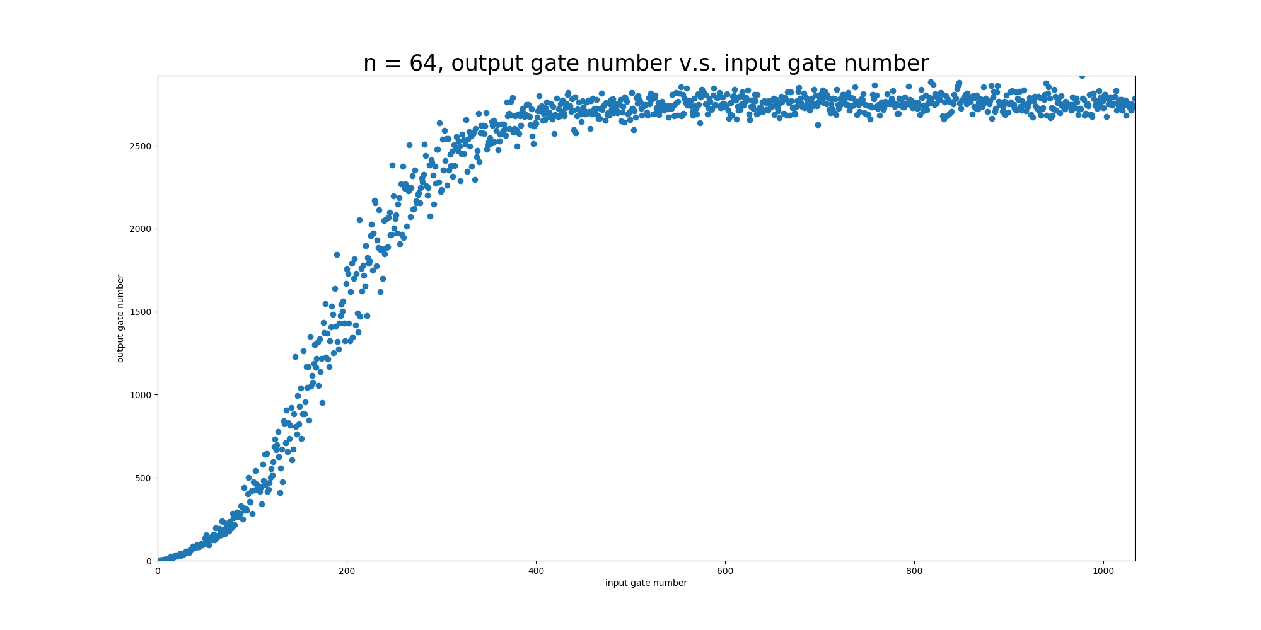
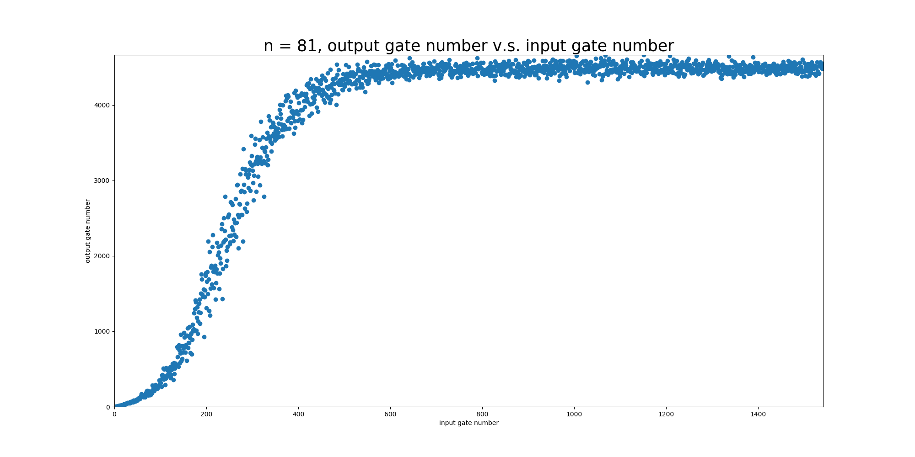
Experimental Results without connectivity
Test circuit is generated by randomly generate C-NOT.

Slide 28
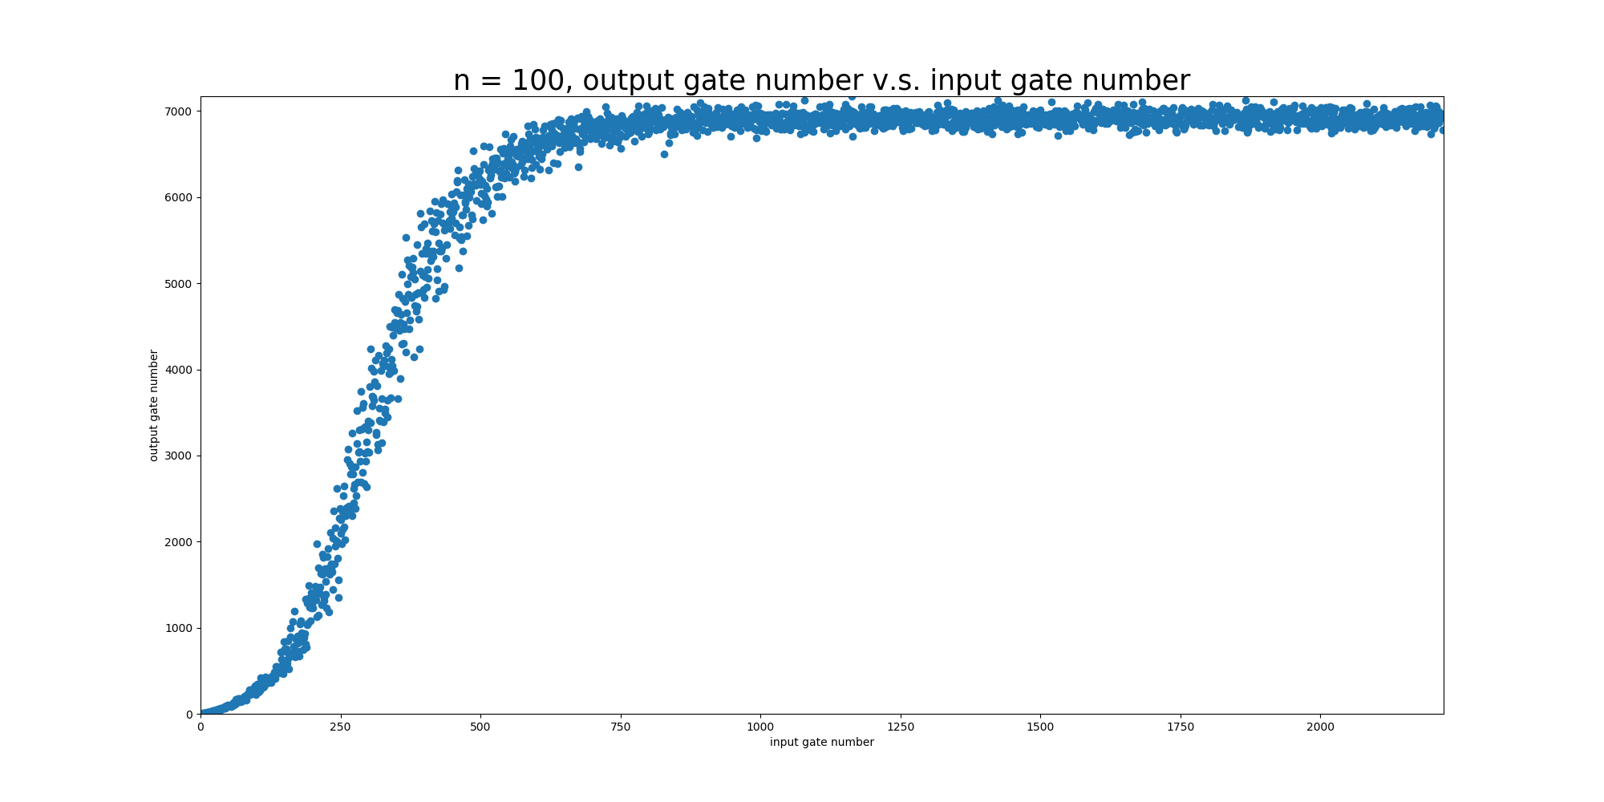
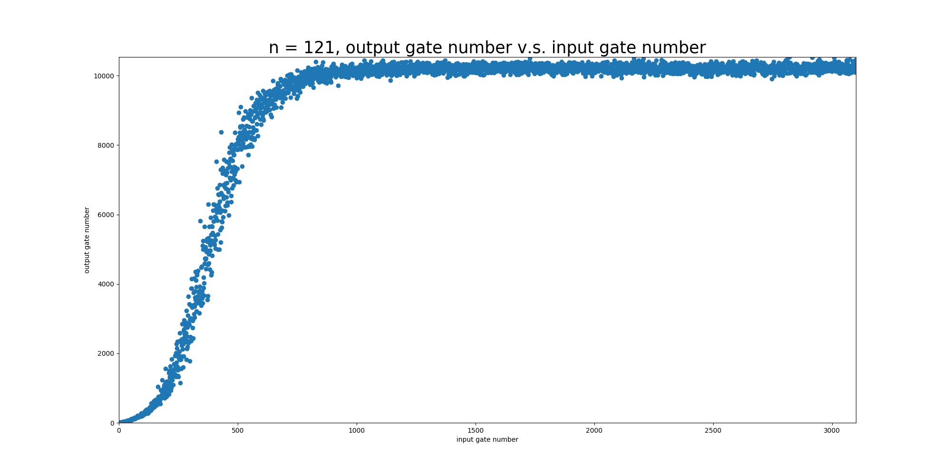
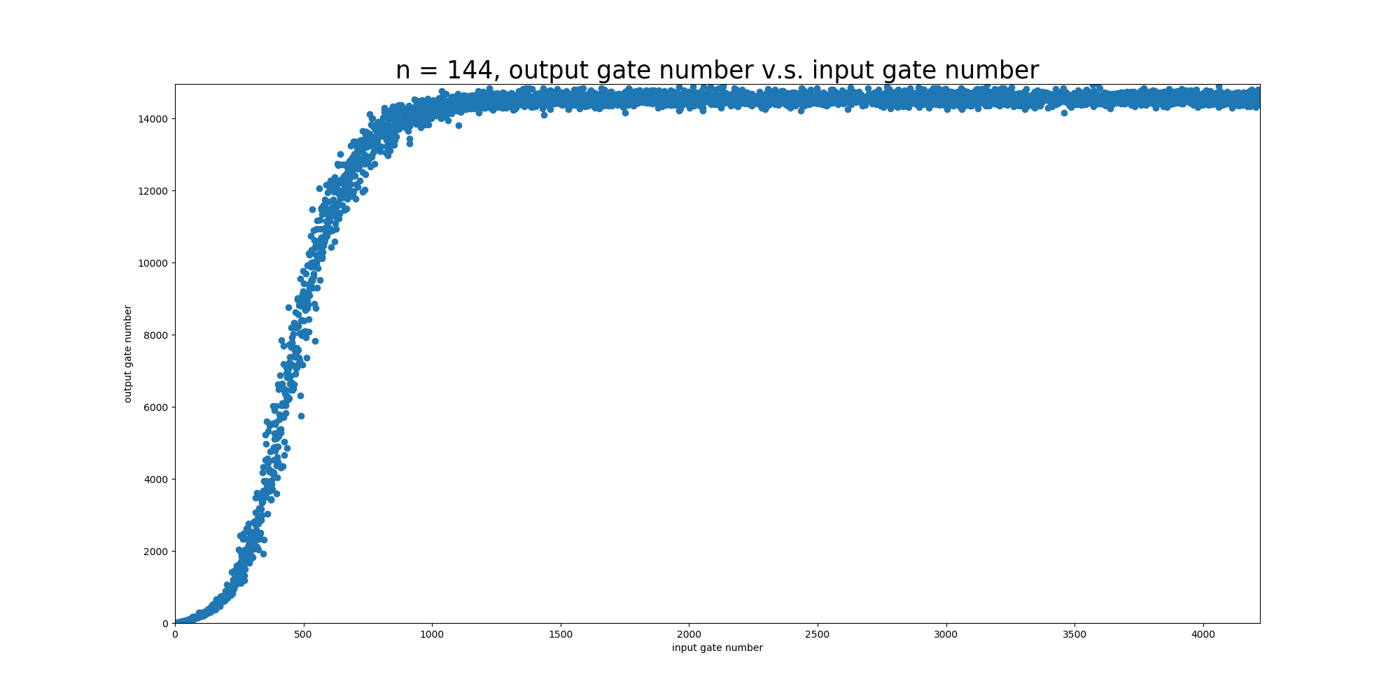
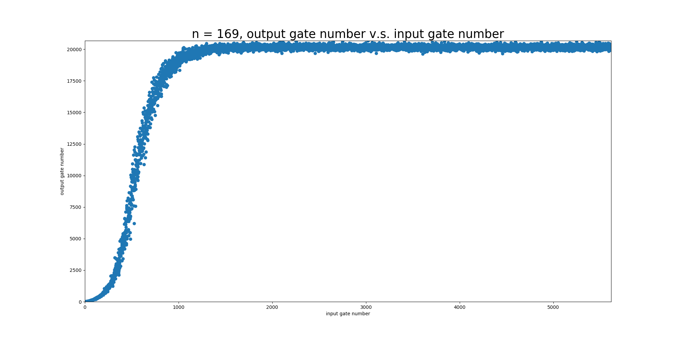
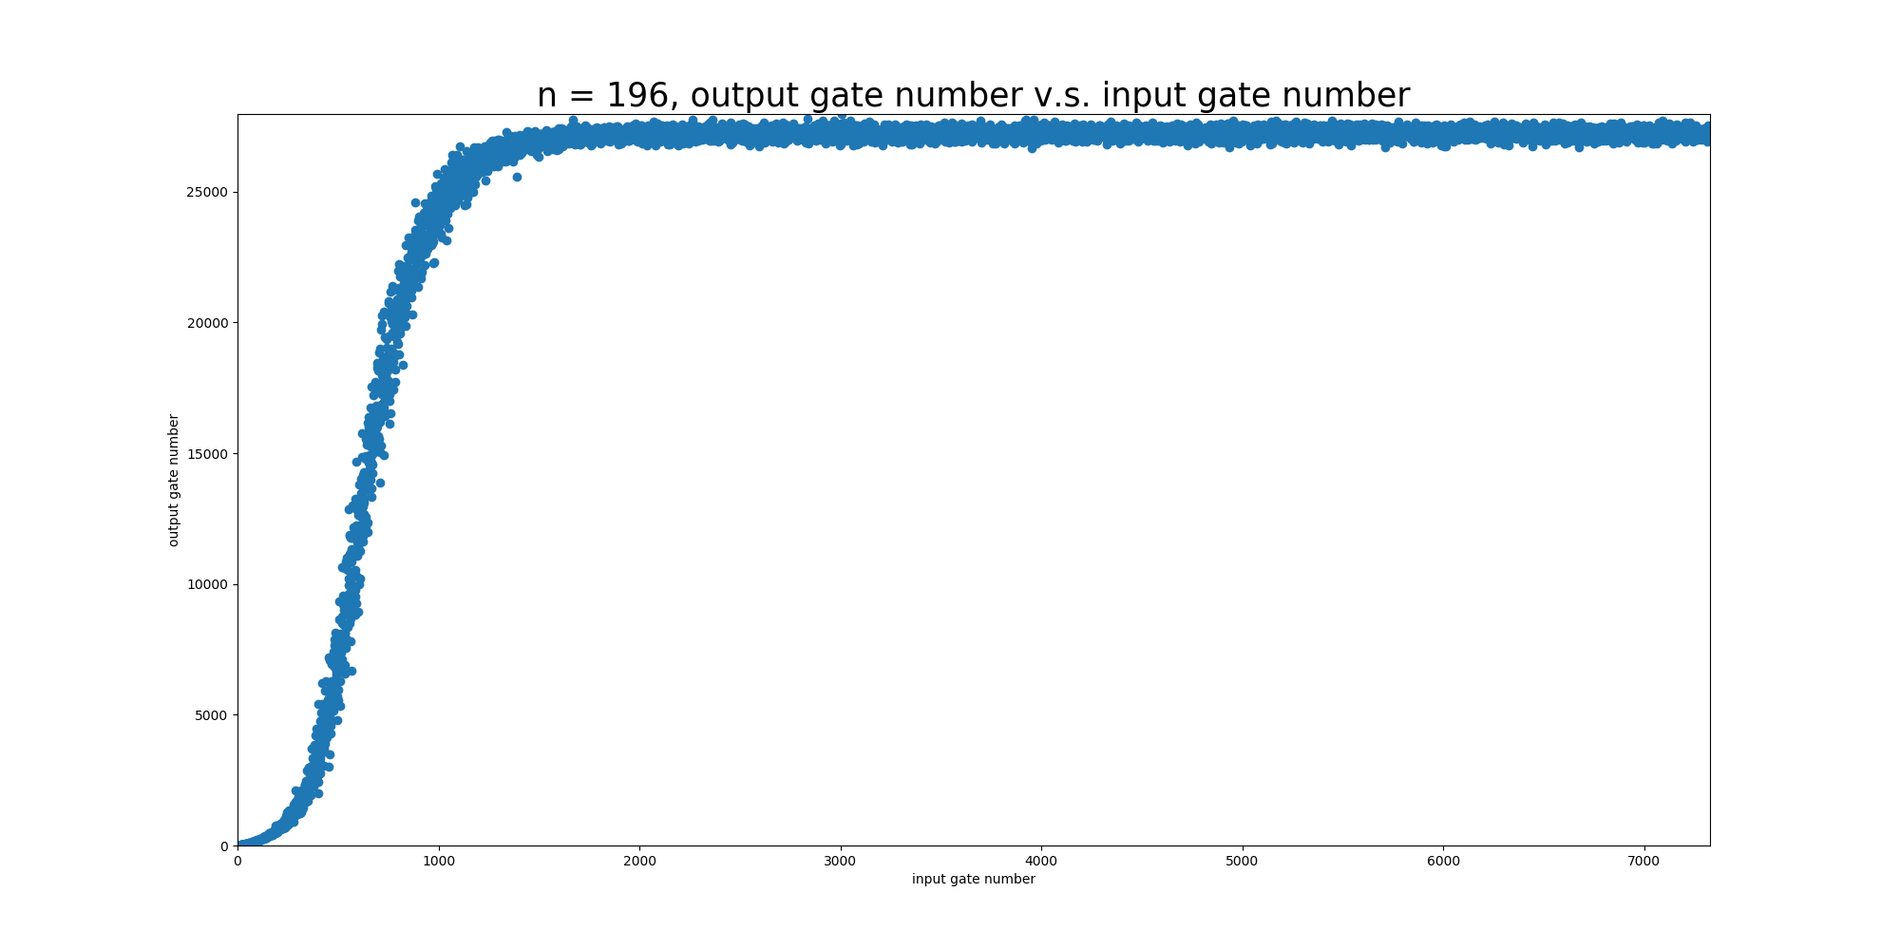
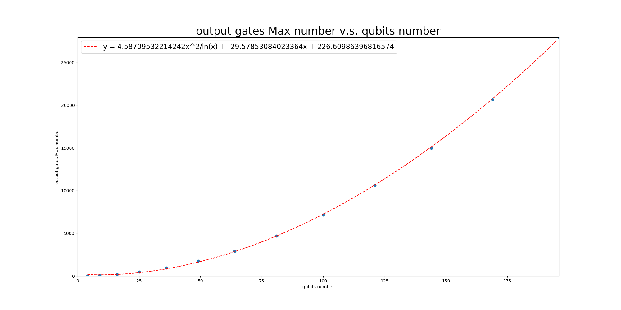
Experimental Results without connectivity
Test circuit is generated by randomly generate C-NOT.

Slide 29
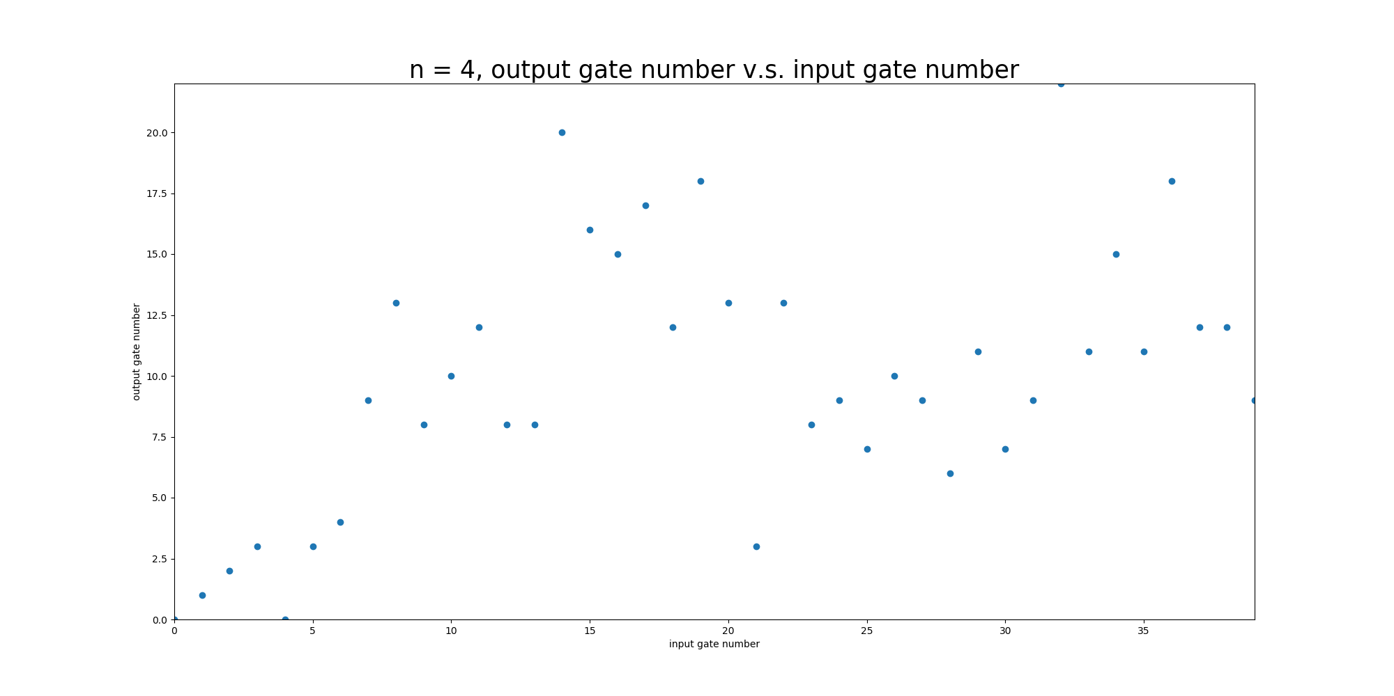
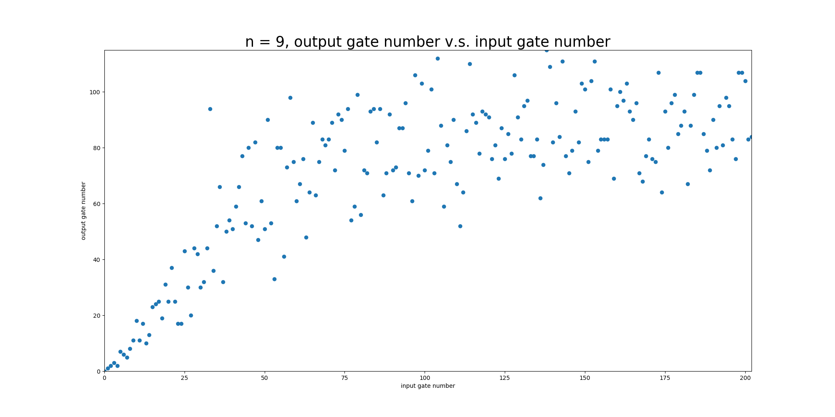
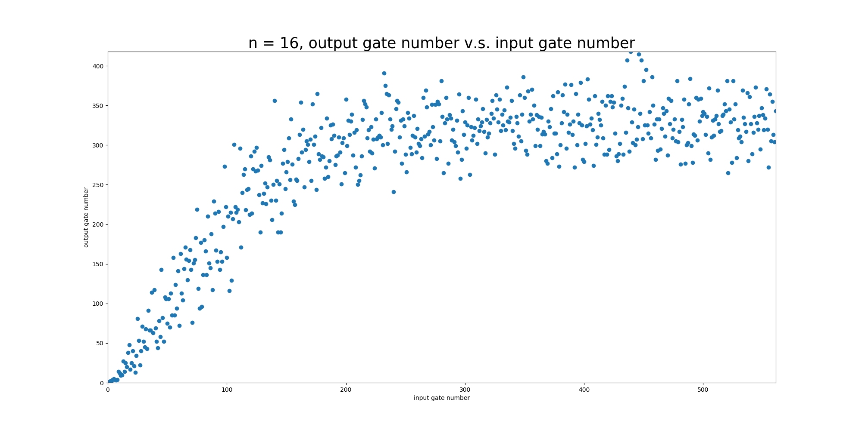
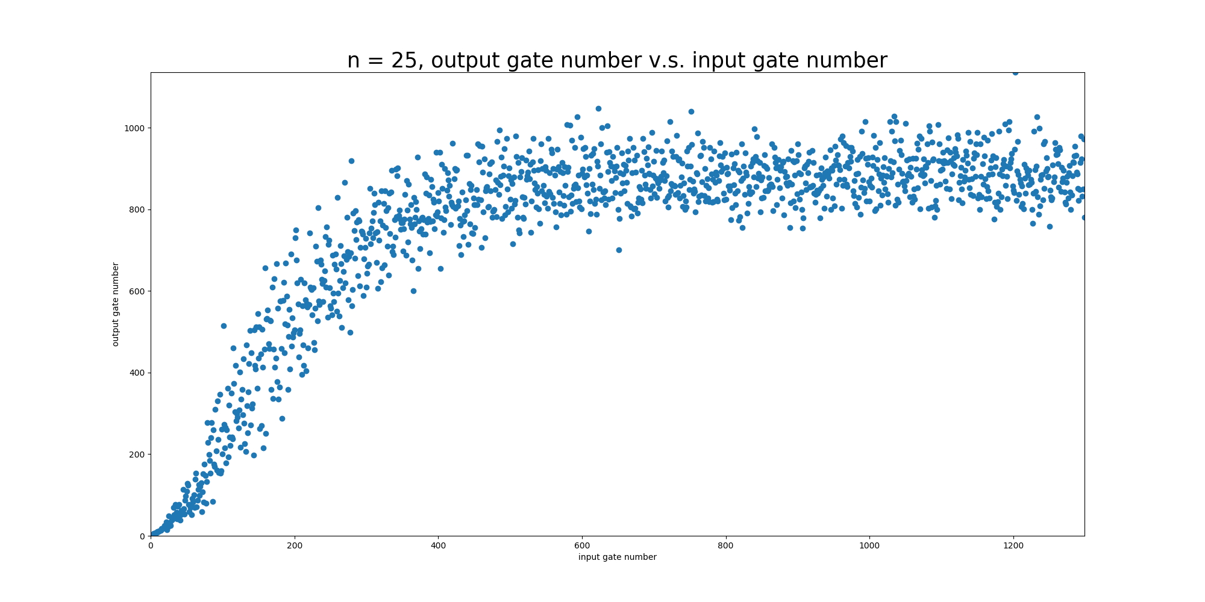
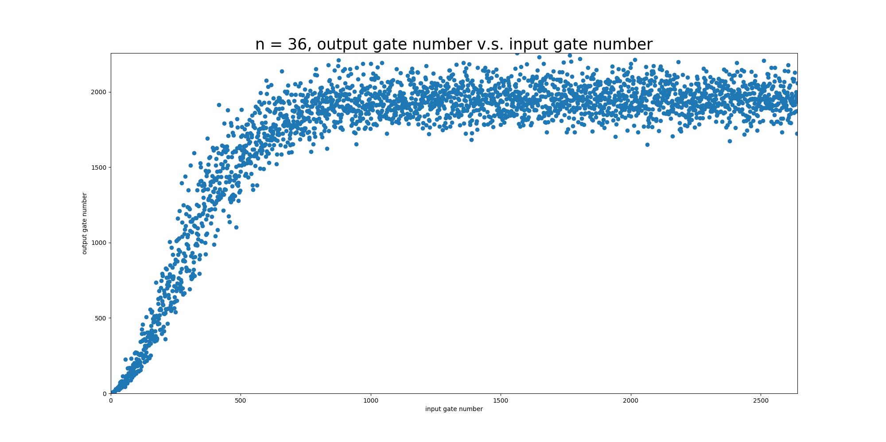
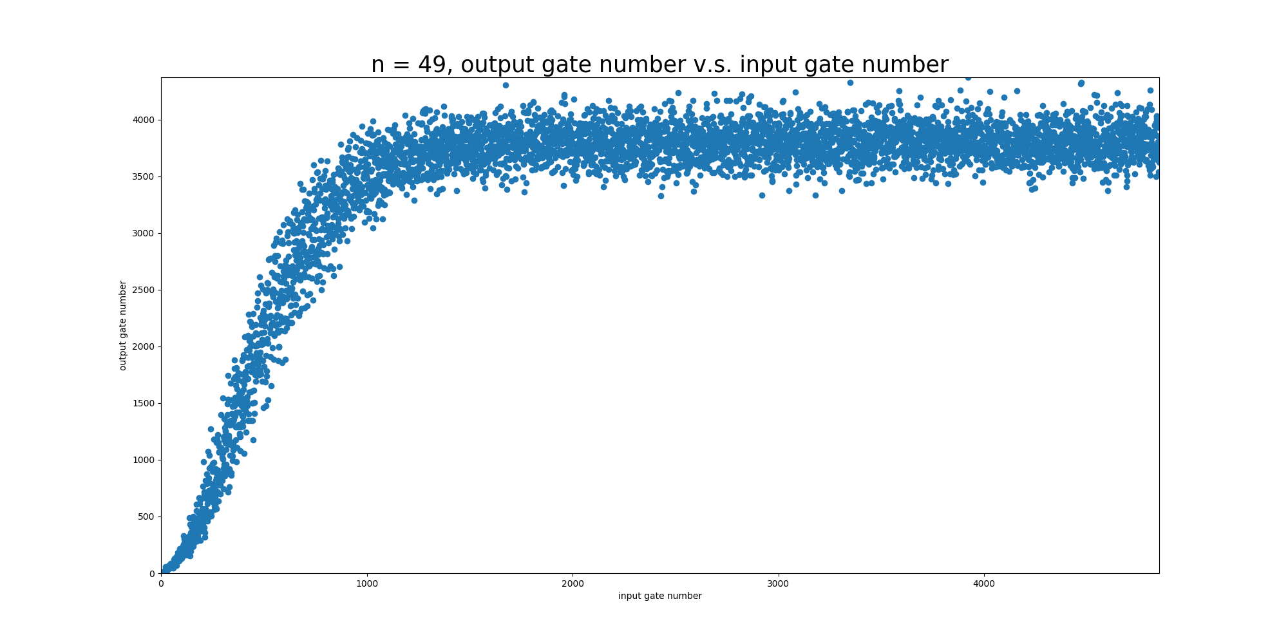
Experimental Results with connectivity
Test circuit is generated by randomly generate C-NOT.

Slide 30
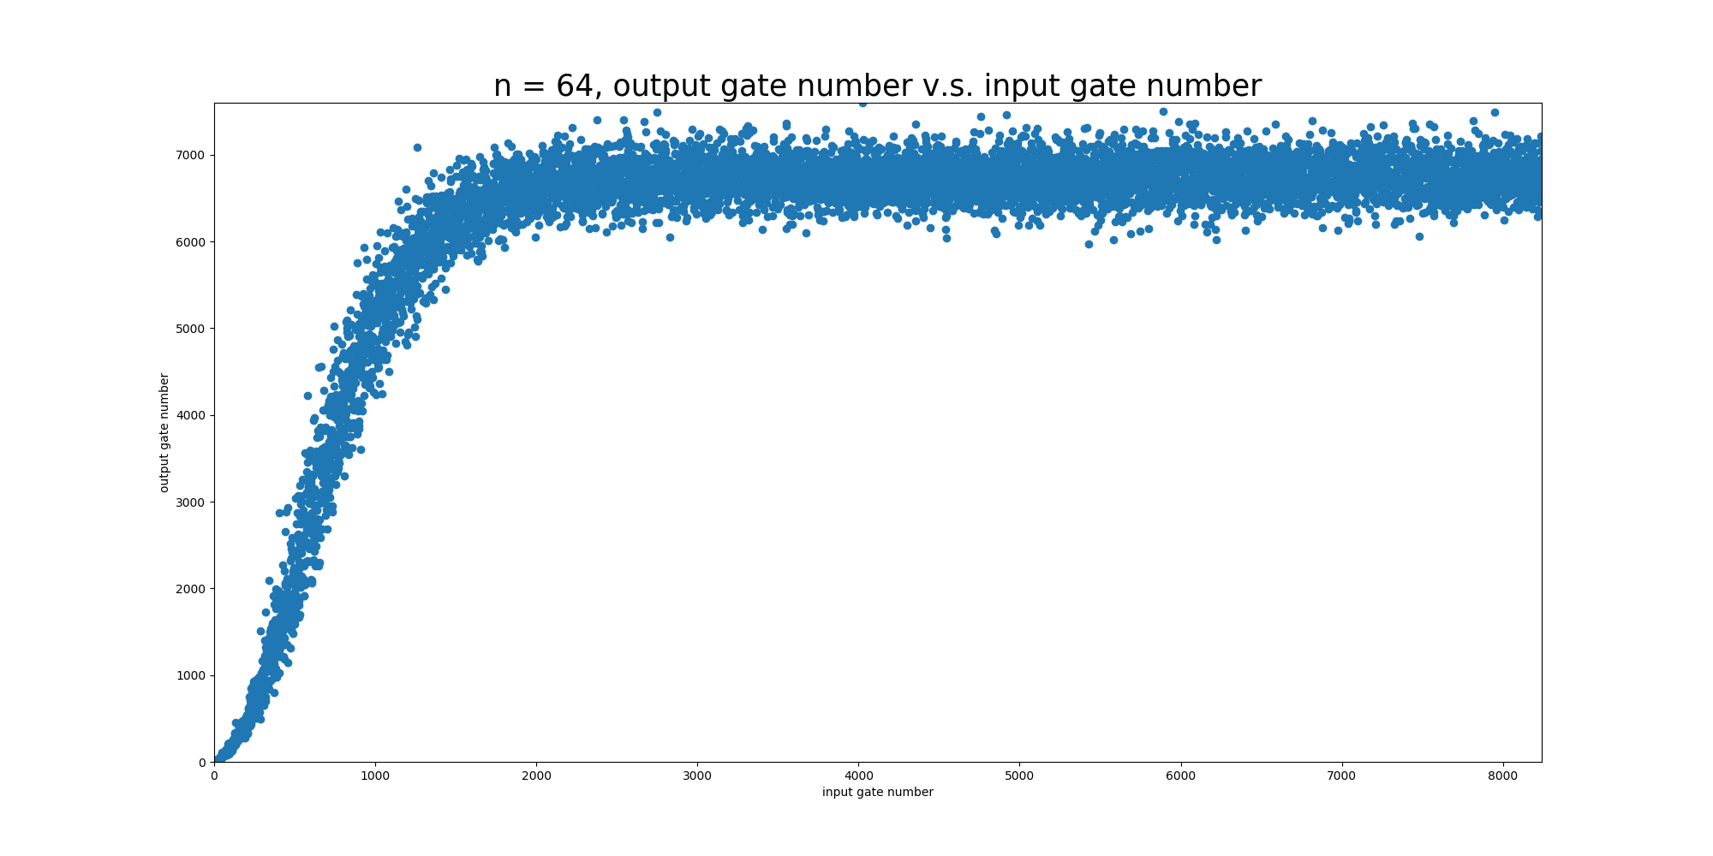
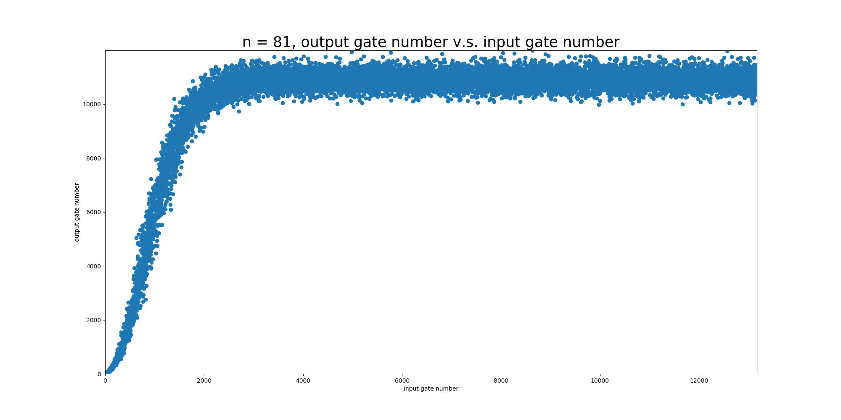

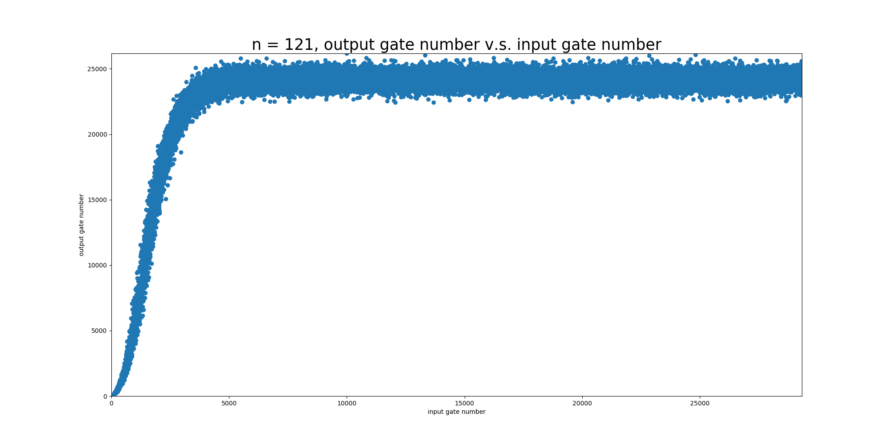
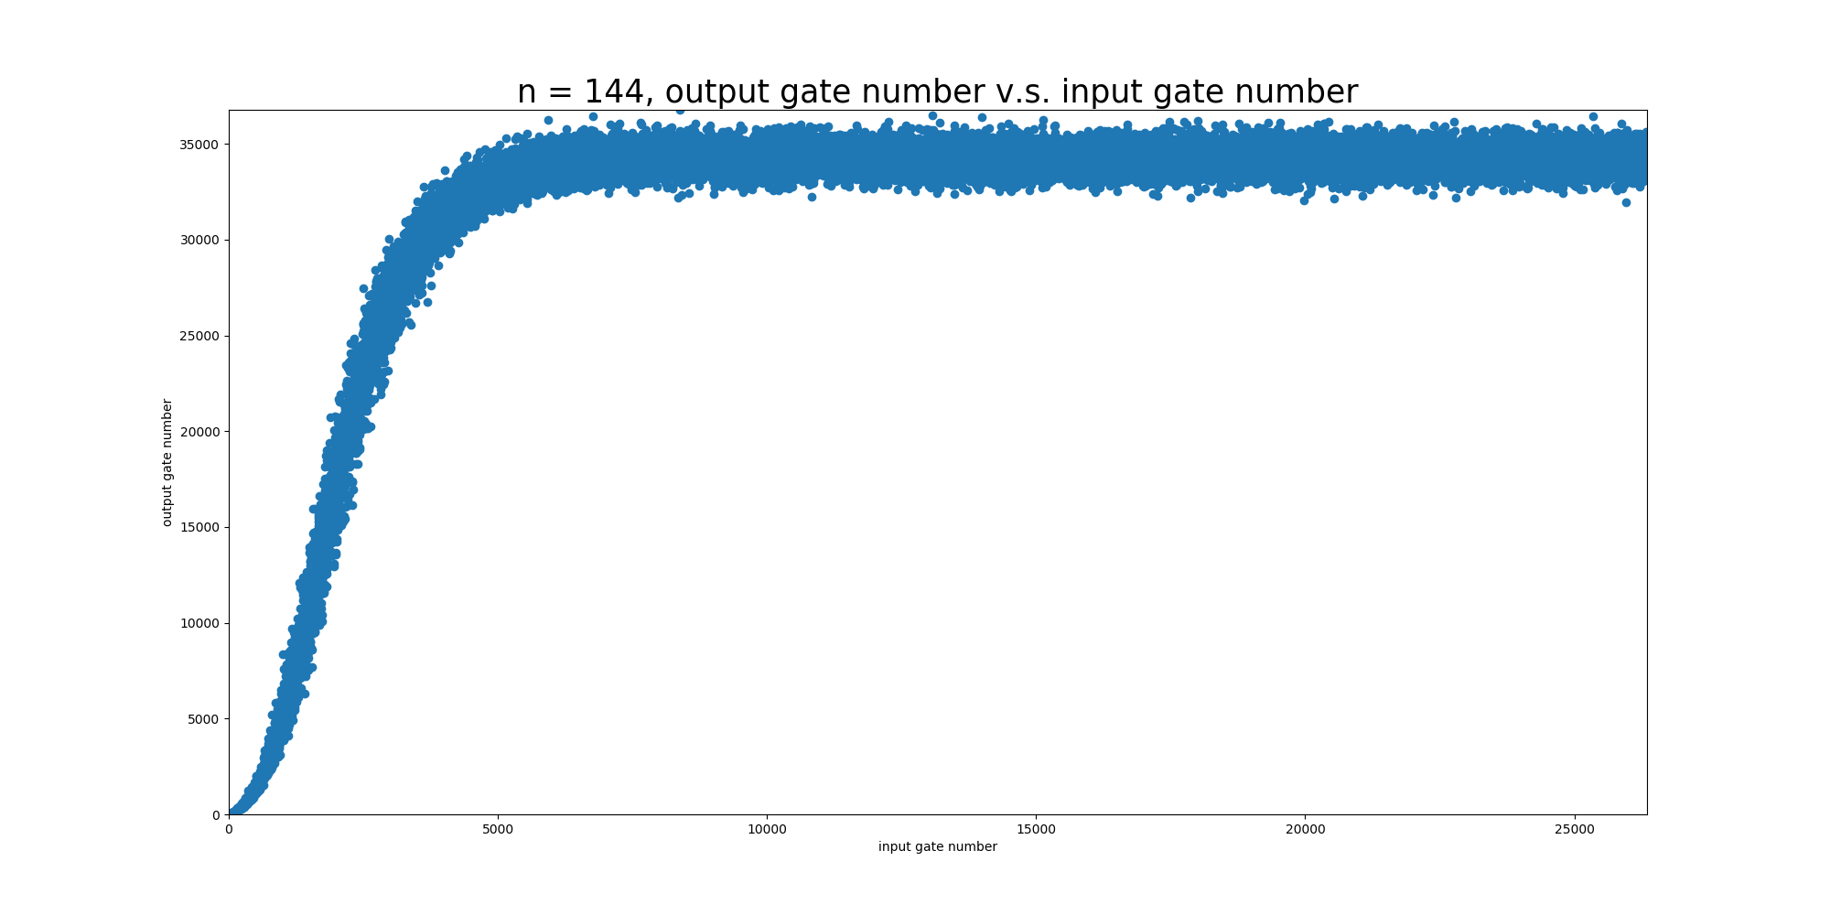
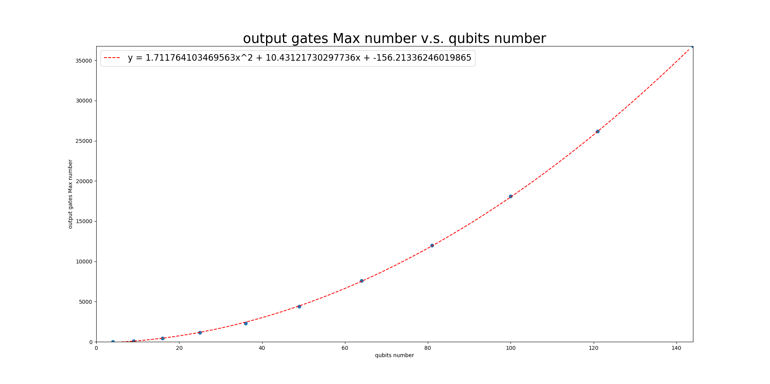
Experimental Results with connectivity
Test circuit is generated by randomly generate C-NOT.

Slide 31
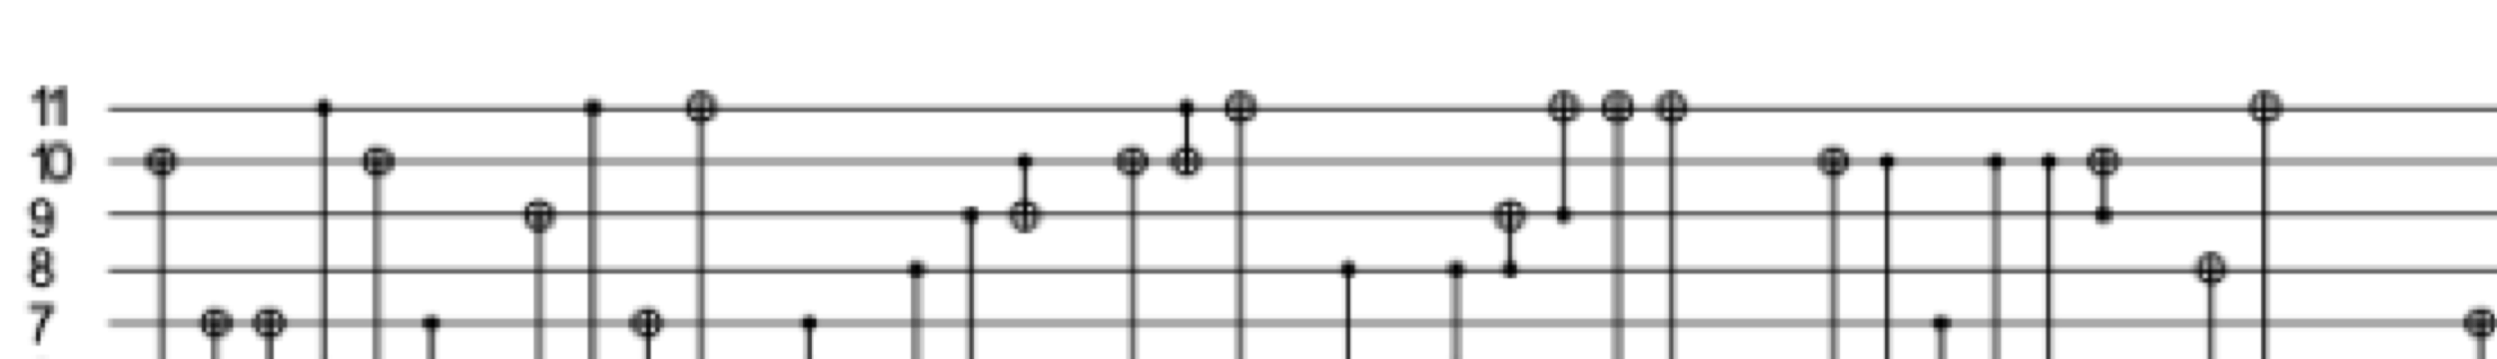
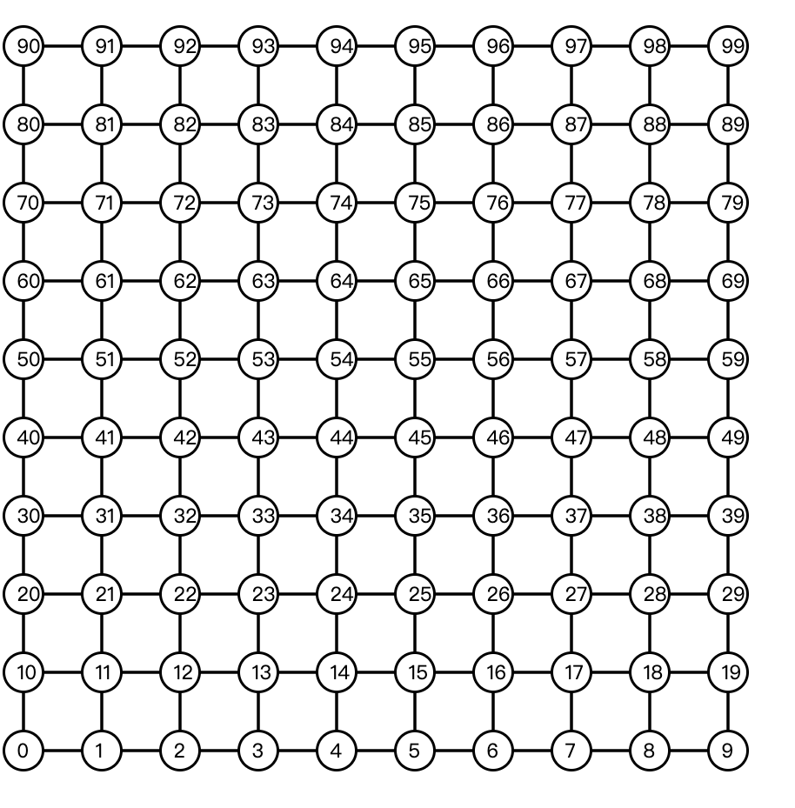
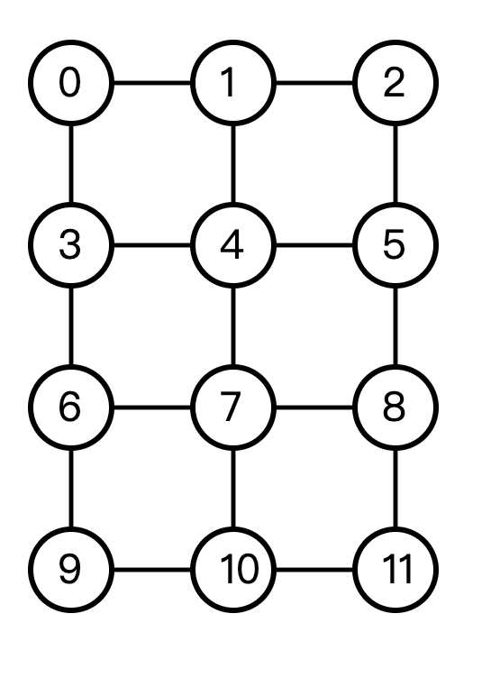
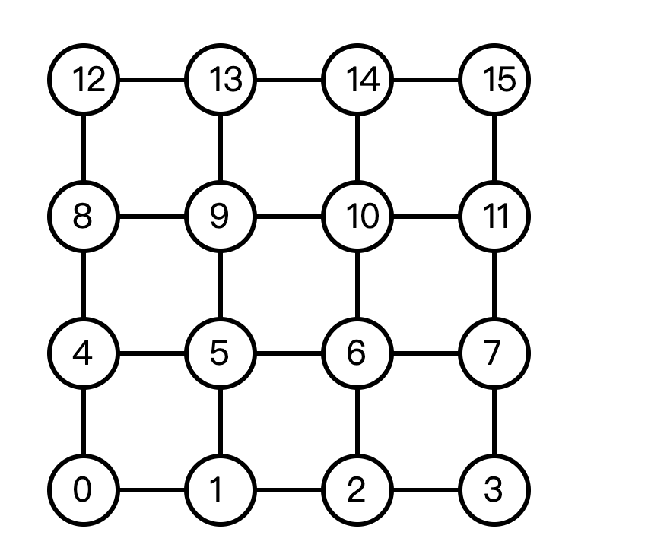
Visualization(python)

Slide 32
Outline
Introduction and previous work
Implementation and Contribution
Experimental Results
Observation and Discussion

Slide 33
Observation and Discussion
Observation
These two method both perform bad at simple cases. Maybe it is because when focus at a single column, the other columns’ information is lost.
The second method says that partitioning has bad performance. Maybe it is because of the increasing number of Steiner trees.
Future work
Work on connectivity graph that is not rectangular.
Given a matrix and a connectivity graph architecture, how to place the qubits ?

Slide 34

Thank You!

