Slide 1
μ-reactors for Heterogeneous Catalysis

Slide 2
Outline
Motivation & Introduction
Heating
The Grand Master Plan
Area Measurements
Oscillating CO oxidation
Sensitivity Measurements
Time-Of-Flight Mass Spectrometry
Summary

Slide 3
Introduction & Motivation
Heterogeneous catalysis is important
in many parts of modern life:
Fertilizers
Crude oil cleaning
Chemical industry
Car exhaust cleaning
…
Harvesting of solar energy
Chemical processes utilizing excess energy from renewable sources
Energy storage

Slide 4
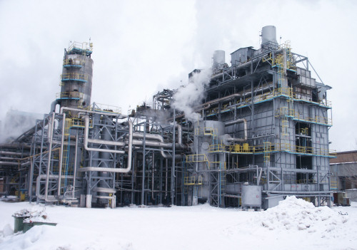
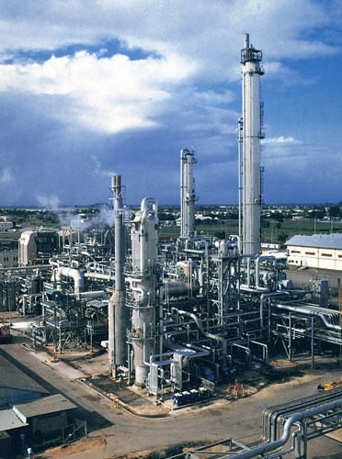
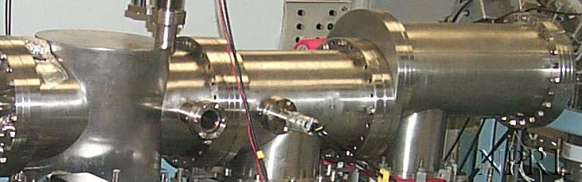
Introduction & Motivation
Many kinds of experimental catalysts needs to be tested in an early state of development
Often the amount of material will be extremely limited due to factors such as
Material costs
Fabrication constraints
Toxicity

Slide 5
Introduction & Motivation
The μ-reactor provides an excellent platform for testing of experimental catalysts.
Advantages includes:
High sensitivity
Low gas consumption
High safety level
Low thermal mass
Photo: Thomas Pedersen
CAD-drawing: Thomas Pedersen

Slide 6
Experimental Setup
Photo: Mathias Kjærgaard Christensen

Slide 7
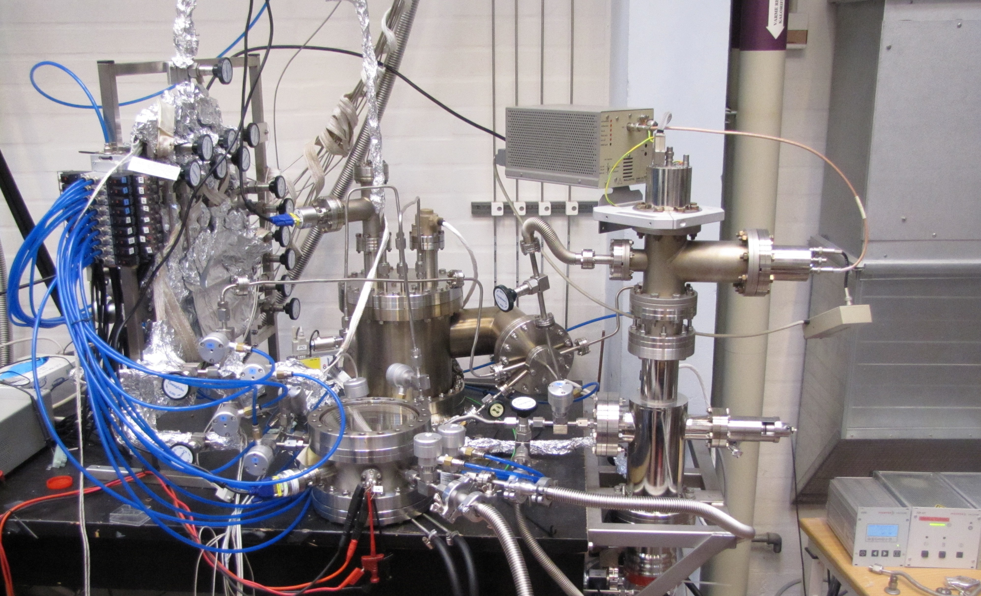
Experimental Setup
Photo: Mathias Kjærgaard Christensen

Slide 8
Experimental Setup

Slide 9
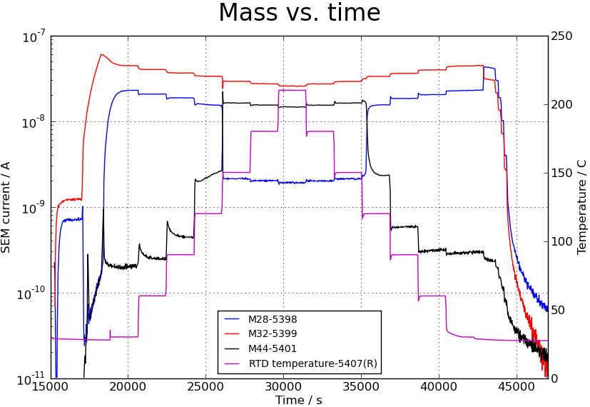
A Typical Measurement
CO oxidation on Pd thin film

Slide 10
General Measurement Strategy

Slide 11
General Measurement Strategy
The Grand Master Plan:
Thin-film measurements
Nanoparticle measurements
Publish

Slide 12
Heating

Slide 13
Heating

Slide 14
Temperature profiles

Slide 15
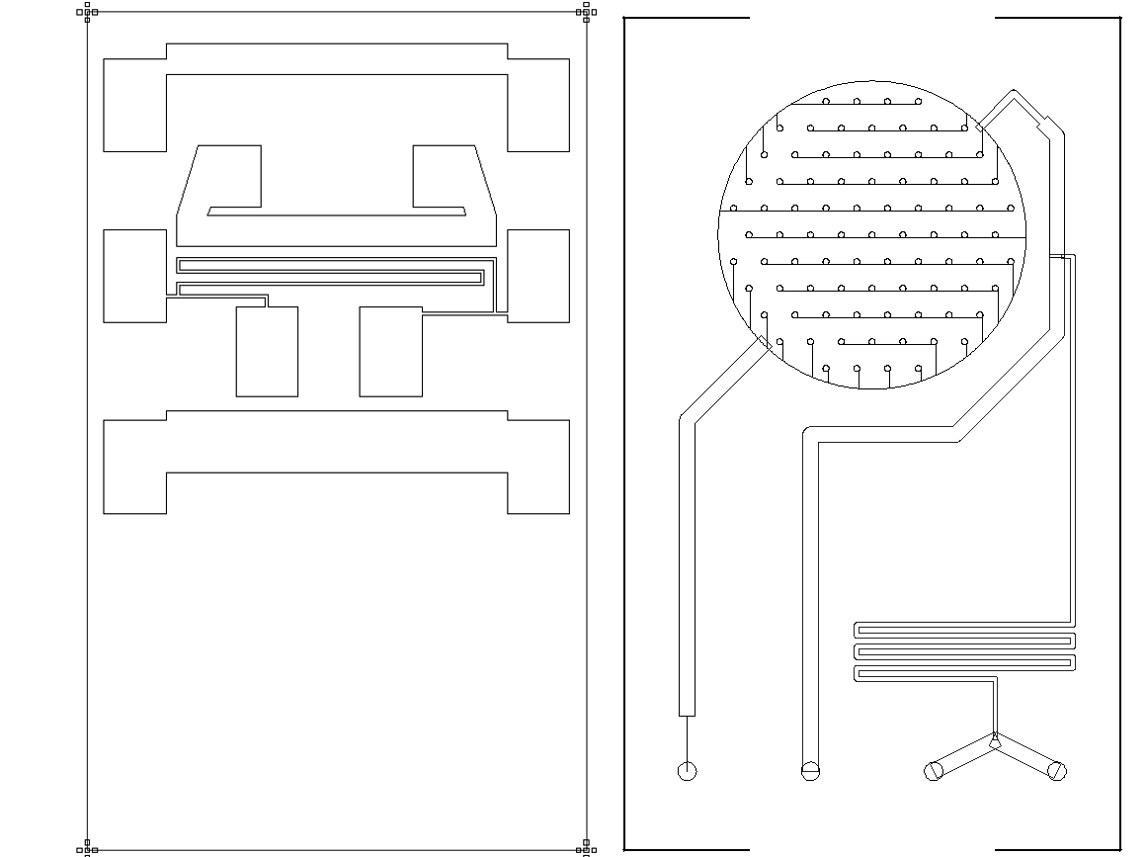
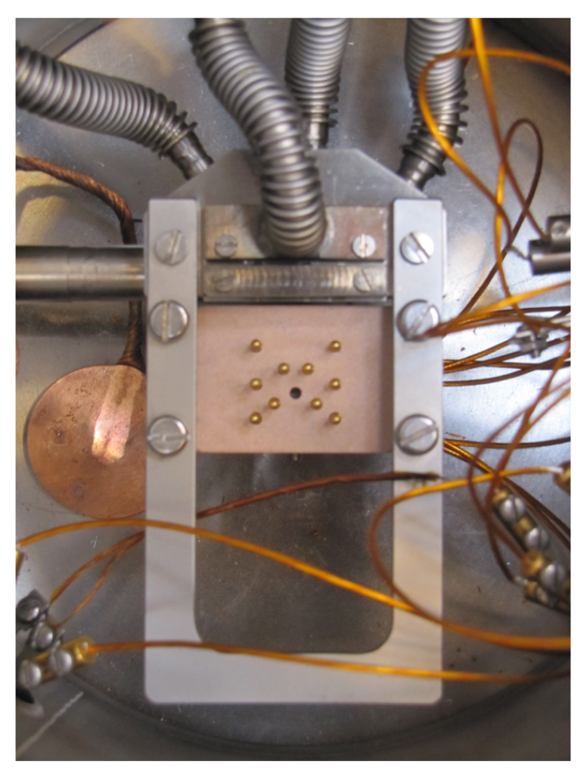
Heating V2.0
CAD Drawing: Thomas Pedersen
Photo: Mathias Kjærgaard Christensen

Slide 16
Measuring surface area

Slide 17
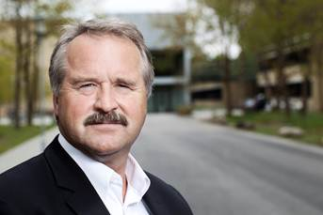
Measuring surface area
We need a way of measuring the active area of the catalysts in the reactor

Slide 18
Area Measurements
Measurement principle:
CO-titration
Dose oxygen
Evacuate reactor
Dose CO
Watch for CO2
Limitations
Works only for Pt
Not very sensitive

Slide 19
Area Measurements
Calibration experiments performed on thin films
Easy cleaning
Known surface area
Stable system allows for lots of experimentation
Sensitivity....
Reproducebility....

Slide 20
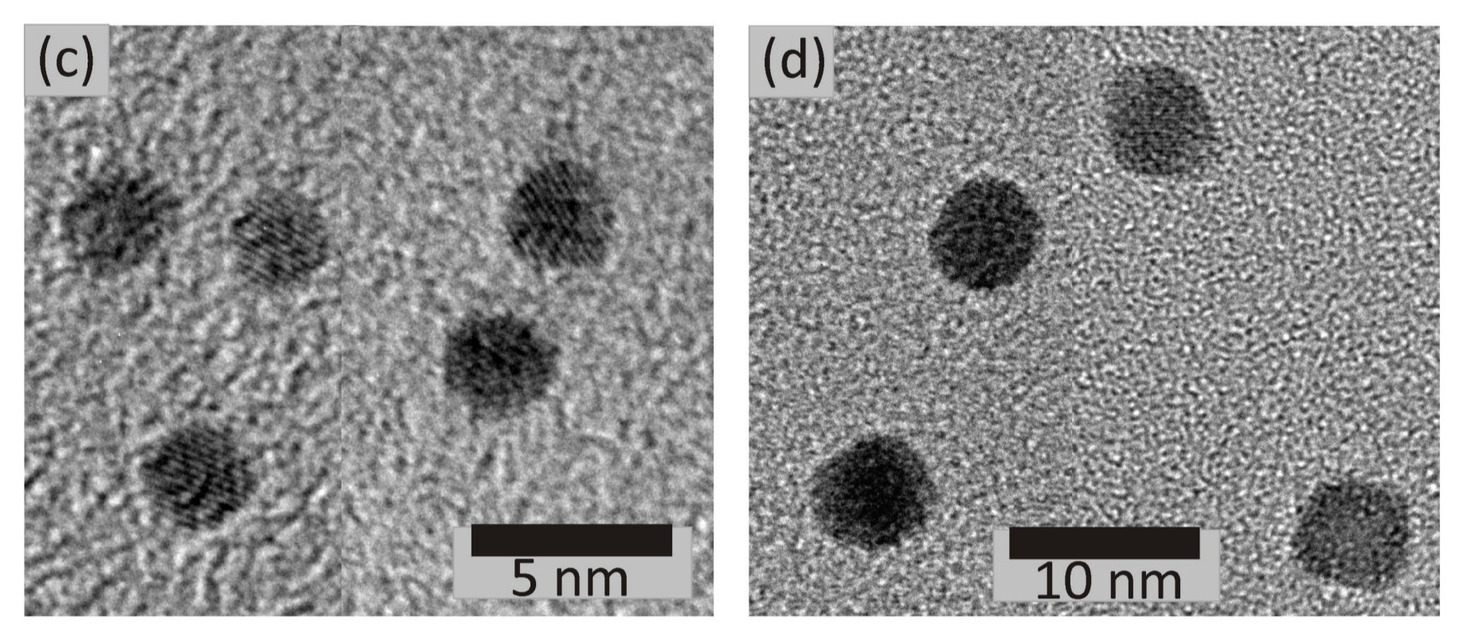
Area Measurements
According to the Grand Master Plan, we should now measure on nanoparticles.
The chosen sample has a nominal coverage of 10% of 5nm particles.
Measurement program:
Heating to 420◦ C in 1.0 bar O2
Heating to 300◦ C in 1.0 bar He
Heating to 300◦ C in 0.5 bar CO
Heating to 350◦ C in 1.0 bar O2
Heating to 300◦ C in 0.5 bar CO
Heating to 250◦ C in 1.0 bar O2
Heating to 300◦ C in 0.5 bar CO
Heating to 150◦ C in 1.0 bar O2
Heating to 300◦ C in 0.5 bar CO
Structural modiﬁcation of Pt model systems under high pressure CO annealing
D.N. McCarthy, et. al C.E. Strebel, T.P. Johansson, A. den Dunnen, A. Nierhoff, J.H.Nielsen, and Ib Chorkendorff, 2012

Slide 21
Area Measurements
Nanoparticle sample
Thin-film sample

Slide 22
Area Measurements

Slide 23
Area Measurements
The Grand Master Plan:
Thin-film measurements
Nanoparticle measurements
Publish
Establish new characterization tool for the reactors

Slide 24
Oscillating Reactions

Slide 25
Oscillating Reactions
The story starts a dark and stormy saturday evening....
Experiments for a bachelors thesis¹ a was done and the setup was idling for the rest of the weekend
An idling sample of size-selected nano-clusters is the perfect time for random experiments!
Tried to run a classic CO oxidation light-off experiment in extremely high oxygen concentration
¹ Mikkel Rykær Kraglund: Reactivity of mass selected nanoparticles measured in microreactors, 2011

Slide 26
Oscillating Reactions
Data with unusually low quality called for an explanation

Slide 27
Oscillating Reactions

Slide 28
Oscillating Reactions
A more systematic study was initialized
A large set of nanoparticle samples was tested for oscillatory behavior

Slide 29
Oscillating Reactions
Model based on work from:
B. L. M. Hendriksen, M. D. Ackermann, R. van Rijn, D. Stoltz, I. Popa, O. Balmes, A. Resta, D. Wermeille, R. Felici, S. Ferrer, and J. W.
M. Frenken. The role of steps in surface catalysis and reaction oscillations. Nature Chemistry, 2(9):730–734, September 2010.

Slide 30
Oscillating Reactions
Oscillations self sustained for several days, with steadily increasing period.

Slide 31
Oscillating Reactions
Oscillations are heavily dependent on temperature and mildly dependent on gas composition.

Slide 32
Oscillating Reactions
The Grand Master Plan:
Thin film measurements
Nanoparticle measurements
Publish Submit

Slide 33
Sensitivity Measurements
Observation. The sample loading for the oscillation experiments was very low.
Question. How small amounts of catalyst can be measured in the μ-reactor setup?

Slide 34
Sensitivity Measurements
Thomas Pedersen produced a wafer with Pt spots of different sizes. Six of these have so far been successfully measured.
# | Radius / μm | Area / μm² | Reactor coverage
N5 | 3.5 | 38.5 | 4.9 x 10⁻⁷
N8 | 15 | 707 | 9.0 x 10⁻⁶
N9 | 25 | 1960 | 2.5 x 10⁻⁵
N10 | 50 | 7850 | 1.0 x 10⁻⁴
N11 | 250 | 196000 | 2.5 x 10⁻³

Slide 35
Sensitivity Measurements
# | Radius / μm | Area / μm² | Reactor coverage
N5 | 3.5 | 38.5 | 4.9 x 10⁻⁷
N8 | 15 | 707 | 9.0 x 10⁻⁶
N9 | 25 | 1960 | 2.5 x 10⁻⁵
N10 | 50 | 7850 | 1.0 x 10⁻⁴
N11 | 250 | 196000 | 2.5 x 10⁻³

Slide 36
Sensitivity Measurements
Background correction
To do quantitative analysis, it is necessary to subtract the CO2 background.

Slide 37
Sensitivity Measurements
Background correction
To do quantitative analysis, it is necessary to subtract the CO2 background.
Background turns out to be dominated by oxygen:
ICO₂ ~ 0.0082 x IO₂

Slide 38
Sensitivity Measurements
Background correction
Using the background correction
the linear region can be significantly extended.

Slide 39
Sensitivity Measurements
Mass Spec Calibration
How do we get from MS-output to actual turn over frequency?
Use the approximately known total flow and calculate from the total SEM current.

Slide 40
Sensitivity Measurements
From the known sensitivity absolute turnover can be calculated.
Area normalization shows that all samples falls on approximately the same line.
Number of sites on Pt: ~6.5x10⁶ μm⁻²

Slide 41
Sensitivity Measurements
Finally, we are able to calculate absolute numbers for activation energy and prefactor.
Errorbars expresses fitting uncertainty and thus under estimates the real error.

Slide 42
Sensitivity Measurements
Take home messages regarding sensitivity:
CO oxidation can be extremely efficient on Pt
Even minute amounts of metal (espcially Pt) contamination must be avoided in the μ-reactors
The Grand Master Plan:
Thin film measurements
Nanoparticle measurements
Publish

Slide 43
Time-Of-Flight Mass Spectrometry

Slide 44
Time-Of-Flight Mass Spectrometry
Drawing:
Jordan TOF Products, Inc
Drawing: Thomas Andersen

Slide 45
Time-Of-Flight Mass Spectrometry

Slide 46
Time-Of-Flight Mass Spectrometry
Mass resolution much superior to a QMS allows for separation of OH and NH3

Slide 47
Time-Of-Flight Mass
Spectrometry
The Grand Master Plan:
Thin film measurements
Nanoparticle measurements
Thin film measurements
Publish

Slide 48
Conclusions
The many advantages of the μ-reactor platform has been demonstrated
A new and improved heating scheme has been implemented
A method to determine the amount of actual active catalyst surface area has been developed (at least for Platinum...)
Oscillating CO oxidation reactions has been demonstrated
The very high sensitivity of the platform has been shown and turn over frequencies of almost 10⁵ has been achived
The successful application of Time-Of-Flight Mass Spectrometry to the platform has been shown

Slide 49
Acknowledgments
Thank you to a long list of people...
My familly and friends (especially Sine and Gro & Sia!)
Ib Chorkendorff
Ole Hansen
Thomas Pedersen
Dan, Peder, Peter and Anders
Jane Hvolbæk Nielsen
Ole Trinhammer
Anders Nierhoff
Peter Vesborg
Mathias Kjærgaard Sørensen
Thomas Andersen
Kenneth Nielsen
+ everybody at CINF!!!

