Slide 1
EthiCars
Can autonomous vehicles make ethical decisions one day?
by Robert Juhasz, April 2021

Slide 2
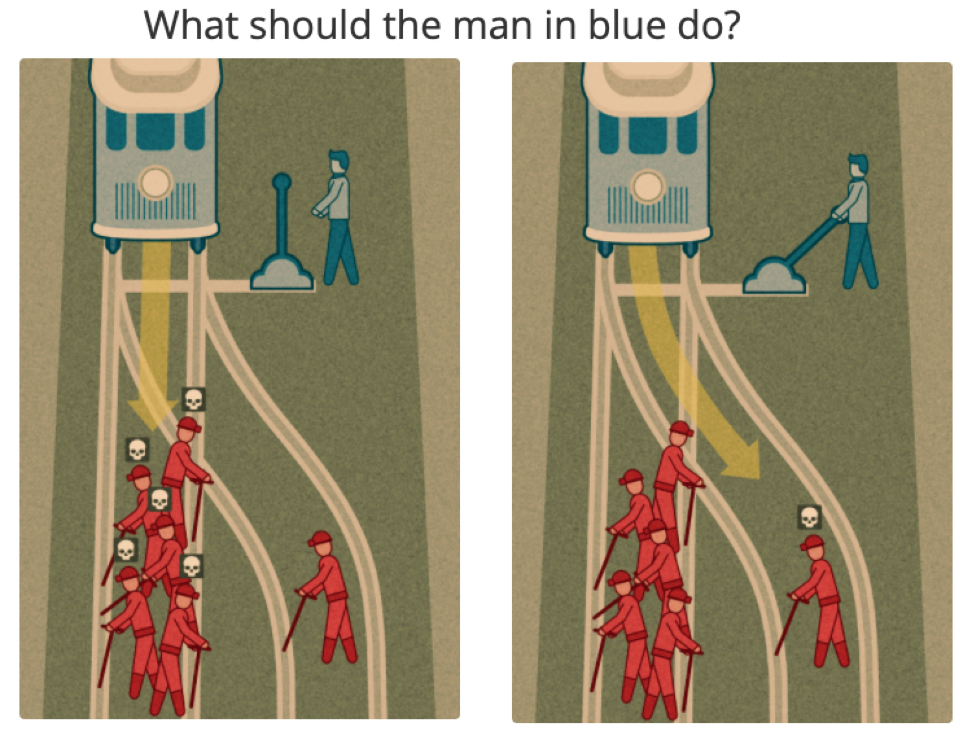
Moral Machine Project
An MIT crowd sourcing project
Collect human decisions in various scenarios
Two deadly outcomes in a car accident
Based on the old "trolley problem”
Ethical dilemma:
Sacrifice one person to save more.

Slide 3
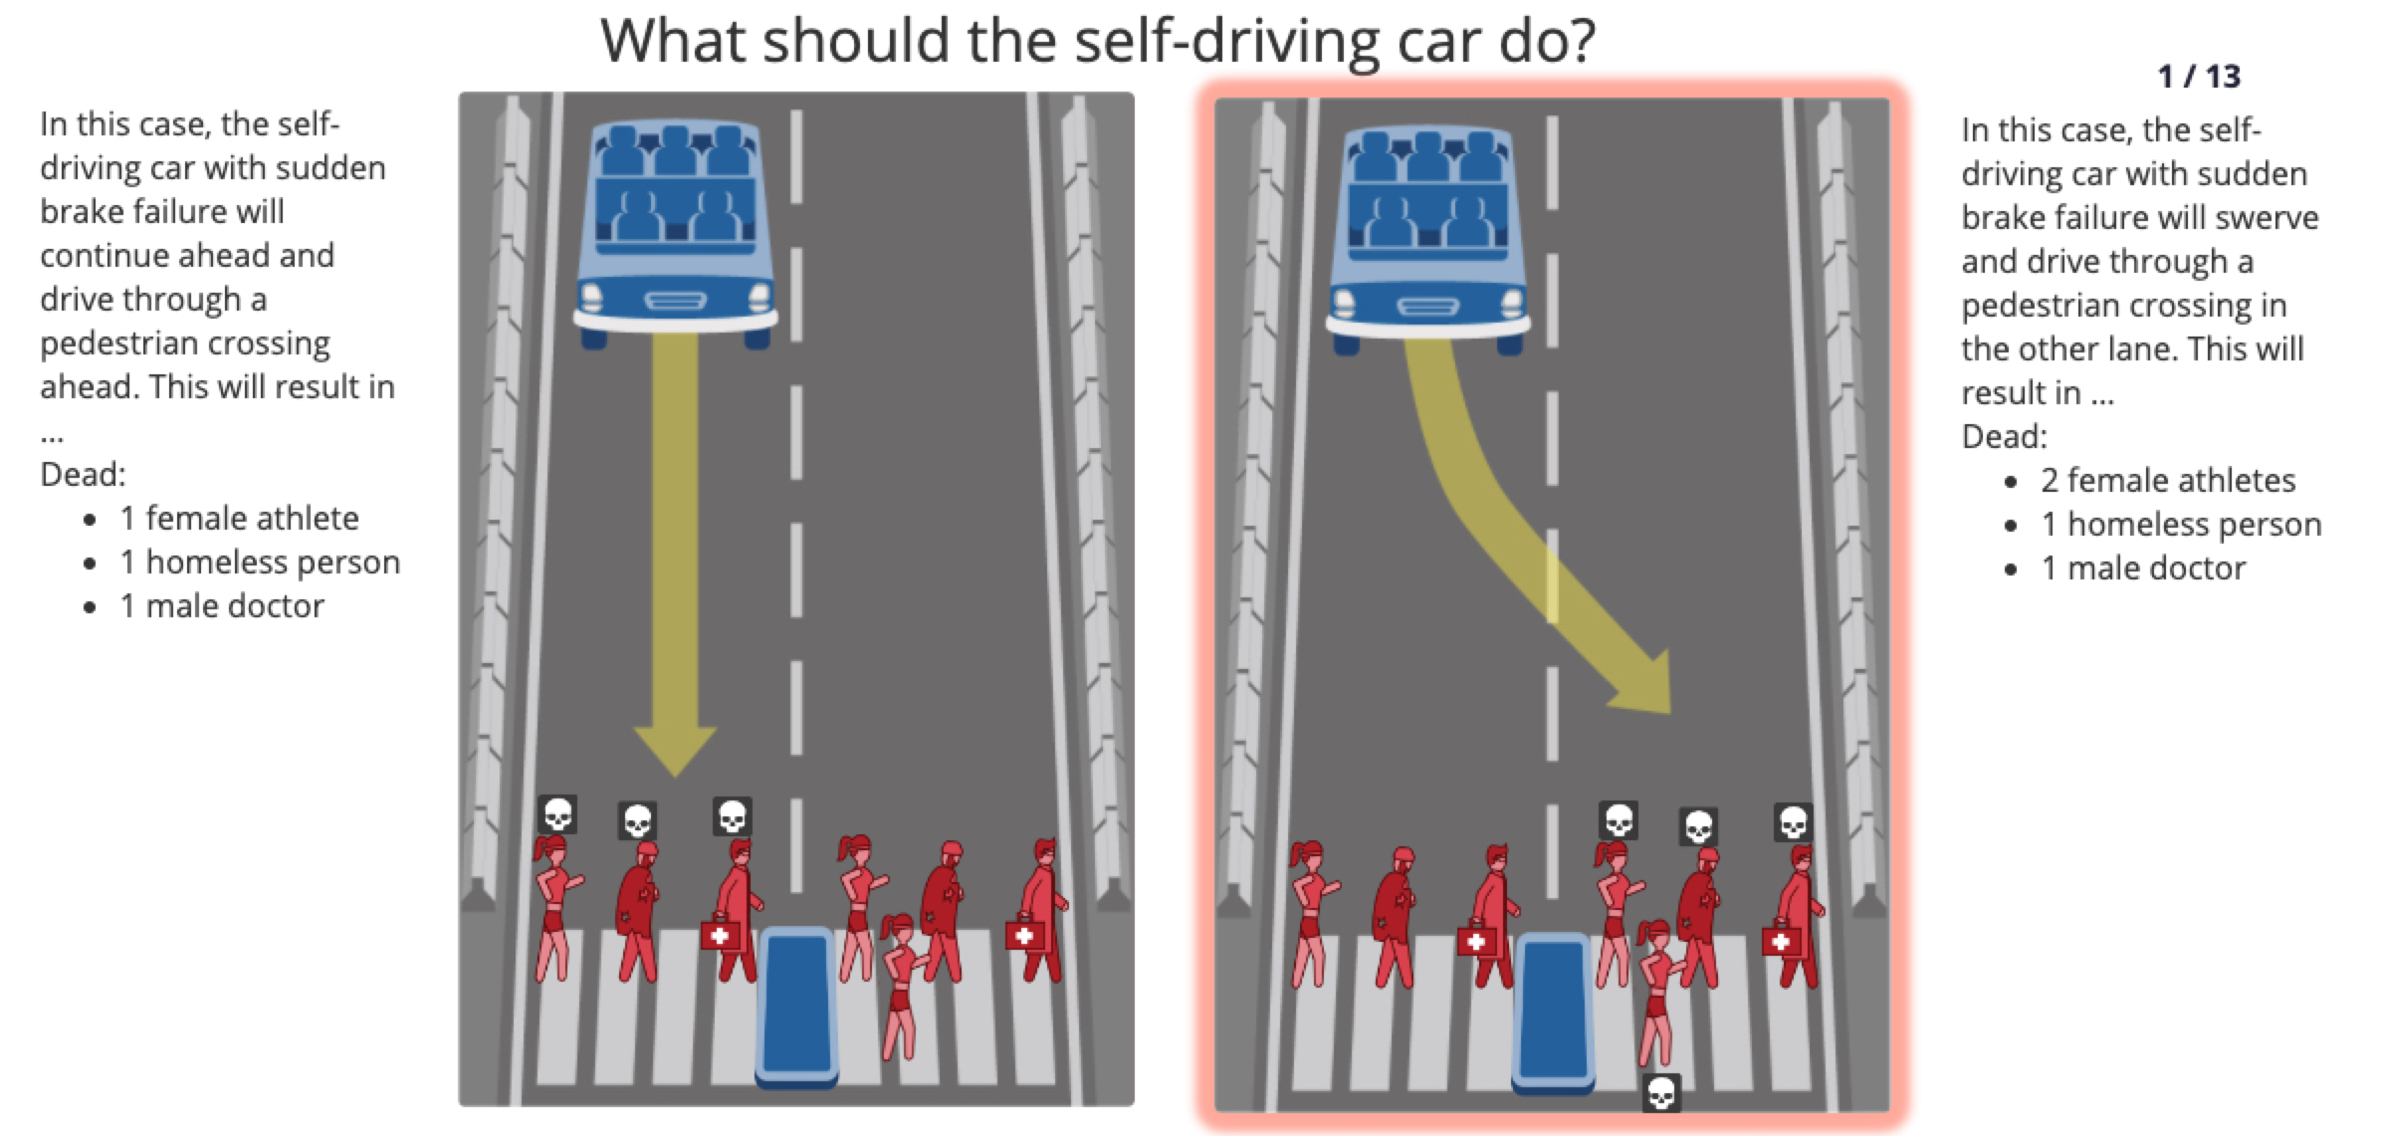
Moral Machine Project

Slide 4






The Data Pipeline
Moral Machine database
Downloaded from OSF
Main data in 2 CSV files
#1 | 70.3M rows | 11.6 GB
#2 | 11.3M rows | 1.83 GB
Additional external data with country information

