Slide 1
Simulated hurricane migration visualization
Brad bolan
Robert horn
Nathan lyles
Kevin mueler
Robert skelton

Slide 2
goals
Create the basis of a website for predicting migration based on hurricane paths
Make a simple elegant design for the site
Develop new skills in web development
Exposure to a team environment

Slide 3
Design Stage
Originally had difficulty coming up with a relevant idea for the project
Scrapped many of our early ideas for various reasons
Technically difficult
Hard to relate to migration
Eventually came up with a doable design that was relevant to the theme of the event

Slide 4
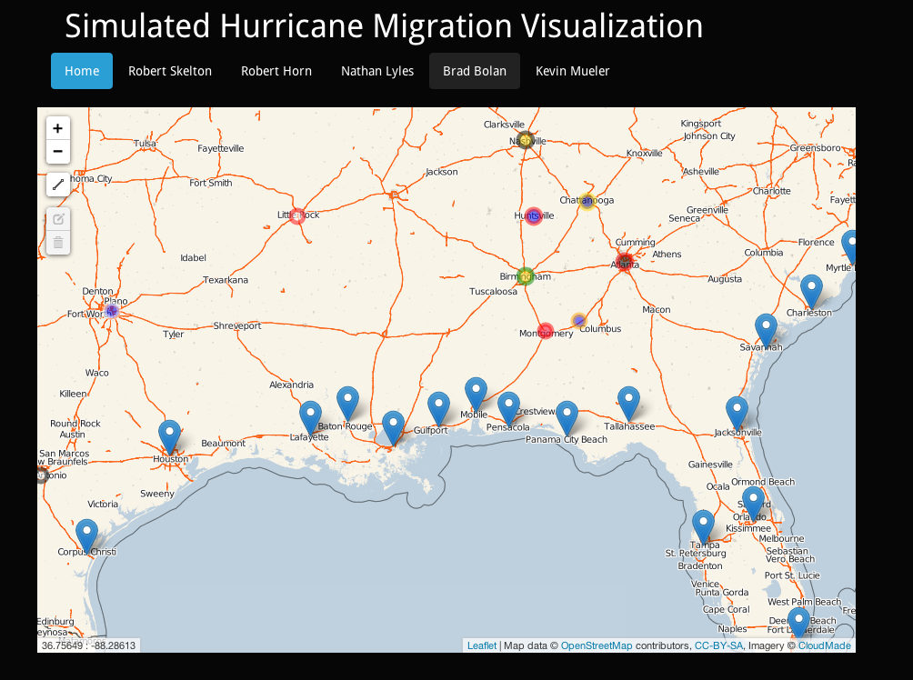
implementation
Worked on a user interface implemented into a simple website
Simultaneously worked on backend program for predicting the migration patterns of people temporarily relocated by hurricanes

Slide 5
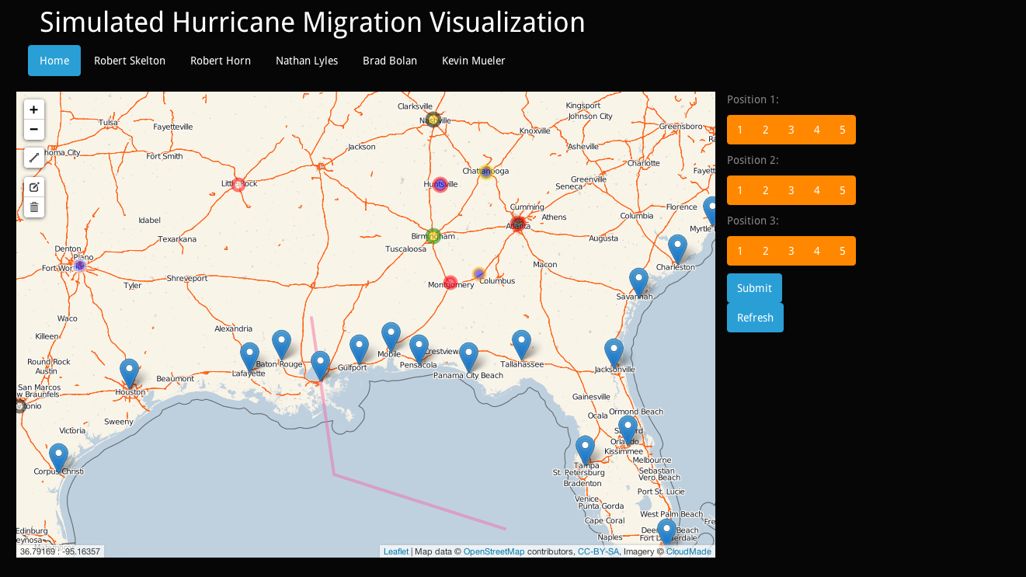
Operation

