Slide 1
Product Service Implementation
An overview of implementing microservices for the products.
Presented by Bin Liu
Version 1

Slide 2
Requirements
Functional requirements:
Develop a register product UI screen and API that captures product details and saves in DB.
Build an API to get the product details.
Build an API that allows changes to the product price. It will send the price change event to Kafka and update the changes to DB.
Reads the price change event from Kafka.
Build a UI screen to view the Product details and update the product details in case of price change event.

Slide 3
Technologies
Java
Spring/Spring Boot → Build microservices
Kafka
For registering new product, price update
ReactJS
UI for product related operations
Postgres
Database to store the product (we could consider NoSQL DB based on requirement analysis)
Docker, Docker compose
Container for Postgres, Keycloak, Zookeeper, Kafka
Note: Can use command “docker compose up” to start all containers (defined in docker-compose.yml)
Keycloak
OAuth2.0 authentication and authorization
Needs to configure Keycloak first before running the application!

Slide 4
Implementation
Create an ReactJS app
Client UI is implemented and deployed in pure ReactJS/JavaScript
Client UI is integrated with Keycloak for authentication and authorization
Client UI is consists of the following components:
Login screen
Integrated with Keycloak
User can perform the following actions
Sign In, Forgot Password, Register
Main screen
Provides links which allows user to either go to product registration or product list view
Provides Logout button
Product registration screen
User can register a new product by entering Product Name and Product Price
Product list view screen
User can perform Price Update, Delete Product, View Product actions
Product view screen
When user stays on product view screen, if the product price is changed he can see the price change in the view screen in real time

Slide 5
Implementation
Create Java Microservice One - Product Microservice
Product microservice is the end point for ReactJS interaction and it defines the following functionalities:
Register Product
End Point:
POST /api/v1/products
Accepts the product details from the ReactJS client
Checks if the product already exist with the same product name by calling another microservice, if the product already exists, throws the error back to client, otherwise, send product details information to Kafka for saving to the database
Get list of products
End Point:
GET /api/v1/products
Retrieve the paged products from another microservice and return them to ReactJS client so ReactJS client can view the products page by page
Calling another microservice to retrieve the paged products from database

Slide 6
Implementation
Create Java Microservice One - Product Microservice
Product microservice is the end point for ReactJS interaction and it defines the following functionalities:
Update Product Price
End Point:
PUT /api/v1/products/{id}/update-price
Accepts the product ID and new price from the ReactJS client
Send product ID and new price information to Kafka for updating the record in the database
Delete Product
End Point
DELETE /api/v1/products/{id}
Accepts the product ID from the ReactJS client
Send product ID information to Kafka for deleting the record in the database

Slide 7
Implementation
Create Java Microservice One - Product Microservice
Product microservice is the end point for ReactJS interaction and it defines the following functionalities:
Get Product Details
End Point:
GET /api/v1/products/{id}
Accepts the product ID from the ReactJS client
Get the product details by calling another microservice which retrieves the data from the database
Provide Really Time Price Update to ReactJS client
End Point
GET /api/v1/products/updates
Registers a consumer to price change product-price-changes topic
Returns Flux to ReactJS client for updating the new price on UI

Slide 8
Implementation
Create Java Microservice Two - Persistence Microservice
Persistence microservice is the end point for accepting the request from Microservice One and performs database operations and returns the results to Microservice One, it does not interact with ReactJS client directly:
Get list of products
End Point:
GET /api/v1/products
Accepts request from Microservice One
Retrieve the paged products from the database and return them to Microservice One
Get Product Details
End Point
GET /api/v1/products/{id}
Accepts request from Microservice One
Retrieve the product details from the database and return them to Microservice One

Slide 9
Implementation
Create Java Microservice Two - Persistence Microservice
Persistence microservice is the end point for accepting the request from Microservice One and performs database operations and returns the results to Microservice One, it does not interact with ReactJS client directly:
Check if Product Exists by Name
End Point:
GET /api/v1/products/exists-by-name? name=<Product_Name>
Accepts request from Microservice One
Returns a Boolean of true if product already exists in the database otherwise returns false
Kafka consumers
Listens to product_create_topic
Retrieves the product information from Kafka and saves into the database

Slide 10
Implementation
Create Java Microservice Two - Persistence Microservice
Persistence microservice is the end point for accepting the request from Microservice One and performs database operations and returns the results to Microservice One, it does not interact with ReactJS client directly:
Kafka consumers
Listens to product_price_topic
Retrieves the product information from Kafka
If the new price is not the same as existing price, updates the product new price into the database and sends the new price to Kafka so Microservice One consumer can get the change and update ReactJS client
Listens to product_delete_topic
Retrieves the product information from Kafka and delete the product from the database

Slide 11
Architecture Considerations
We should consider the following areas for the deployment of microservices
High availability and reliability
Scalability
Fault Tolerance
Monitoring and Logging

Slide 12
Architecture Considerations
Based on the areas of consideration we suggest to use cloud based solutions
Sample usage of cloud based solution
Cloud:
AWS
Services:
API Gateway
Simplified API Management - Centralized Management, Versioning
Scalability - Auto-Scaling, Global Reach
Security - Built-in Security Features, DDoS Protection, TLS/SSL Termination
Performance Optimization – Caching, Low Latency
Monitoring and Analytics - Detailed Metrics, Logging
Integration with AWS Services - Seamless Integration, Event-Driven Architecture
Cost Efficiency - Pay-as-You-Go, Free Tier
API Customization and Transformation - Request/Response Transformation, Validation and Throttling
Custom Domain Names and SSL - Custom Domains, Automatic SSL/TLS
Developer Productivity - SDK Generation, Documentation
Flexible Deployment Options - Stage Management, Canary Releases

Slide 13
Architecture Considerations
Sample usage of cloud based solution
Services:
ELB
High Availability and Fault Tolerance - Automatic Scaling, Multi-AZ Support
Flexible Load Balancing Options - Support for Multiple Protocols, Application Load Balancer (ALB), Network Load Balancer (NLB), Gateway Load Balancer
Security - SSL Termination, Integration with AWS WAF, DDoS Protection
Automatic Health Checks - Health Monitoring, Automated Failover
Improved Performance - Low Latency, Connection Draining
Cost-Effective - Pay-as-You-Go, Savings Plans
Seamless Integration with AWS Services - Elastic Beanstalk and ECS, Auto Scaling Integration
Advanced Traffic Management - Content-Based Routing, Cross-Zone Load Balancing
Operational Monitoring and Logging - CloudWatch Integration, Access Logs
Simplified Management - Managed Service, API and CLI Support

Slide 14
Architecture Considerations
Sample usage of cloud based solution
Services:
Amazon Managed Streaming for Apache Kafka
Fully Managed Service - Ease of Operation
Scalability - Elastic Scaling
Security - Integrated Security Features, Private Networking
High Availability - Multi-AZ Deployment
Cost Efficiency - Pay-as-You-Go Pricing, Automated Scaling
Seamless Integration - AWS Ecosystem Integration, Kafka Ecosystem Compatibility
Operational Monitoring - CloudWatch Integration, Logging and Metrics
Durability and Reliability - Replication and Data Durability, Automatic Recovery
Support for Kafka Versions - Multiple Kafka Versions
Developer-Friendly - Simplified Kafka Operations

Slide 15
Architecture Considerations
Sample usage of cloud based solution
Services:
EC2 or Elastic Beanstalk
Deploy the microservices
Amazon EC2 is ideal when you need complete control, custom configurations, and the flexibility to handle diverse and complex workloads
AWS Elastic Beanstalk is perfect for developers who want a managed service that simplifies deployment, scaling, and management, allowing them to focus on the application rather than the infrastructure

Slide 16
Architecture Considerations
Sample usage of cloud based solution
Services:
Amazon RDS for PostgreSQL
Managed Service
Scalability
High Availability
Automatic Backups
Performance Monitoring
Security
Cost-Effectiveness
Ease of Migration
High Performance
Integration with AWS Ecosystem

Slide 17
Architecture Considerations
Sample usage of cloud based solution
Services:
Monitoring and Logging
Monitoring Services
Amazon CloudWatch – Metrics, Alarms, Logs, Events
AWS X-Ray - Distributed Tracing, Service Maps
AWS CloudTrail - Audit Logs, Event History
AWS Trusted Advisor - Best Practices Checks
Logging Services
Amazon CloudWatch Logs
AWS Config
AWS Lambda Logs
Amazon S3 Logging
Amazon RDS Enhanced Monitoring

Slide 18
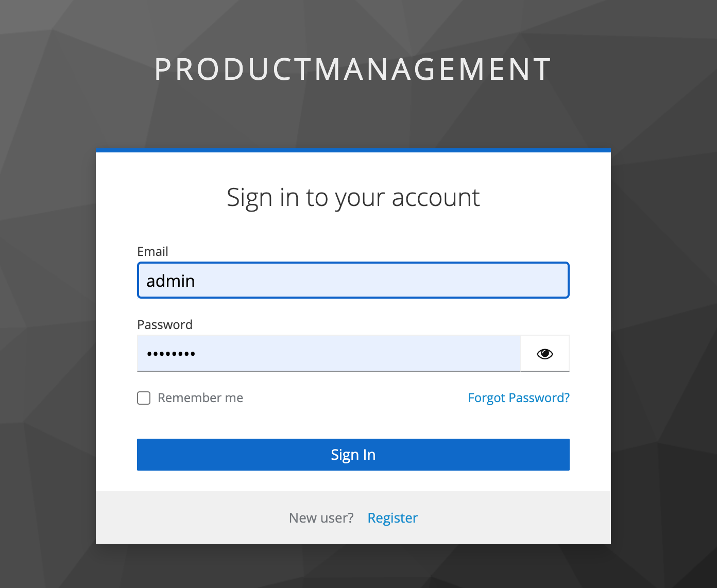
Screen Shots

Slide 19

Screen Shots

Slide 20
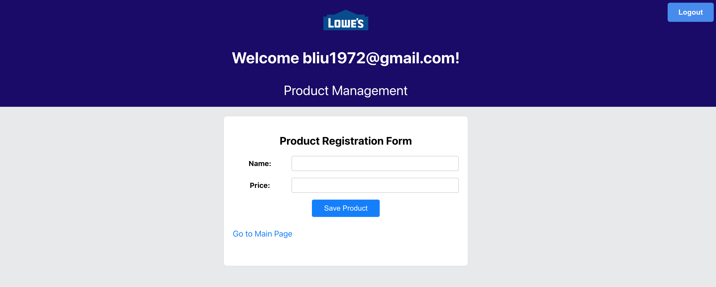
Screen Shots

Slide 21
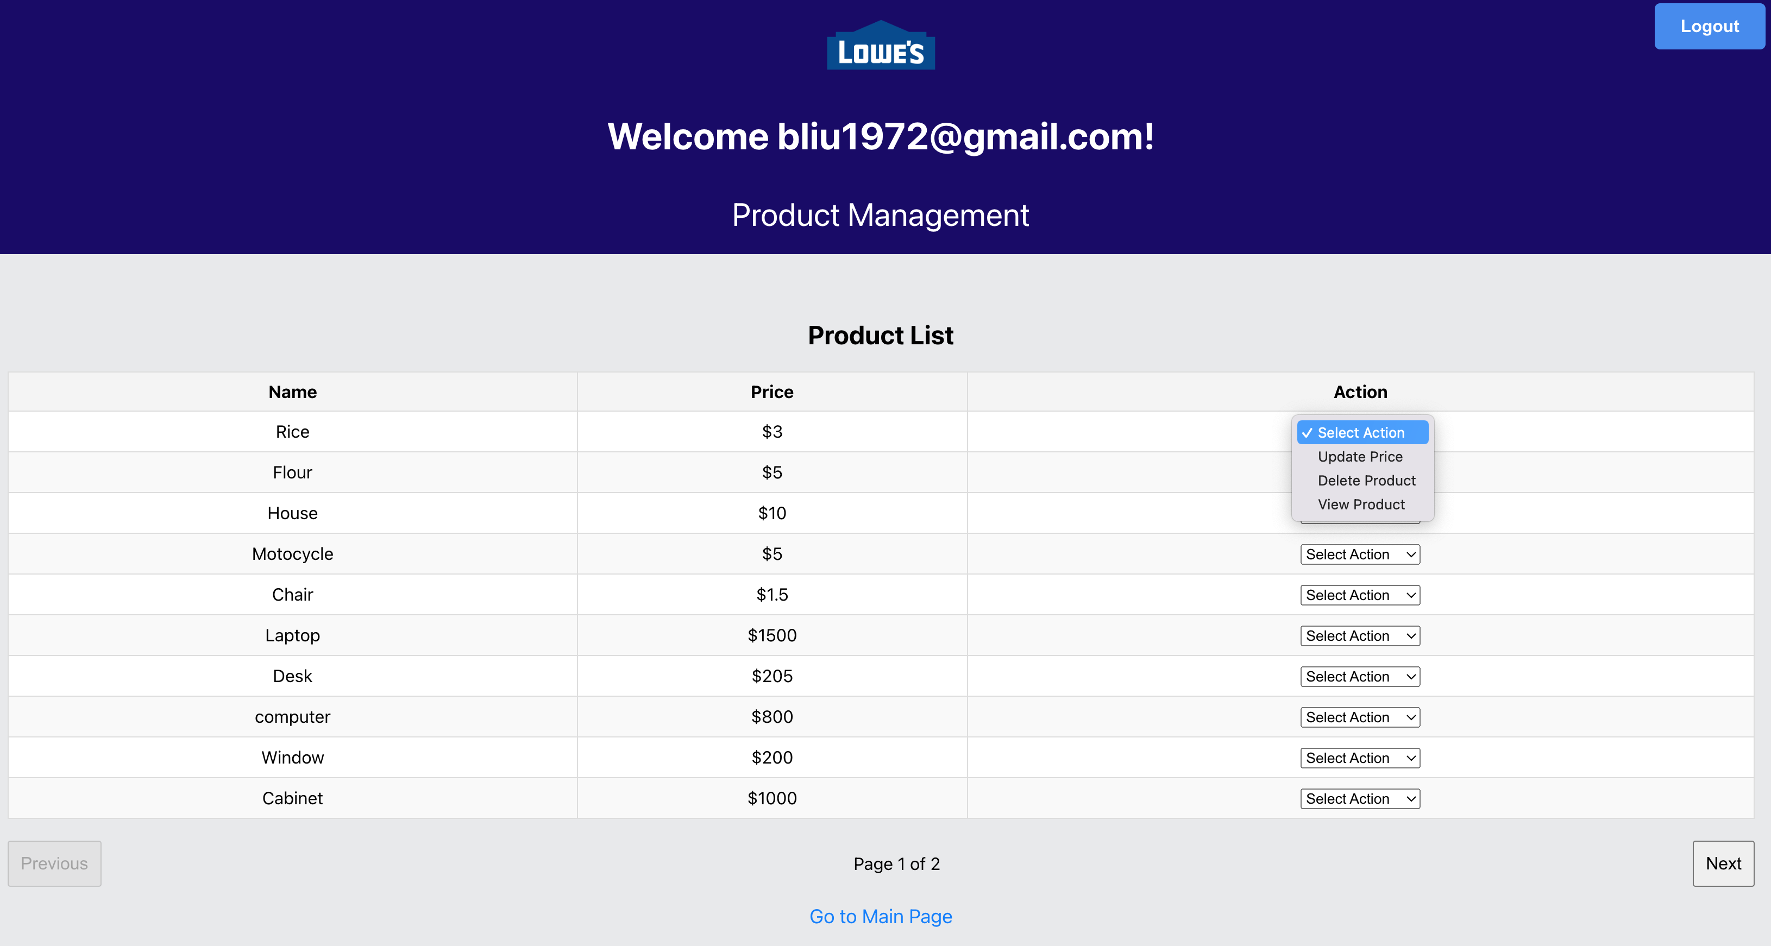
Screen Shots

Slide 22
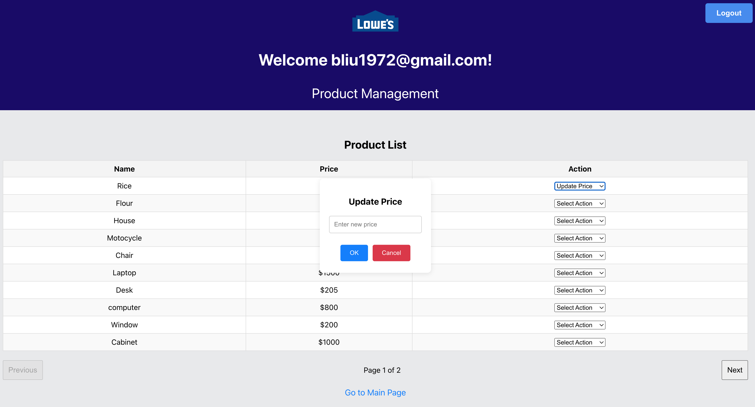
Screen Shots

Slide 23
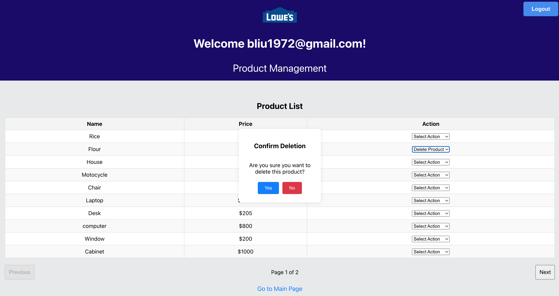
Screen Shots

Slide 24
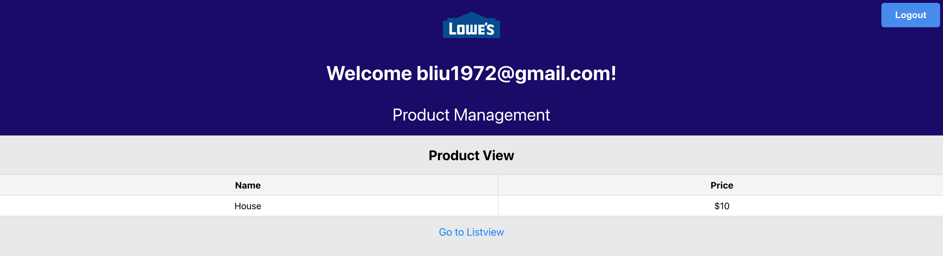
Screen Shots

