Slide 1
JAVA 17
BOOK: LEARN JAVA 17 PROGRAMMING
SECOND EDITION
NICK SAMOYLOV
BIZ APPS
CORE MODELS (“SINCE 9/2022”)
WEB APP DEVELOPER
Robert Kigobe 12-13-2023

Slide 2
Contents
Overview of Java Programming: 12/13/2023
Strings
The enhanced switch statement

Slide 3
String literals
Strings are anything enclosed in “”, ‘’ e.g “abc”,’abc’ or the keyword null
String literals are all stored in the string pool
String objects are not stored in the string pool and will need an intern() to join the pool
Java 15 introduced a new String literal called a text block
Until Java 8, Strings were internally represented as an array of characters – char[], encoded in UTF-16, so that every character uses two bytes of memory.
With Java 9 a new representation is provided, called Compact Strings. This new format chooses the appropriate encoding between char[] and byte[] depending on the stored content. The amount of heap memory will be significantly lower, which in turn causes less Garbage Collector overhead on the JVM.

Slide 4
Strings code - requires ide formatting
public class StringClass {
public static void main(String[] args) {
//String literals java 14
String s = "abc"; String t = "abc"; System.out.println("=========>String literals");
System.out.println(s==t); System.out.println("abc" == t);
//String objects
String s1 = new String("abc"); String t1 = new String("abc");
System.out.println("\n\n=========>String objects"); System.out.println(s1==t1 ); System.out.println("abc" == t1); System.out.println("abc" == t1.intern()); System.out.println(t1 == "abc");
//Text blocks
//Old version
String html = "<html>\n"+
" <body>\n"+
" <p>Hello world.</p>\n" +
" </body>\n" +
"</html>\n";
//After Java 15
String html1 = """
<html>
<body>
<p>Hello world.
</body>
</html>
""";
System.out.println("\n\n=========>String text blocks”); System.out.println(html1); System.out.println(html);
//String Imutability
String str1 = "abc"; String r1 = str1; str1 = str1 + "def"; String r2 = str1;
System.out.println("\n\n=========>String immutability"); System.out.println(r1 == r2); System.out.println(r1.equals(r2));
}}

Slide 5
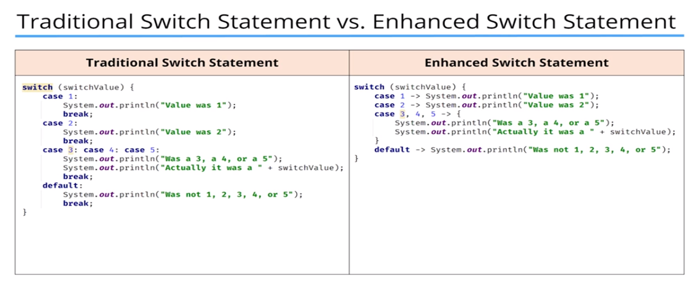
The switch statement

Slide 6
The switch statement
The enhanced statement has no break.
The enhanced switch statement allows expressions to be evaluated in the case blocks.
If the enhanced statement is being called to return a value, yield is used to return the value needed and not return.

Slide 7
Enhanced switch code - requires an ide formatting
public class Switch {
public static void main(String[] args) {
int value = 3; System.out.println("Traditional if statement");
if (value == 1) { System.out.println("Value was 1");
} else if (value == 2) { System.out.println("Value was 2");
} else { System.out.println("Value was not 1 or 2");
}
//Traditional switch statement
//Only byte, short, int, char, String, enum
//fall through happens when a break is not encountered executing all ines till a break is found
int valueSwitch = 8;
System.out.println("\n\nTraditional switch");
switch (valueSwitch) { case 1: System.out.println("Switch Value was 1"); break;
case 2: System.out.println("Switch Value was 2"); break;
case 3: case 4: case 5:
System.out.println("Switch Value was a 3, a 4, or a 5"); System.out.println("Switch Value was actually a " + valueSwitch); break;
default: System.out.println("Switch Value was not 1, 2, 3, 4, 5"); break; }
//new switch features
switch (valueSwitch) { case 1 -> System.out.println("Switch Value was 1");
case 2 -> System.out.println("Switch Value was 2"); case 3, 4, 5 -> {
System.out.println("\n\nModern switch"); System.out.println("Switch Value was a 3, a 4, or a 5");
System.out.println("Switch Value was actually a " + valueSwitch); }
default -> System.out.println("Switch Value was not 1, 2, 3, 4, 5"); } }

