Slide 1
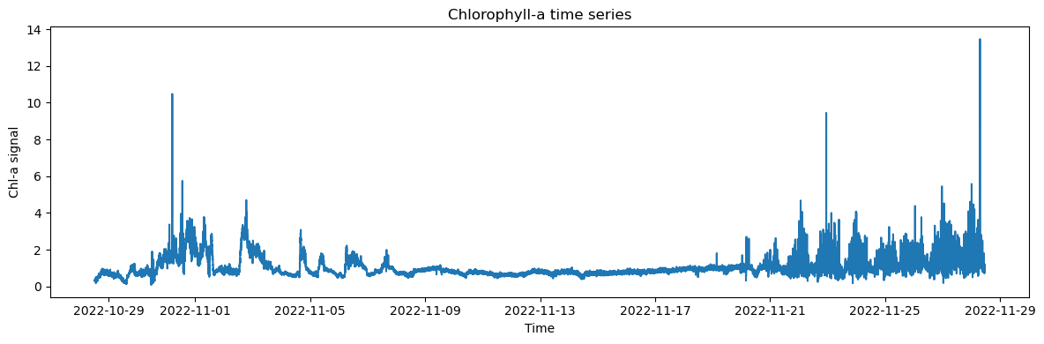
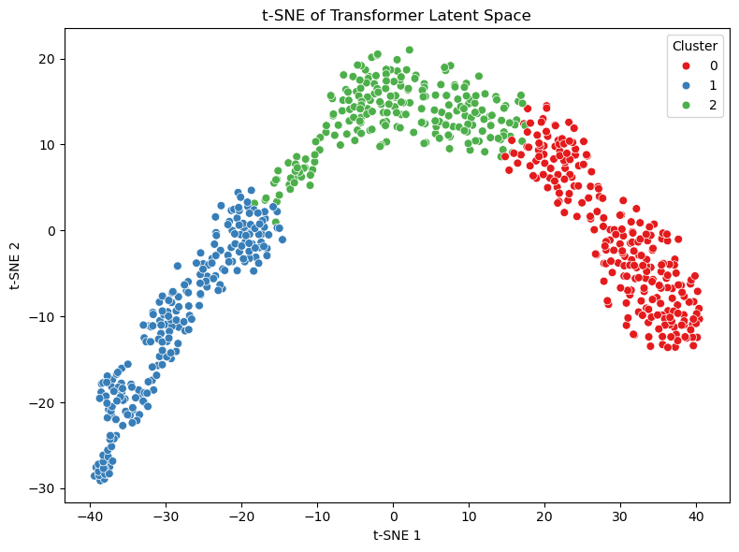
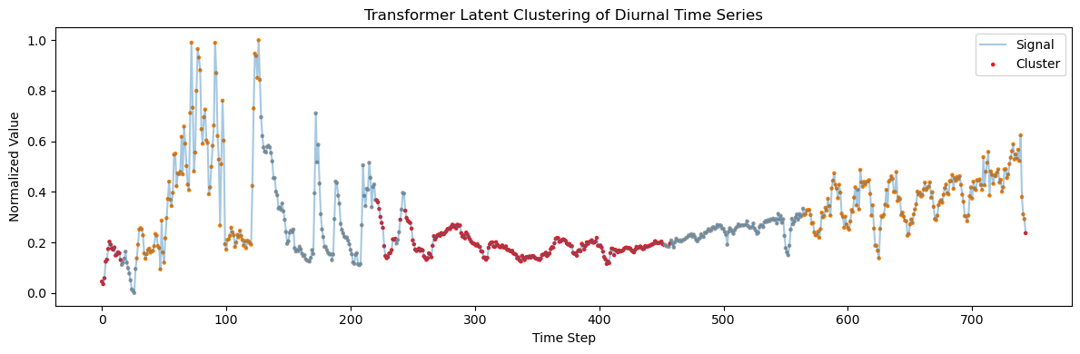


Filtering to hourly data and windowing diurnal cycles
Lower dimensional latent space
Representation learning of lower dimensions using Transformer encoder with self-attention
Kmeans clustering as unsupervised learning

