Slide 1
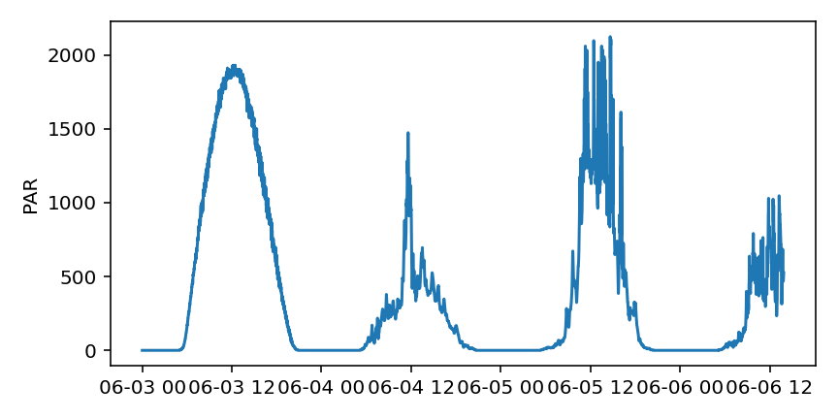
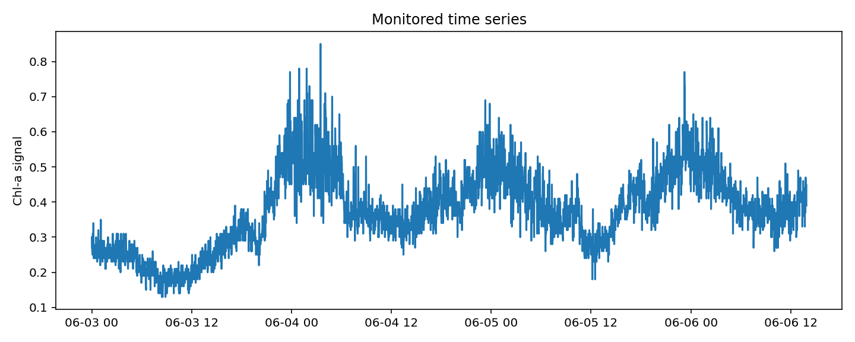
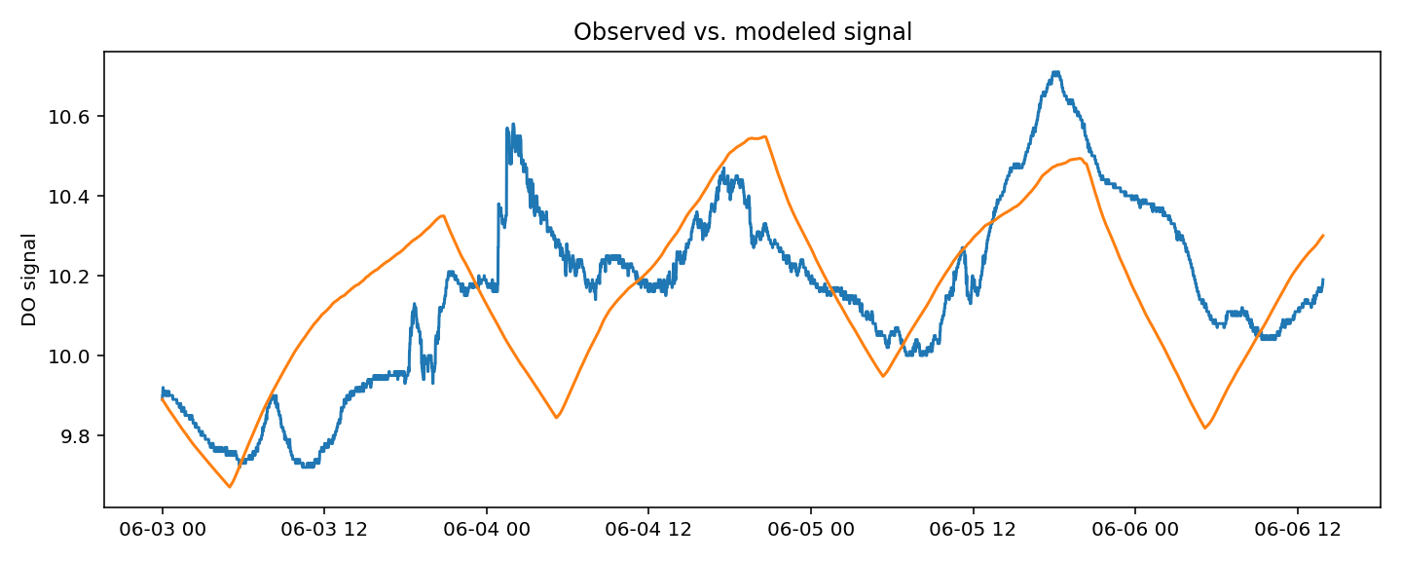
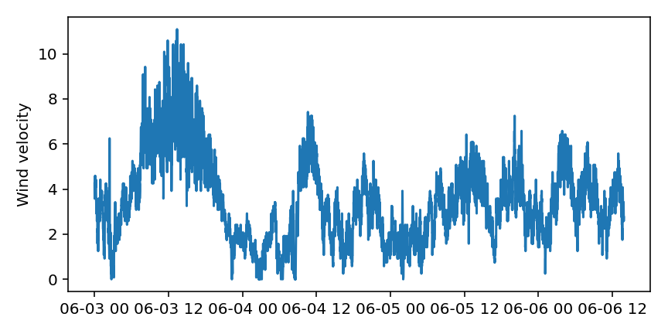

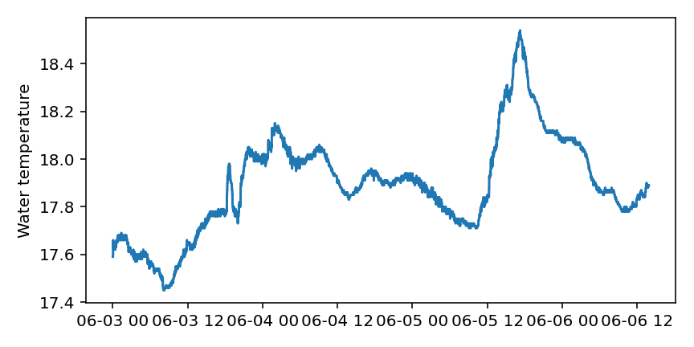
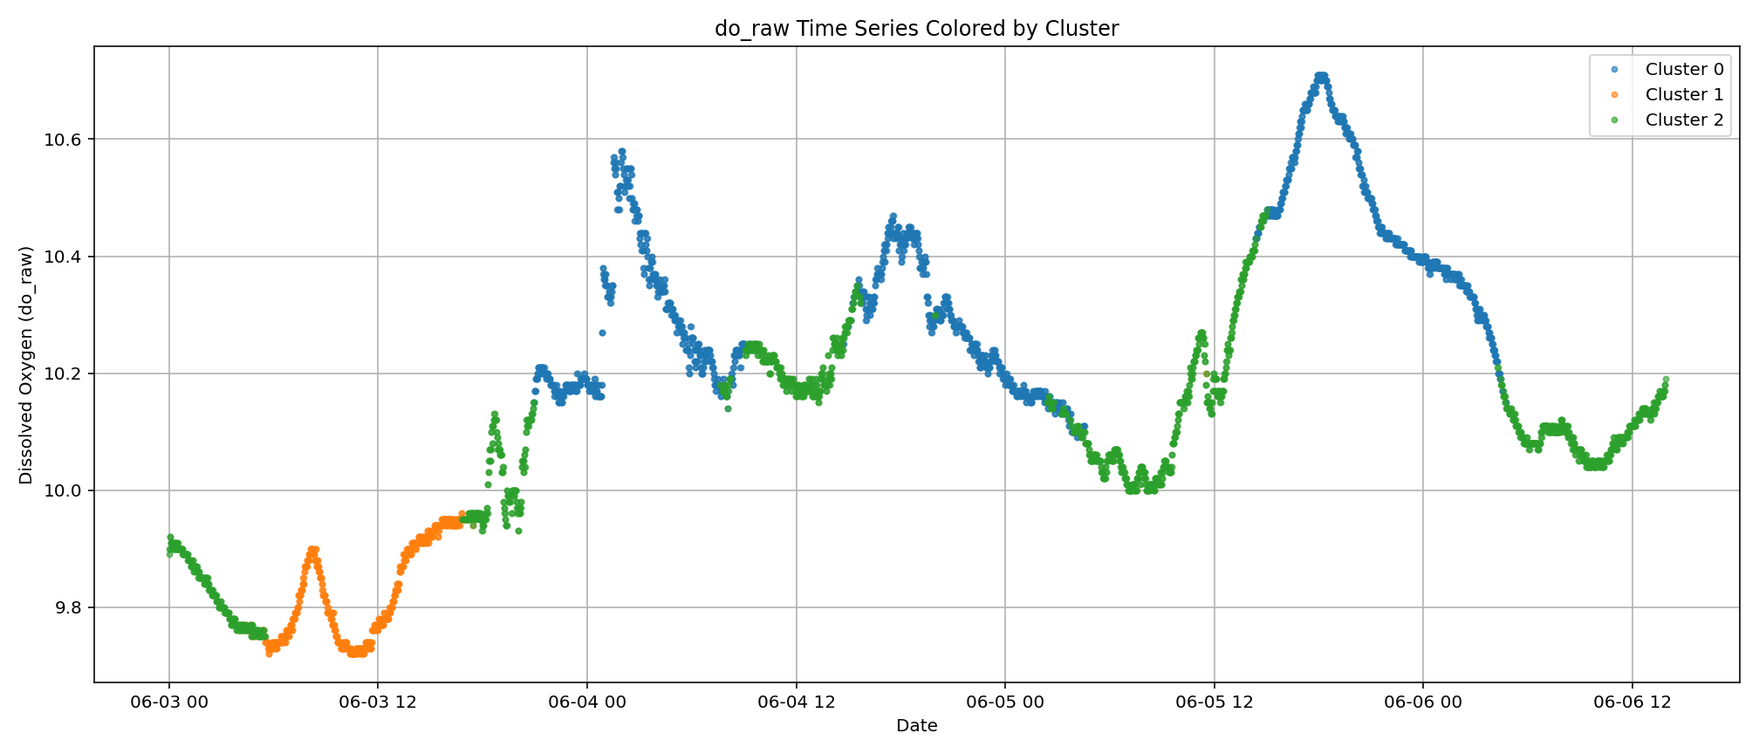
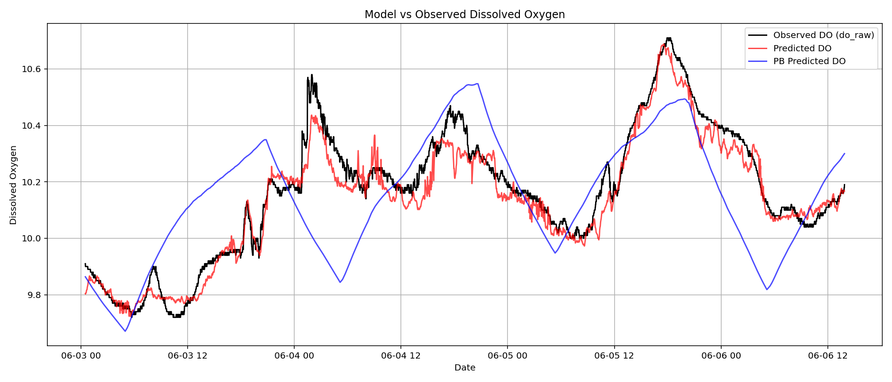
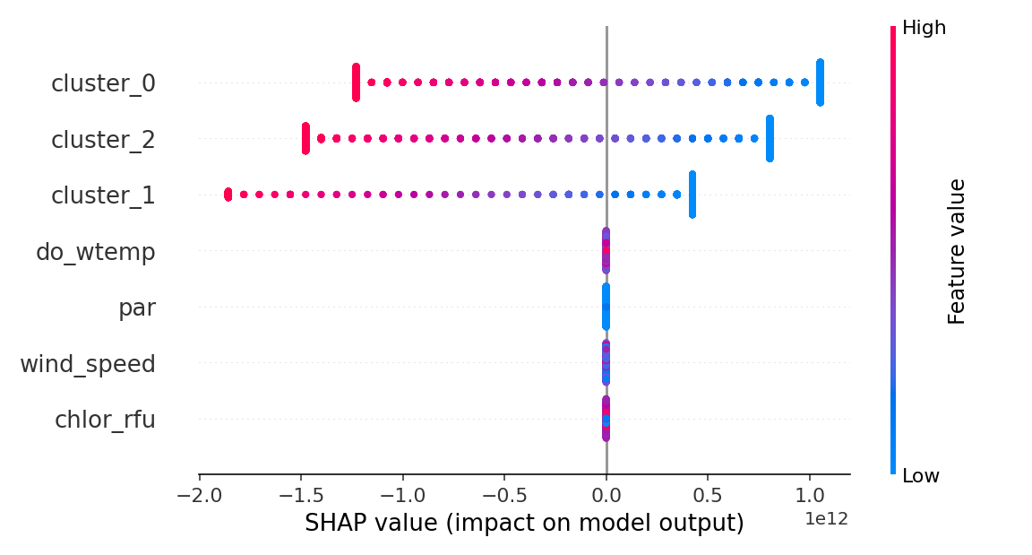
Monitoring data
Process-based bulk oxygen model
Knowledge-guided initialization on modeled DO (pre-training)
Encoder-Decoder LSTM
Fine-tuning on observed DO data
Self-supervised clustering through self-attention
Explanatory ML highlights that DL uses the clusters (compound information)
DL model replicates observed data

