Slide 1
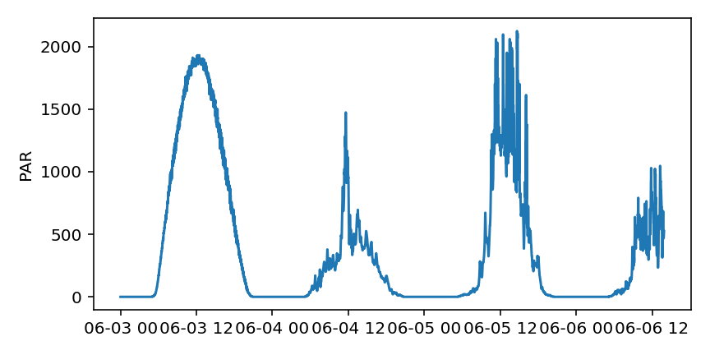
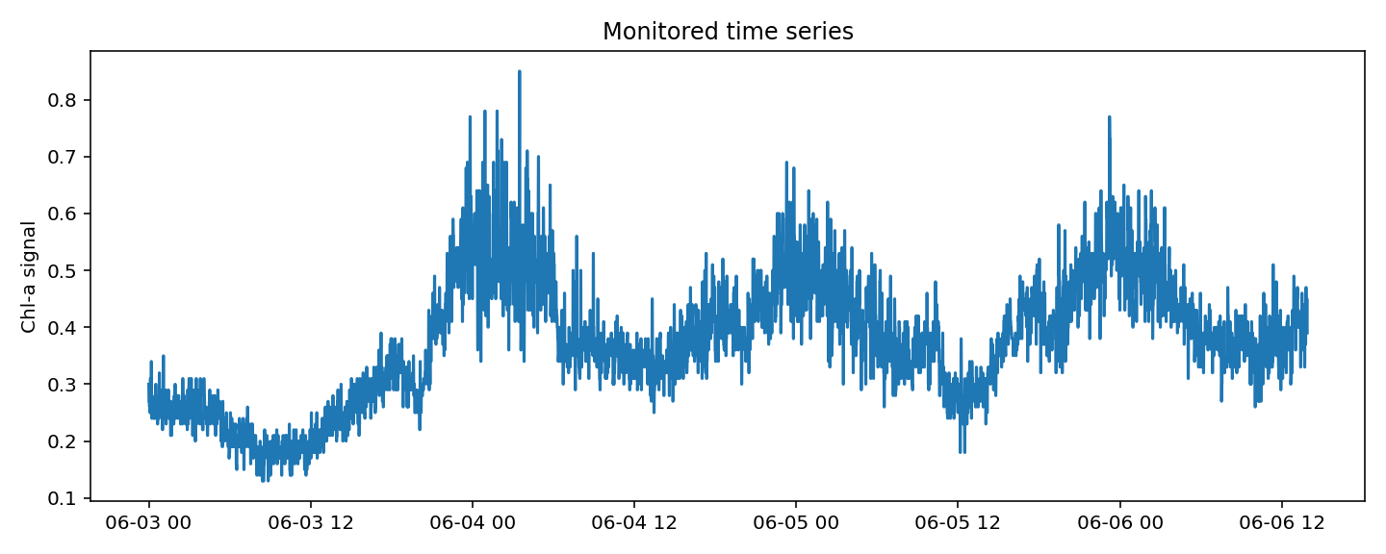
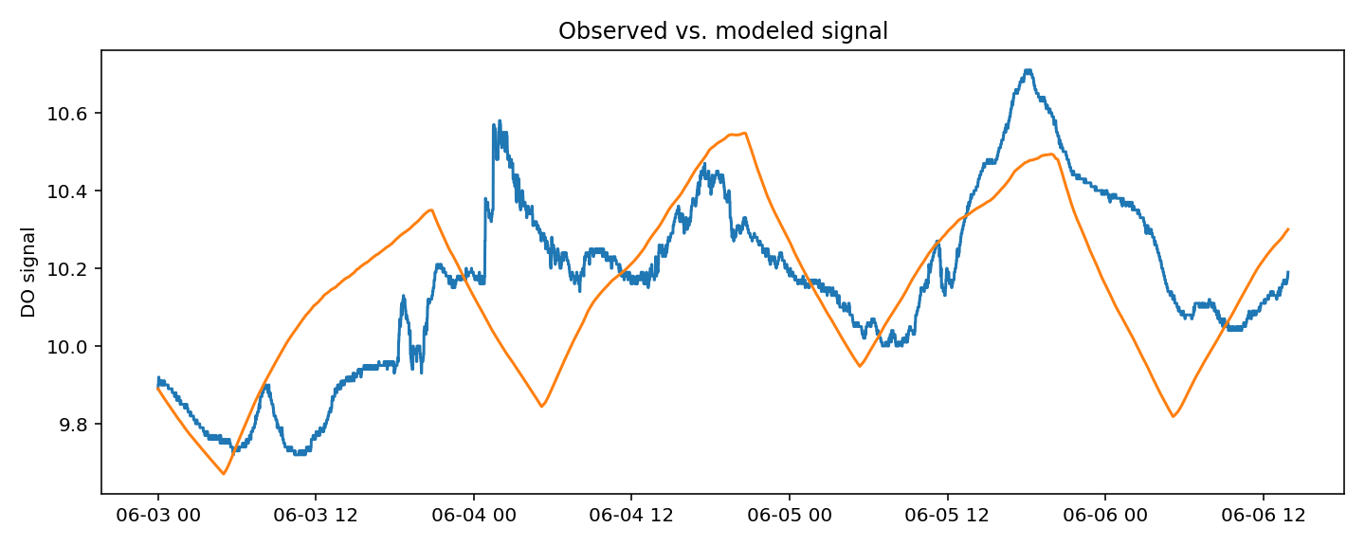
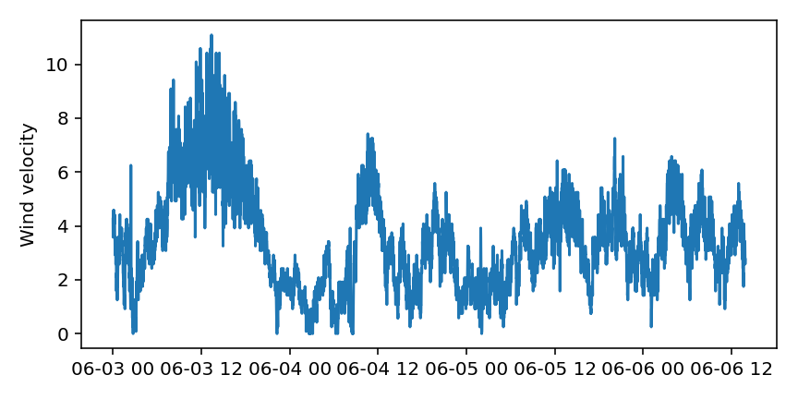

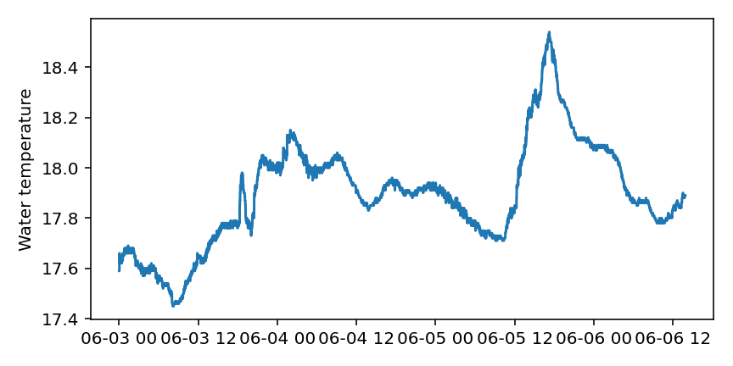
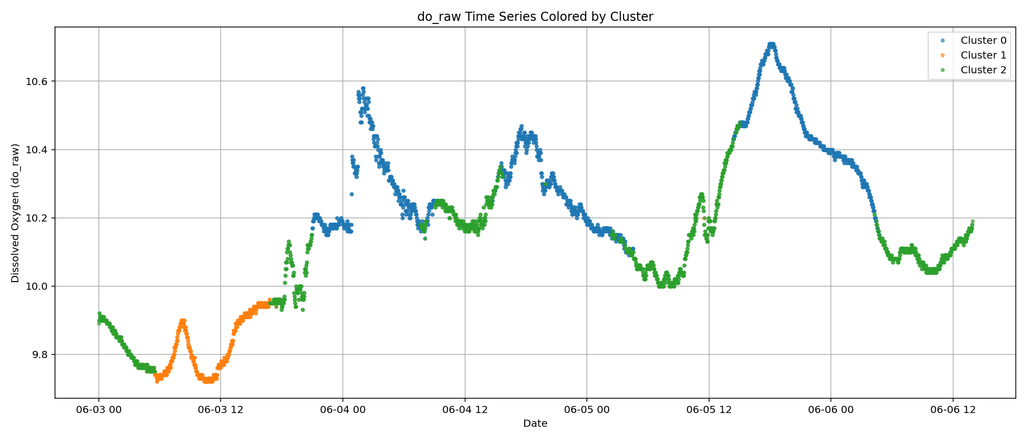
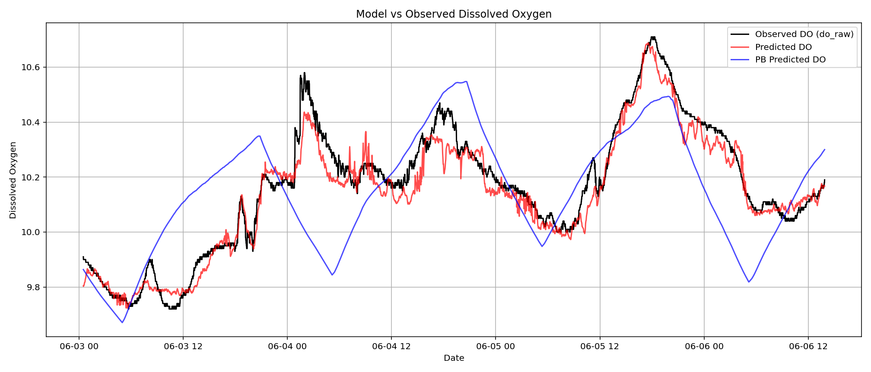
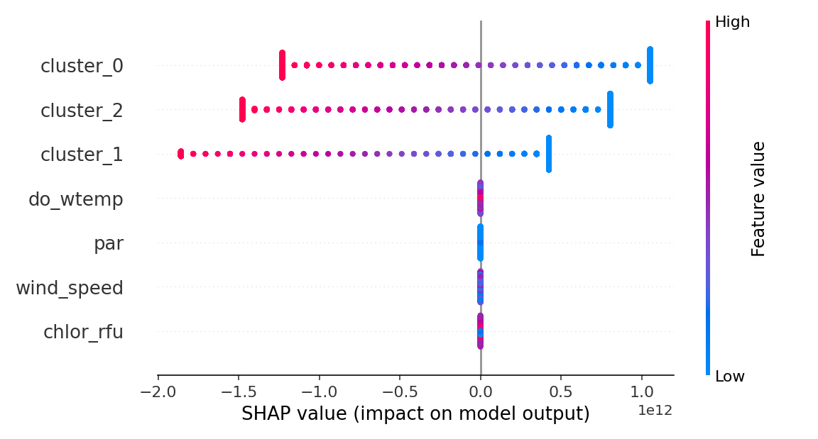
Monitoring data
Process-based bulk oxygen model
Knowledge-guided initialization on modeled DO (pre-training)
Encoder-Decoder LSTM
Fine-tuning on observed DO data
Self-supervised clustering through self-attention
Explanatory ML highlights that DL uses the clusters (compound information)
DL model replicates observed data

Slide 2
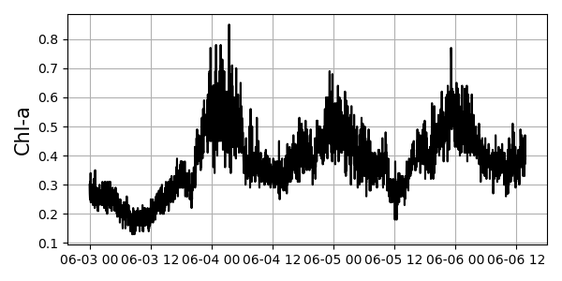
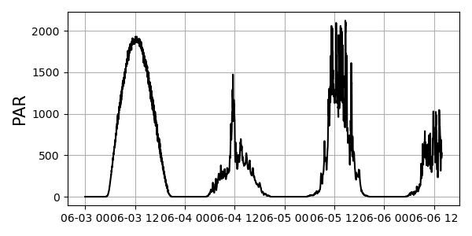
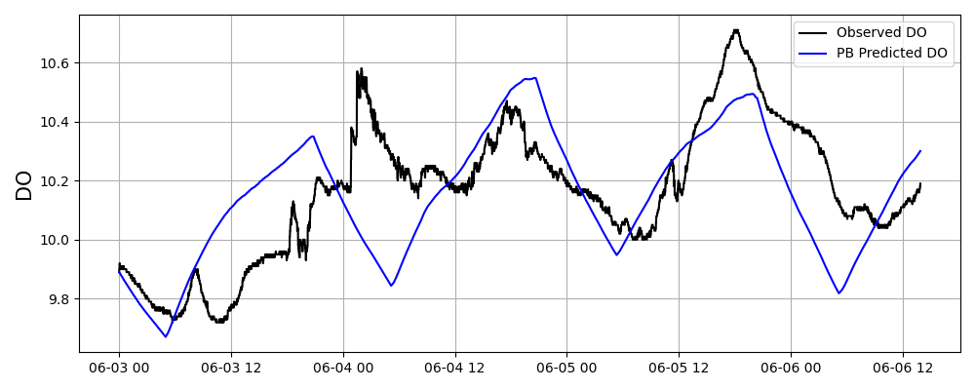
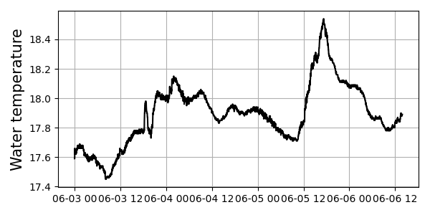
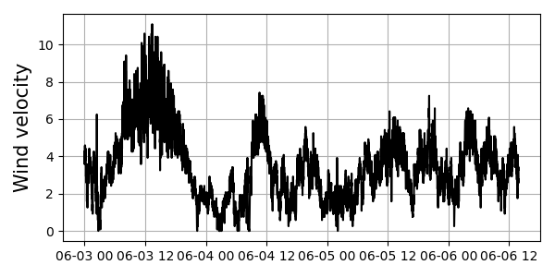
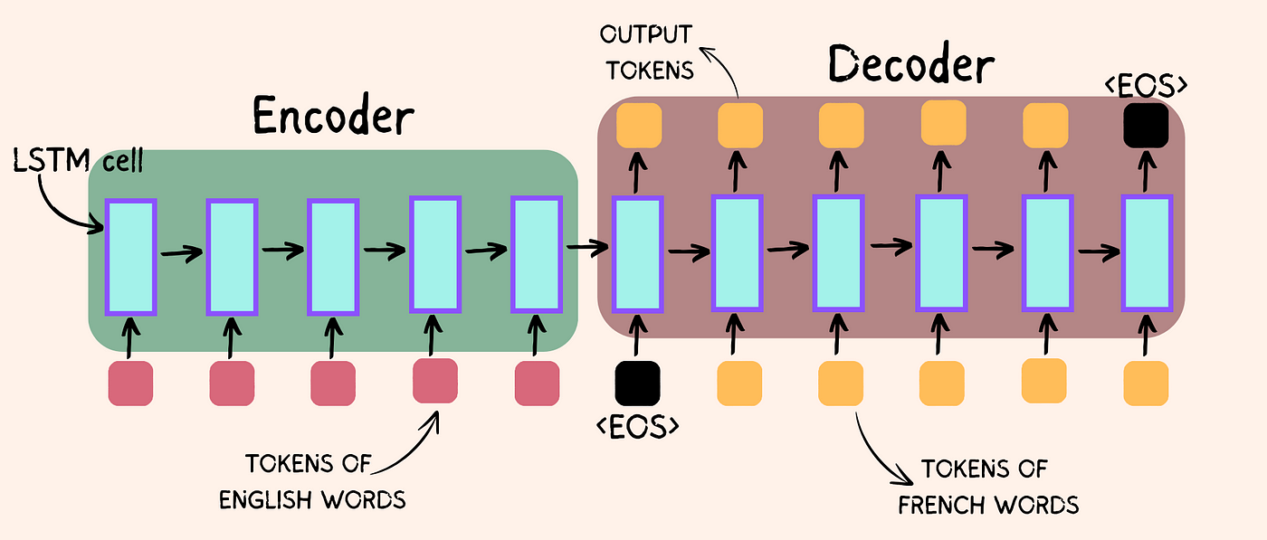
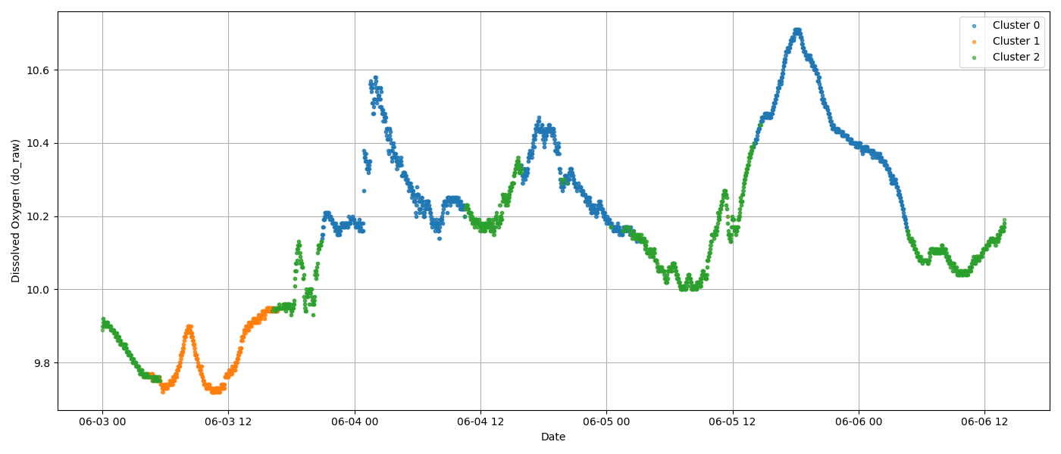
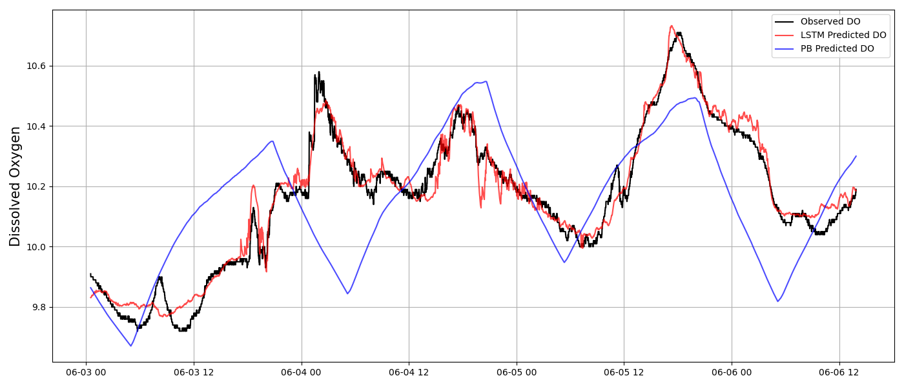
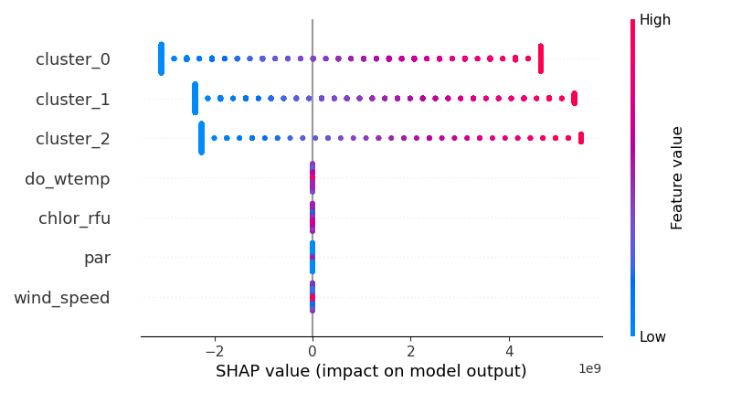
(B) Process-based bulk oxygen model
Atmospheric exchange
Primary production
Respiration
(A) Monitoring data
KNOWLEDGE
(E1) Knowledge-guided initialization on modeled DO (pre-training)
(C) Encoder-Decoder LSTM
(F) Explanatory ML highlights that DL uses the clusters (compound information)
(E2) Fine-tuning on observed DO data
(D) Self-supervised clustering through self-attention
(E3) DL model replicates observed data
MACHINE LEARNING

