Slide 1
Linear Regression with AI Prompting
Created by: Norbert Major
2024.12.02.

Slide 2

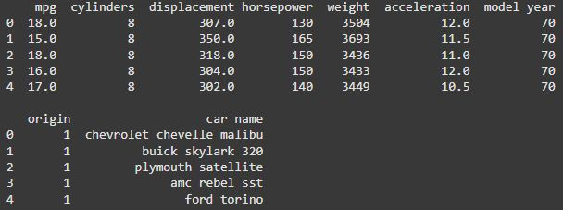
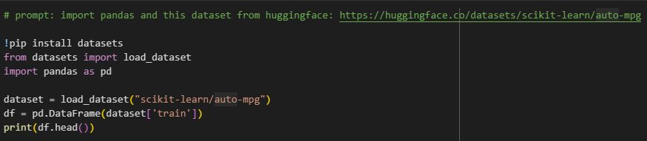
Dataset
https://huggingface.co/datasets/scikit-learn/auto-mpg
Auto Miles per Gallon (MPG) Dataset
Contains data of fuel consumption of different cars from the 70’s and 80’s
Importing

Slide 3
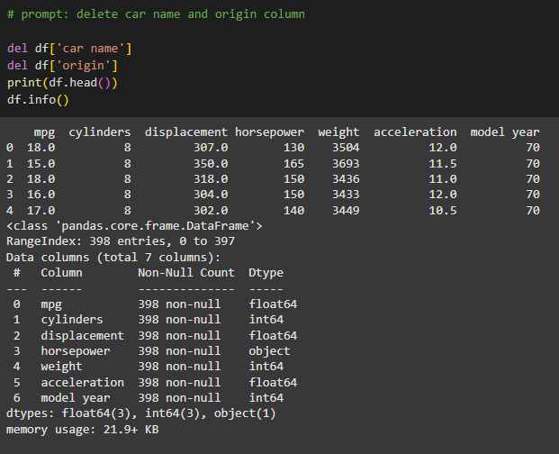
Data Cleaning
Getting rid of unnecesary columns, like:
Car name
Origin
We will work with:
MPG
Cylinders
Displacement
Horsepower
Weight
Acceleration
Model Year

Slide 4
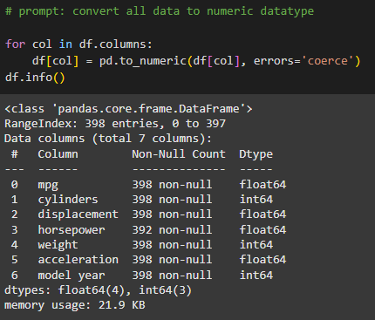
Data cleaning
One extra step:
Converting all the data to numeric datatype
Horsepower: object -> float

Slide 5
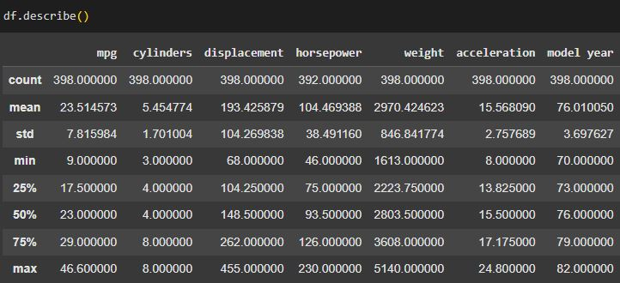
Getting familiar with the data

Slide 6
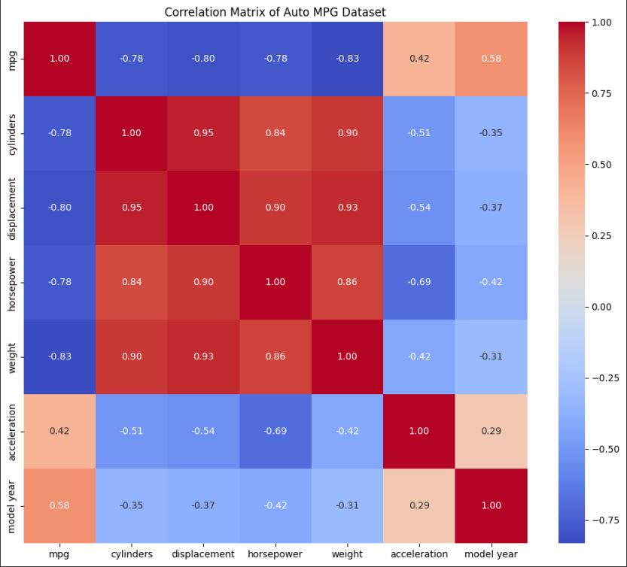
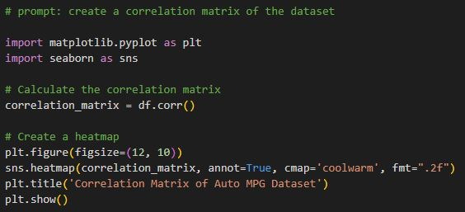
Correlation matrix
Shows the correlation between the variables
1 -> strong correlation
-1-> strong inverse correlation
0 -> no correlation

Slide 7
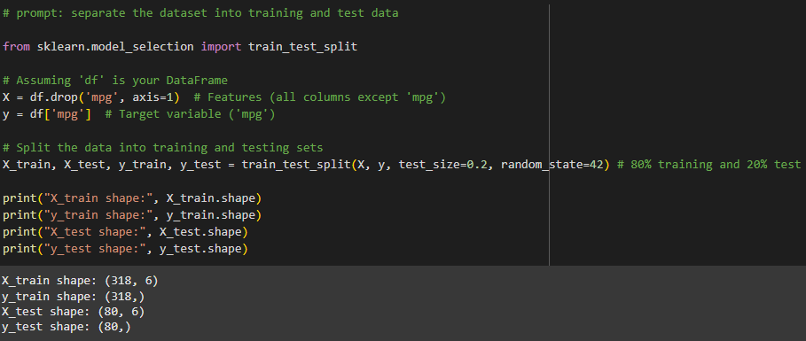
Splitting the data into training and testing datasets

Slide 8
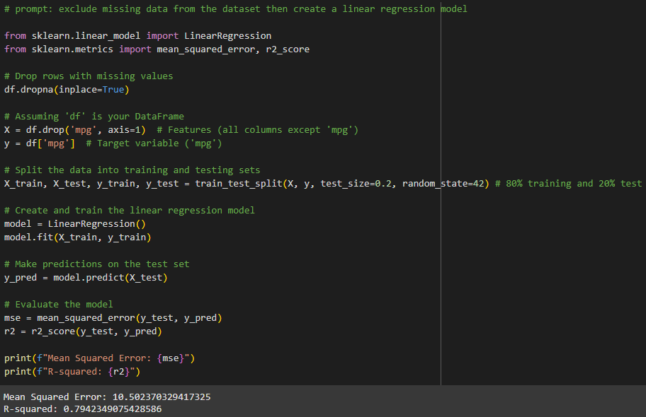
Another emerging problem: missing data

Slide 9
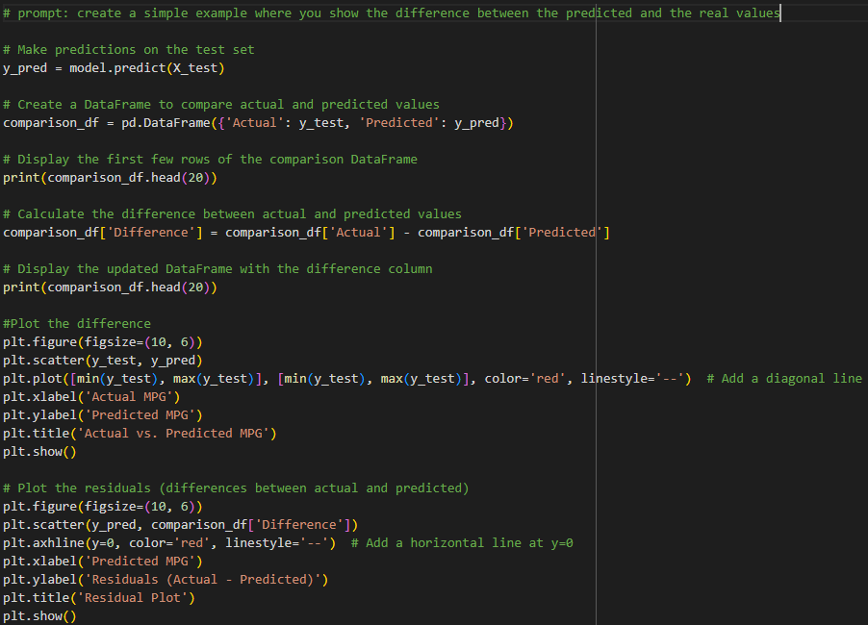
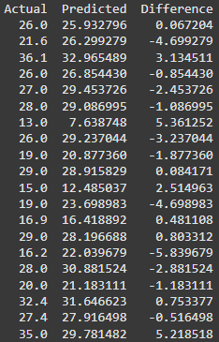
Showing the result of our Model

Slide 10
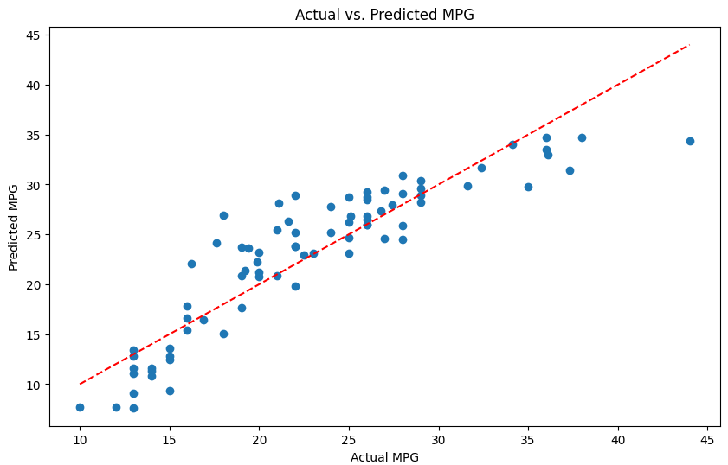
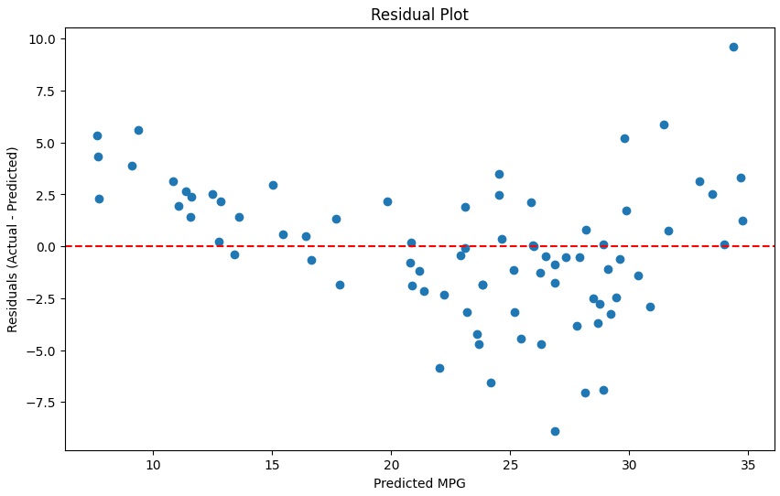
Showing the result of our Model
Could be better – let’s try to make it better!

Slide 11
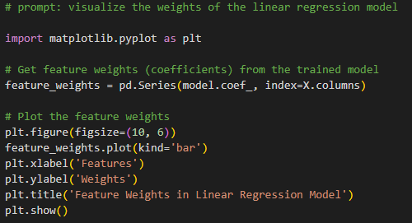
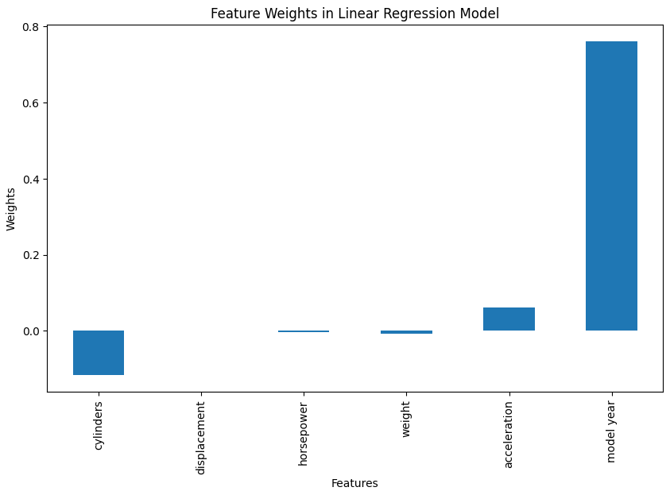
Showing the weights in the Linear Regression Model
Model year with the biggest weight?
Interesting…

Slide 12
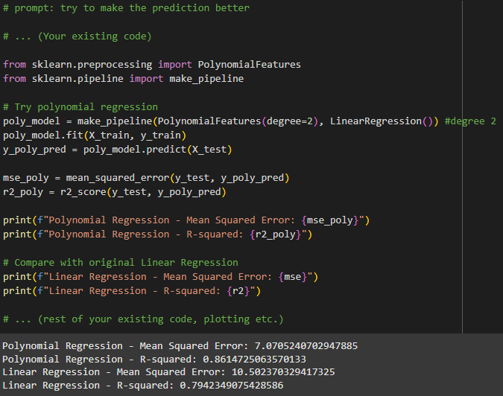
Polynomial Regression
Polynomial regression is a type of regression analysis used to model the relationship between a dependent variable and one or more independent variables when the relationship is nonlinear. It extends linear regression by fitting a polynomial equation to the data, which allows for modeling more complex patterns.

Slide 13
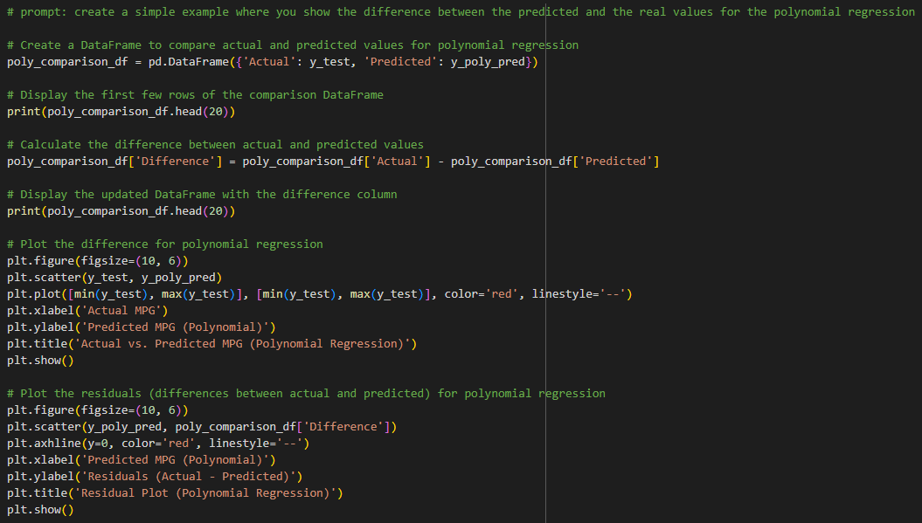
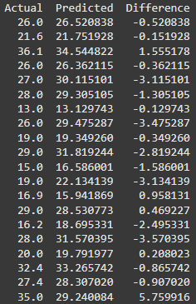
Showing the result of the Polynomial Model

Slide 14
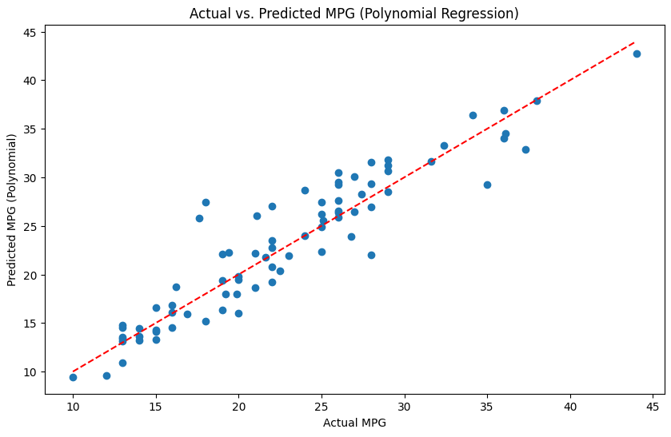
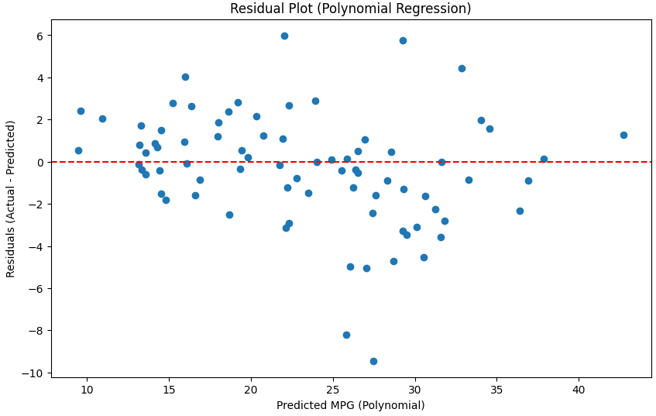
Showing the result of the Polynomial Model

Slide 15
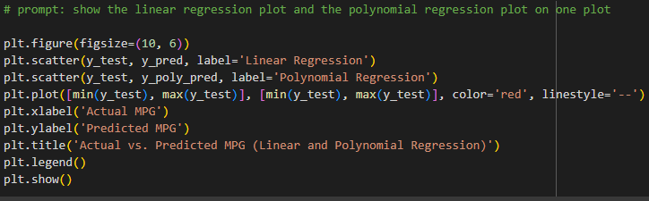
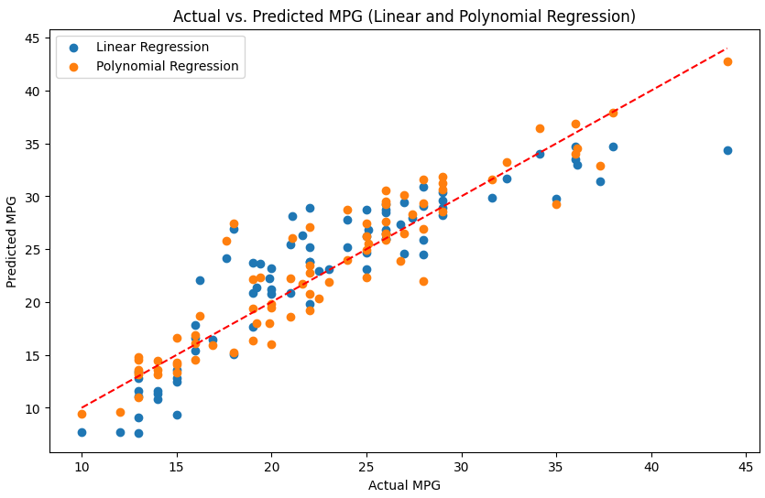
Linear VS Polynomial
Still could be better?
Maybe – Let’s try!

Slide 16
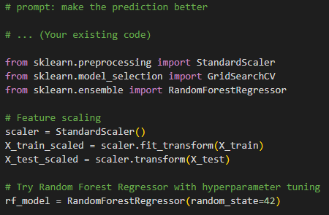
Random Forest Regression
Random Forest Regression is an ensemble learning method that uses a collection of decision trees to perform regression tasks. It is an extension of the Random Forest algorithm, which is primarily known for classification but can also handle regression tasks effectively.
We got our best score:

Slide 17
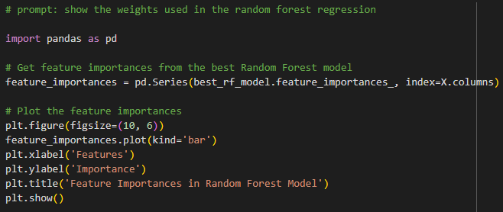
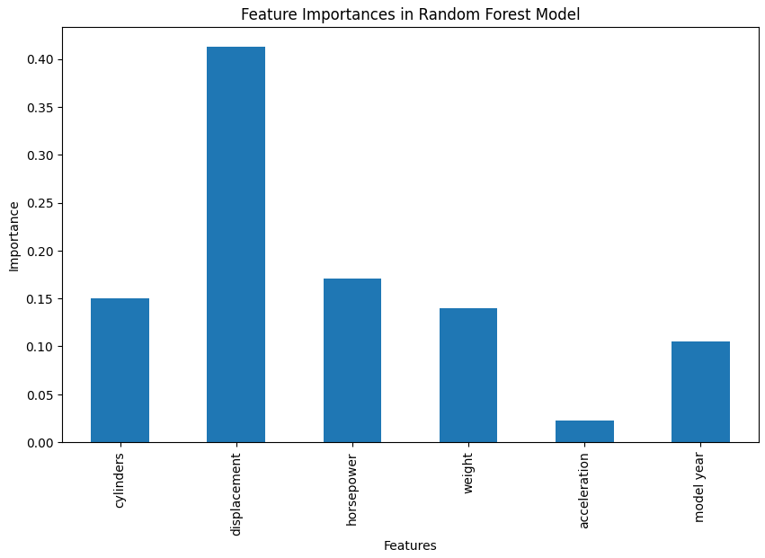
Random Forest weights
Now this one makes a lot more sense than the weights in the linear regression model!

Slide 18
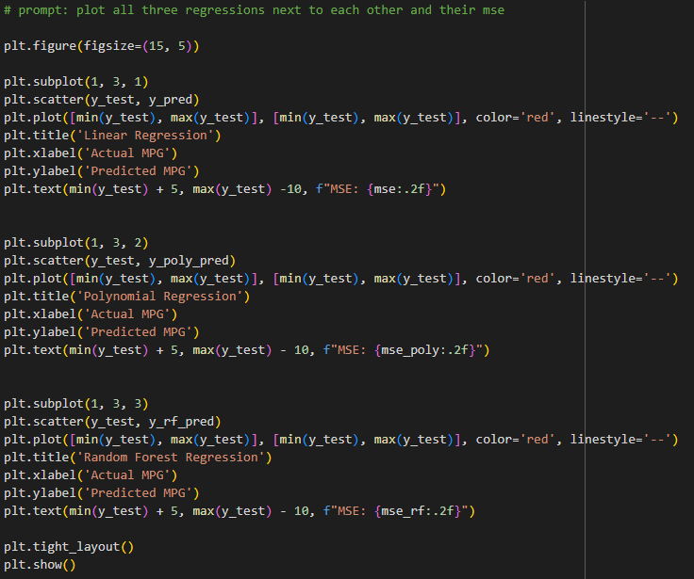
Plotting all of our results

Slide 19
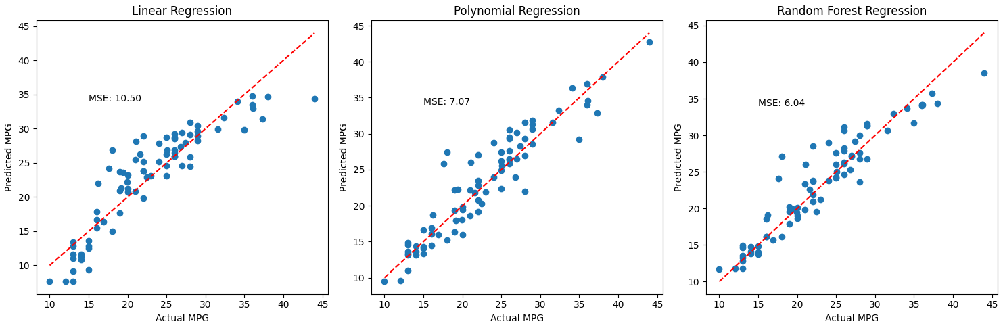
Plotting all of our results

Slide 20
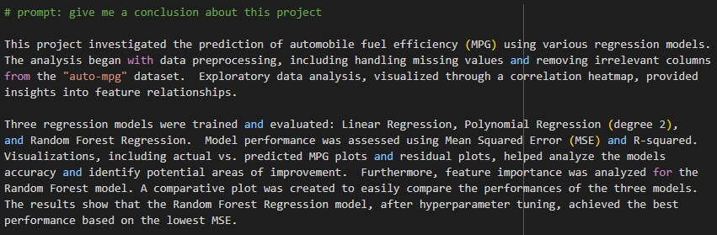
Conclusion

Slide 21
Thank you for your attention!

