Slide 1
Airline passenger satisfaction analysis
Szabó Ákos
2024

Slide 2
The problem
An airline company aims to identify the most dissatisfied customers and develop strategies to improve their satisfaction levels.

Slide 3
Data overview
The dataset contains information about previous airline passengers, including their satisfaction levels with the various services.
The variables include:
Demographics: e.g. age, gender
Travel details: e.g. type of travel, class, flight distance, delay time
Satisfaction ratings for the various services: e.g. inflight Wi-Fi, seat comfort, food and drink, online boarding, baggage handling
Overall satisfaction: binary feature about the overall satisfaction of the passenger

Slide 4
Data preprocessing and correlation analysis
Preprocessing steps include:
Removing rows with missing values
Dropping irrelevant ID-like columns
One-hot encoding categorical variables for the analysis
Correlation analysis:
Visualize a correlation matrix to identify relationships between variables
Focus on features that have the strongest correlation with overall airline satisfaction

Slide 5
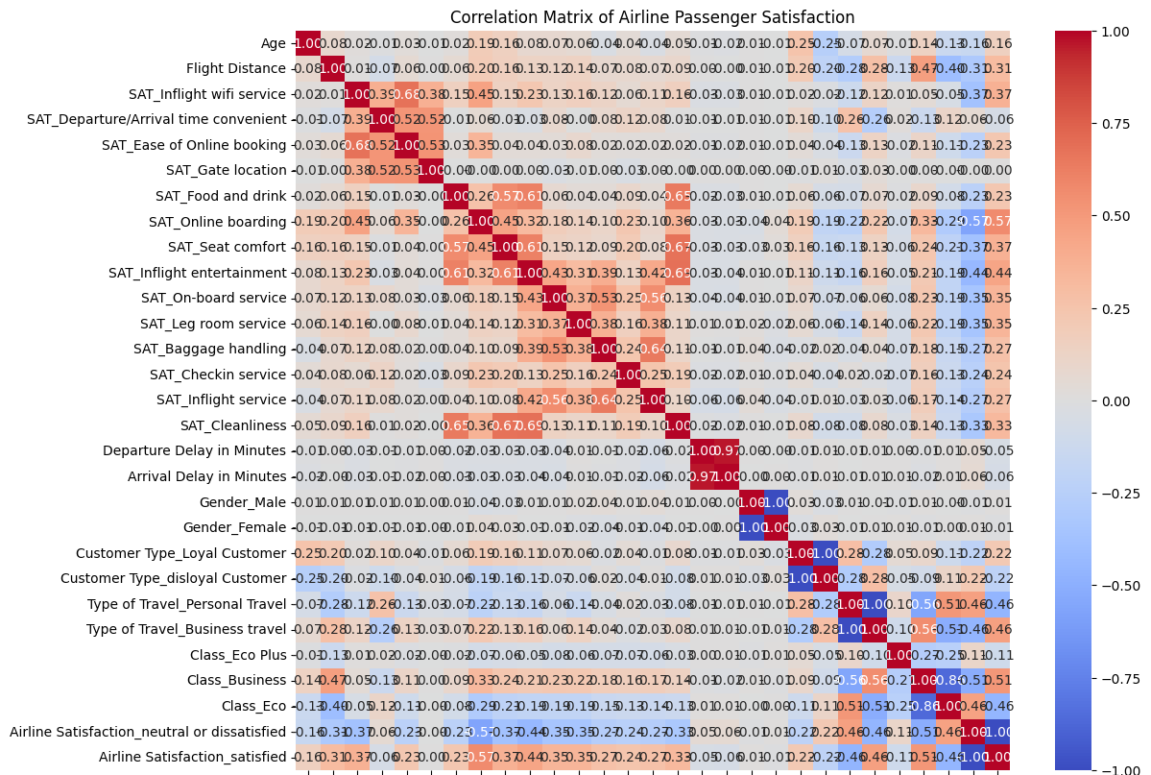


Slide 6
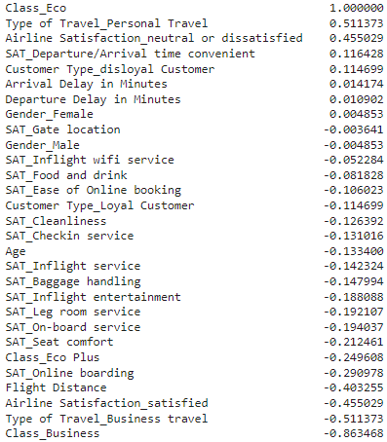
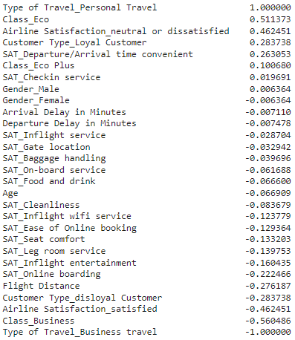
…more correlations
The features’ correlation with the Eco class and the Personal travels

Slide 7
Key findings
Based on the data analysis, passengers traveling in Eco class and those on Personal travel tend to be more dissatisfied.
Specific areas of dissatisfaction within these groups include:
Seat comfort
Departure delays
Inflight Wi-Fi
Inflight entertainment
Food and drink

Slide 8
Improvement strategies
For Eco class:
Enhance seat comfort (e.g., increased legroom, better cushioning)
Improve inflight entertainment options
Upgrade food and drink quality and variety
Reduce departure delays
For Personal travel:
Prioritize online booking experience
Offer reliable and fast inflight Wi-Fi
Focus on convenient gate locations

Slide 9
Prioritizing strategies and implementation considerations
High-impact changes to prioritize:
Punctuality: Minimizing delays is crucial for all travelers
Reliable Wi-Fi: Essential for business travelers and increasingly important for leisure travelers
Seamless Online Booking: A user-friendly experience is key to satisfaction
For the implementation:
Define specific steps, allocate resources, and delegate tasks for each improvement initiative.
Track progress and measure the impact of changes on passenger satisfaction.

Slide 10
Thank you!
Artificial Intelligence in planning and decision making
Business Informatics MSc
University of Debrecen
2024
A special thanks to Gemini for helping me
in this course and assignment!

