Slide 1
Are you dreaming of a White Christmas?
Has snowfall patterns changed in Nashville Tennessee?
Notes:
Good afternoon, I hope you guys are as excited as I am to talk about Snowfall in Nashville, TN. For anyone that celebrates Christmas, as of today we are a week away from the Holiday! I’m hopeful Jack Frost will visit us this week.

Slide 2
Agenda
Introduction
Data Sources
Data Journey
Findings
Notes:
During this presentation we will be touching on the Data Sources, we will take a digital sleigh ride through the Data Journey, and will conclude with the Findings.

Slide 3

Introduction
Why are we here?
Notes:
For Native Nashvillian’s you maybe familiar with News 4 Snowbird. When I was younger seeing this awesome penguin meant that I may be lucky enough to miss school.

Slide 4
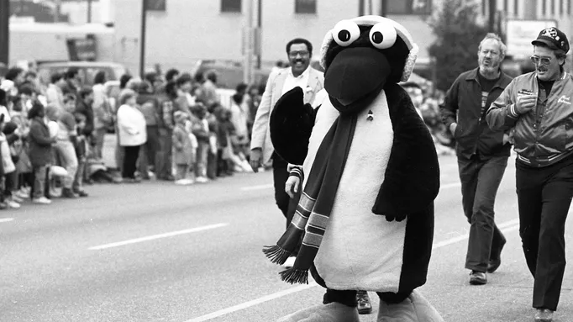
Notes:
This is an older photograph of Snowbird with his awesome friend Bill Hall on the left.

Slide 5
Bill Hall, Snowbird, and Snow Days OH MY!!
News 4 Snowbird has been announcing Tennessee and Kentucky school closing for over 30 years
Bill Hall was the Meteorologist usually accompanying Snowbird from the 80s and 90s
As I grew up over the years I’ve notice Middle Tennessee wasn’t getting as much snow as it used to
Notes:
Snowbird has been announcing school closing for close to 30 years.
Bill Hall was the Meteorologist accompanying Snowbird in the 80s and 90s. Over the years in Nashville I notice the winterland I once enjoyed appeared to be slowly going away.

Slide 6
Data Questions
Has snowfall patterns changed in Nashville, TN?
Has precipitation patterns changed in Nashville, TN?
What could be causing these changes?

Slide 7
Data Sources
How will we be answering the Data Questions?

Slide 8
Data Sources
East Tennessee State University
Tennessee Climate Office
Texas A&M University
Southern Regional Climate Center
Climate Data Portal
Notes:
To my surprise Tennessee has a Climate Office sponsored by East Tennessee State University. The Climate Office also partnered with other university’s and non-profits. The data I’ll be using today comes from the Southern Regional Climate Center.

Slide 9

Data Journey
Notes:
We will be traveling at the speed of wire for some and wifi for others as we buckle up on my digital sleigh through this journey.

Slide 10
Data Specifics
We will be talking through weather data recorded between November 30th, 1961 to November 30th, 2021
This data is from a weather station at Nashville International Airport (BNA)
Notes:
The data we will be looking at is from a weather station at Nashville International Airport between the dates of November 30th, 1961 and November 30th, 2021

Slide 11
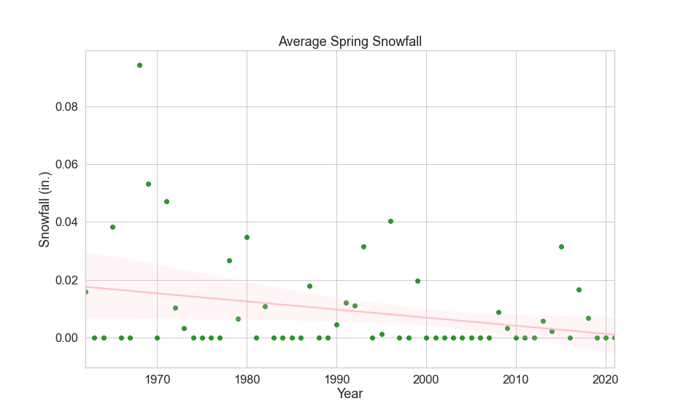
Has Snowfall patterns changed?

Slide 12
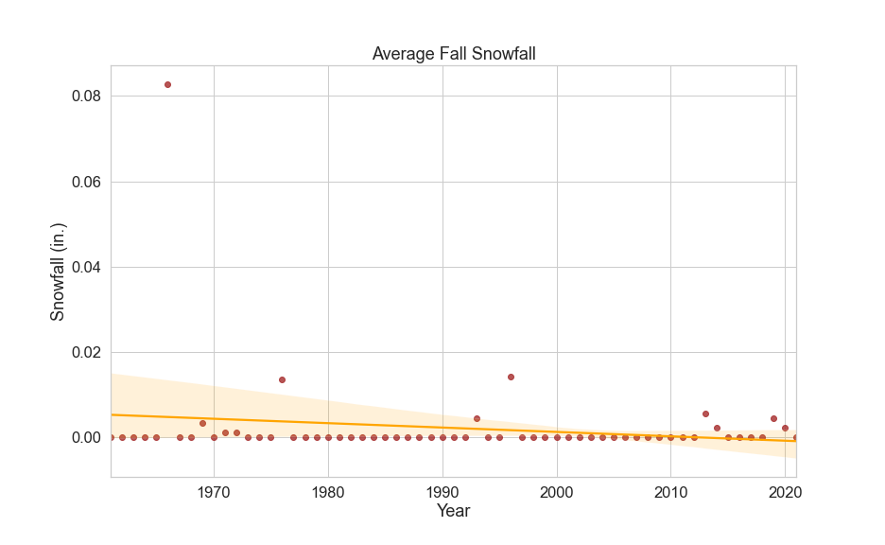
Fall Snowfall Patterns

Slide 13
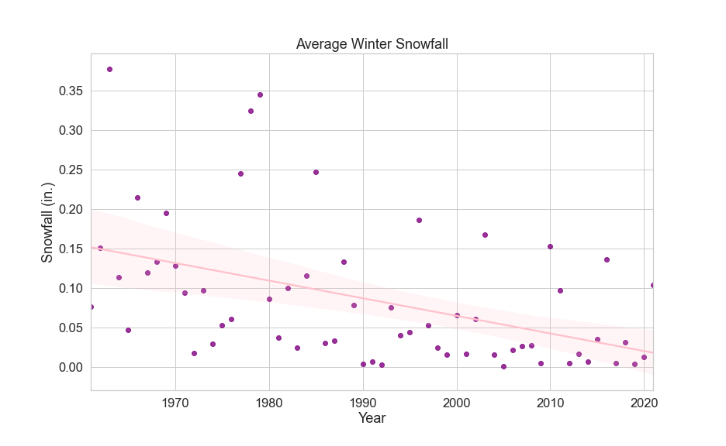
Winter Snowfall Patterns

Slide 14
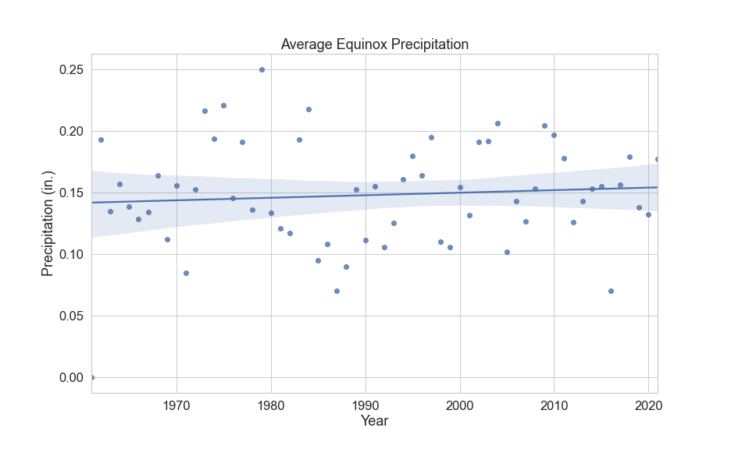
Has Precipitation patterns changed?

Slide 15
What could be causing this changes?
I’m not a Geoscientist or a Meteorologist, but I’ve found some interesting data.
Next we will look at what the average temperature looks like over the decades by season.

Slide 16
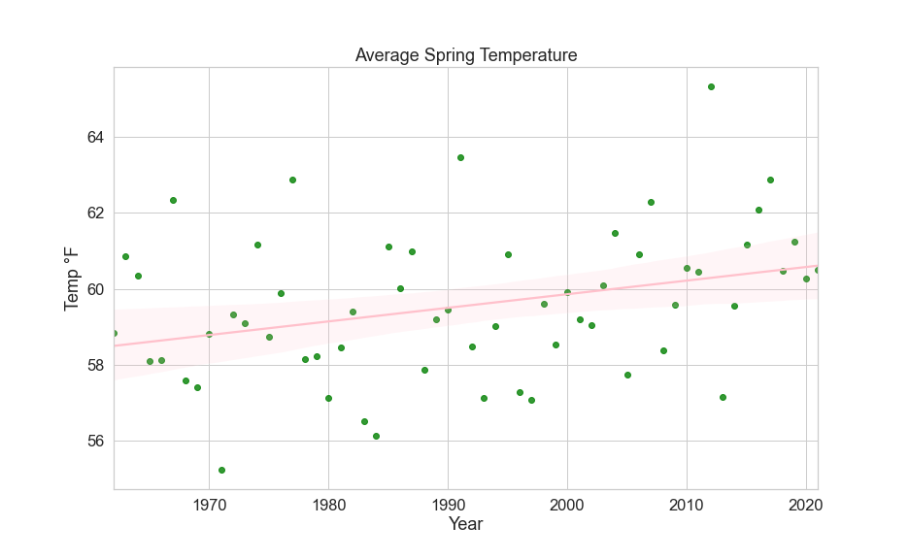
Has the Average Temperature Changed?

Slide 17
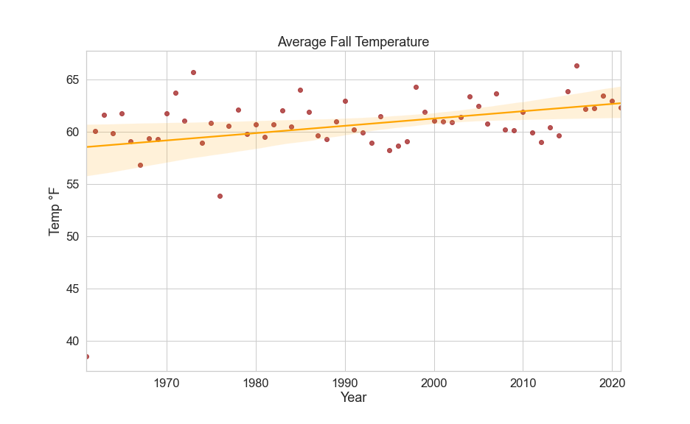
Fall Average Temperature

Slide 18
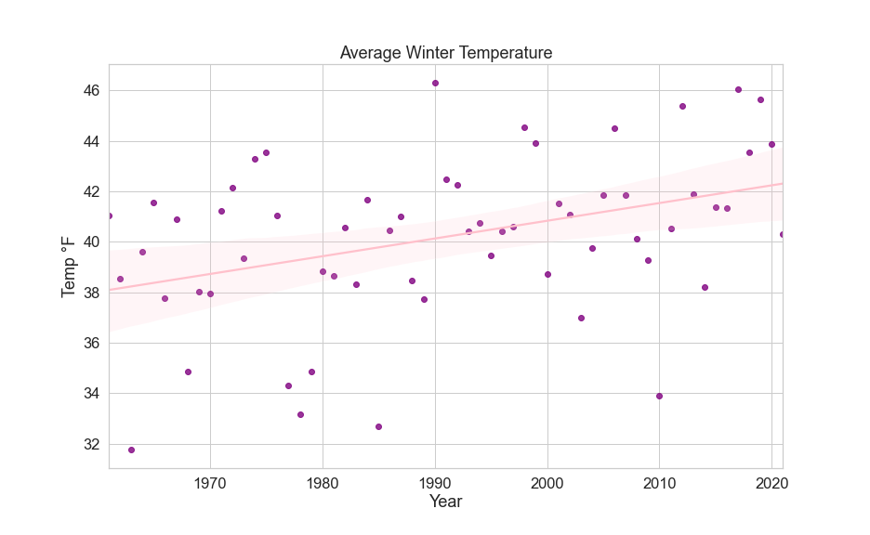
Winter Average Temperature

Slide 19
Findings
What is the data saying?

Slide 20
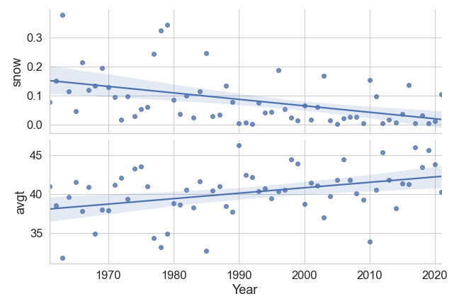
Winter Snowfall and Average Temperature

Slide 21
Spring Snowfall vs. Spring Temperature

Slide 22
Fall Snowfall vs Fall Temperature

Slide 23
Winter Snowfall vs Winter Temperature

Slide 24
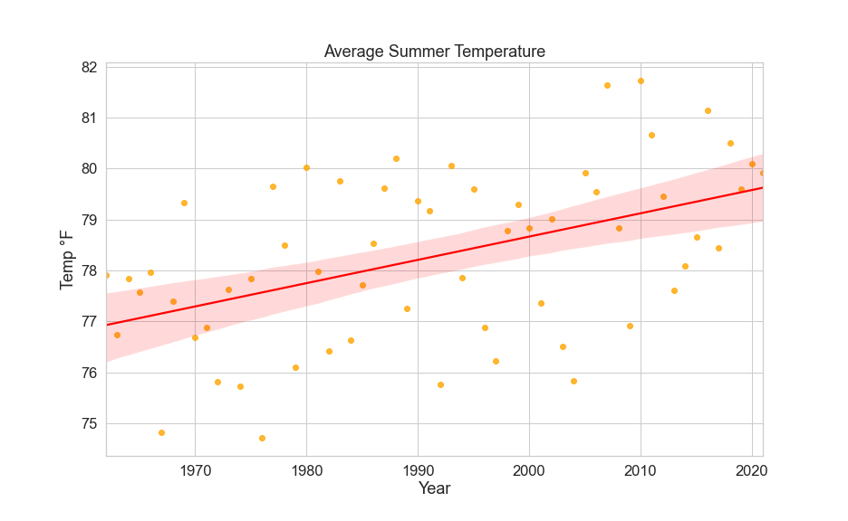
Winter Temp vs Summer Temp

Slide 25
Questions
Thank you and Happy Holidays!

