Slide 1

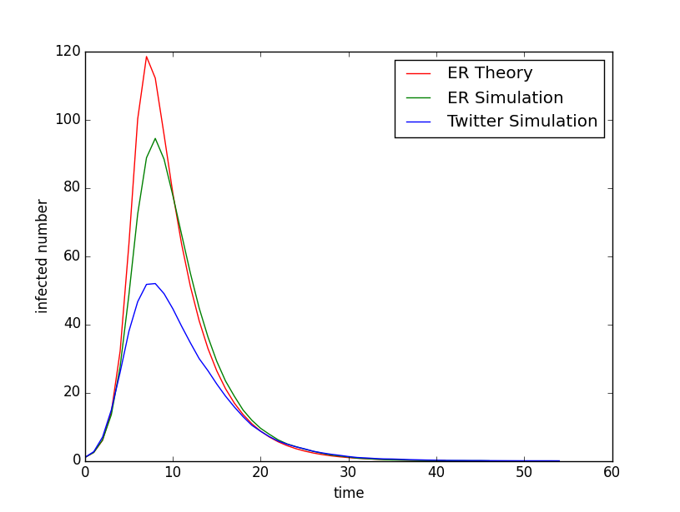
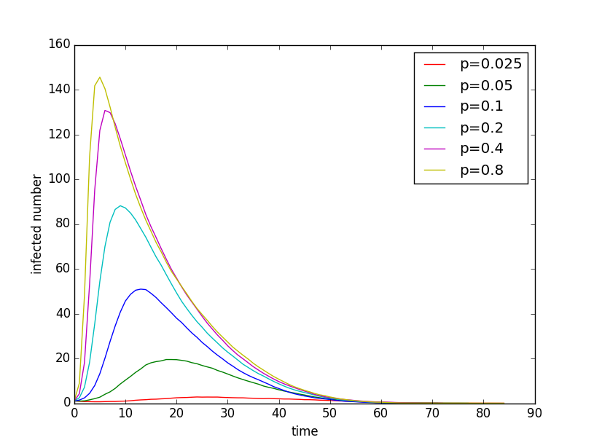
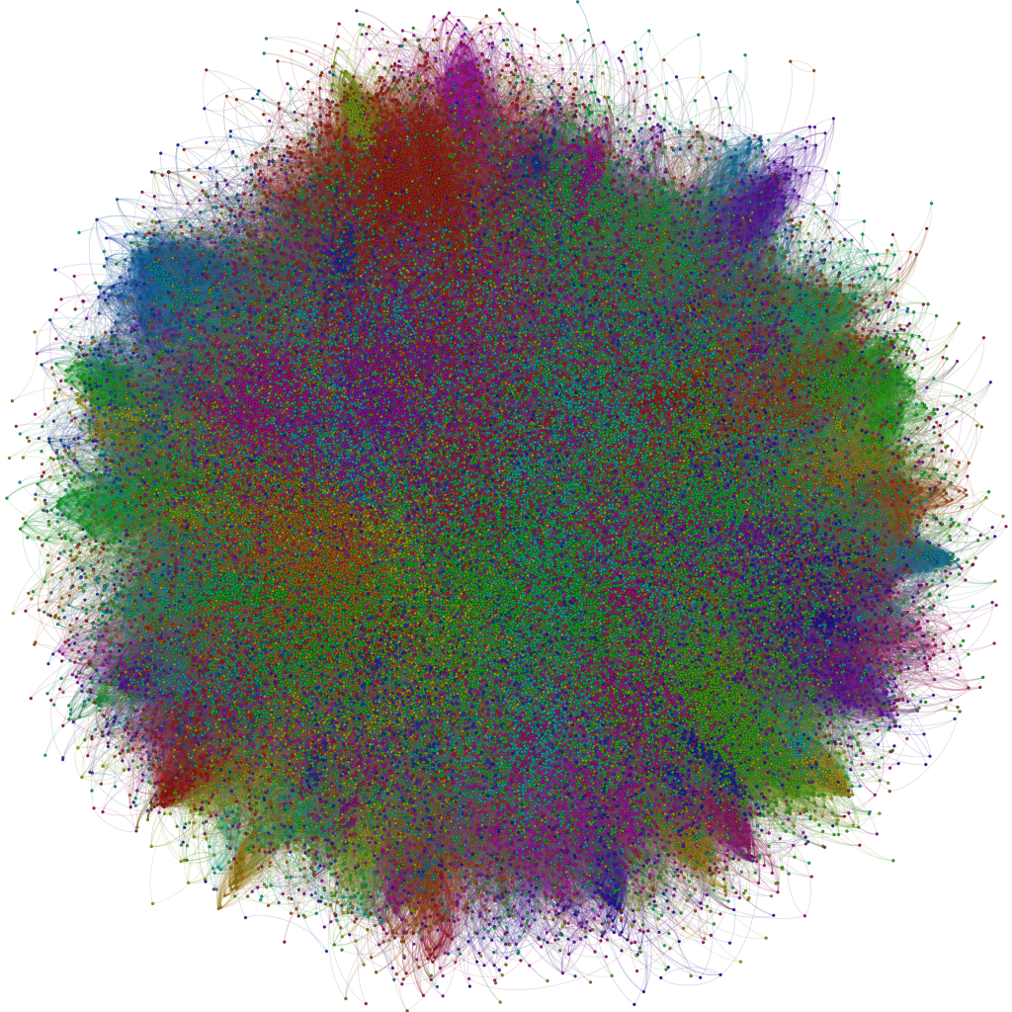
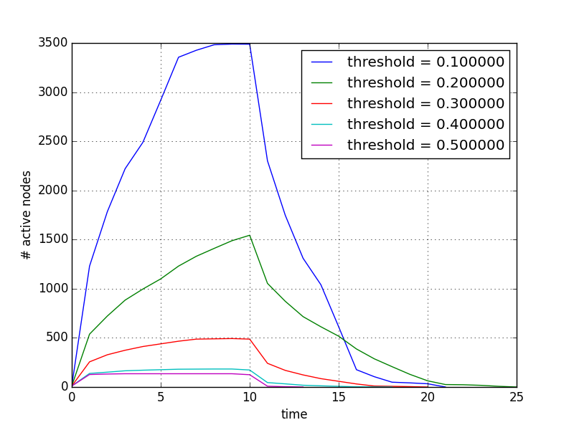

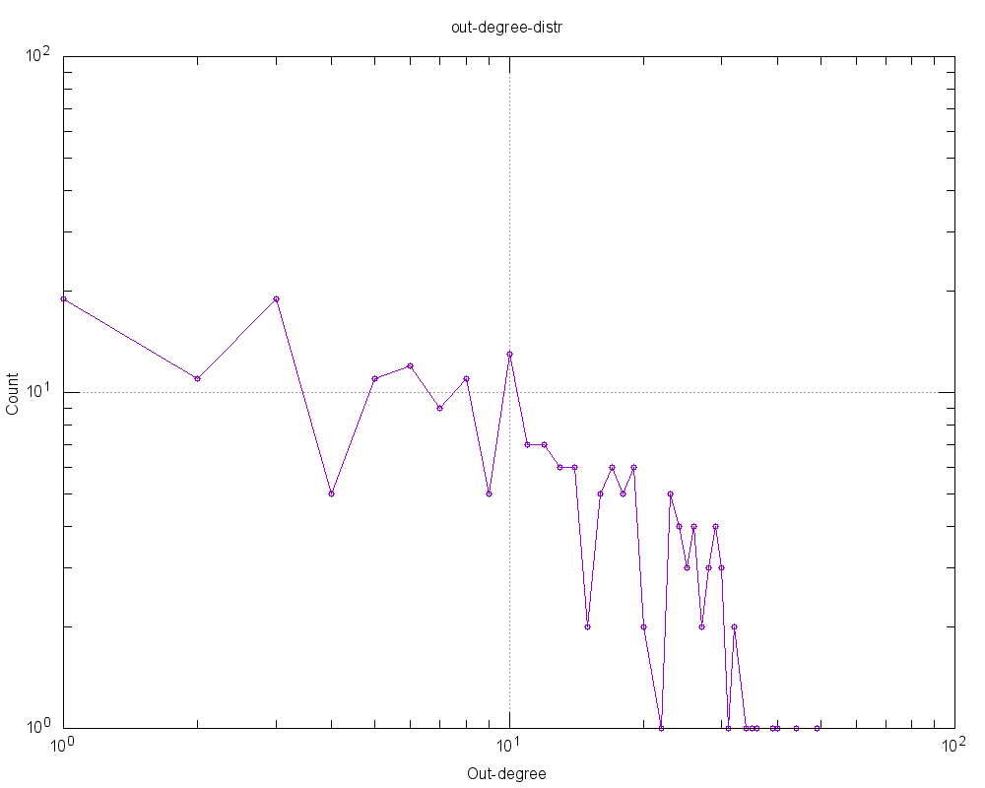

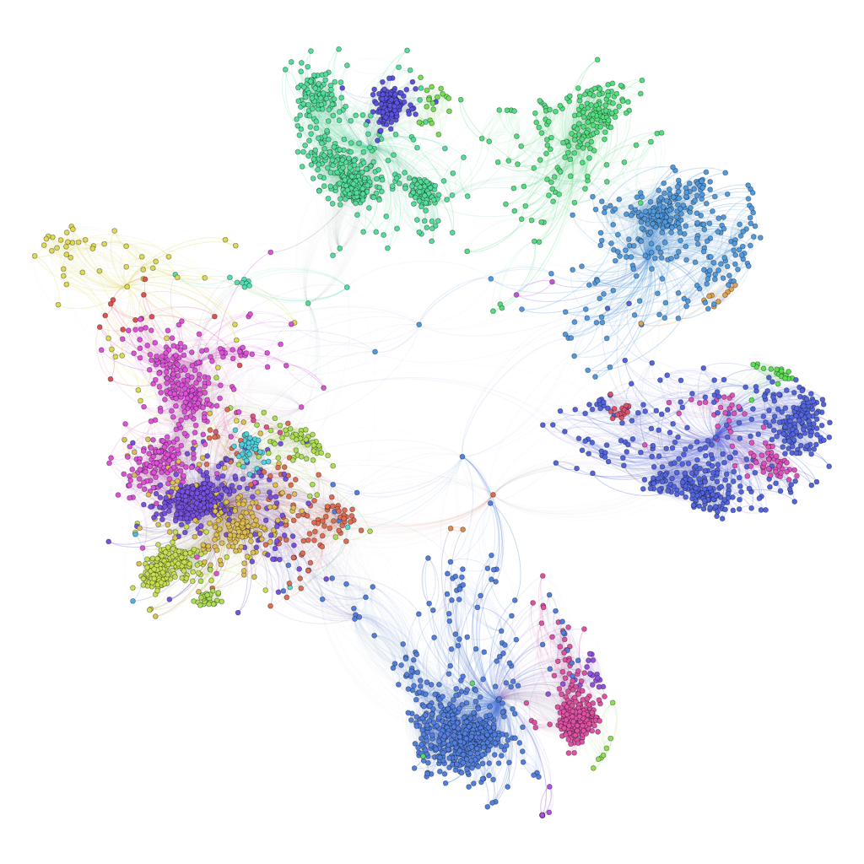
Time-variant Influence Spread in Social Networks
Jingning Ji, Yang Zhao, Yuchen Li
Department of Electrical Engineering, Computer Science
Stanford University
DATASET
INTRODUCTION
1.2 Extension of Probabilistic Model
Extension Model 1 description:
Based on daily observation, the more a person’s friends
are using a product, the more likely he’s going to continue
using it. Therefore, we can set the recover rate q of a node to decrease by the number of its adopted friends.
Extension Model 2 description:
• As time iteration increases, p, the probability
of any node being infected by its neighbour decreases.
• Also the probability q such that n become inactive
forever becomes larger as time iteration increases.
2. Time-variant Linear Threshold Model
• The model is based on a graph where an edge from i to j indicates i has influence on j. The influence value I is proportional to the number of common friends
• Each node i has an activeness sequence, which is
a non-increasing sequence of real numbers in the range (0, 1].
For inactive nodes, their activeness are 0.
• Each node j has a threshold in the range [0, 1]. At each time step, for any node j, it receives activeness from its neighbors.
•  Each node i has an upper bound of times to be
Activated and let’s call this activation upper bound. This allows a node to be activated for more than once. In default, the activation upper bound is 1, i.e. any node can be activated at most once.
Figure 1 shows the visualization of twitter data set.
Figure 2 shows the degree
distribution from a sample of it. We can see that it is absolutely preferential attachment and roughly meets power law distribution.
Figure 3 shows the visualization
of the Facebook data. We used this data set primarily in our Linear Threshold Model.
In this project, we are studying on the influence spreading through a social network. We have compared the strength and limitations of models used in related papers, and we found out that those literatures didn’t focus too much on the time-variant change in influence. We decided to study the problem of influence spreading in social network where the strength of influence may change over time. This is an interesting problem because it can model many situations that the influence becomes weaker over time like in rumor spreading network.
PROBLEM STATEMENT
Figure 4.
Figure 5.
We will develop 2 main models to simulate on the following problem:
• Initially there is a set of initial influencer that is active in a network
• In each time iteration, an active node can infect its inactive neighbors based on its influence
• Also in each time iteration, an active node has a probability to recover from its active state.
Our goal is to construct different models on such problem and find the most suitable model to use.
Our evaluation metric is to maximize the integral of the number of active nodes over time based on some initial setting of active nodes.
Figure 6.
Figure 1. Twitter data visualization
CONCLUSIONS
EXPERIMENTAL EVALUATION
MODELS AND ALGORITHM
1.1 Simple Probabilistic Model for diffusion evolution
The model description is:
• Initially there are K people active in a network
• Each time an active person has probability q
to recover.
• Every time, an active person has probability p to infect his neighbor.
• All people who has adopted won’t adopt again.
1.1 Simple Probabilistic Model for diffusion evolution
1.2 Extension of Probabilistic Model
2. Time-variant Linear Threshold Model
REFERENCES
Figure 2. Twitter data degree distribution
[1] Damon Centola, The spread of behavior in an online social network experiment, Science, 2010.
[2] S. Morris. Contagion. Review of Economic Studies 67, 57-78, 2000.
[3] Bakshy, Rosenn, Marlow, and Adamic, The role of social networks in information diffusion, Proc. WWW, 2012
[4] D. Kempe, J. Kleinberg, E. Tardos, Maximizing the Spread of Influence Through a Social Network, KDD’03.
Figure 3. Facebook data visualization

