Slide 1
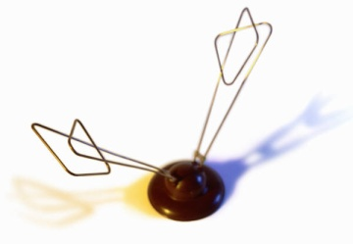


Eve
EM emanations
Evan
Sound emanations
Evita
Power Fluctuations
Alice

Slide 2
1ns
Measurement
Sampling

Slide 3
Inst A
Measure this Periodic Signal
Other Activity
A
B
A
B
Inst B
(a) Naïve Methodology
(b) Our Methodology
Notes:
CarrierFig

