Slide 1
Crimes Against Women (India)
HDSC22: Premiere Project Presentation
PP22-C623-Apache-Team
Presenters: Mohammed Zaid Habibulla and Tomisin Oluwasile

Slide 2
Apache Team Members
Tomisin Oluwasile PL
Krish Panchigar APL
Udoh Chigozie QA
Abdulquddus Ajibade
Adedolapo Akinjagunla
Ahmed Mohammed Alsayed Ibrahim
Annine Duclaire KENNE
Anshul Goel
Chigozie Udoh
Esther Ajayi
Fayokunmi Somoye
Godson Ebenuwa
Harsh Savaliya
Krish Panchigar
Mariam Bello
Mohammed Zaid Habibulla
Samyak Zaveri
Tomisin Oluwasile
Ysabel Katchy

Slide 3

Problem Statement & Objective
To design a model that predicts the future number of violent acts that will be committed against women in selected regions.
This prediction can be used to take preventive measures or deploy resources to reduce such cases.

Slide 4
Process Flow
Data Cleaning
EDA
Model Training and Evaluation
Model Deployment
Data Acquisition

Slide 5
Data Acquisition
Website:
https://www.kaggle.com/greeshmagirish/crime-against-women-20012014-india
Summary:
State-wise and district level data on the various crimes committed against women in India between 2001-2014
Features:
State/UT: 36 unique states and Union Territories in India
District: 916 unique districts in India from the dataset
Year: Between 2001 and 2014
Rape: number of rape cases recorded
Kidnapping and abduction: number of kidnapping and abduction recorded
Dowry deaths: number of dowry related deaths recorded
Assault on women: number of assaults on women recorded
Insult to modesty: number of insults to modesty recorded
Cruelty by husband: number of cruelty by husband recorded
Importation of girls: number of girls imported

Slide 6
Data Cleaning
There were no missing values in the data set.
All columns were in their correct data type.
There was however inconsistency due to repetition of states/UT and districts due to case changes (lower and upper case). For example, we had GUJARAT and gujarat.
There were also cases of inconsistency due to abbreviations and wrong spellings. For example in our dataset, we had BHOPAL RLY. and BHOPAL RAILWAY.

Slide 7
Exploratory Data Analysis (EDA)
Exploratory data analysis was done using python after cleaning the data to understand major trends and perform descriptive analysis.
Number of variables were visually plotted to identify major trends.
Some of the important plots along with the conclusion from exploratory analysis is provided in the next few slides.

Slide 8
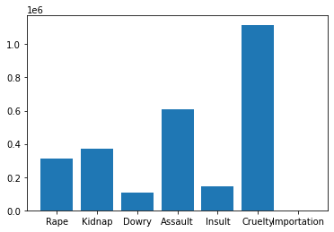
Plot showing count of various forms of violence against women from 2001 to 2014
Over a million cases of cruelty and half million cases of assault have been reported in just 14 years.

Slide 9
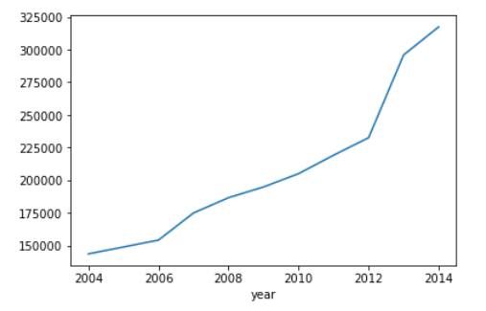
Plot showing total acts of violence through 2001-2014
The aggregate cases of violence against women have been consistently rising throughout years.

Slide 10
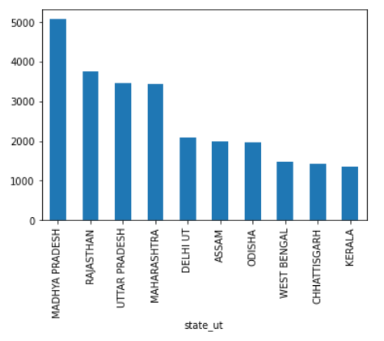
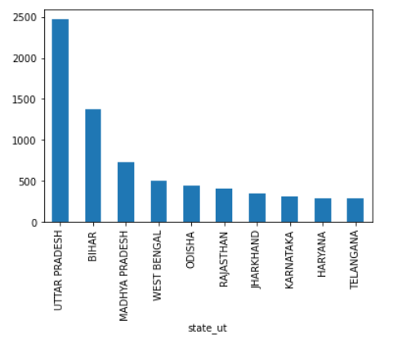
TOP 10 STATES BY RAPE CASES AND DOWRY DEATHS (2014)
Dowry deaths state wise comparison
Top 10 states that have reported highest rape case in 2014, Madhya Pradesh and Rajasthan have high prevalence rate.
Top 10 states that have reported highest dowry deaths cases in 2014, Uttar Pradesh and Bihar have unusually high cases.

Slide 11
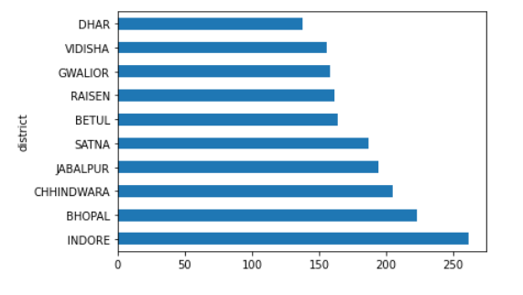
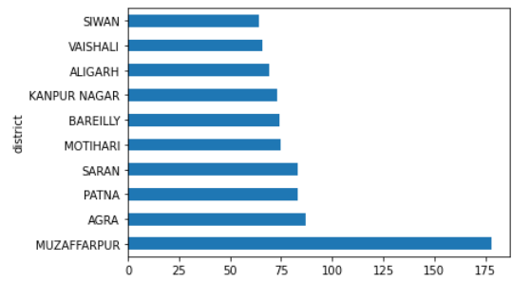
Top districts with highest rape and dowry deaths cases from top states.
Top 10 districts in Madhya Pradesh that have reported highest rape case in 2014.
Top districts from Uttar Pradesh and Bihar with high cases of dowry deaths.

Slide 12
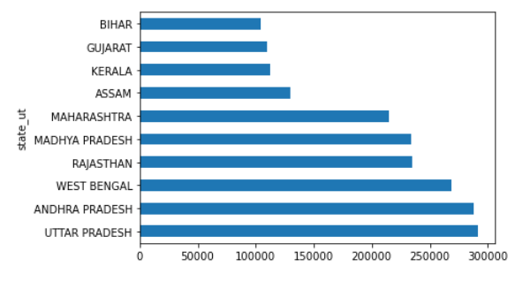
Top states in terms of number of cases reported.
Conclusion
From EDA, it is clear that the incidences of violence against women have been increasing. States like Madhya Pradesh, Uttar Pradesh and Bihar have deep rooted record of practicing such evil acts. It is also observed that with increase in one form of violence there is positive relation that the other forms are also practiced.
Above mentioned states are mostly poor and have low literacy rates. It is essential to generate social awareness as well as focus on economic development of such states.

Slide 13
Model Training - Linear Regression Forecasting model
Model is trained to forecast the crime rate for the next 2 years (2015 and 2016) for all the states
For forecasting, the data has to be in time series pattern/ sequential pattern
Here, for each state we have data from 2001 to 2014 i.e., 14 data points or time-series points
For model training, the data is split into train and validation set
Linear Regression forecasting model is used to forecast the crime rate of the states
The error (RMSE) of quadratic regression model is 17.45

Slide 14


Slide 15
THANK YOU FOR YOUR TIME
Apache Team

