Slide 1
Using health records in the UK Biobank
Dr Robert Maidstone
30th January 2025

Slide 2
Outline
About me
Importance of health records in research
Integration of health records in UK Biobank
Types of health records
Data Stored
Ethics and rules for using health records
Analysis of health record data
Recap

Slide 3
What’s available in the UK Biobank?
Hospital inpatient data
Information on hospital admissions.
Includes; date of admission, diagnosis (and underlying conditions) during admission, procedures and discharge information.
Coded using ICD-9, ICD-10, OPCS-3 and OPCS-4 codes
Death data
Date and cause(s) of death
coded using ICD-10 codes
Cancer data
Linkage to national cancer registries notifications of cancer registrations
includes data on cancer diagnosis (as ICD-9 and ICD-10 codes) and cancer histology code

Slide 4
What’s available in the UK Biobank?
First occurrences of medical conditions
Maps clinical codes from hospital admissions, primary care, death records and self reported medical conditions to 3-character ICD-10 codes and provides date of first occurrence.
Algorithmically-defined health outcomes
Created from self-reported health information, hospital inpatient data and death data. First diagnosis for each participant of a small number of health conditions
Primary care data
Some available in UK Biobank at moment but only for 45% participants and for period prior to 2017.

Slide 5
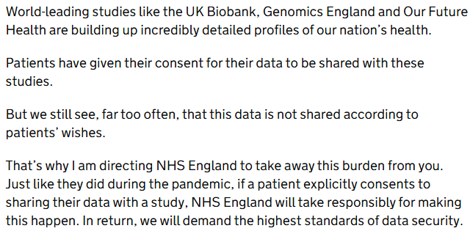

Wes
Wes Streeting speech to GPs about primary care data

Slide 6
Benefits/limitations of health records in research
Benefits
High yield, low maintenance source of longitudinal real-world data for large patient populations
Provide a wealth of information and clinical contexts that are useful for clinical research and translation into practice
Limitations
Limited time period
Missing data and biases (especially in what is reported)
Misclassification
Completeness and accuracy may vary/differ between systems/nations and over time.
Time delay – between incidence and diagnosis
Kim et al., (2023). Challenges in and Opportunities for Electronic Health Record-Based Data Analysis and Interpretation Gut Liver.

Slide 7
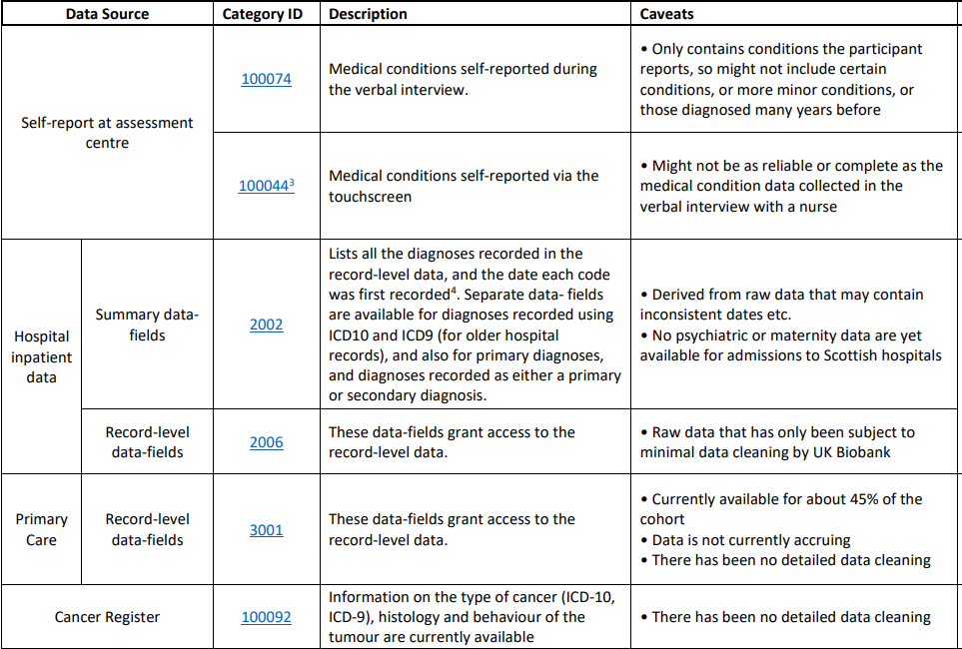
Caveats in UKB fields
Health outcomes overview document: https://biobank.ndph.ox.ac.uk/showcase/refer.cgi?id=596

Slide 8
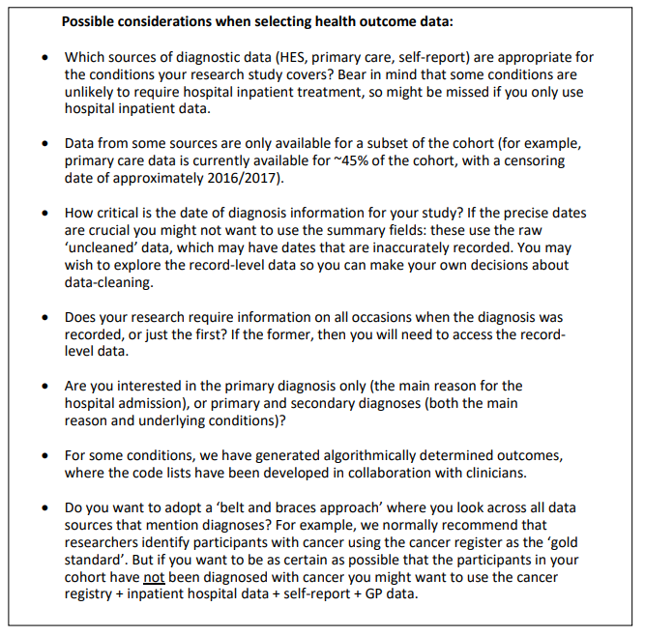
Health outcomes overview document: https://biobank.ndph.ox.ac.uk/showcase/refer.cgi?id=596

Slide 9
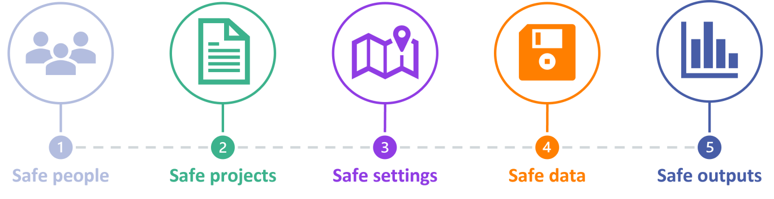
Ethics of using health data
Safe People: can the data user be trusted to use the data in an appropriate manner? Do the researchers have the knowledge and skills to act in accordance with the required standards of behaviour?
Safe Projects: is the use of this data appropriate, lawful, ethical, and sensible? Is the project expected to deliver public benefit?
Safe settings: does the tool that the researcher is using to access the data prevent unauthorised use or mistakes? Are there controls on the way the data is accessed, both from a technology perspective and considering the physical environment?
Safe Data: is there a disclosure risk in the data itself? Has the data been treated appropriately to minimise the potential for identification of individuals or organisations?
Safe outputs: do the results of the research using the data prevent someone from identifying individuals from the data? What can be done to minimise risk when releasing the findings of the project?
HDR UK

Slide 10
Asthma and shift work
Asthma is common, affecting 339 million people worldwide and costing the UK £1.1 billion.
Asthma displays marked time of day variations in symptoms, airway calibre and in underpinning inflammatory pathways.
The physiological diurnal variation in airway calibre is under direct circadian control, and amplified in asthma, suggesting coupling between the internal body clock and pathogenic processes.
Night shift work is a highly prevalent (20% of workers) cause of circadian misalignment.

Slide 11
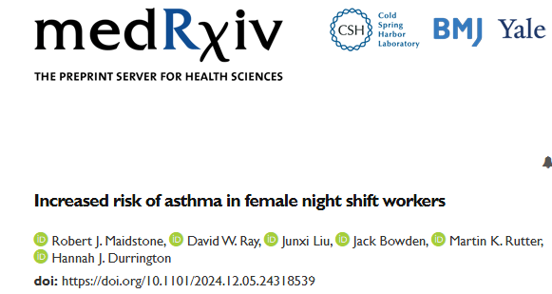
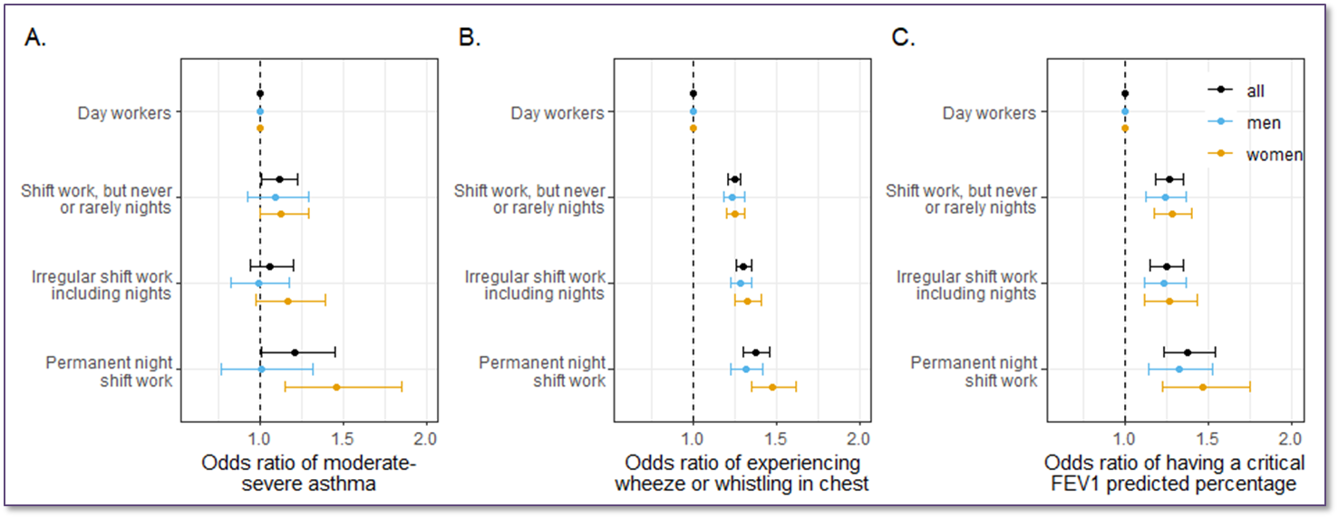
Cross-sectional study: Asthma and shift work
Sex-shift work interactions; p=0.02 p<0.05 p=0.73

Slide 12
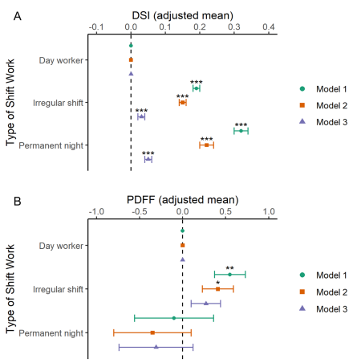
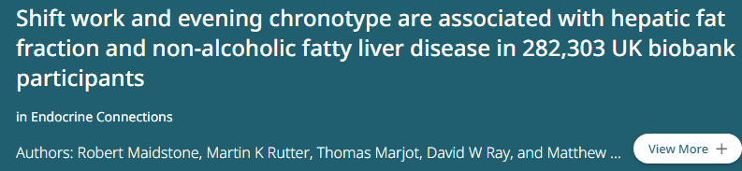
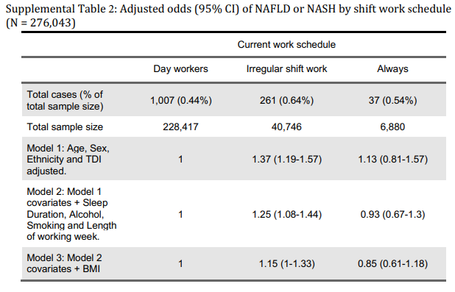
Cross-sectional study: Fatty liver disease and shift work

Slide 13
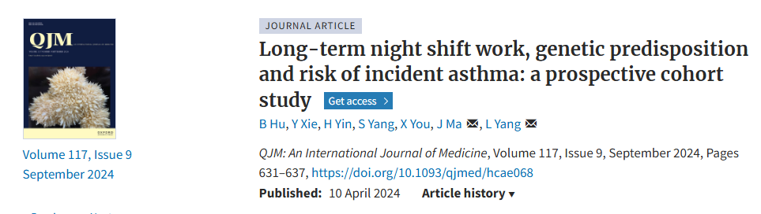
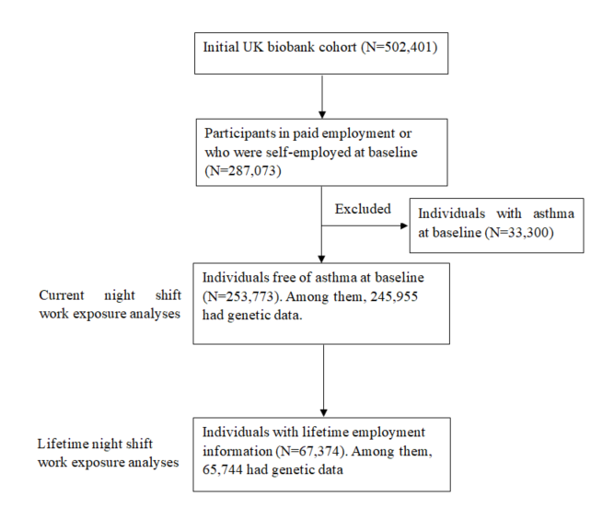
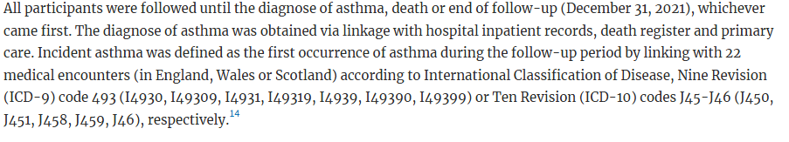
Prospective study: Asthma and shift work

Slide 14
Summary
UK Biobank has many different health record data available; hospital admissions, death data, cancer data, primary care data and derived fields.
Can be really powerful for health research, but does come with limitations
Care needs to be taken when selecting which data to be used.
Health records need to be used ethically.
Thank you for listening ☺

