Slide 1
Creating a Predictive Model for Electricity Consumption
Robert Marshall
December 1, 2022

Slide 2
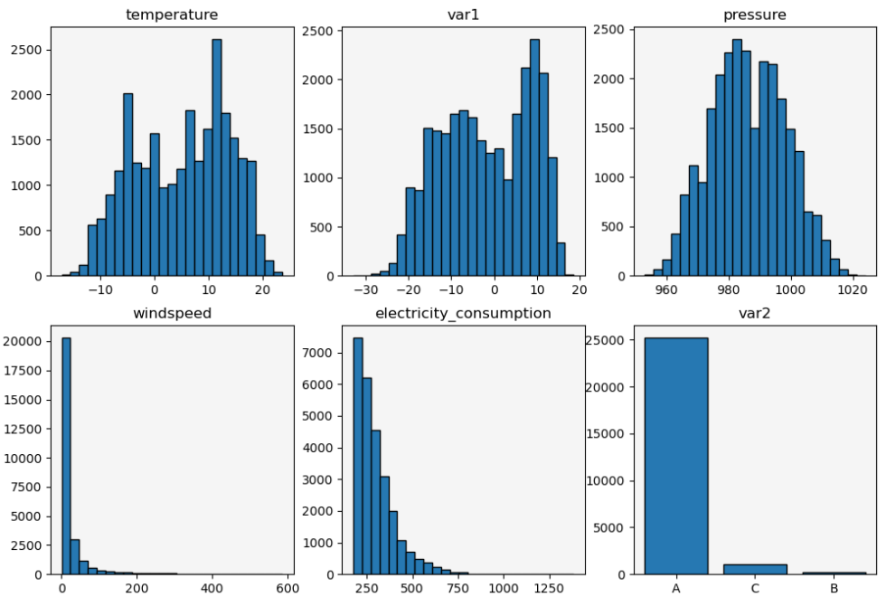
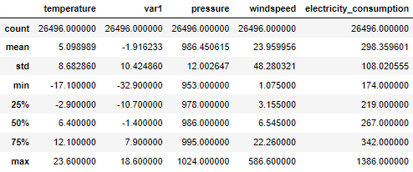
Data Exploration
4 years of data from July 2013 through June 2017
Bimodal distributions for temperature and var1
Large right tails for windspeed and electricity_consumption
Fairly cold location—heating necessary in winter

Slide 3
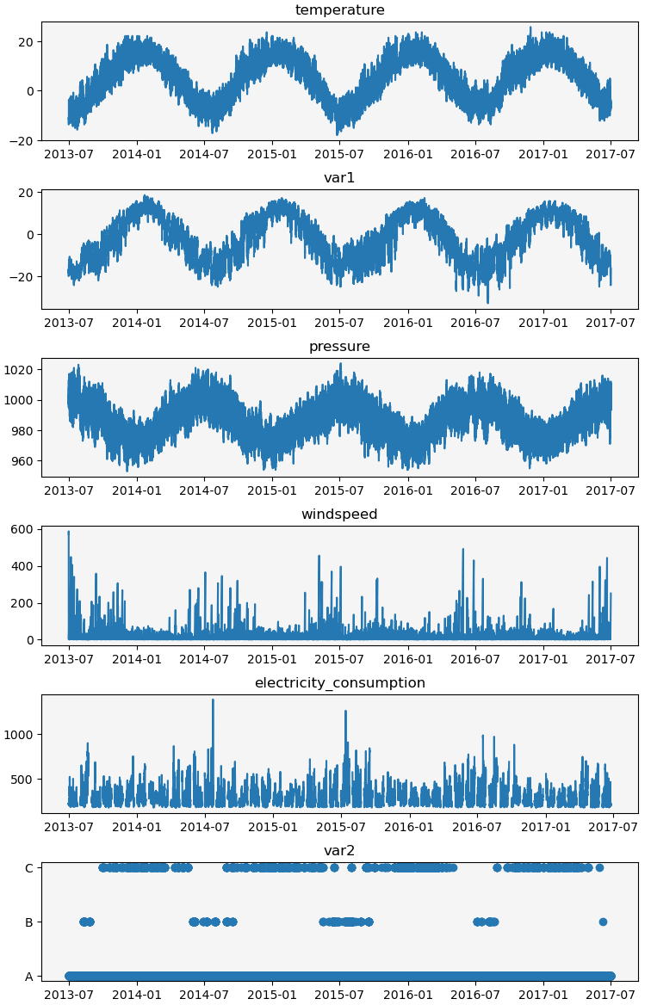
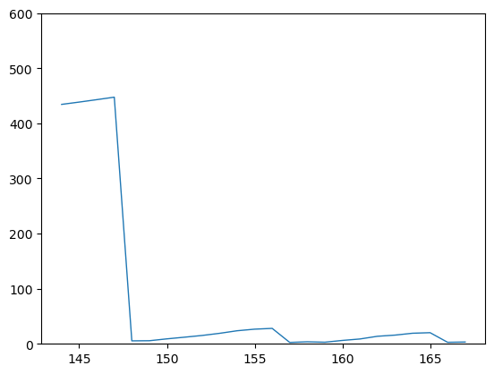
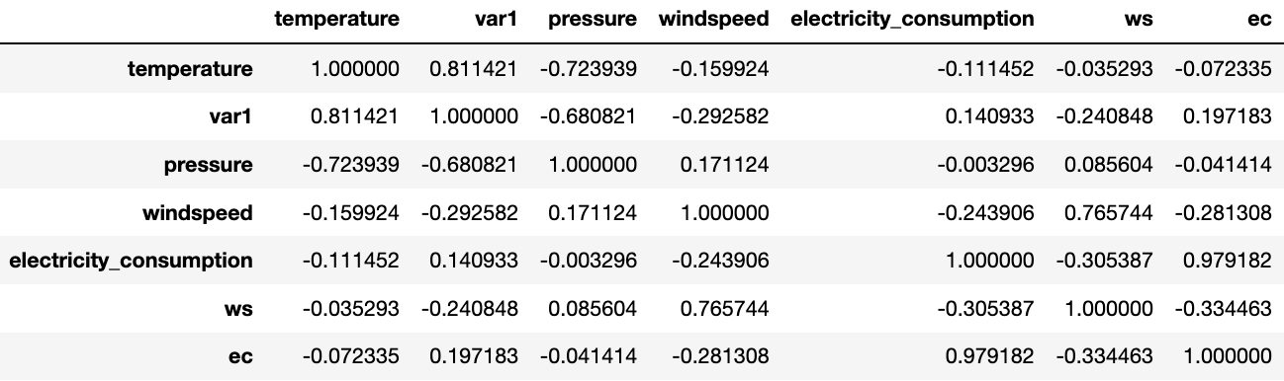
Data Exploration
Time series highlight seasonal cycles
Electricity consumption generally higher in the (southern hemisphere) winter, lower in summer
Var2 seems meaningful
Include month as a predictor
Strong correlations between temperature, pressure, and var1 features
*Wind consistently ramps down steeply

Slide 4
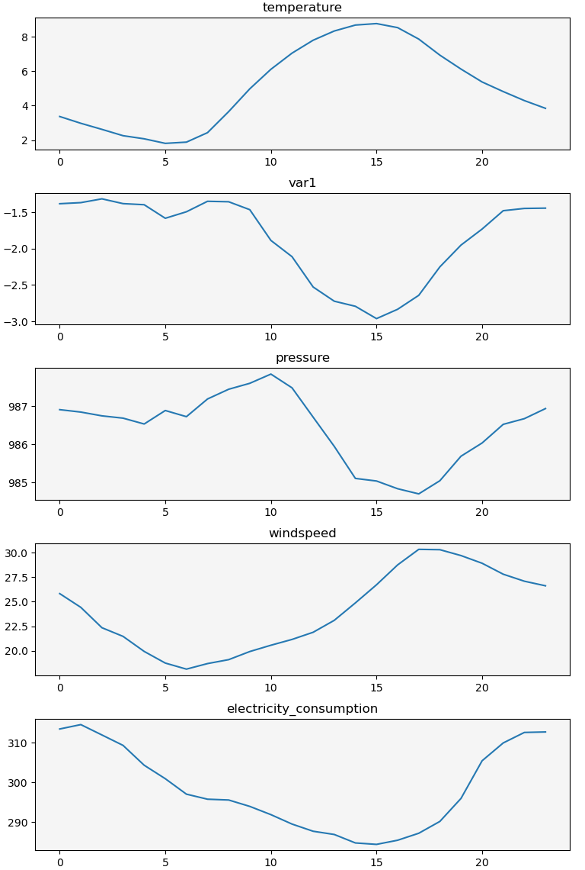
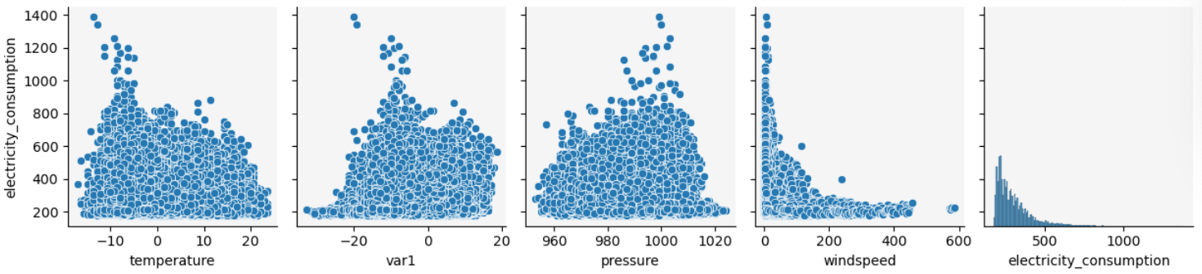
Data Exploration/Cleaning
Diurnal Trends
Data cleaning summary
Remove wind speeds > 500
Remove electricity consumption > 1000
Remove two points far from the main group in electricity_consumption vs windspeed scatterplot
Use log windspeed and log electricity consumption in model
Electricity consumption highest late night through early morning
Electricity consumption lowest late morning through early afternoon
Include hour as a predictor

Slide 5
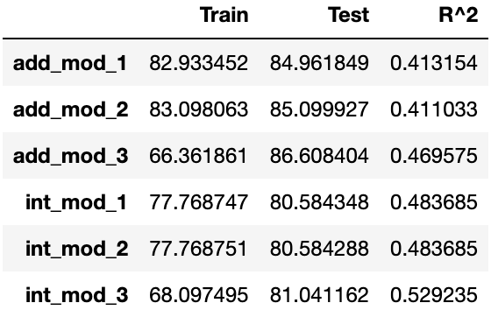
Predictive Model
Supervised regression problem
Try an additive multiple linear regression model
Try a second-degree interaction MLR model as well
Use backward BIC elimination to simplify models, remove less meaningful predictors
Use Cook’s Distance to filter out highly influential data points
Split train into a train and a cv set to aid with model selection
6 total regression models
Removing high-influence points helps train RMSE and R² but hurt test RMSE
Backward elimination models did not perform meaningfully different than full models
Overfitting does not appear to be a problem
Favor the backward elimination model among interaction models
Favor the full model among the additive models
$$electricity consumption \sim var1+ws+var2+month+hour$$
$$electricity consumption \sim {\left(var1+ws+var2+month+hour\right)}^{2}$$

Slide 6
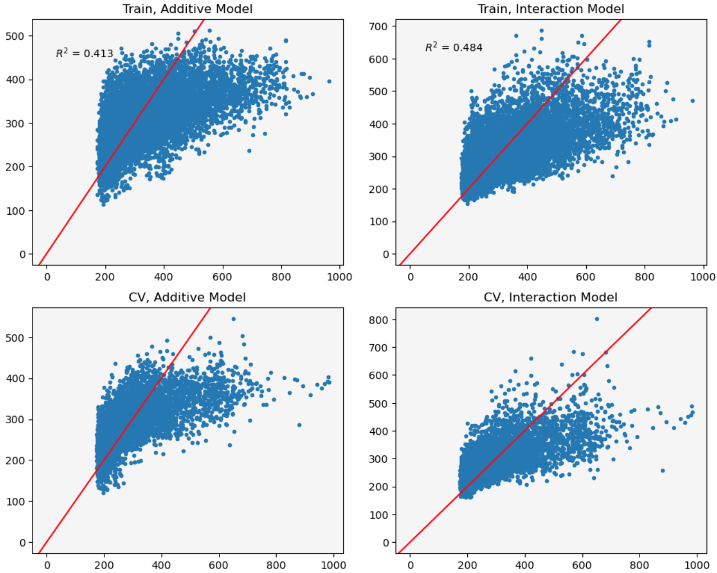
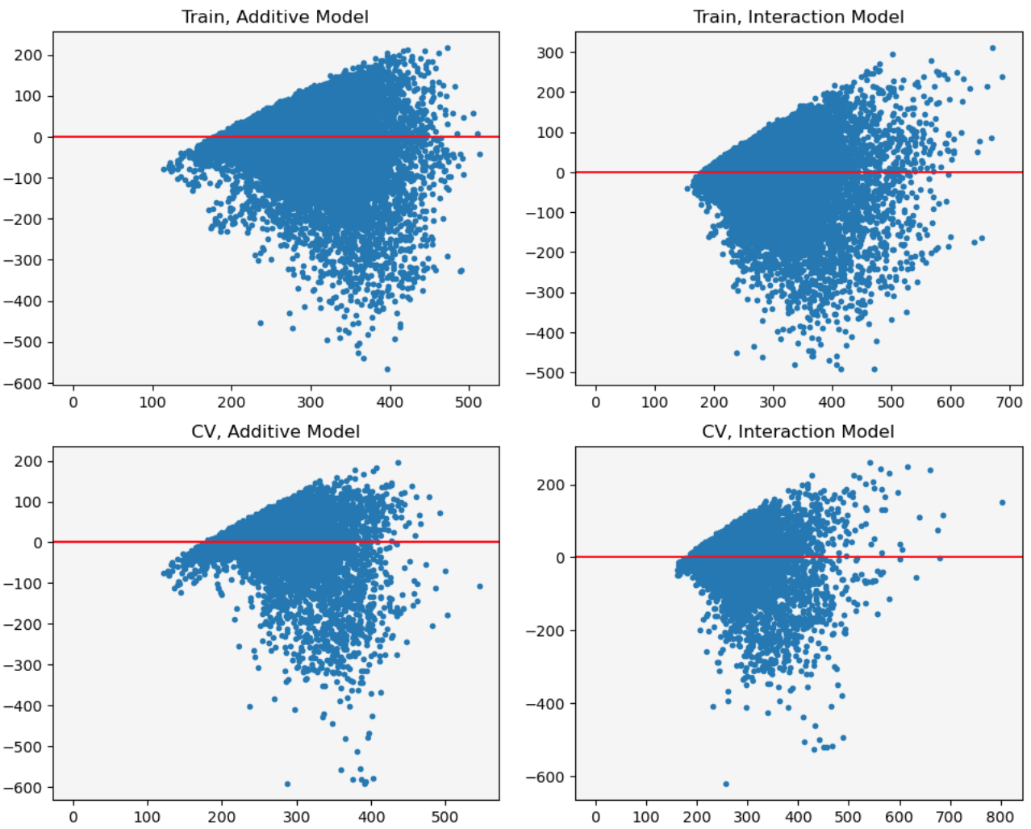
Predictive Model

Slide 7
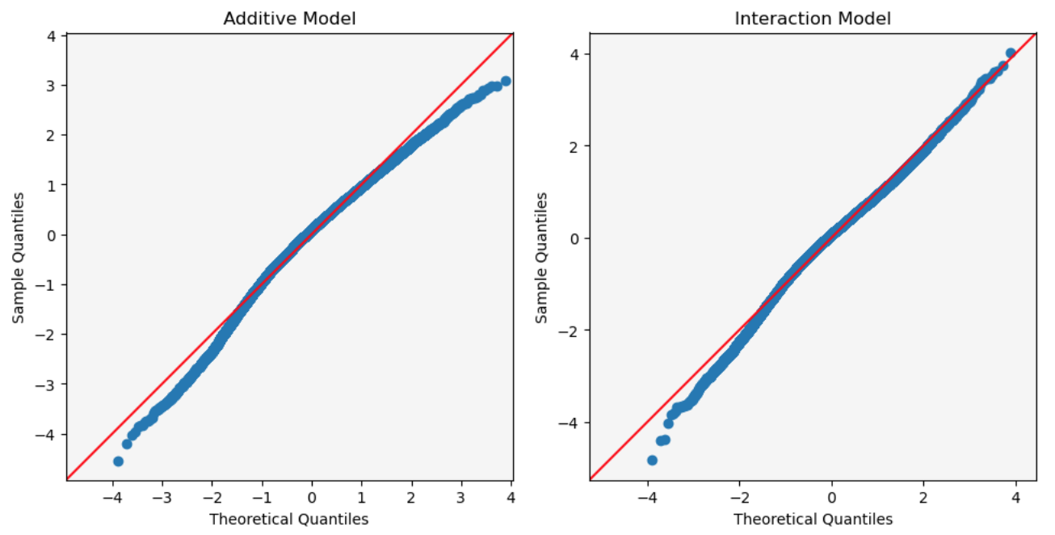
Predictive Model
Interaction model seems superior both in stats and diagnostics
Both models show problems with homoscedasticity and normality of residuals
Further feature engineering could be helpful
Try different transformations of predictors or the target
Likely some multicollinearity present
VIF analysis and feature elimination could help
PCA could help as well

Slide 8
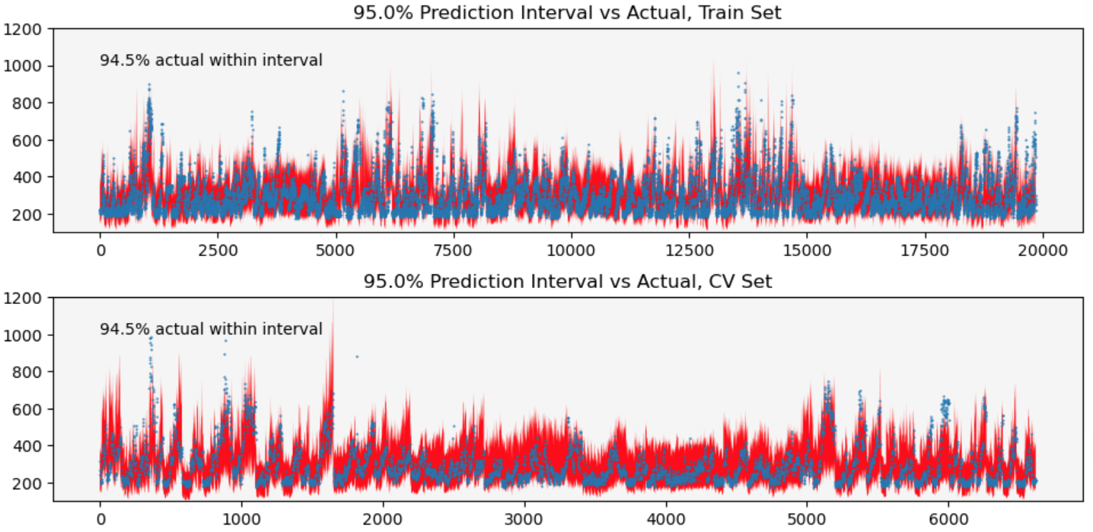
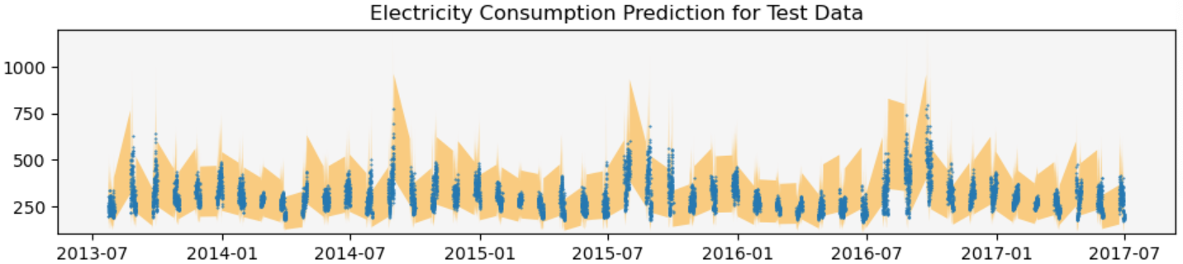
Predictive Model: Results
95% prediction intervals successfully capture about 95% of the actual data in both train and CV data

