Slide 1
Creating a Predictive Model for Electricity Consumption
Robert Marshall
December 1, 2022

Slide 2
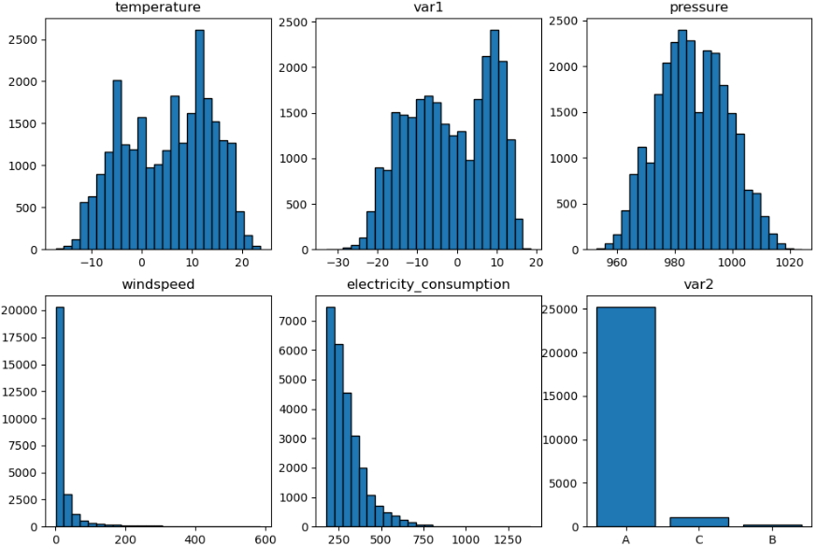
Data Exploration
Bimodal distributions for temperature and var1
Large right tails for windspeed and electricity_consumption
4 years of data from July 2013 through June 2017

Slide 3
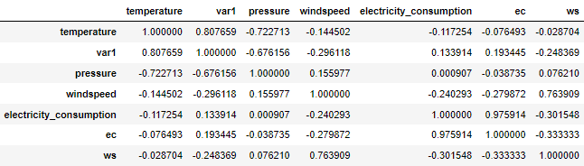
Data Exploration
Test
Test
Test

Slide 4
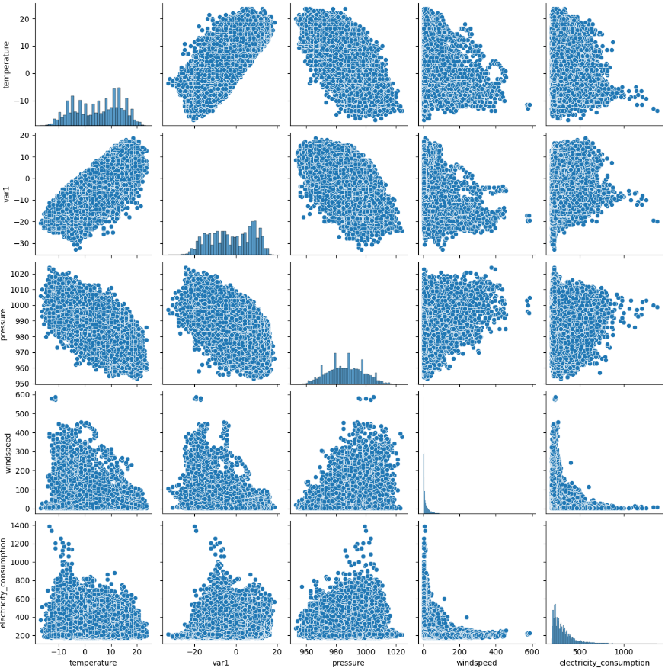
Data Exploration
Test
Test
Test

Slide 5
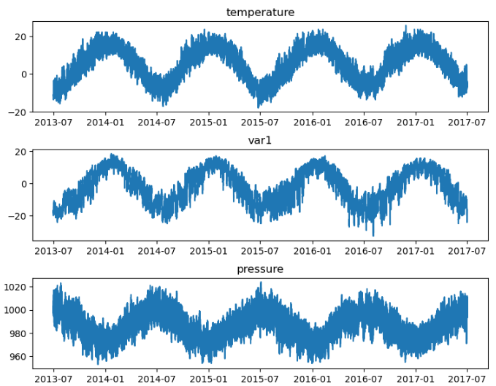
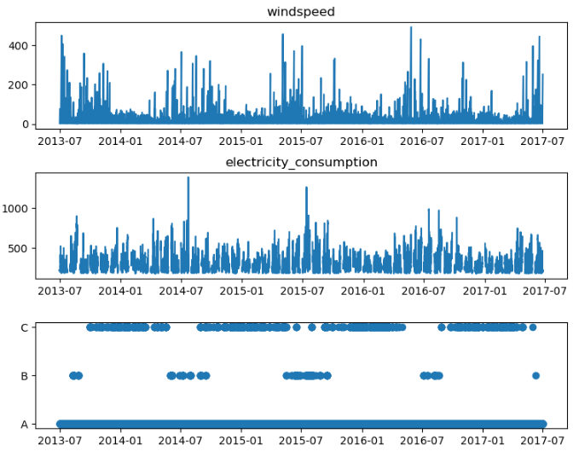
Data Exploration

Slide 6
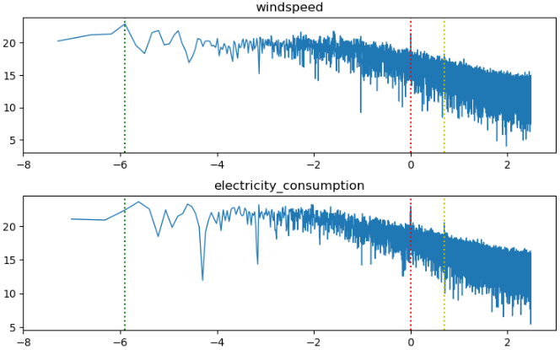
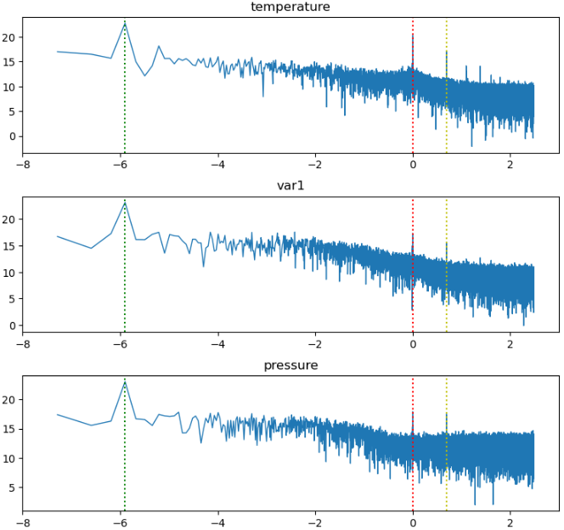
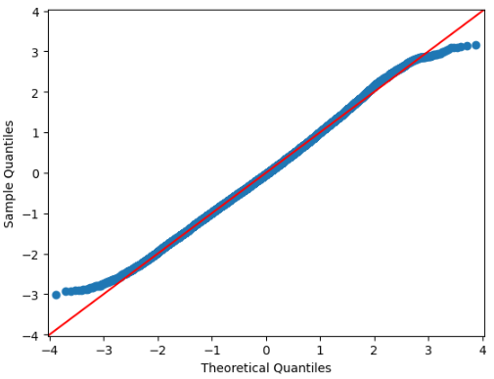
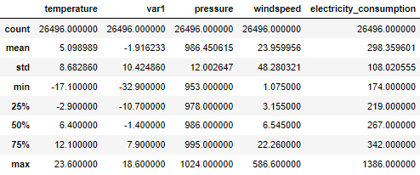
Data Exploration

