Slide 1
Creating a Predictive Model for Electricity Consumption
Robert Marshall
December 1, 2022

Slide 2
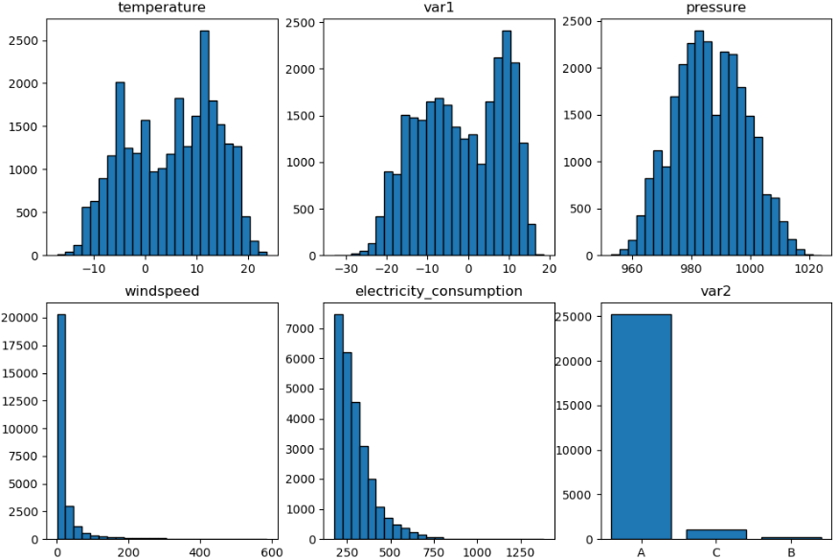
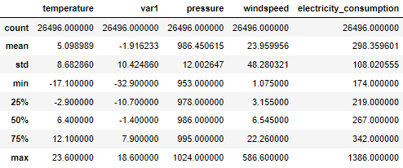
Data Exploration
4 years of data from July 2013 through June 2017
Bimodal distributions for temperature and var1
Large right tails for windspeed and electricity_consumption
Fairly cold location—heating necessary in winter

Slide 3
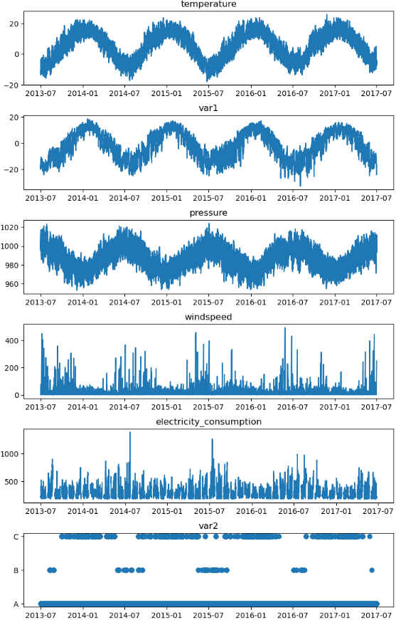
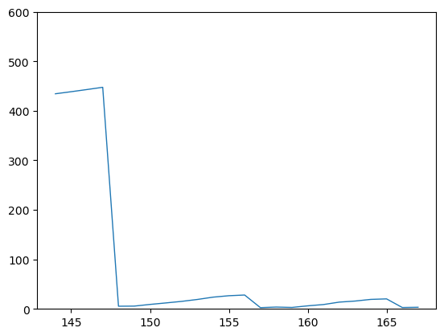
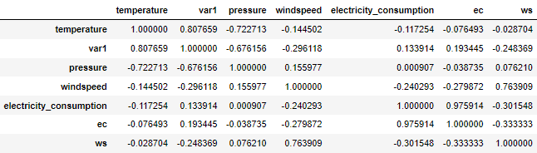
Data Exploration
Time series highlight seasonal cycles
Strong correlations between temperature, pressure, and var1
Electricity consumption generally higher in the (southern hemisphere) winter, lower in summer
Var2 seems meaningful
Pressure lower in summer
Winds strongest in winter
*Wind consistently ramps down steeply

Slide 4
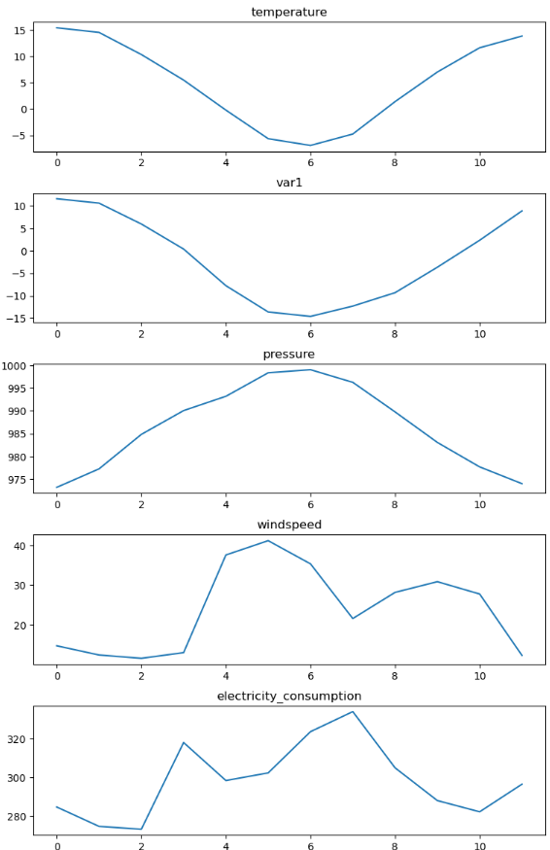
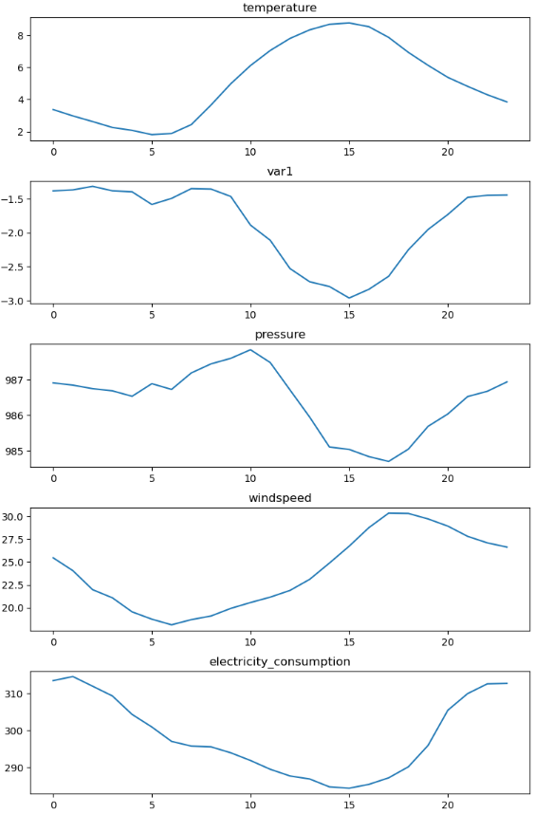
Data Exploration
Test
Test
Test

Slide 5
Data Exploration
Test
Test
Test

Slide 6
Data Exploration

