Slide 1
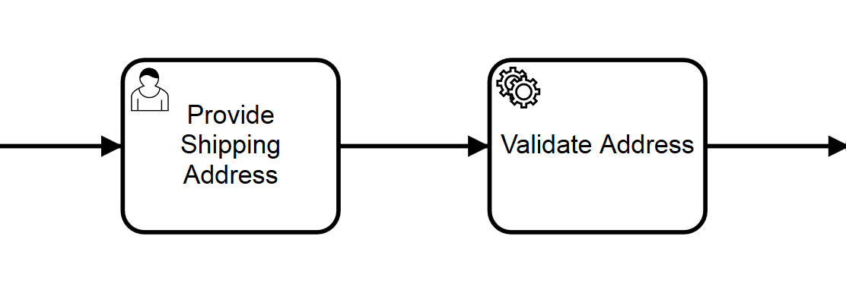
Type: external,
Topic: Address Validation
1: taskService.complete(..)
External Task List
External Task:
Employee Onboarding
External Task: Shipping Scheduling
External Task: Address Validation
…
2: externalTaskService.fetchAndLock(..)
3: externalTaskService.complete(..)
Address Validation Worker

