Slide 1

Capstone 2
IHME Mental Health Data
Presented by: Robert McCarn
06/09/2022

Slide 2


Global Burden of Disease (GBD)
https://vizhub.healthdata.org/gbd-results/
Most comprehensive global study—analyzing 286 causes of death, 369 diseases and injuries, and 87 risk factors in 204 countries and territories—reveals how well the world’s population were prepared in terms of underlying health for the impact of the COVID-19 pandemic.
DataBank (GDP)
https://databank.worldbank.org/reports.aspx?source=2&series=NY.GDP.MKTP.CD&country=#
World Development Indicators (WDI) is the primary World Bank collection of development indicators, compiled from officially recognized international sources. It presents the most current and accurate global development data available, and includes national, regional and global estimates.

Slide 3
The Data

Slide 4
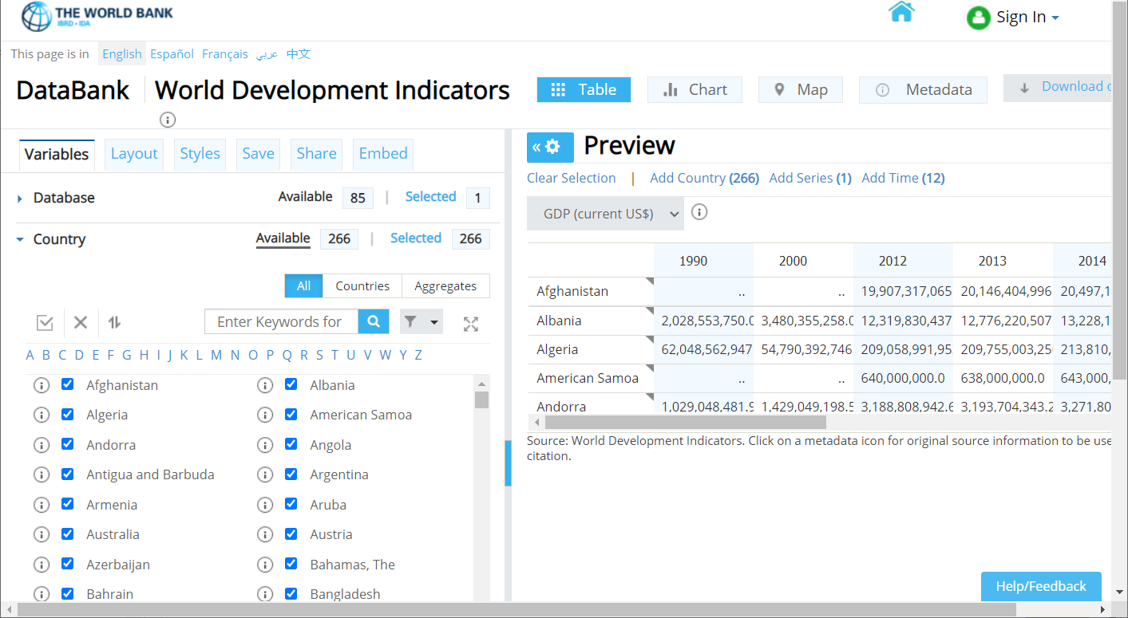
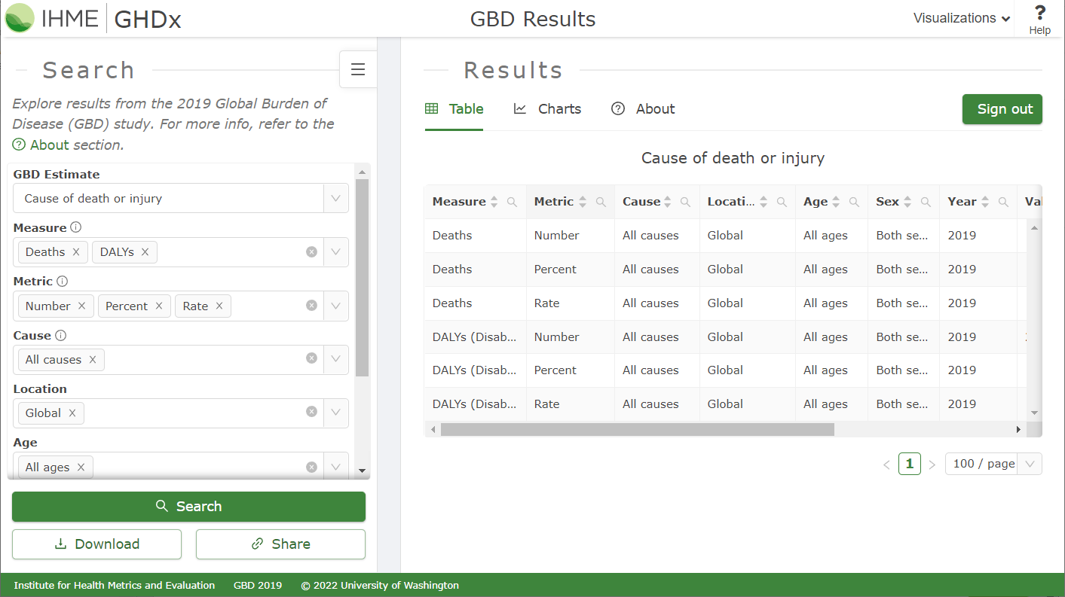
Gathering Data
Online Data Dashboards – Filtering for Mental Illness

Slide 5
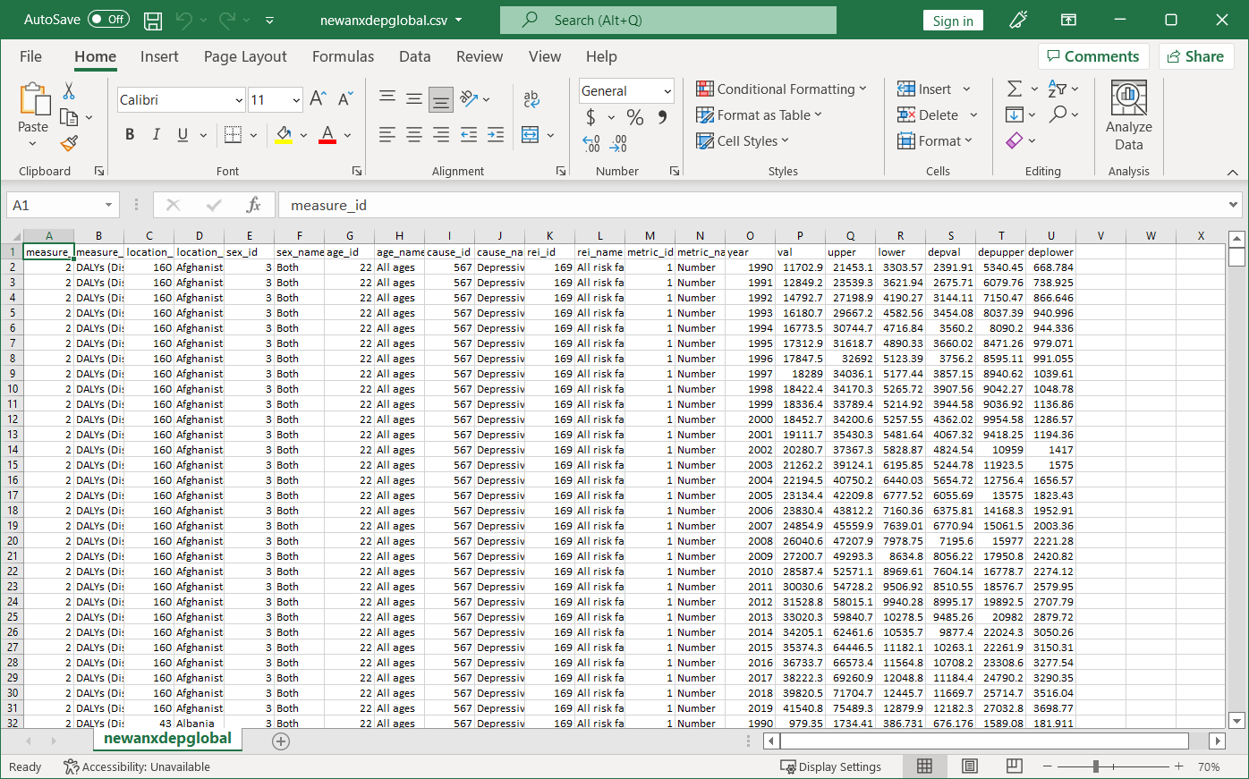
Transforming and Cleaning Data in Excel
Merging Data from Two Different Tables, to Analyze Two Separate Diseases.
Creating a Matching Countries Column to merge IHME and World Bank Data

Slide 6
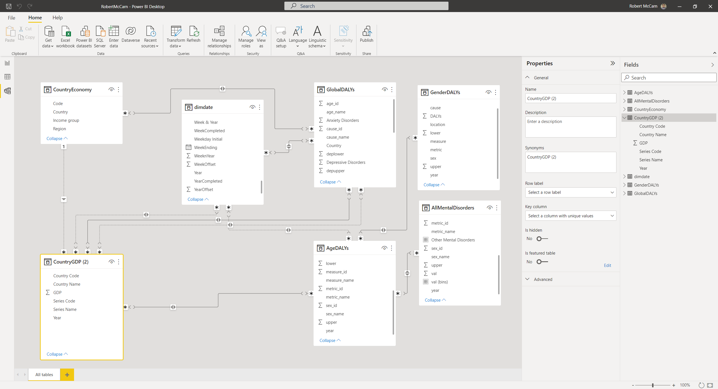
Relationships

Slide 7
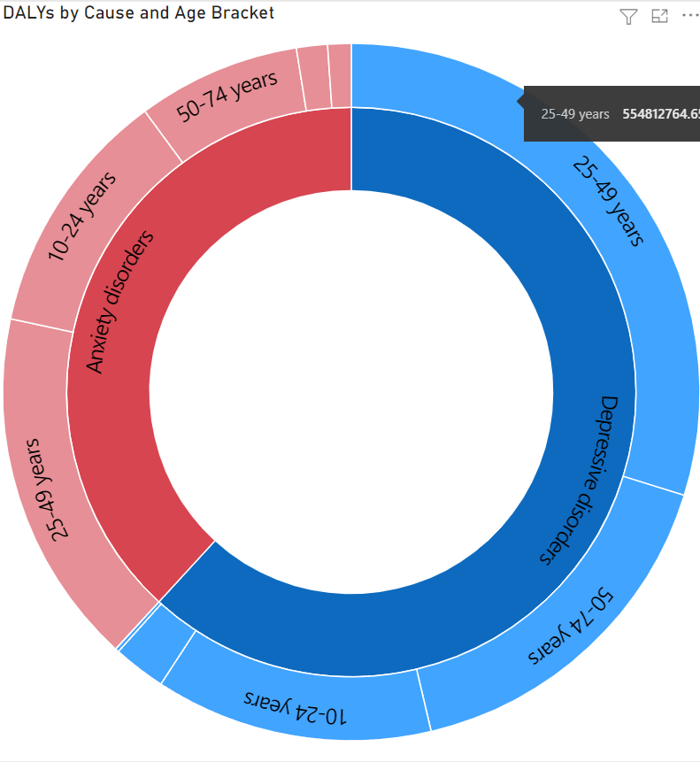
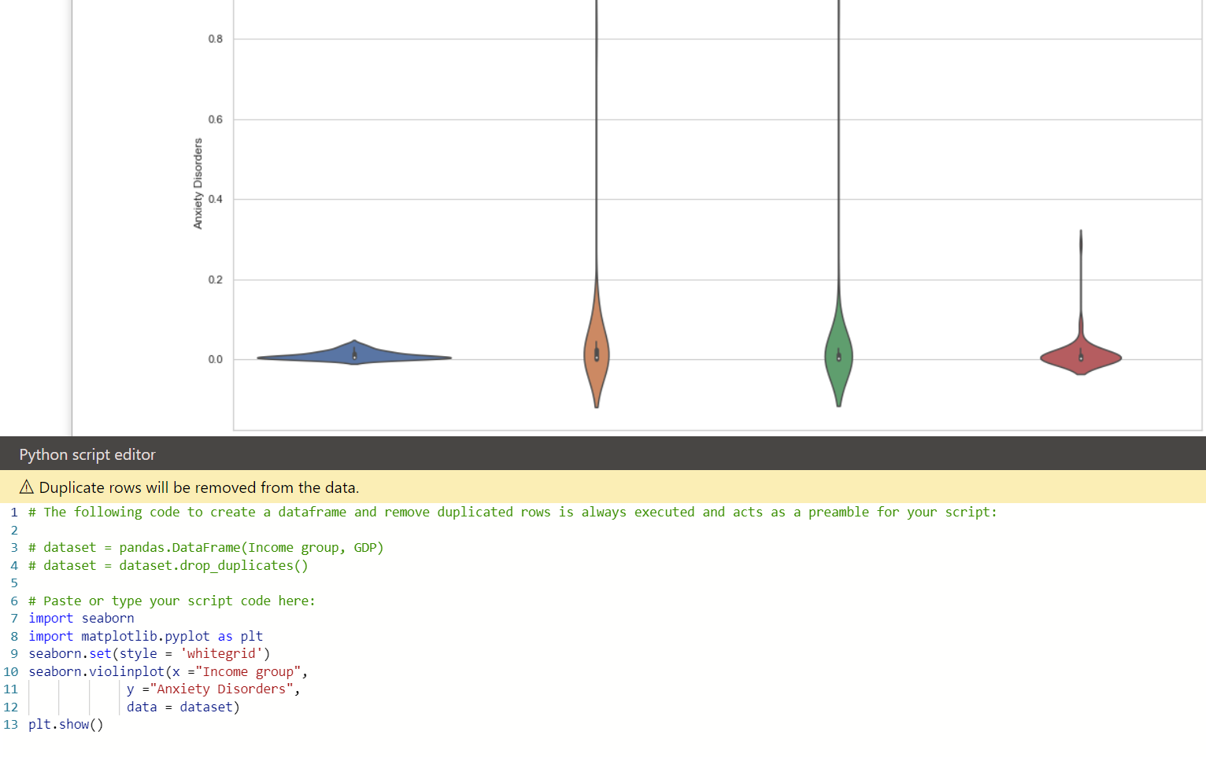
Custom Visualizations
Tiered Donut Chart
Violin Plot (Python)

Slide 8
Demo

