Slide 1

Machine Learning System: Drum Audio → MIDI
Robert McKean
Global Active, LLC

Slide 2
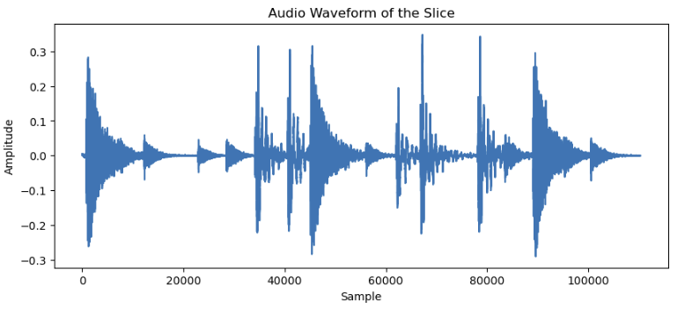
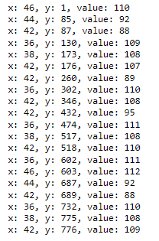
Project Goal
Convert recorded drum audio into structured MIDI note events.
Output: MIDI note events
note number
relative timing
velocity
Input: drum audio recording (wav)
Convolution-based
AI modeling
Modeling Approach:
Train a convolutional neural network to predict time-aligned MIDI notes from STFT features computed on short audio slices.
Page 2 of 12
Notes:
Example:

Slide 3
System Overview
The system converts short audio slices into MIDI activity predictions.
The Pipeline
1. Extract short audio slices
2. Convert audio to spectral features (STFT)
3. Predict note activity with a CNN
4. Generate a MIDI activity heatmap
5. Extract note events → MIDI file
Page 3 of 12
Notes:
Example:

Slide 4
Architecture Diagram
Audio Input
Trainable STFT
Front End
Learned Spectral Features
…
2.5 s waveform slice
44.1 kHz audio (mono)
110,250 samples
Short-Time Fourier Transform
N_fft = 2048
Hop = 128
STFT magnitude
frequency bins × time steps
encoder input tensor
Convolutional Encoder
Transposed-Conv
Decoder
MIDI Activity Heatmap
…
3 Conv1d + MaxPool stages progressive channel reduction temporal compression
3 ConvTranspose1d stages temporal reconstruction feature expansion
127 MIDI note channels time-aligned activity predictions post-processing extracts hits
End-to-end architecture converting short audio slices into dense MIDI note activity predictions.
Page 4 of 12
Notes:
Example:

Slide 5
Dataset Construction
Phase 1 - Generate Training Source Data
Combine thousands of MIDI drum loops into a continuous sequence
Render audio from the MIDI file using multiple drum kits and VST plug-ins
Produce synchronized audio and MIDI recordings (ground truth)
Phase 2 - Create Training Examples
Segment recordings into aligned 2.5 s audio–MIDI slices
Preserve exact alignment between waveform and MIDI events
Use audio slice as model input (X)
Phase 3 - Generate Target Output
Convert MIDI events into a note–time activity heatmap
Heatmap represents MIDI note number vs time
This heatmap becomes the training target (Y)
Phase 4 - Model Training and Verification
Train the convolutional model on paired X/Y slices
Compare predicted heatmaps to reference targets
Extract note events and generate MIDI output
Training dataset:
9.5 hours of synchronized audio–MIDI data
Page 5 of 12

Slide 6
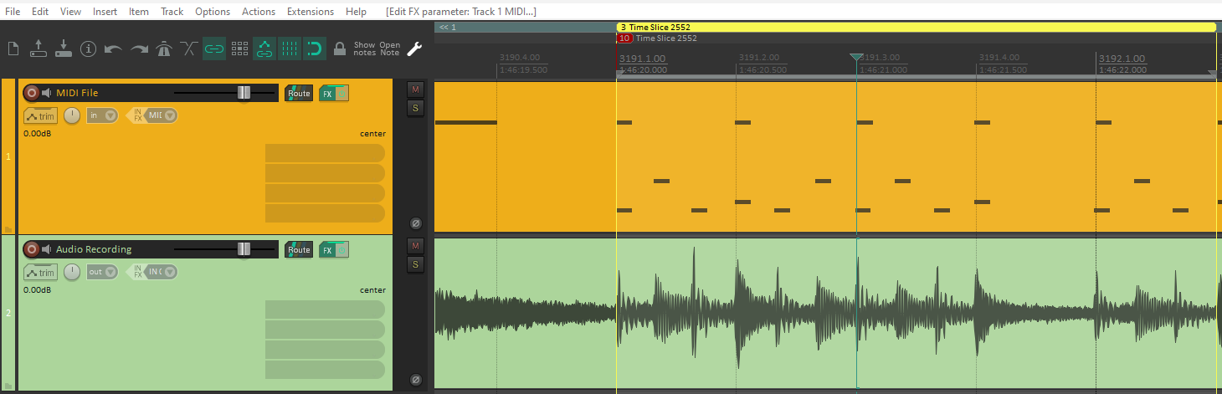
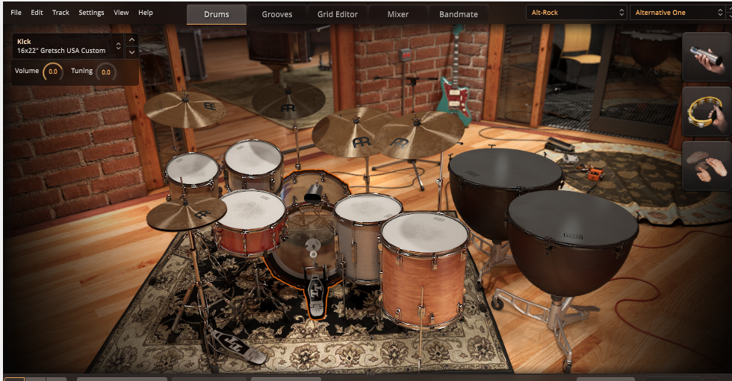
Create the MIDI and Audio Files
The MIDI file combines thousands of MIDI loops into one long file (9.5 hours).
Audio files were then created by using a drum plug-in.
Multiple drum kits were used to provide a variety of sounds for training.
DAW software showing MIDI file and generated drum audio.
Drum plug-in used to generate audio file.
Page 6 of 12
Notes:
Example:

Slide 7
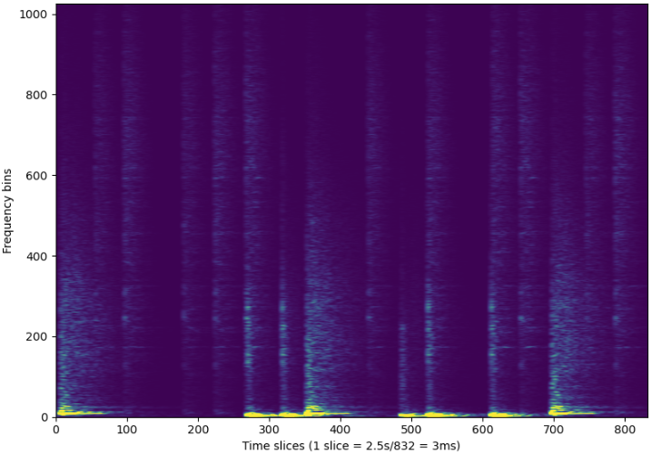
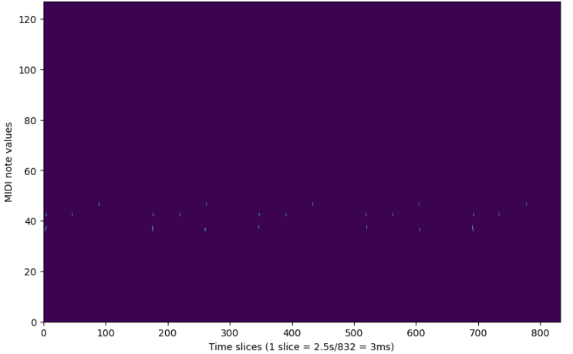
Training the Model
Note that the STFT data aligns with the note data in the target output.
torch.Size([32, 110250])
Input: drum recording (wav)
torch.Size([1, 110250])
STFT of Input (nnAudio)
C
ONV-LAY E
R
S
Target Output (Y) – MIDI data
X data for training
Model
Y data for training
(Ground Truth)
Page 7 of 12
Notes:
Example:

Slide 8
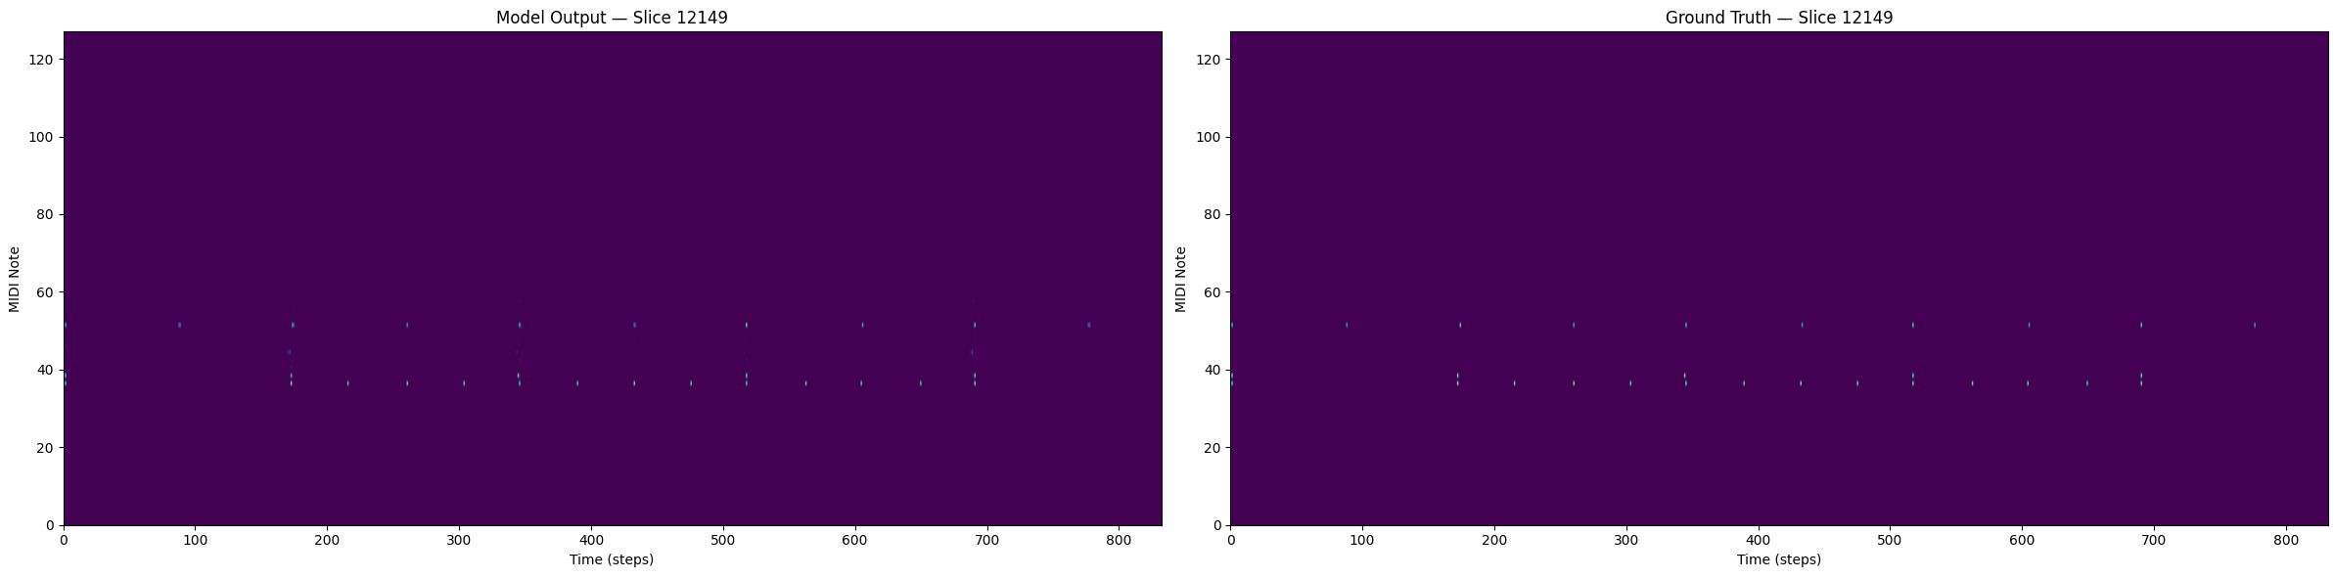
Results – Target Output vs Actual Output
Target Output – MIDI data
Actual Model Output – MIDI data
The dots represent:
The relative timing (X axis)
MIDI note number (Y axis)
Velocity of the note (dot brightness).
Page 8 of 12
Notes:
Example:

Slide 9
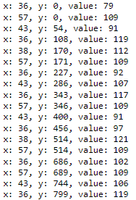
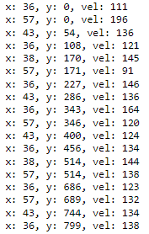
Results – Actual Values
For this 2.5s slice (2552), the note (x) and relative time (y) values match exactly between the actual and predicted MIDI values.
Conclusion: The model accurately predicted the timing and the specific drums triggered from a random audio sample, even when multiple drums were triggered simultaneously.
The values (note velocity) are higher on the post-modeled files. More detailed scaling analysis is required to improve.
For this example:
Slice number: 2552
Threshold: 0.5
Original midi file
Post-modeled midi file
Page 9 of 12
Notes:
Example:

Slide 10
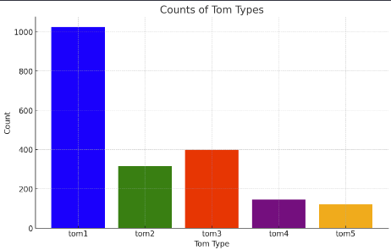
Biggest Challenges
Quality drum data. Used drum samples from Kontakt, EZ Drummer 3, and individual one-shots.
Even with a folder full of individual drums (toms, for example), there will be outliers. Electronic drums sound different than acoustic drums, for example.
Required: A larger curated drum set. With 10,000’s of drums - curating this data was the largest challenge.
Developed unsupervised K-clustering to sort and classify drums. Effective.
Memory. Deeper algorithms use more memory and take longer to model. Needed to keep GPU memory below 8GB to run on laptop’s NVIDIA GeForce RTX3080.
Below are the results from K-clustering approximately 2,000 individual tom tom drum samples.
The primary separator was the tone, with tom1 being the lowest in frequency.
Page 10 of 12

Slide 11
Lessons Learned
Results were strong for drums used during training. Broader generalization requires a larger curated dataset.
More tuning of the model would be helpful, including steps that would increase GPU memory consumption.
MIDI note resolution: 3ms. Could be decreased at the expense of more GPU memory and longer training.
Tip: Input tensor length must be compatible with convolution algorithms. This program needed to truncate input tensor from 862 to 832 samples.
Tip: Create a test tensor with random data to confirm that the model produces the expected output data format. The output from the model must match the format of the Y data.
In summary, I was able to:
Identify a practical solution to generate MIDI from audio.
Develop a strategy for generating supervised X/Y training data.
Create large synchronized audio and MIDI datasets.
Generate curated and cleaned-up data for modeling.
Implement a convolutional neural network from scratch.
Use k-means clustering to categorize drum samples.
Deliver a working system using Python and PyTorch.
Page 11 of 12

Slide 12
Thank you!
Page 12 of 12

